Slide 1

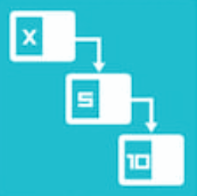

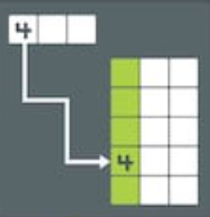
Our Agenda
Hashing
Stacks
Queues
Linked Lists

Slide 2
HASHING
H(K)
Saac Sornchai

Slide 3
Hashing
Our Mission
Understand Hashing
1
Hash Function
2
Hash Table
3
How to Implement Hash Table
4

Slide 4
Hashing
Our Mission
Understand Hashing
1
Hash Function
2
Hash Table
3
How to Implement Hash Table
4

Slide 5

Hashing
H(K)
1

Slide 6

Hashing
H(K)
1
H(K)
5

Slide 7
Hashing
H1(K)
1
H2(K)
7

Slide 8
Hashing
H3(K)
8
H3(K)
8

Slide 9
Hashing
Our Mission
Understand Hashing
1
Hash Function
2
Hash Table
3
How to Implement Hash Table
4

Slide 10
Hash Function
Any function that can be used to map data of arbitrary size onto data of a fixed size.
The values returned by a hash function are called
hash values, hash codes, digests or simply hashes

Slide 11
Hash Function
HashValue = Hash(Key)

Slide 12
Hash Function
Key | HashValue = Key % 10
70 | 0
55 | 5
25 | 5
38 | 8
79 | 9

Slide 13
HashValue = Key % 10
int hash(int key) { return key % 10; }

Slide 14
Hash Function
Key | HashValue = Key % 10 + 1
70 | 1
55 | 6
25 | 6
38 | 9
79 | 10

Slide 15
HashValue = Key % 10 + 1
int hash(int key) { return key % 10 + 1; }

Slide 16
Hash Function
Key | HashValue = Key % 26
70
55
25
38
79

Slide 17
Hash Function
Key | HashValue = Key - 'a' + 1
'a'
'b'
's'
'x'
'z'

Slide 18
Hashing
Our Mission
Understand Hashing
1
Hash Function
2
Hash Table
3
How to Implement Hash Table
4

Slide 19
Hash Table
A data structure used to store keys/value pair.
Use a hash function to compute index of array which an element will be inserted or searched

Slide 20
Keys/Value Pair
Need to store data
108 10 555 93 44 29 54 0 219
Use a hash function HashValue = Key % 5

Slide 21
Keys/Value Pair Collision
HashValue = Key % 5
Key | 108 | 10 | 555 | 93 | 44 | 29 | 54 | 0 | 219
Hash Value | 3 | 0 | 0 | 3 | 4 | 4 | 4 | 0 | 4
Collision

Slide 22
Hash Table
HashValue = Key % 5
[0]
10
555
0
[1]
[2]
[3]
108
93
[4]
44
29
54
219

Slide 23
Hashing
Our Mission
Understand Hashing
1
Hash Function
2
Hash Table
3
How to Implement Hash Table
4

Slide 24
Node
Using struct
typedef struct _node { int data; struct _node* next; } Node;

Slide 25
Init Hash Table
Using array of Head Node
void initHashTable (Node** table) { for (int i = 0; i < SIZE; i++) table[i] = NULL; }
[0]
[1]
[2]
[3]
Node* table[SIZE]; initHashTable(table);
[4]

Slide 26
Hash Function
int hash (int x) { return x % PRIME; }

Slide 27
Print Table
void printTable (Node** table) { Node* current; for (int i = 0; i < SIZE; i++) { printf("[%2d]: ", i); current = table[i]; while (current != NULL) { printf("%5d ", current->data); current = current->next; } printf("\n"); } }

Slide 28
Add Node to Table
void addHT (Node** table, int value) { Node* temp = (Node *) malloc(sizeof(Node)); temp->data = value; int pos = hash(value); Node* first = table[pos]; temp->next = first; table[pos] = temp; }

Slide 29
Hash Table
Node* table[SIZE]; initHashTable(table); addHT(table, 10); addHT(table, 20); printTable(table);

Slide 30
Hashing
Next
Stack

