Slide 1



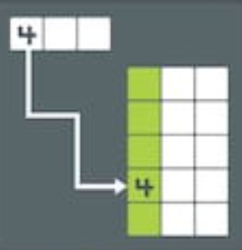
Our Agenda
Hashing
Stacks
Queues
Linked Lists

Slide 2
LINKED LIST
L
Saac Sornchai

Slide 3
Linked List
Our Mission
Understand Linked List
1
How to implement Linked List
2
Operation on Linked List
3

Slide 4
Linked List
Our Mission
Understand Linked List
1
How to implement Linked List
2
Operation on Linked List
3

Slide 5
Node
Collect data in one node
Data
Next
ข้อมูลที่เก็บใน Node
Address ของ Node ถัดไป

Slide 6
Linked List
Commonly used linear data structure - group of nodes in sequence
...
NULL
Head
(Tail)

Slide 7
Singly Linked List
data
next
data
next
data
next
data
next
NULL
Head
(Tail)
each node has data part and address part
address part points to next node in the sequence of nodes

Slide 8
Doubly Linked List
previous
data
next
previous
data
next
previous
data
next
NULL
NULL
Head
Tail
each node has data part and two address part
one address part points to the previous node
another address part points to the next node

Slide 9
Circular Linked List
data
next
data
next
data
next
data
next
Head
last node points back to first node

Slide 10
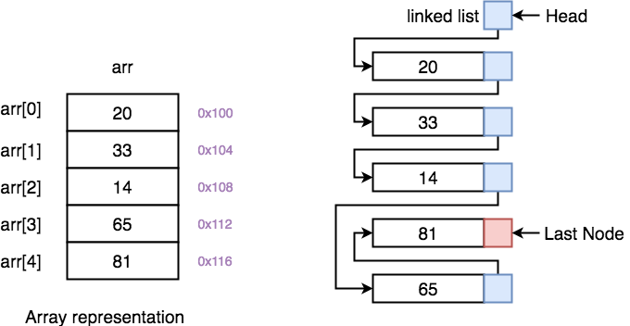
Array v.s. Linked List

Slide 11
Array v.s. Linked List
1/7
Array
Linked List
Collection of elements of same data type
Ordered collection of elements of same type, Which are connected to each other using pointers

Slide 12
Array v.s. Linked List
2/7
Array
Linked List
Random Access
accessed directly using their index
accessing elements is fast with O(1)
Sequential Access
sequentially traverse to access any node
O(n)

Slide 13
Array v.s. Linked List
3/7
Array
Linked List
stored in contiguous memory location
new elements can be stored anywhere in the memory

Slide 14
Array v.s. Linked List
4/7
Array
Linked List
Insertion and Deletion takes more time
memory locations are consecutive and fixed
Insertion and Deletion operations are fast in linked list

Slide 15
Array v.s. Linked List
5/7
Array
Linked List
Static Memory Allocation
allocated as soon as the array is declared, at compile time
in Stack section
Dynamic Memory Allocation
allocated at runtime when new node is added
in Heap section

Slide 16
Array v.s. Linked List
6/7
Array
Linked List
single dimensional
two dimensional
multidimensional
Linear(Singly)
Doubly
Circular

Slide 17
Array v.s. Linked List
7/7
Array
Linked List
Size of array must be specified at declaration
Size of Linked list is variable It grows at runtime

Slide 18
Linked List
Our Mission
Understand Linked List
1
How to implement Linked List
2
Operation on Linked List
3

Slide 19
Singly Linked Node
Using struct
typedef struct _node { int data; struct _node* next; } Node;

Slide 20
Singly Linked List
Node* head = NULL;
NULL
Head

Slide 21
Singly Linked List
Node* head = NULL; Node* temp = (Node*) malloc(sizeof (Node)); temp->data = 10; temp->next = head; head = temp; printf("%d\n", head->data);
10
Head

Slide 22
Print Singly Linked List
void print_list (Node* head) { Node *current = head; while (current != NULL) { printf("%5d", current->data); current = current->next; }
printf("\n"); }
10
Head

Slide 23
Linked List
Our Mission
Understand Linked List
1
How to implement Linked List
2
Operation on Linked List
3

Slide 24
Operation: Insert First
Node* insert_first (Node* node, int value) { // create a new node Node* temp = (Node*) malloc(sizeof (Node));
temp->data = value; // assign data to new node temp->next = node; // point it to old first node node = temp; // point first to new first node return node; }

Slide 25
Using: Insert First
Node *head = NULL;
head = insert_first(head, 10); print_list(head); head = insert_first(head, 12); print_list(head);
12
10
Head

Slide 26
Operation: Insert Last
void insert_last (Node** node, int value) { if (*node == NULL) { *node = insert_first(*node, value); return; } Node* temp = *node; // find last node while (temp->next != NULL) temp = temp->next; temp->next = malloc(sizeof(Node)); temp->next->data = value; temp->next->next = NULL; }

Slide 27
Using: Insert Last
Node* head = NULL; insert_last(&head, 20); print_list(head); insert_last(&head, 22); print_list(head);
20
22
Head

Slide 28
Operation: Remove First
int remove_first (Node** head, int* dataOut) { if (*head == NULL) return 0; Node* next = (*head)->next; int data = (*head)->data; free(*head); *head = next; *dataOut = data; return 1; }

Slide 29
Using: Remove First
int found = remove_first(&head, &data); if (found) { printf("remove %d\n", data); } else { printf("no data to remove\n"); }
print_list(head);

Slide 30
Operation: Remove Last
int remove_last (Node** head, int* dataOut) { if (*head == NULL) return 0; if ((*head)->next == NULL) { *dataOut = (*head)->data; free(*head); *head = NULL; return 1; } Node* current = *head; while (current->next->next != NULL) current = current->next; *dataOut = current->next->data; free(current->next); current->next = NULL; return 1; }

Slide 31
Using: Remove Last
found = 0; while (head != NULL) { found = remove_last(&head, &data); printf("remove %d\n", data); print_list(list2); }

Slide 32
Insert Node (Incomplete)
Need always sorted list
void insert_node (Node** head, int value) { Node* temp = (Node*) malloc(sizeof(Node)); temp->data = value; Node* current = *head; while (value > current->next->data) { current = current->next; } temp->next = current->next; current->next = temp; }

Slide 33
Using: Insert Node
10
20
30
40
Head
Node* head = NULL; insert_last(&head, 10); insert_last(&head, 20); insert_last(&head, 30); insert_last(&head, 40); print_list(head); insert_node(&head, 25); print_list(head);

Slide 34
Insert Node (Bug 1)
Need always sorted list
10
20
25
30
40
Head
insert_node(&head, 5); print_list(head); // What's happened // How to fix it?

Slide 35
Insert Node (Bug 2)
Need always sorted list
10
20
25
30
40
Head
insert_node(&head, 45); print_list(head); // What's happened // How to fix it?

Slide 36
Insert Node (Bug 3?)
Need always sorted list
NULL
Head
Node* head = NULL;
insert_node(&head, 10); print_list(head);

Slide 37
Using: Insert Node
Need always sorted list
Node* head = NULL; insert_node(&head, 10); insert_node(&head, 20); insert_node(&head, 30); insert_node(&head, 40); insert_node(&head, 25); print_list(head);

Slide 38
Doubly Linked Node
Using struct
typedef struct _node {
struct _node* prev; int data; struct _node* next; } Node;

Slide 39
Doubly Linked List
Node* head = NULL;
Node* tail = NULL;
NULL
NULL
Head
Tail

Slide 40
Doubly Linked List
Node* head = NULL; Node* tail = NULL; Node* temp = (Node*) malloc(sizeof (Node)); temp->data = 10; temp->next = tail; temp->prev = head; head = temp; tail = temp; printf("%d\n", head->data); printf("%d\n", tail->data);
Head
10
Tail

Slide 41
Print Doubly Linked List
void print_from_head (Node* head) { Node* current = head; while (current != NULL) { printf("%5d", current->data); current = current->next; } printf("\n"); }

Slide 42
Print Doubly Linked List
void print_from_tail (Node* head) { Node* current = head; while (current != NULL) { printf("%5d", current->data); current = current->prev; } printf("\n"); }

Slide 43
Operation: Insert First
void insert_first (Node** head, Node** tail, int value) { Node* temp = (Node*) malloc(sizeof(Node)); temp->data = value; temp->prev = NULL; if (*head == NULL) { temp->next = NULL; *tail = temp; } else { temp->next = *head; (*head)->prev = temp; } *head = temp; }

Slide 44
Using: Insert First
Node* head = NULL; Node* tail = NULL; insert_first(&head, &tail, 10); insert_first(&head, &tail, 20); insert_first(&head, &tail, 30); insert_first(&head, &tail, 40); printf("H: "); print_from_head(head); printf("T: "); print_from_tail(tail);

Slide 45
Operation: Insert Last
void insert_last (Node** head, Node** tail, int value) { Node* temp = (Node*) malloc(sizeof(Node)); temp->data = value; temp->next = NULL; if (*head == NULL && *tail == NULL) { temp->prev = NULL; *head = temp; } else { temp->prev = *tail; (*tail)->next = temp; } *tail = temp; }

Slide 46
Using: Insert Last
Node* head = NULL; Node* tail = NULL; insert_last(&head, &tail, 15); insert_last(&head, &tail, 25); insert_last(&head, &tail, 35); insert_last(&head, &tail, 45); printf("H: "); print_from_head(head); printf("T: "); print_from_tail(tail);

Slide 47
Doubly Sorted Linked List
Need always sorted list

Slide 48
Linked List
Next
Hashing

