Slide 1

Memory Leak in Node

Slide 2
Memory Leak Tools
Memwatch
Memwatch tool ➔ “how to find leak in node”.
Get it from : GitHub’s fork list for the repository.
This module is useful because it can emit leak events if it sees the heap grow over 5 consecutive garbage collections.
Heapdump
Great tool which allows Node.js developers to take heap snapshot and inspect them later with Chrome Developer Tools.

Slide 3
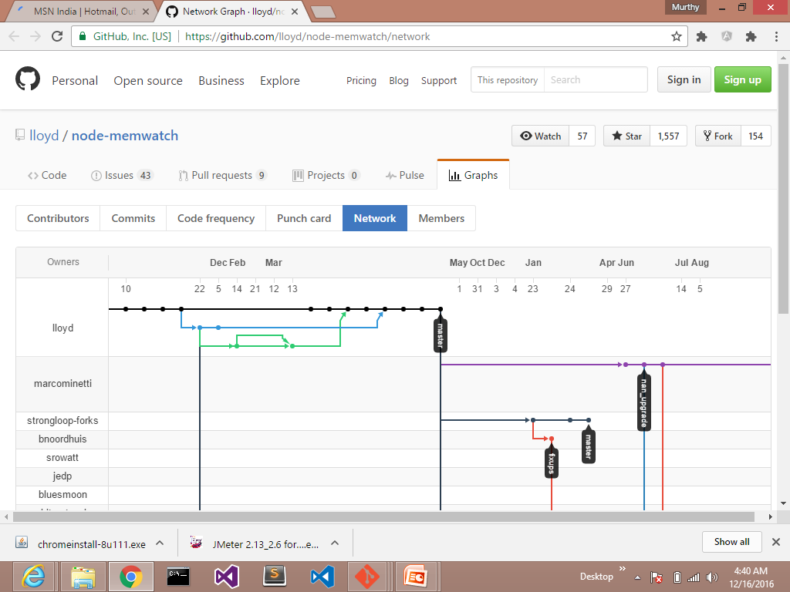
Memory Leak Tools

Slide 4
Memory Leak Tools
Node-inspector
it allows to connect to a running application, take heap dump and even debug and recompile it on the fly.

Slide 5
Memory Leak Testing
var restify = require('restify');
var server = restify.createServer();
var tasks = [];
server.pre(function(req, res, next) {
tasks.push(function() {
return req.headers;
});
// Synchronously get user from session, maybe jwt token
req.user = { id: 1, username: 'Leaky Master', };
return next();
});

Slide 6
Memory Leak Testing
server.get('/', function(req, res, next) {
res.send('Hi ' + req.user.username);
return next();
});
server.listen(3000, function() {
console.log('%s listening at %s', server.name, server.url);
});
The array tasks would grow over application lifetime causing it to slow down and eventually crash.

Slide 7
Memory Leak Testing
GC in V8 employs stop-the-world strategy, therefore it means more objects you have in memory the longer it will take to collect garbage.
On log observe that in the beginning of the application life it would take an average of 20ms to collect the garbage, but few hundred thousand requests later it takes around 230ms.
[28093] 7644 ms: Mark-sweep 10.9 (48.5) -> 10.9 (48.5) MB, 25.0 ms [HeapObjectsMap::UpdateHeapObjectsMap] [GC in old space requested].
[28093] 7717 ms: Mark-sweep 10.9 (48.5) -> 10.9 (48.5) MB, 18.0 ms [HeapObjectsMap::UpdateHeapObjectsMap] [GC in old space requested].
28093] 7866 ms: Mark-sweep 11.0 (48.5) -> 10.9 (48.5) MB, 23.2 ms [HeapObjectsMap::UpdateHeapObjectsMap] [GC in old space requested].
[28093] 637508 ms: Mark-sweep 235.7 (290.5) -> 235.7 (290.5) MB, 357.2 ms [HeapObjectsMap::UpdateHeapObjectsMap] [GC in old space requested].

Slide 8
Memory Leak Testing
People who are trying to access our application would have to wait 230ms longer now because of GC.
Also GC is invoked every few seconds which means that every few seconds users would experience problems accessing our application. And delay will grow up until application crashes.
These log lines are printed when a Node.js application is started with the –trace_gc flag:
$node --trace_gc app.js

Slide 9
GC performance and Debuggig Tips
Try to avoid memory leaks.
During the mark phase in full GC the application is actually paused until garbage collection is completed. This means the more objects you have in the heap, the longer it will take to perform GC and the longer users will have to wait.

Slide 10
GC performance and Debuggig Tips
Always give names to closures and functions
It’s much easier to inspect stack traces and heaps when all closures and functions have names.
db.query('GIVE THEM ALL', function GiveThemAllAName(error, data) { ...})
Avoid large objects in hot functions
Avoid large objects inside of hot functions so that all data is fit into New Space. All CPU and memory bound operations should be executed in background.
Also avoid deoptimization triggers for hot functions, optimized hot function uses less memory than non-optimized ones.

Slide 11
GC performance and Debuggig Tips
Hot functions should be optimized
Hot functions that run faster but also consume less memory cause GC to run less often. V8 provides some helpful debugging tools to spot non-optimized functions or deoptimized functions.

Slide 12
GC performance and Debuggig Tips
Avoid polymorphism for IC’s in hot functions
Inline Caches (IC) are used to speed up execution of some chunks of code, either by caching object property access obj.key or some simple function.
function x(a, b) { return a + b;}
x(1, 2); // monomorphic
x(1, “string”); // polymorphic, level 2
x(3.14, 1); // polymorphic, level 3

Slide 13
GC performance and Debuggig Tips
When x(a,b) is run for the first time, V8 creates a monomorphic IC.
When we call x a second time, V8 erases the old IC and creates a new polymorphic IC which supports both types of operands integer and string.
When we call IC the third time, V8 repeats the same procedure and creates another polymorphic IC of level 3.
After IC level reaches 5 (could be changed with –max_inlining_levels flag) the function becomes megamorphic and is no longer considered optimizable

Slide 14
GC performance and Debuggig Tips
Don’t add large files to memory
This one is obvious and well known. If you have large files to process, for example a large CSV file, read it line-by-line and process in little chunks instead of loading the entire file to memory.
There are rather rare cases where a single line of csv would be larger than 1mb, thus allowing you to fit it in New Space

Slide 15
GC performance and Debuggig Tips
Do not block main server thread
If have some hot API which takes some time to process, such as an API to resize images, move it to a separate thread or turn it into a background job.
CPU intensive operations would block main thread forcing all other customers to wait and keep sending requests.
Unprocessed request data would stack in memory, thus forcing full GC to take longer time to finish.

Slide 16
GC performance and Debuggig Tips
Know your tools
There are various debuggers, leak cathers, and usage graphs generators. All those tools helps to make software faster and more efficient.

