Slide 1
Automatic Thresholding

Slide 2
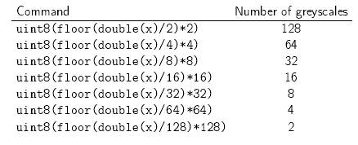
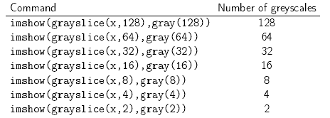
Review: Image Quantization

Slide 3
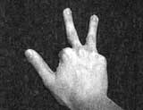

Basic Idea of Image Segmentation
Segmentation is often considered to be the first step in image analysis.
  The purpose is to subdivide an image into meaningful non-overlapping regions, which would be used for further analysis.
  It is hoped that the regions obtained correspond to the physical parts or objects of a scene (3-D) represented by the image (2-D).
In general, autonomous segmentation is one of the most difficult tasks in digital image processing.
Example
Notes:
As an example, you can see how segmentation can be integrated into an intelligent application. Above are two screenshots: a noisy image taken with a mobile phone (converted to greyscale), and the segmented using the threshold selection algorithm detailed later. Finally, data collected via border tracing (which requires a binary image) can be used to count the number of fingers in the image.

Slide 4
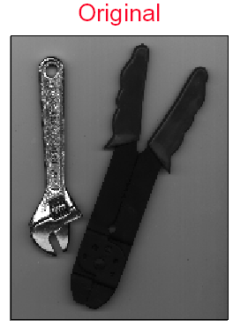
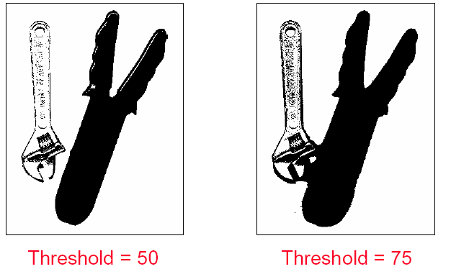
Basic Idea of Image Segmentation
All the image segmentation methods assume that:
  1. the intensity values are different in different regions, and,
  2. within each region, which represents the corresponding object in a scene, the intensity values are similar.
Notes:
im=imread('tools.bmp');
» imshow(im)
» figure(2); im1=imshow(double(im)>50);
» figure(3); im1=imshow(double(im)>80);

Slide 5
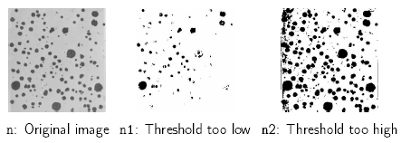
Choosing a threshold: Review
Image thresholding classifies pixels into two categories:
– Those to which some property measured from the image falls below a threshold, and those at which the property equals or exceeds a threshold.
– Thesholding creates a binary image → binarization
e.g. perform cell counts in histological images
Choosing a threshold is something of a “black art”:
n=imread(‘nodules1.jpg’);
figure(1); imshow(n);
n1=im2bw(n,0.35);
n2=im2bw(n,0.75);
figure(2), imshow(n1);
figure(3), imshow(n2);

Slide 6
Fixed Thresholding
• In fixed (or global) thresholding, the threshold value is held constant throughout the image:
  – Determine a single threshold value by treating each pixel independently of its neighborhood.
• Fixed thresholding is of the form:
0 f(x,y)<T
g(x,y) =
1 f(x,y)>=T
Assumes high-intensity pixels are of interest, and low-
intensity pixels are not.

Slide 7
Threshold Values & Histograms
• Thresholding usually involves analyzing the histogram
  – Different features give rise to distinct features in a histogram
  – In general the histogram peaks corresponding to two features will overlap. The degree of overlap depends on peak separation and peak width.
• An example of a threshold value is the mean intensity value

Slide 8

Automatic Thresholding Algorithm: Iterative threshold selection
1 Select an initial estimate of the threshold T. A good initial value is the average intensity of the image.
3. Calculate the mean grey values and of the partitions, R1, R2 .
2. Partition the image into two groups, R1, R2 , using the threshold T.
4. Select a new threshold:
5. Repeat steps 2-4 until the mean values and in successive iterations do not change.

Slide 9
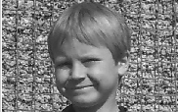
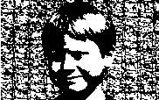
Matlab Implementation
Matlab function opthr
addpath C:\Zhang\scm3511\week3\matlab
im = imread('boy.jpg');
I = rgb2gray(im);
I=double(I);
T=opthr(I);
bim=(I>T);
subplot(1,2,1), imshow(I, gray(256));
subplot(1,2,2), imshow(bim)

Slide 10
Possible Variations
Pick an initial threshold value, t (say 128).
Calculate the mean values in the histogram below (m1) and above (m2) the threshold t.
Calculate new threshold. tnew = (m1 + m2) / 2.
If the threshold has stabilized (t = tnew), this is your threshold level. Otherwise, t become tnew and reiterate from step 2.

Slide 11
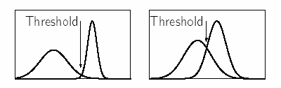
Optimal Thresholding
Histogram shape can be useful in locating the threshold.
  – However it is not reliable for threshold selection when peaks are not clearly resolved.
  – A “flat” object with no discernable surface texture,and no colour variation will give rise to a relatively narrow histogram peak.
Choosing a threshold in the valley between two overlapping peaks, and
inevitably some pixels will be incorrectly classified by the thresholding.
The determination of peaks and valleys is a non-trivial problem

Slide 12
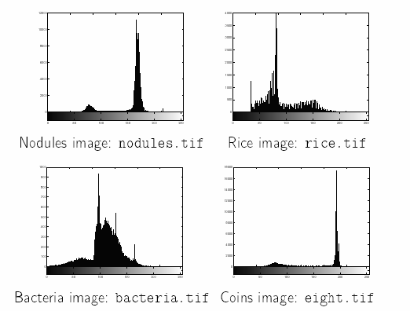

Slide 13
Optimal Thresholding
• In optimal thresholding, a criterion function is devised that yields some measure of separation between regions.
  – A criterion function is calculated for each intensity and that which maximizes this function is chosen as the threshold.
Otsu’s thresholding chooses the threshold to minimize the
intraclass variance of the thresholded black and white pixels.
  Formulated as discriminant analysis: a particular criterion function
  is used as a measure of statistical separation.

Slide 14



Otsu’s Methold
Otsu’s thresholding method is based on selecting the lowest point between two classes (peaks).
Frequency and Mean value:
    Frequency: N: total pixel number
    Mean: n_{i}: number of pixels in level i
Analysis of variance (variance=standard deviation²)
    Total variance:

Slide 15
Otsu’s Methold
between-classes variance (δ_{b}² ):
The variation of the mean values for each class from the overall intensity mean of all pixels:
δ_{b}² = ω₀ (μ₀ - μ_{t} ) ² + ω₁(μ₁ - μ_{t} ) ²,
Substituting μ_{t} = ω₀ μ₀ + ω₁μ₁, we get:
δ_{b}² = ω₀ω₁(μ₁ - μ₀ )²
  ω_{0,} ω_{1,} μ_{0,} μ₁ stands for the frequencies and mean
  values of two classes, respectively.
Notes:
The between classes variance is the separability measure for the two classes

Slide 16
Otsu’s Method
The criterion function involves between-classes variance to the total variance is defined as:
  η = δ_{b}² / δ_{t}²
All possible thresholds are evaluated in this way, and the one that maximizes η is chosen as the optimal threshold

Slide 17
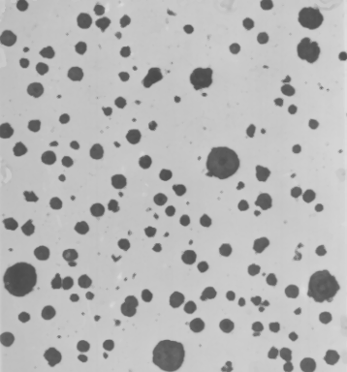
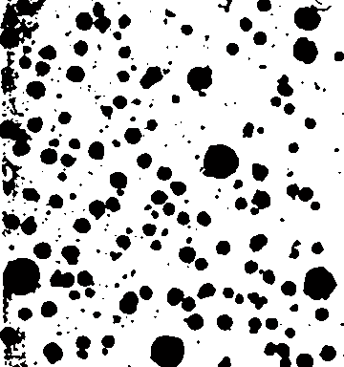
Matlab function for Otsu’s method
function level = graythresh(I)
GRAYTHRESH Compute global threshold
using Otsu's method. Level is a normalized
intensity value that lies in the range [0, 1].
>>n=imread('nodules1.tif');
>> tn=graythresh(n)
tn = 0.5804
>> imshow(im2bw(n,tn))

Slide 18
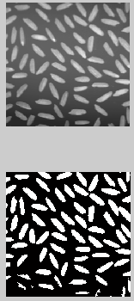
r=imread('rice.tif');
graythresh;
subplot(211);
imshow;
subplot(212);
imshow(im2bw(r,tr))

