Slide 1

Coupled Principal Component Analysis
作者 ：Ralf Moller, Axel Konies
讲解人：李博

Slide 2

作者的相关信息
Ralf Moller
Chair of the Computer Engineering Group University of Bielefeld（比勒费尔德）.
http://www.ti.uni-bielefeld.de/
PhD in Department of Computer Science, University of Zurich
Research
Visual landmark navigation in analog hardware
Sahabot project
UV/green contrast for landmark detection

Slide 3
作者的相关信息
主要文章(大约47篇):
A self-stabilizing learning rule for minor component analysis
International Journal of Neural Systems, Vol. 14, No. 1 (2004), 1-8
Coupled Principal Component Analysis
IEEE Transactions on Neural Networks, Vol. 15, No. 1 (2004), 214-222
An Extension of Neural Gas to Local PCA
Neurocomputing, Vol. 62 (2004), 305-326
Interlocking of learning and orthonormalization in RRLSA
Neurocomputing, Vol. 49, No. 1-4, December 2002, 429-433
Insects Could Exploit UV-Green Contrast for Landmark Navigation
Journal of Theoretical Biology, Vol. 214, No. 4, February 2002, 619-631
An Extension of Neural Gas to Local PCA
Neurocomputing, Vol. 62 (2004), 305-326

Slide 4
作者的相关信息
Axel Knies

Slide 5
文章的相关信息
文章出处:IEEE TRANSACTIONS ON NEURAL NETWORKS
发表时间:2004
相关文献
  E. Oja, “A simplified neuron model as principal component analyzer”,Journal of Mathematical Biology, vol. 15, pp. 267–273, 1982.
  T. D. Sanger, “Optimal unsupervised learning in a single-layer linear feedforward neural network”, Neural Networks, vol. 2, no. 6, pp. 459–473, 1989.
  Ralf Möller “A self-stabilizing learning rule for minor component analysis ”,International Journal of Neural Systems, vol. 14, no. 1, pp.1-8 ,2004

Slide 6
文章摘要
A framework for a class of coupled principal component learning rules is presented. In coupled rules, eigenvectors and eigenvalues of a covariance matrix are simultaneously estimated in coupled equations. Coupled rules can mitigate the stability-speed problem affecting non-coupled learning rules, since the convergence speed in all eigendirections of the Jacobian becomes widely independent of the eigenvalues of the covariance matrix. A number of coupled learning rule systems for principal component analysis, two of them new, is derived by applying Newton’s method to an information criterion. The relation to other systems of this class, the adaptive learning algorithm (ALA), the robust recursive least squares algorithm (RRLSA), and a rule with explicit renormalization of the weight vector length, are established.

Slide 7
文章摘要
文章介绍了一组coupled 主成分学习准则。在coupled 准则中，协方差矩阵特征向量和特征值被同时估计。Coupled 准则能够减轻速度稳定性问题对于非coupled学习准则的影响，因为在 Jacobian 的所有特征方向上的收敛速度都广泛独立于协方差矩阵的特征值。很多PCA coupled 学习准则系统对于目标函数应用了Newton 法。最后给出此类其他系统，如：ALA（自适应学习算法），RRLSA（鲁棒的最小二乘回归算法），以及一种直接重正化权重向量长度的准则，与coupled 学习准则的关系。

Slide 8
研究背景和研究意义
PCA/MCA，and NN
  PCA（Principal Component Analysis）
  MCA（Minor Component Analysis）
  Neural network approaches to PCA (MCA)pursue an “online” approach where an estimate of the principal (minor) directions is updated after each presentation of a data point.
the way for dimension reduction and data compression
Eigenvector , eigenvalue → Eigenface

Slide 9
本文所研究问题的提出
PCA is an ingredient of many signal processing applications。
There is many neural principal component analyzers. e.g. Oja [1] and Sanger [2];
the speed-stability problem plagues most non-coupled learning rules.
Coupled learning rules could resolve the problem of non-coupled learning rules in some degree.

Slide 10
本文解决思路的基本思想
Coupled learning rules can be derived by applying Newton’s method to a common information criterion. A Newton descent yields learning rules with approximately equal convergence speed in all eigendirections of the system. Moreover, all eigenvalues of the Jacobian of such a system are approximately -1, thus the dependence on the eigenvalues of the covariance matrix can be eliminated.

Slide 11
文章提纲
INTRODUCTION
DERIVATION OF COUPLED LEARNING RULE SYSTEMS
ANALYSIS OF EIGEN-MOTION
ONLINE PCA SYSTEM
ANOTHER PCA SYSTEM: ALA
ONLINE MCA SYSTEM
RELATION TO OTHER PCA RULES
SIMULATIONS
DISCUSSION

Slide 12
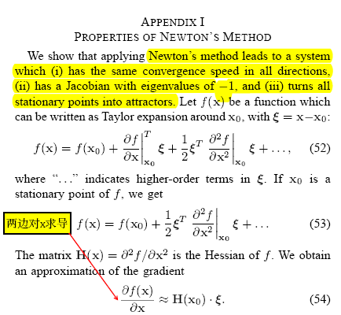
相关基础知识的介绍

Slide 13
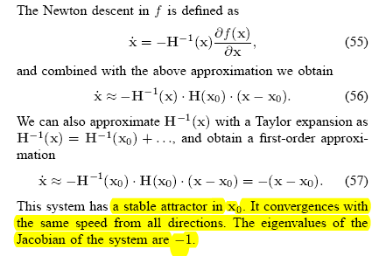
相关基础知识的介绍

Slide 14
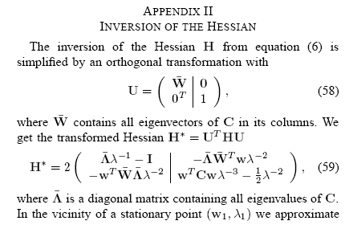
相关基础知识的介绍

Slide 15
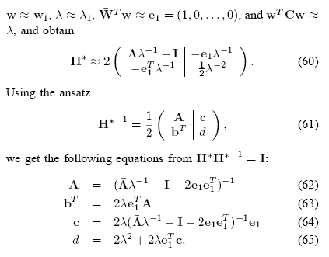
相关基础知识的介绍

Slide 16
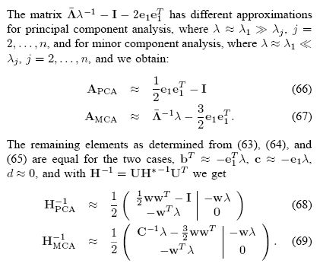
相关基础知识的介绍

Slide 17
相关基础知识的介绍
Mahalanobis distance
D²_{t}(x) = (x – m_{t})S⁻¹_{t}(x – m_{t}) ^{t}
    D_{t} is the generalized squared distance of each pixel from the t group
    S_{t} represents the within-group covariance matrix
    m_{t} is the vector of the means of the variables of the t group
    X is the vector containing the values of the environmental variables observed at location x

Slide 18


DERIVATION OF COUPLED LEARNING RULE SYSTEMS
An Extension of Neural Gas to Local PCA
  Ralf Möller, Heiko Hoffmann
  Neurocomputing, Vol. 62 (2004), 305-326
求导

Slide 19

DERIVATION OF COUPLED LEARNING RULE SYSTEMS

Slide 20
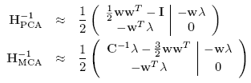




DERIVATION OF COUPLED LEARNING RULE SYSTEMS
+
+
PCA
MAC

Slide 21



ANALYSIS OF EIGEN-MOTION
A. Coupled PCA system
Computate J*’s eigenvalues, | J* - aI| = 0.

Slide 22
ANALYSIS OF EIGEN-MOTION
A. Coupled PCA system
Since stability requires and thus
we find that only principal eigenvector-eigenvalue pairs arestable stationary points, while all other stationary points are saddles or repellers. Moreover we see that, if we assume all eigenvalues are , so the system convergeswith approximately equal speed in all its eigendirections, andthis speed is widely independent of the eigenvalues of the
covariance matrix.

Slide 23

ANALYSIS OF EIGEN-MOTION
B. Coupled MCA system
We obtain an MCA condition and
see that for all eigenvalues are thus the
convergence speed is again about equal in all eigendirections
and independent of the eigenvalues of C.

Slide 24
ANALYSIS OF EIGEN-MOTION
C. Non-coupled Systems
non-coupled rules of Oja’s PCA learning rule and the MCA rule suggested by Feng.
  E. Oja, “A simpli E. Oja, “A simplified neuron model as principal component analyzer”,Journal of Mathematical Biology, vol. 15, pp. 267–273, 1982.
  D. Z. Feng, Z. Bao, and L. C. Jiao, “Total least mean squares algorithm,”IEEE Transactions on Signal Processing, vol. 46, no. 8, pp. 2122–2130,August 1998.
non-coupled PCA rules:
non-coupled MCA rules:

Slide 25
ANALYSIS OF EIGEN-MOTION
C. Non-coupled Systems
J
J*
| J* - aI| = 0.
With the learning rate (step size) has to be chosen in accordance with an estimate of .

Slide 26

ANALYSIS OF EIGEN-MOTION
C. Non-coupled Systems
J
J*
| J* - aI| = 0.
With the learning rate (step size) has to be on all
other eigenvalues of the covariance matrix.
There is no learning rate which not only guarantees stability (upper limit defined by the largest eigenvalue) but also ensures a sufficient speed of convergence in all eigendirections.

Slide 27


ONLINE PCA SYSTEM
C = xx^{T} and y = w^{T}x
is a learning rate that decreases to zero over time.
Critical for the behavior of the online rule is the temporal derivative of the (squared) weight vector length, .

Slide 28


ONLINE PCA SYSTEM
+
We see that the sign of this expression does not only depend on w^{T}w, but also on the random variable y, therefore the weight vector length may in principle be fluctuating and only converging when the learning rate becomes sufficiently small.

Slide 29
ONLINE PCA SYSTEM
+
the sign of this expression just depend on wTw . Fluctuations are
therefore avoided.

Slide 30

ANOTHER PCA SYSTEM: ALA
(Adaptive Learning Algorithm)
w^{T}w = 1
J
J*
| J* - aI| = 0.

Slide 31

ANOTHER PCA SYSTEM: ALA
(Adaptive Learning Algorithm)
| J* - aI| = 0.
(1)
(2)
(1) slightly deviate from the close-to-optimal solution (2), but are still approximately equal and widely independent of the eigenvalues of the covariance matrix.

Slide 32

ANOTHER PCA SYSTEM: ALA
(Adaptive Learning Algorithm)
C = xx^{T} , y = w^{T}x, wTw = 1
ALA
Oja’s PCA
We see that ALA can be interpreted as an instance of Oja’s PCA rule. This rule shares the beneficial property of a non-fluctuating
weight vector length with Oja’s rule;

Slide 33
ONLINE MCA SYSTEM
when attempting to turn this system into an online rule, we encounter the problem to replace the inverse covariance matrix C⁻¹ by an expression containing the input vector x.
MAC
?
This transition is obviously not possible if the equation
contains C⁻¹.

Slide 34


RELATION TO OTHER PCA RULES
A. Further Approximation of ALA

Slide 35
RELATION TO OTHER PCA RULES
A. Further Approximation of ALA
indicating that the weight vector length fluctuates. Stability and fluctuations are confirmed by imulations; This novel rule is therefore probably only interesting from the theoretical perspective, but not well suited for practical applications.

Slide 36

RELATION TO OTHER PCA RULES
B. Discrete Learning Rule with Renormalization
The main problem of the cPCA learning rule system is the fluctuation of the weight vector length. This problem can be avoided by explicitly renormalizing the weight vector length
in every time step t, as described by the time-discrete learning
rule system .

Slide 37


RELATION TO OTHER PCA RULES
C. Relation to RRLSA (robust recursive least squares learning algorithm)
Properties: RRLSA proved to be a robust and fast mechanism.

Slide 38

RELATION TO OTHER PCA RULES
C. Relation to RRLSA (robust recursive least squares learning algorithm)
With
This equation is closely related to RRLSA.
RRLSA:

Slide 39
SIMULATIONS
Low-Dimensional Synthetic Data
In the three-dimensional space (n = 3), 1000 data points were randomly generated.

Slide 40
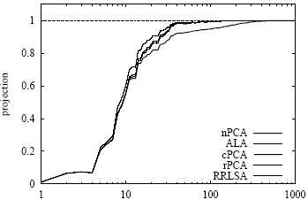
SIMULATIONS
Notes:
the projection of the
eigenvector estimate (weight vector) onto the real principal
eigenvector

Slide 41
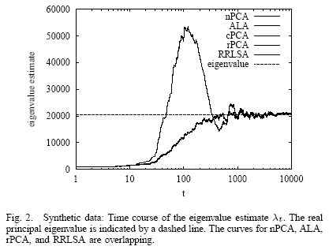
SIMULATIONS

Slide 42
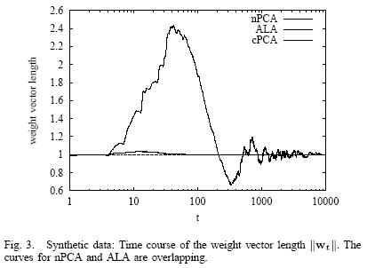
SIMULATIONS

Slide 43
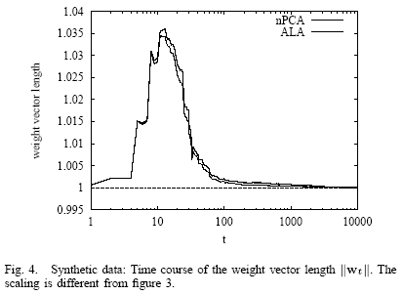
SIMULATIONS

Slide 44
SIMULATIONS
Medium-Dimensional Image Data
The learning rules were also applied to a medium dimensional data distribution (n = 64) formed by 30000 windows of size 8x8 extracted from a gray-scale imageof a natural scene .

Slide 45
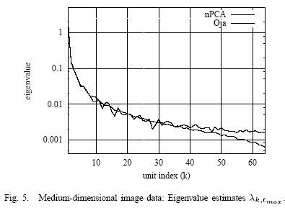
SIMULATIONS

Slide 46
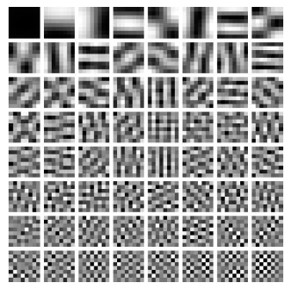
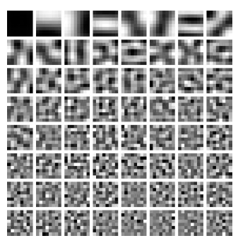

ONLINE MCA SYSTEM

Slide 47
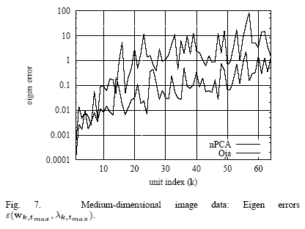
SIMULATIONS

Slide 48
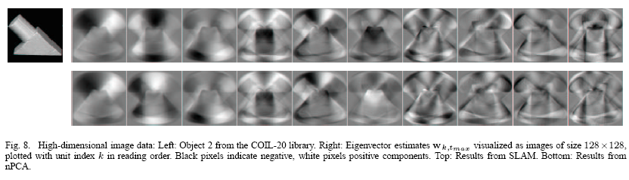
SIMULATIONS
High-Dimensional Image Data
in this case n =16 384. The training data are 72 gray-scale images with 128 x 128 pixels of an object rotating around the vertical axis.

Slide 49
DISCUSSION
1)coupled PCA/MCA.
2)Newton’s method.
3)Online PCA but MCA systems can not.
4)The online form (23, 24) of the nPCA rule may theoretically show fluctuations in the weight vector length.
5)ALA mends the potential problem of fluctuating weight vector
length. The cPCA rule suffers from fluctuations.
nPCA, ALA PCA, Oja’s PCA, and cPCA are equal in some degree.

