Slide 1
Principal Component Analysis and Independent Component Analysis in Neural Networks
David Gleich
CS 152 – Neural Networks
11 December 2003

Slide 2
Outline
Review PCA and ICA
Neural PCA Models
Neural ICA Models
Experiments and Results
Implementations
Summary/Conclusion
Questions

Slide 3
Principal Component Analysis
PCA identifies an m dimensional explanation of n dimensional data where m < n.
Originated as a statistical analysis technique.
PCA attempts to minimize the reconstruction error under the following restrictions
  Linear Reconstruction
  Orthogonal Factors
Equivalently, PCA attempts to maximize variance.

Slide 4
Independent Component Analysis
Also known as Blind Source Separation.
Proposed for neuromimetic hardware in 1983 by Herault and Jutten.
ICA seeks components that are independent in the statistical sense.
Two variables x, y are statistically independent iff P(x Å y) = P(x)P(y).
Equivalently,
E{g(x)h(y)} – E{g(x)}E{h(y)} = 0
where g and h are any functions.

Slide 5
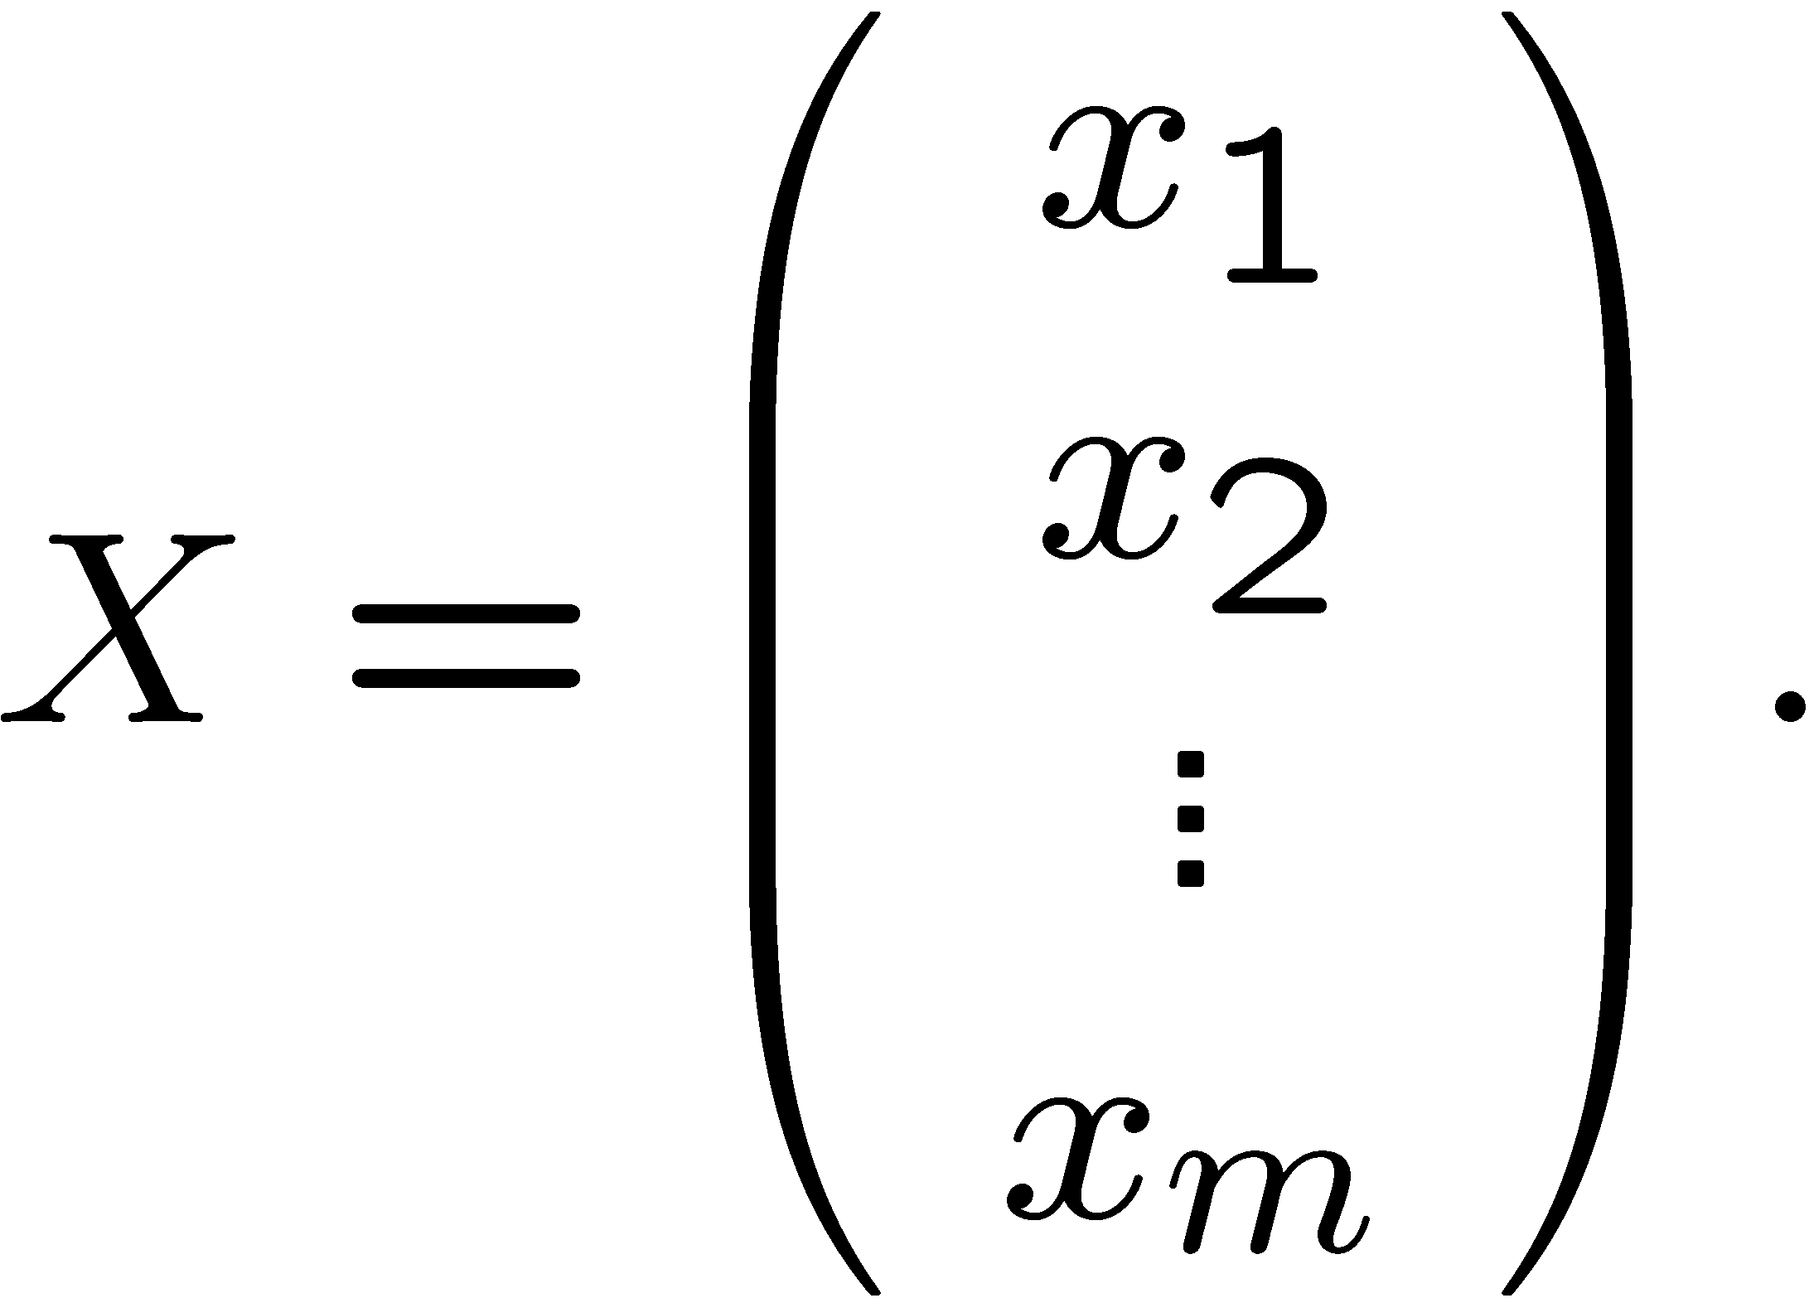
Independent Component Analysis
Given m signals of length n, construct the data matrix
We assume that X consists of m sources such that
X = AS
where A is an unknown m by m mixing matrix and S is m independent sources.

Slide 6
Independent Component Analysis
ICA seeks to determine a matrix W such that
Y = BX
where W is an m by m matrix and Y is the set of independent source signals, i.e. the independent components.
B ¼ A⁻¹ ) Y = A⁻¹AX = X
Note that the components need not be orthogonal, but that the reconstruction is still linear.

Slide 7
PCA with Neural Networks
Most PCA Neural Networks use some form of Hebbian learning.
“Adjust the strength of the connection between units A and B in proportion to the product of their simultaneous activations.”
w_{k+1} = w_{k} + β_{k}(y_{k} x_{k})
Applied directly, this equation is unstable.
||w_{k}||² ! 1 as k ! 1
Important Note: neural PCA algorithms are unsupervised.

Slide 8
PCA with Neural Networks
Another fix: Oja’s rule.
Proposed in 1982 by Oja and Karhunen.
w_{k+1} = w_{k} + β_{k}(y_{k} x_{k} – y_{k}² w_{k})
This is a linearized version of the normalized Hebbian rule.
Convergence, as k ! 1, w_{k} ! e₁.
x₁
w₁
x₂
w₂
w₃
x₃
+
y
w_{n}
x_{n}

Slide 9
PCA with Neural Networks
Generalized Hebbian Algorithm
y = Wx
Δw_{ij,k}=β_{k}y_{ik}x_{jk} - β_{k}y_{ik}∑_{l≤i}y_{lk}w_{lj,k}
ΔW = β_{k}yx^{T} - β_{k}W LT(yy^{T})
x₁
y₁
x₂
x₃
y₂
y_{m}
x_{n}

Slide 10
PCA with Neural Networks
APEX Model: Kung and Diamantaras
y = Wx – Cy , y = (I+C)⁻¹Wx ¼ (I-C)Wx
x₁
y₁
x₂
c₂
x₃
y₂
c_{m}
y_{m}
x_{n}

Slide 11
PCA with Neural Networks
APEX Learning
Properties of APEX model:
  Exact principal components
  Local updates, Δw_{ab} only depends on x_{a}, x_{b,} w_{ab}
  “-Cy” acts as an orthogonalization term

Slide 12
Neural ICA
ICA is typically posed as an optimization problem.
Many iterative solutions to optimization problems can be cast into a neural network.

Slide 13
Feed-Forward Neural ICA
General Network Structure
Learn B such that y = Bx has independent components.
Learn Q which minimizes the mean squared error reconstruction.
B
Q
x
x’
y

Slide 14
Feed-Forward Neural ICA
General Network Structure
Learn B such that y = Bx has independent components.
B
x
y

Slide 15
Neural ICA
Herault-Jutten: local updates
B = (I+S)⁻¹
S_{k+1} = S_{k} + β_{k}g(y_{k})h(y_{k}^{T})
g = t, h = t³; g = hardlim, h = tansig
Bell and Sejnowski: information theory
B_{k+1} = B_{k} + β_{k}[B_{k}^{-T} + z_{k}x_{k}^{T}]
z(i) = ∂/∂u(i) ∂u(i)/∂y(i)
u = f(Bx); f = tansig, etc.

Slide 16
Neural ICA
EASI (Equivariant Adaptive Separation via Independence): Cardoso et al
B_{k+1}=B_{k}-β_{k}[y_{k}y_{k}^{T}–I+g(y_{k})h(y_{k})^{T}-(y_{k})g(y_{k})^{T}]B_{k}
g=t, h=tansig(t)

Slide 17
Oja’s Rule in Action
Matlab Demo!

Slide 18
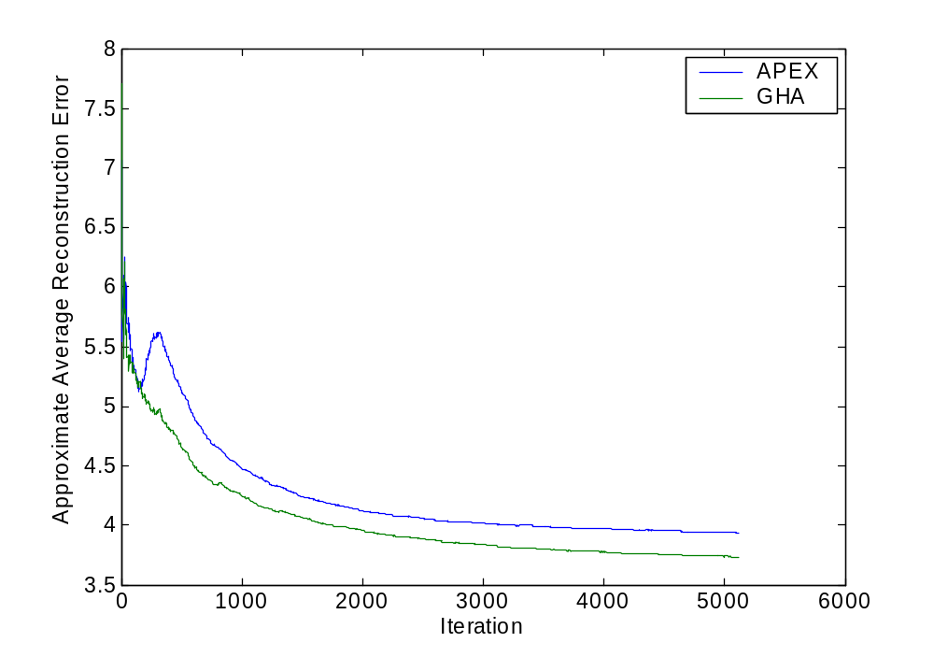
PCA Error Plots – Close Eigenvalues
Final APEX error: 3.898329
Final GHA error: 3.710844
Minimum error: 3.664792

Slide 19
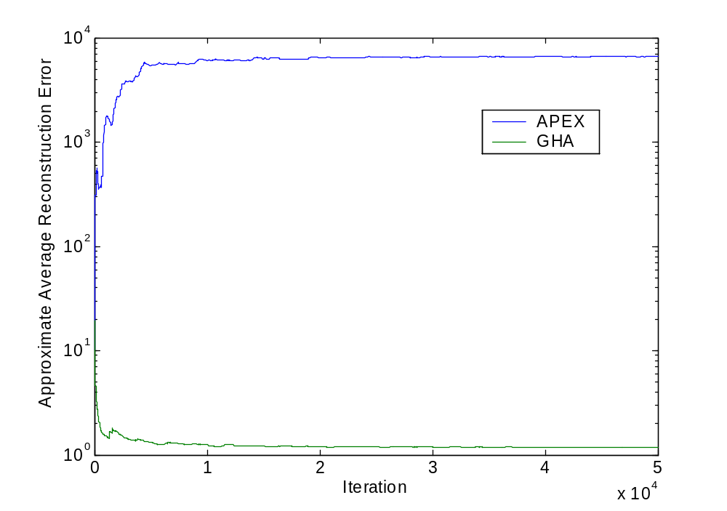
PCA Error Plots – Separate Eigenvalues
Final APEX error: 2322.942988
Final GHA error: 0.875660
Minimum error: 0.082642

Slide 20
Observations
Why just the PCA subspace?
  Bad Oja’s example – Matlab demo!
Why can APEX fail?
  “-Cy” term continually orthogonalizes

Slide 21
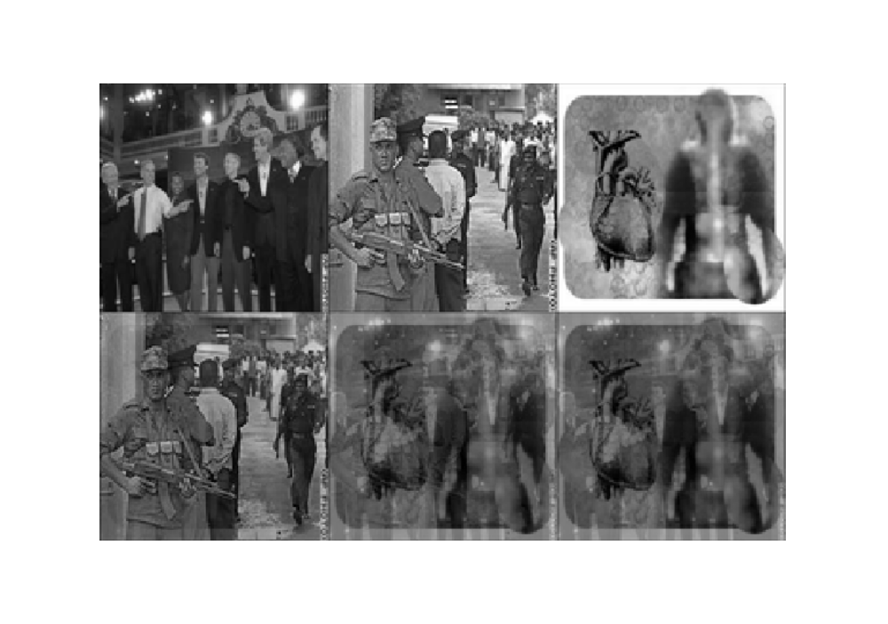
ICA Image Example

Slide 22
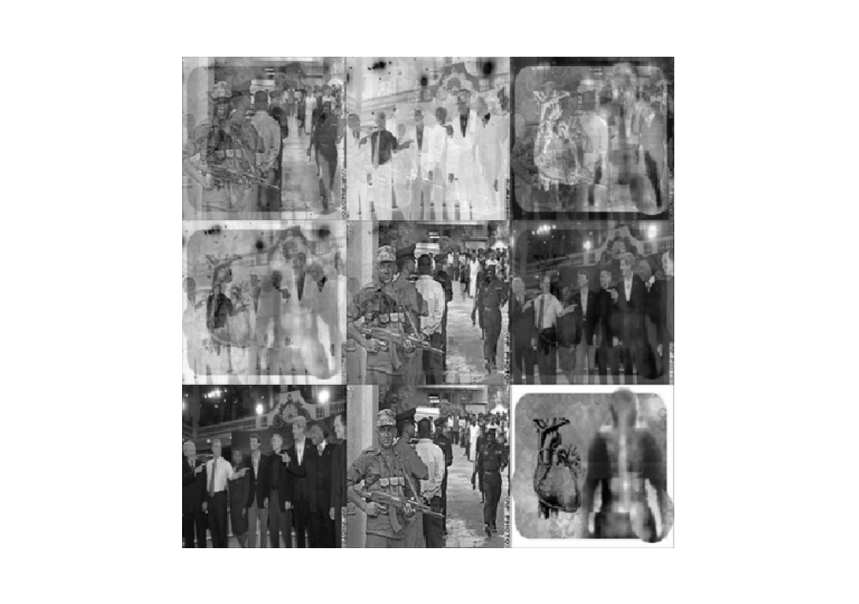
ICA Image Example
Bell and Sejnowski
EASI

Slide 23
Real World Data
8 channel ECG from pregnant mother

Slide 24
Implementation
Matlab sources for each neural algorithm, and supporting functions
  PCA: oja.m; gha.m; apex.m
  ICA: hj.m; easi.m; bsica.m
  Evaluation: pcaerr.m
  Demos: fetal_plots.m; pca_error_plots.m; ojademo.m; ica_image_demo.m
  Data generators: evalpca.m; evalica.m

Slide 25
Future Work
Investigate adaptive learning and changing separations
  Briefly examined this; the published paper on ICA adjusted the learning rate correctly, but didn’t converge to a separation.
Convergence of PCA algorithms based on eigenvalue distribution?
Use APEX to compute “more” components than desired?

Slide 26
Summary
Neural PCA:
  Algorithms work “sometimes.” They tend to find the PCA subspace rather than the exact PCA components
  GHA is better than APEX
Neural ICA:
  Algorithms converge to something reasonable.
  Bell and Sejnowski’s ICA possibly superior to EASI.

Slide 27
Questions?

Slide 28
References
Diamantras, K.I. and S. Y. Kung. Principal Component Neural Networks.
Comon, P. “Independent Component Analysis, a new concept?” In Signal Processing, vol. 36, pp. 287-314, 1994.
FastICA, http://www.cis.hut.fi/projects/ica/fastica/
Oursland, A., J. D. Paula, and N. Mahmood. “Case Studies in Independent Component Analysis.”
Weingessel, A. “An Analysis of Learning Algorithms in PCA and SVD Neural Networks.”
Karhunen, J. “Neural Approaches to Independent Component Analysis.”
Amari, S., A. Cichocki, and H. H. Yang. “Recurrent Neural Networks for Blind Separation of Sources.”

