Slide 1
Analyzing Data Using Clustering Methods
Tyler Borgard

Slide 2
Kmeans
Kmeans splits the data into clusters, each of which is assigned a centroid
The centroid of a cluster is the mean of all the points in the cluster
Each point in the dataset is assigned to the cluster with the closest centroid

Slide 3
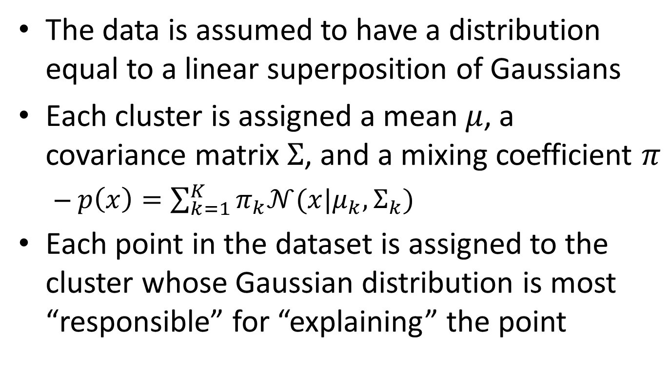
Gaussian Mixture
The data is assumed to have a distribution equal to a linear superposition of Gaussians
Each cluster is assigned a mean $μ$, a covariance matrix $Σ$, and a mixing coefficient $π$
$p\left(x\right)=\sum_{k=1}^{K}{π_{k}𝒩(x|μ_{k},Σ_{k})}$
Each point in the dataset is assigned to the cluster whose Gaussian distribution is most “responsible” for “explaining” the point

Slide 4
Restrictions Made to Datasets
Only included points where:
PI < 10000
CD45 PE > 10000

Slide 5
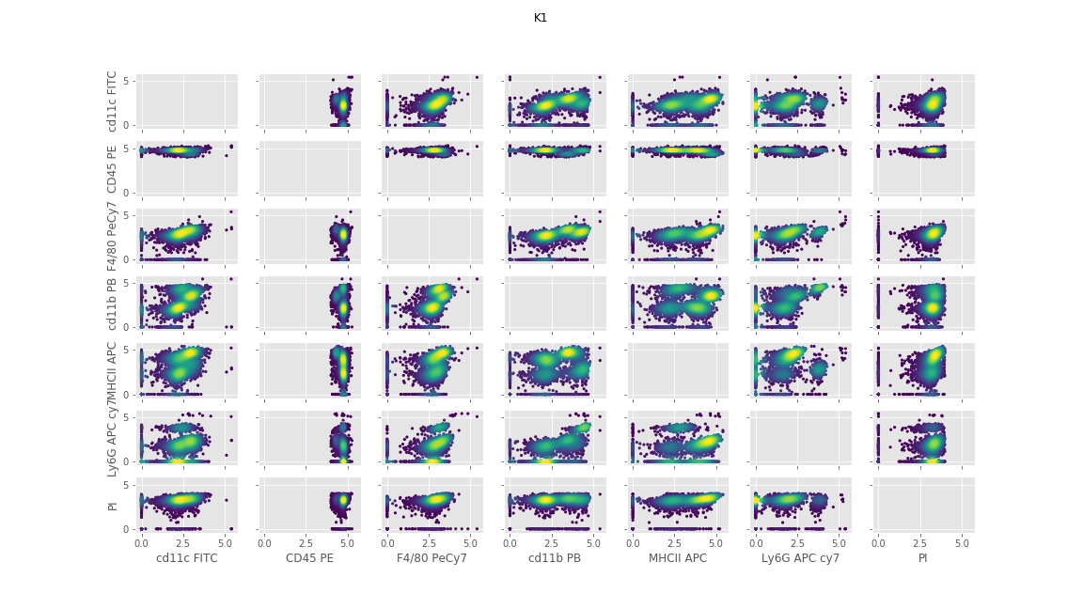
K1 Dataset

Slide 6
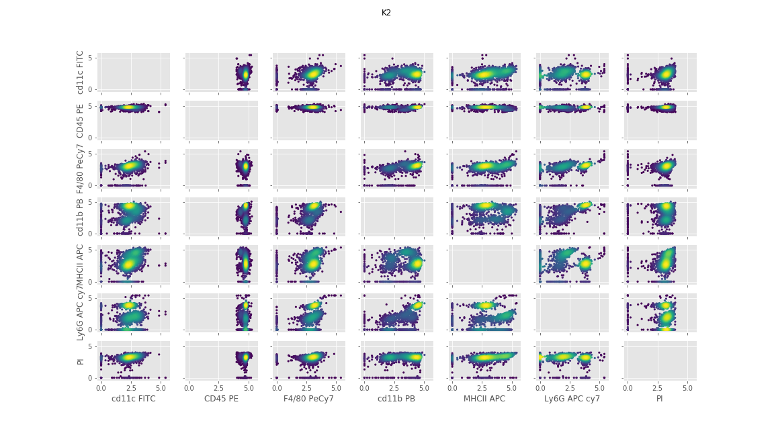
K2 Dataset

Slide 7
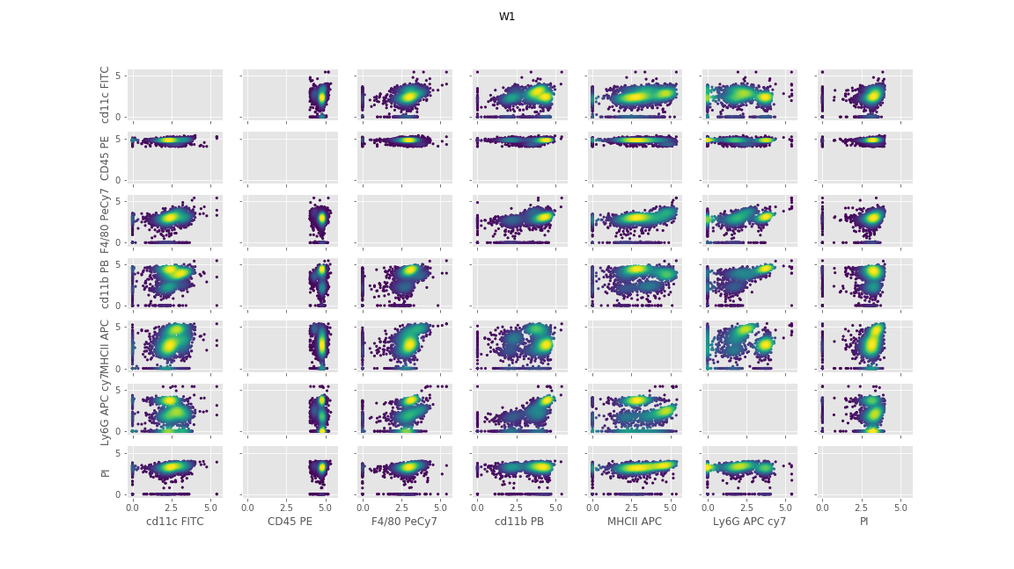
W1 Dataset

Slide 8

W2 Dataset

Slide 9
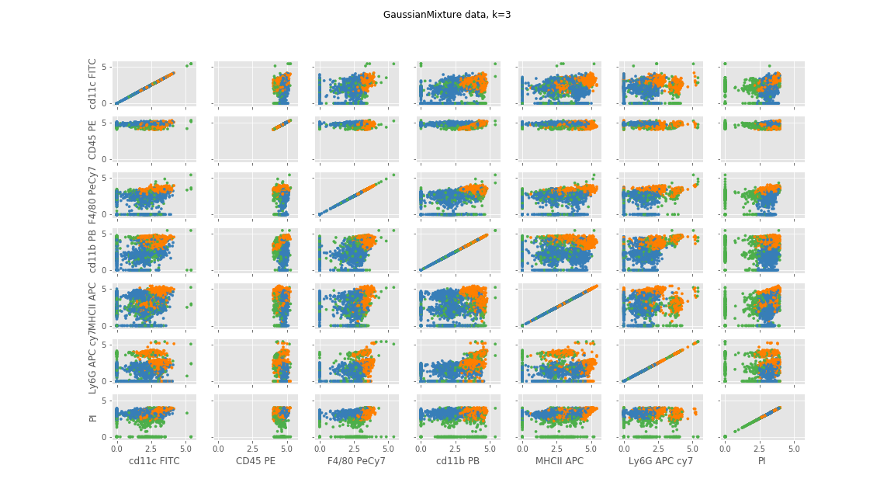
Example Clustering (K1)

Slide 10
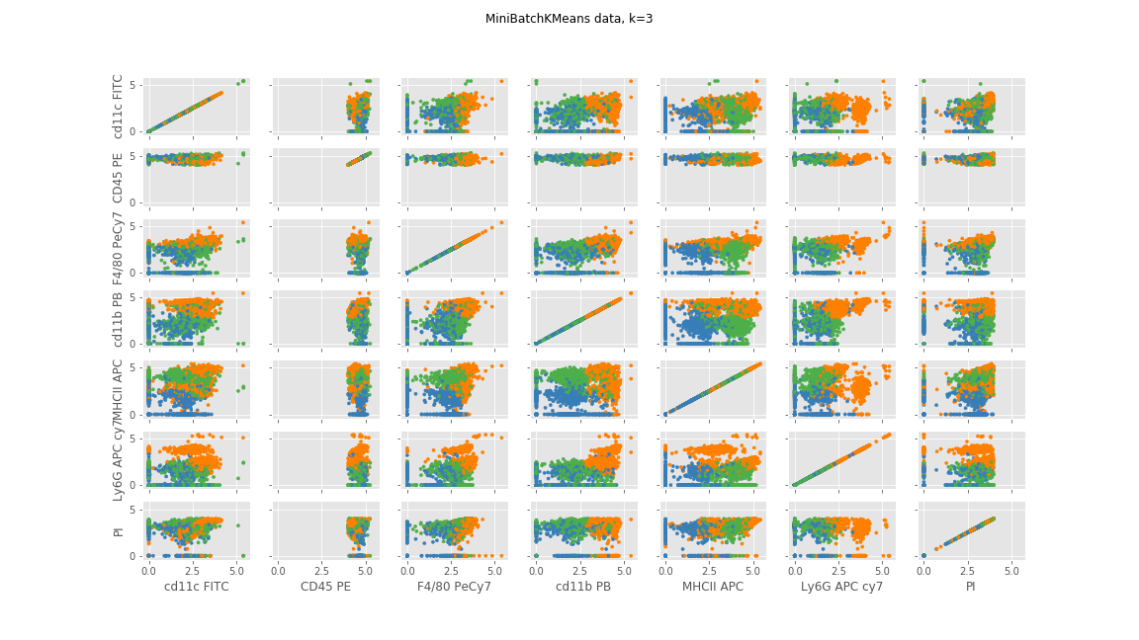
Example Clustering (K1)

Slide 11
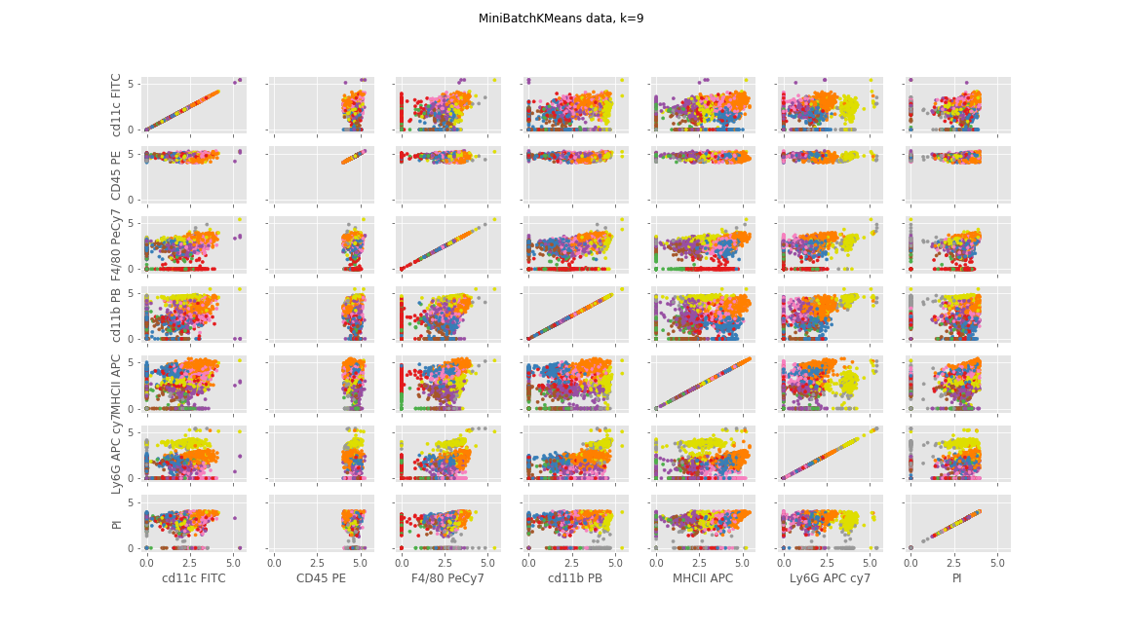
Example Clustering (K1)

Slide 12
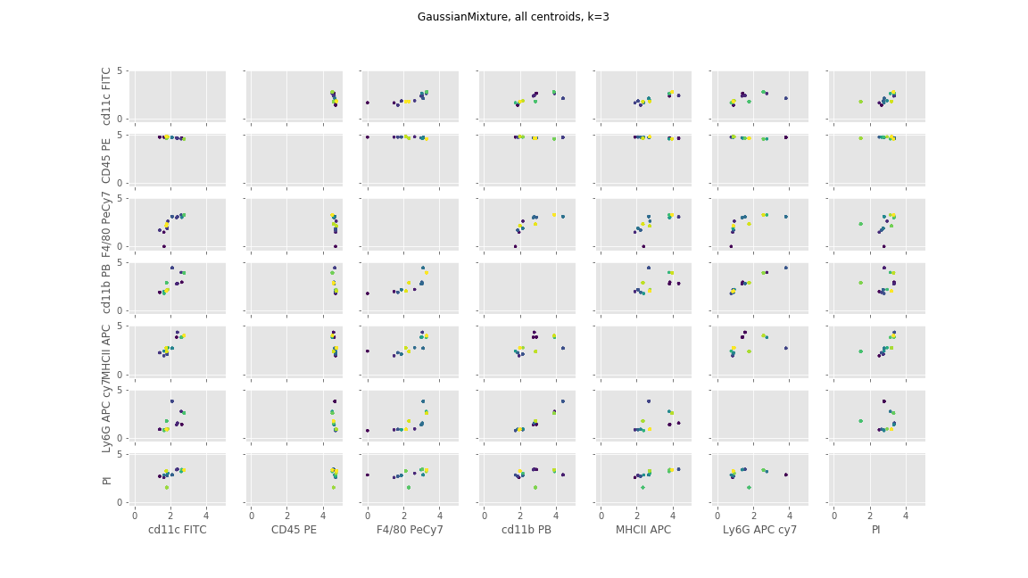
Centroid Plot (K1)

Slide 13
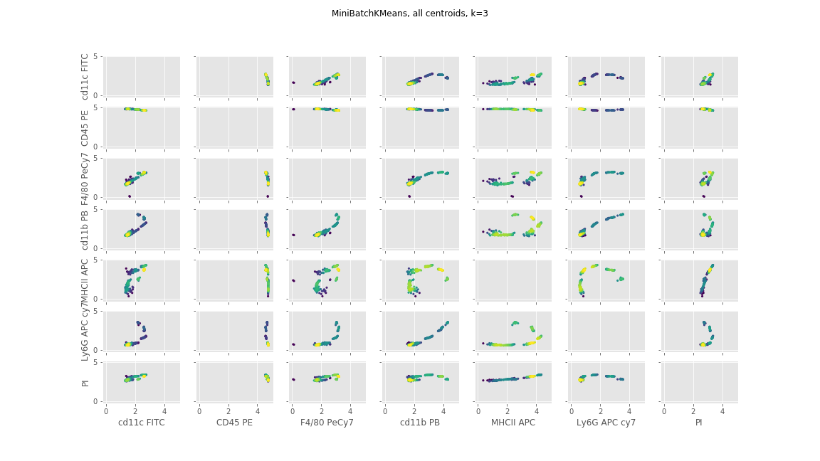
Centroid Plot (K1)

Slide 14
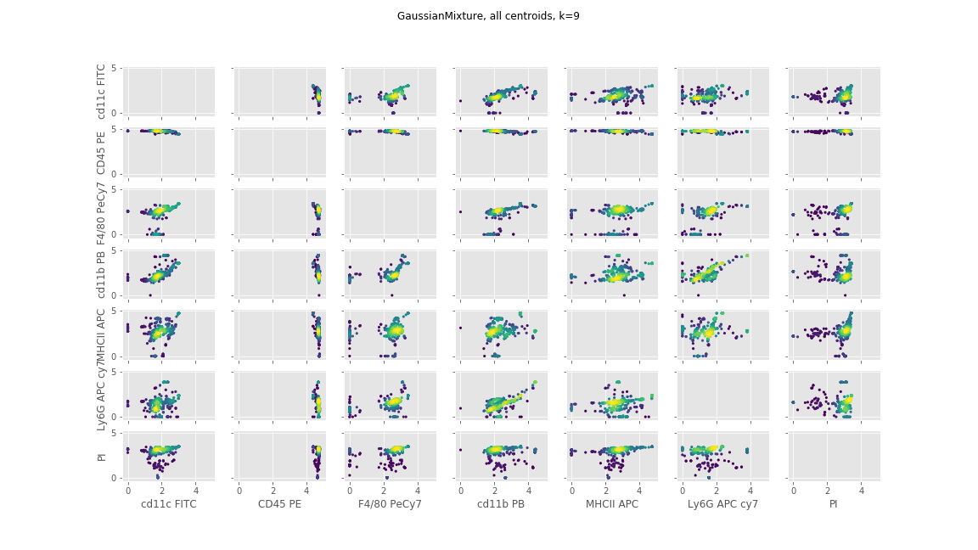
Centroid Plot (K1)

Slide 15
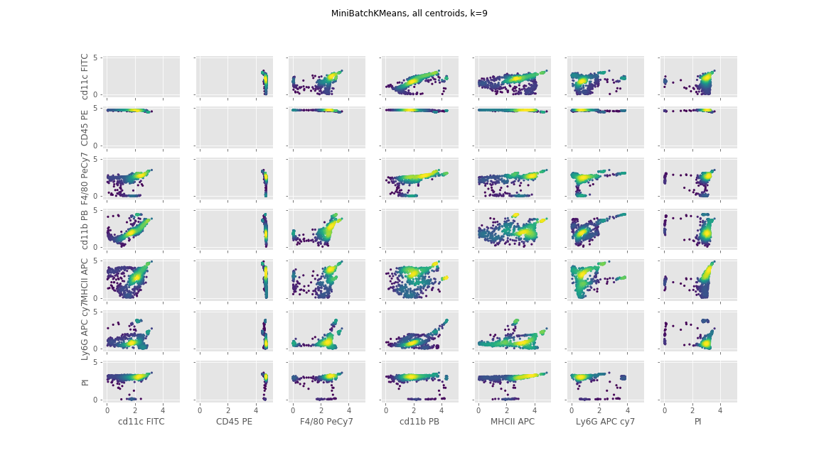
Centroid Plot (K1)

Slide 16
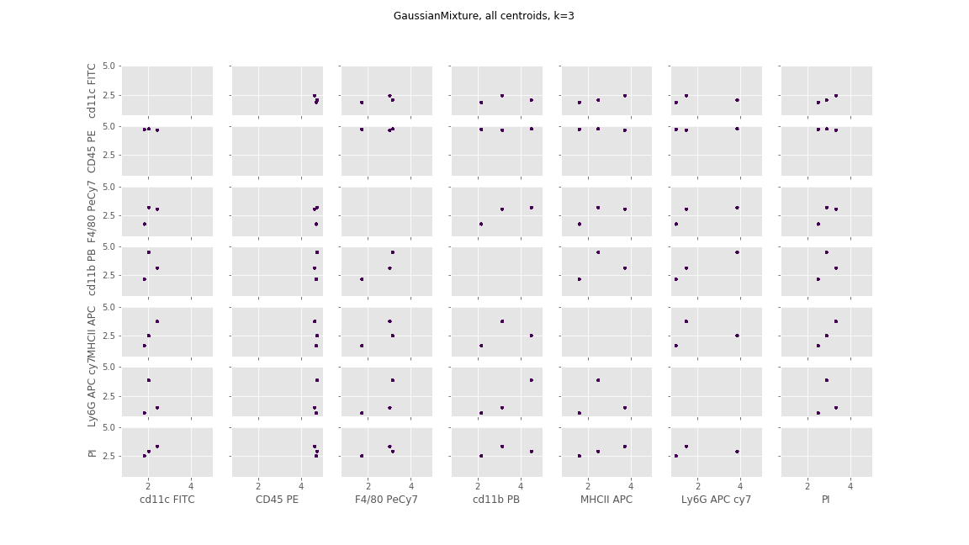
Centroid Plot (K2)

Slide 17
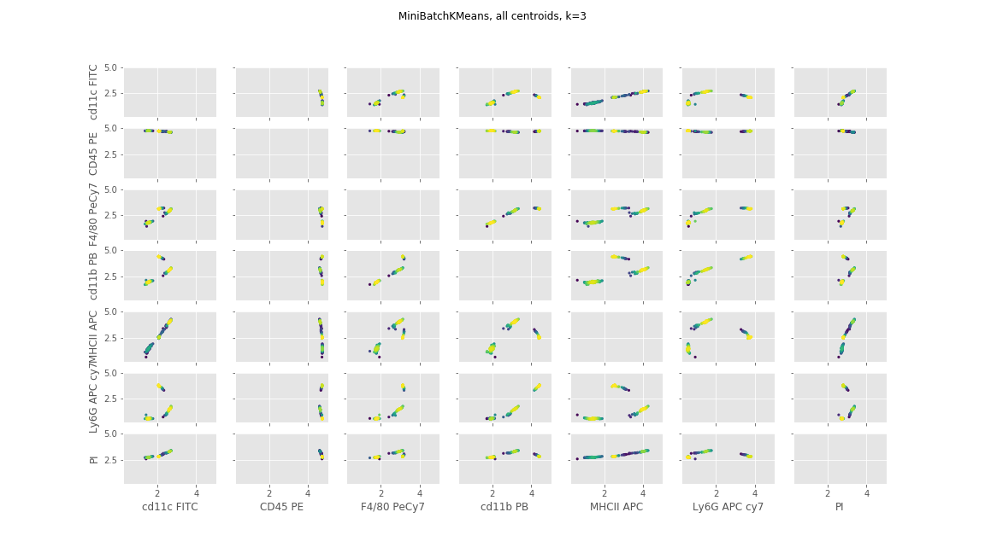
Centroid Plot (K2)

Slide 18
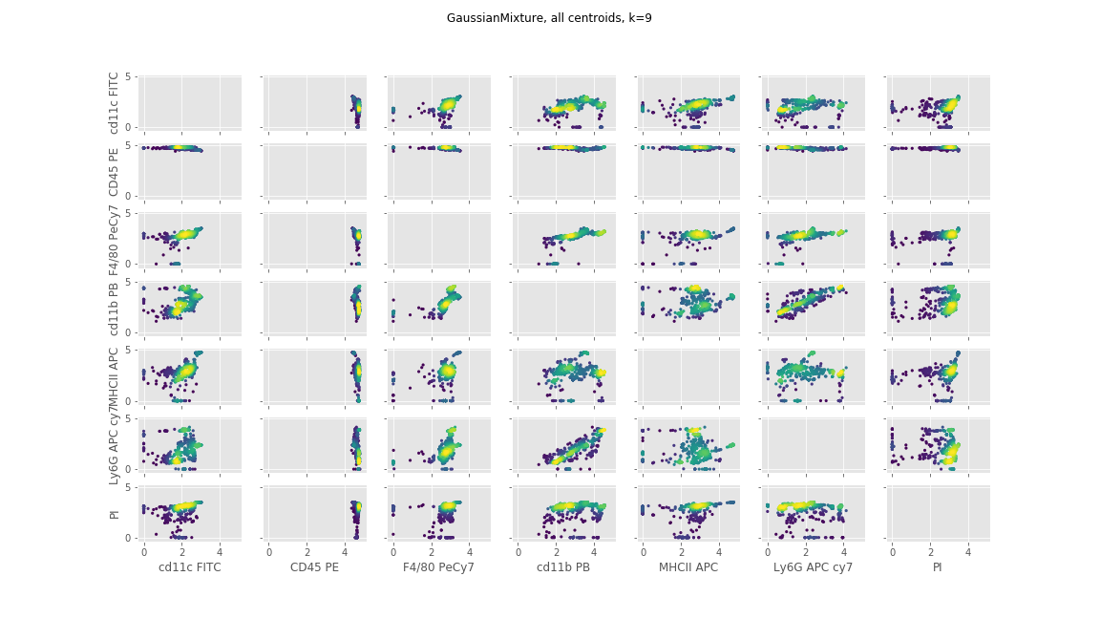
Centroid Plot (K2)

Slide 19
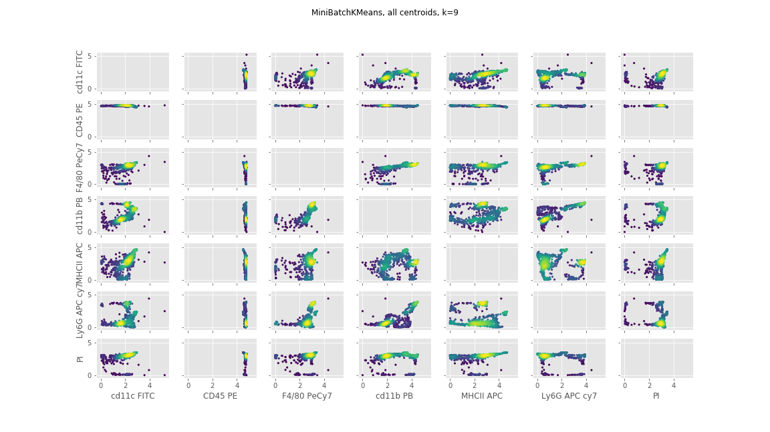
Centroid Plot (K2)

Slide 20
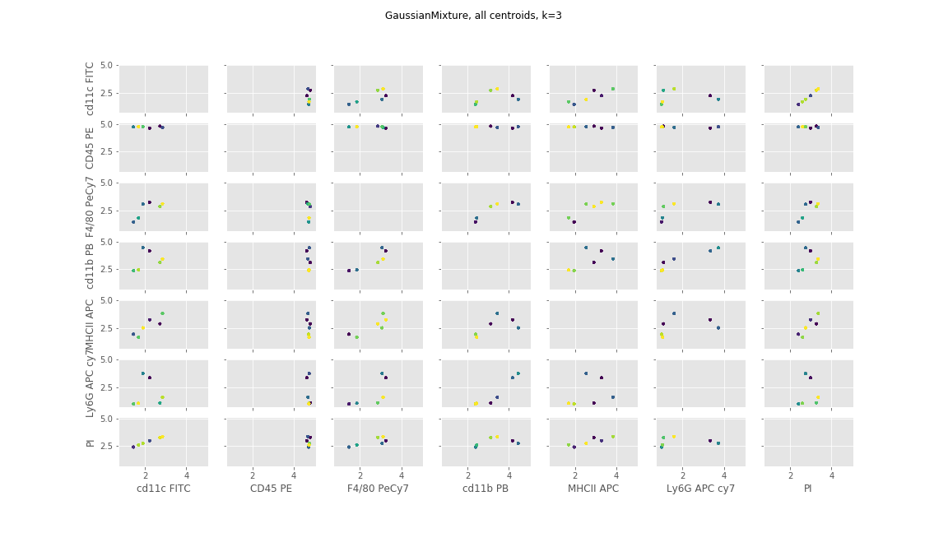
Centroid Plot (W1)

Slide 21
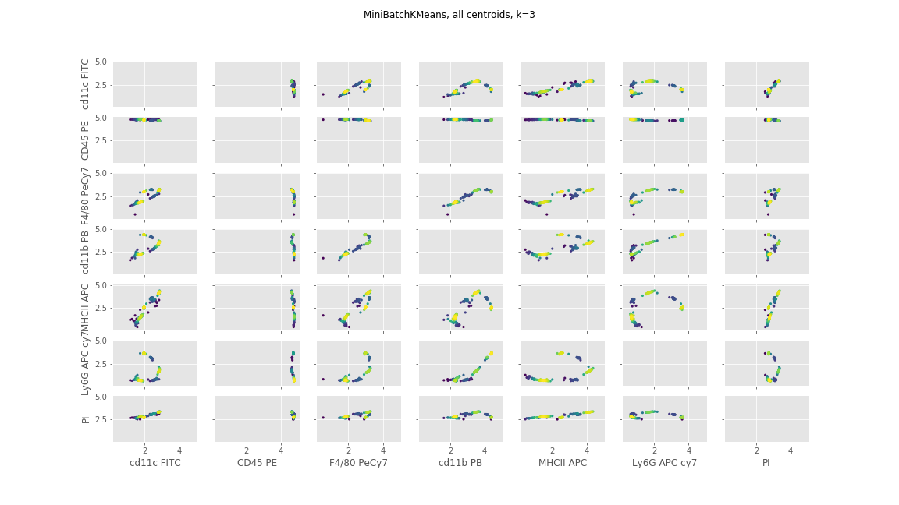
Centroid Plot (W1)

Slide 22
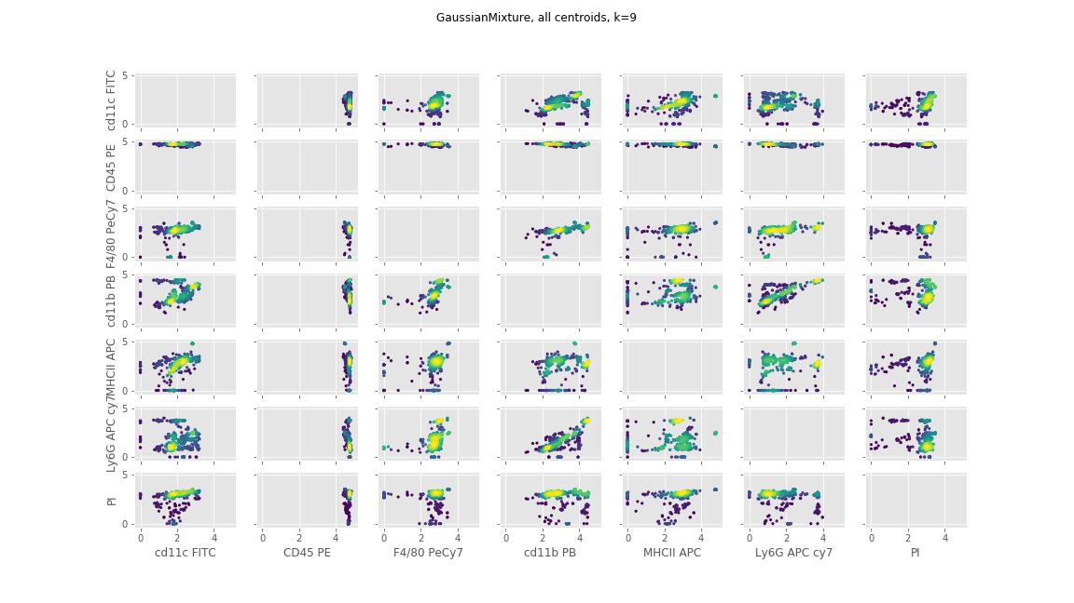
Centroid Plot (W1)

Slide 23
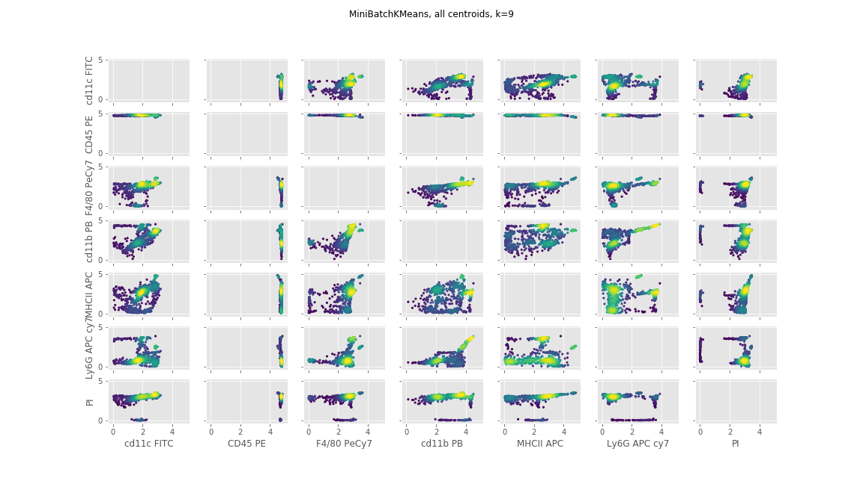
Centroid Plot (W1)

Slide 24
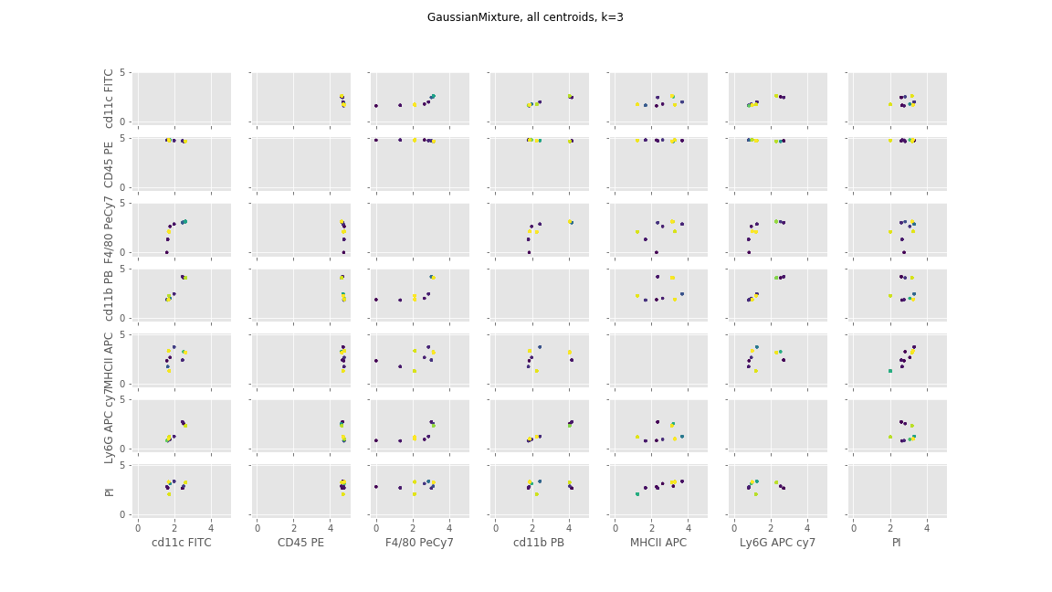
Centroid Plot (W2)

Slide 25
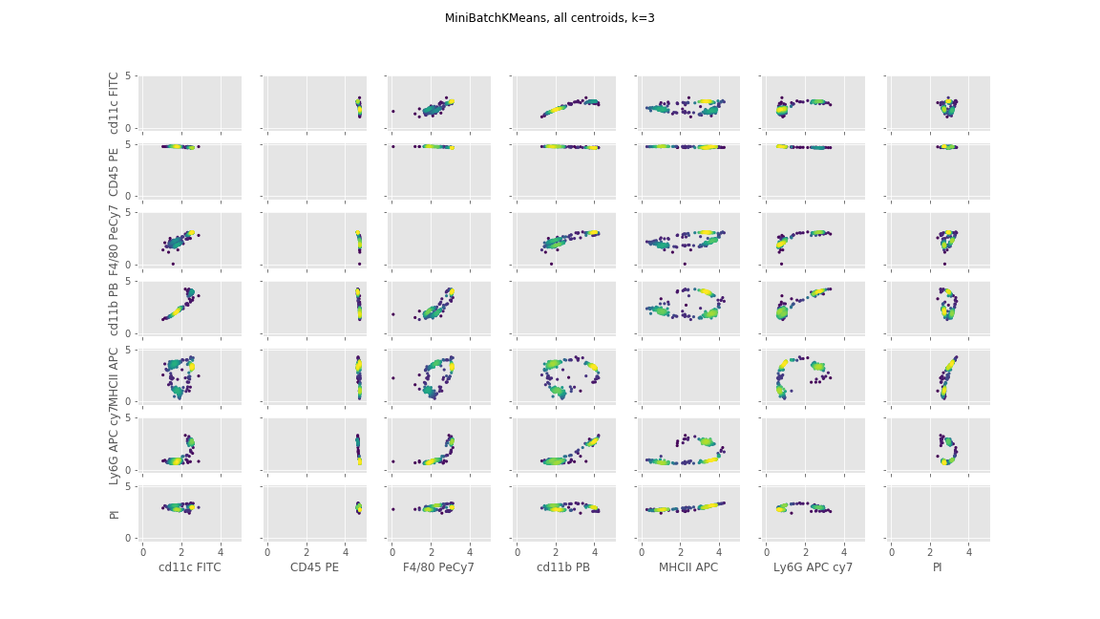
Centroid Plot (W2)

Slide 26
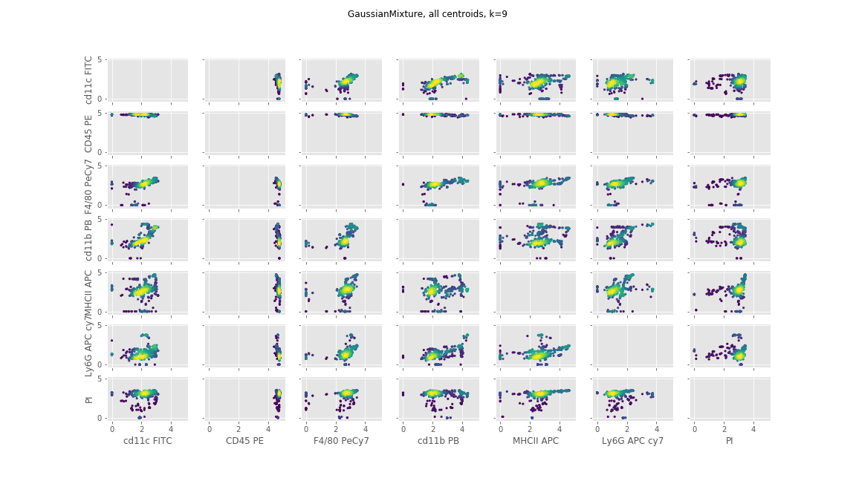
Centroid Plot (W2)

Slide 27
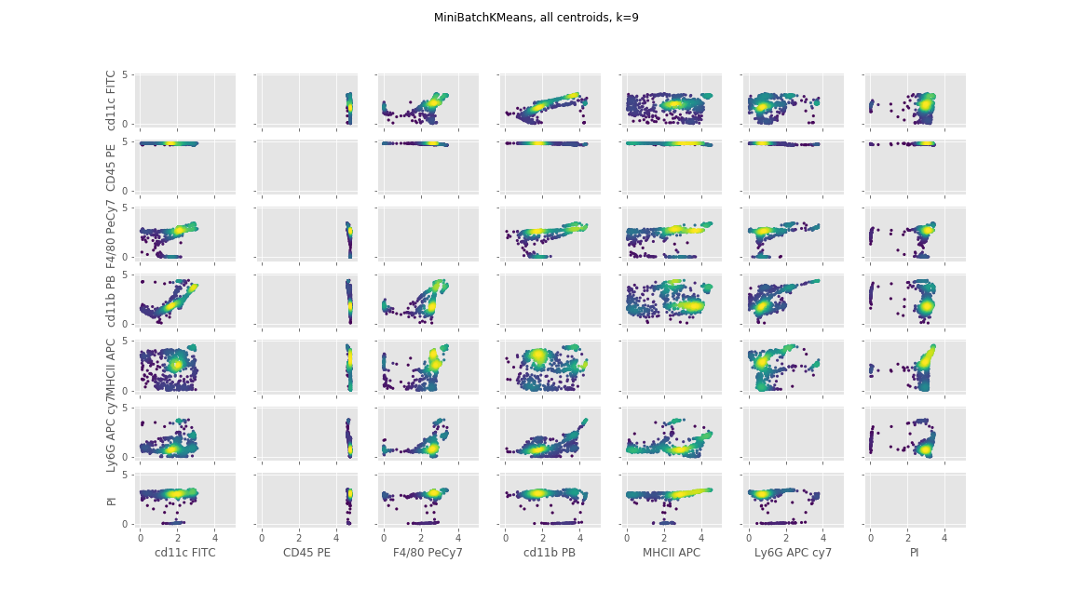
Centroid Plot (W2)

