Slide 1

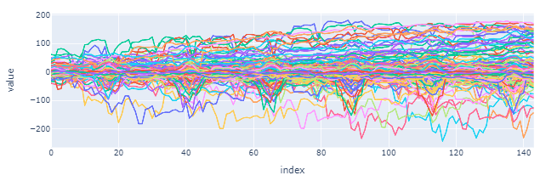

Forecasting Errors
Without regressors
Only previous LMP
With regressors
Load Demand, Temp

