Slide 1

ADSORPTION
The removal of dissolved substances from solution using adsorbents such as activated carbon

Slide 2
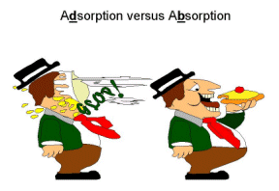

Slide 3
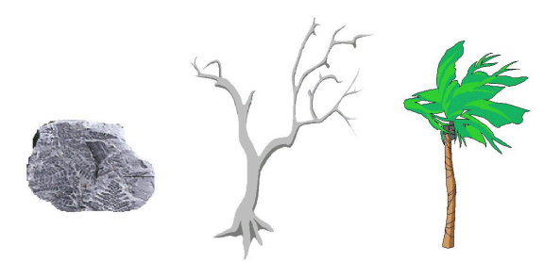
The physical form of the GAC may
depend on source of raw materials

Slide 4
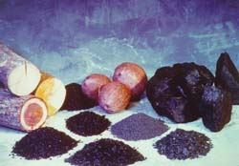

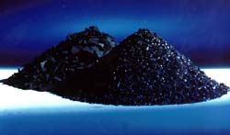
MANUFACTURE OF
ACTIVATED CARBON:
DIFFERENT RAW
MATERIALS

Slide 5
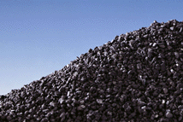
Prior carbonization for softer raw materials

Slide 6
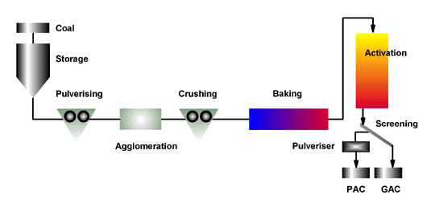
MANUFACTURE OF ACTIVATED
CARBON FROM COAL

Slide 7
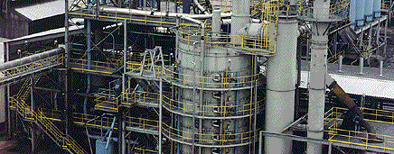
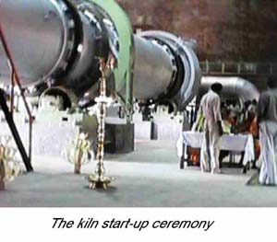
Multiple Hearth ↑
ACTIVATION
FURNACE
TYPES
Rotary kiln ➔

Slide 8



DIFFERENT PHYSICAL FORMS
OF ACTIVATED CARBON

Slide 9
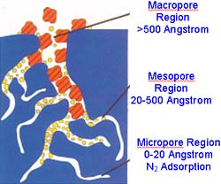

Slide 10
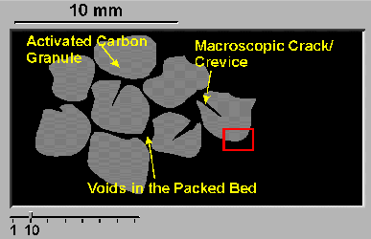
First magnification of carbon granules

Slide 11
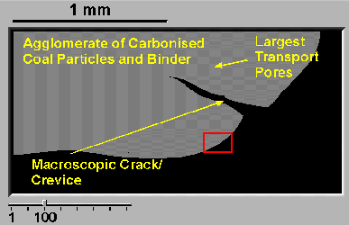
Continued magnification

Slide 12
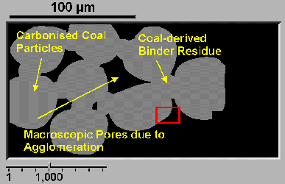
Continued magnification

Slide 13
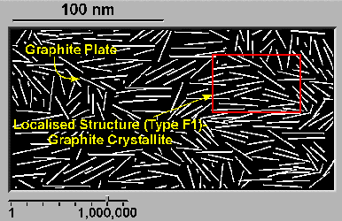
Continued conceptual
magnification

Slide 14
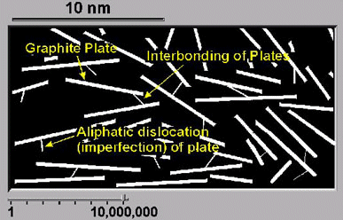
Continued conceptual
magnification

Slide 15
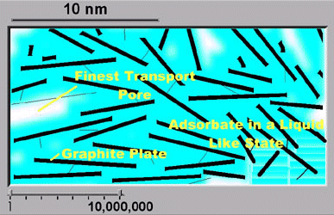
Continued conceptual
magnification

Slide 16
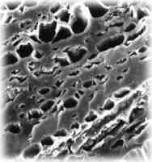
Scanning
Electron
Microscope
Photo of
GAC

Slide 17
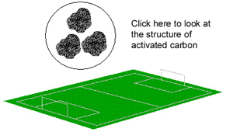
Area of a few grams of activated
carbon

Slide 18
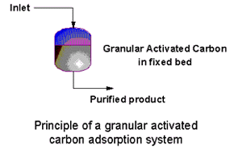
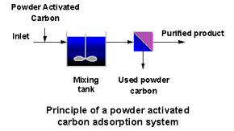
Application
Methodology

Slide 19
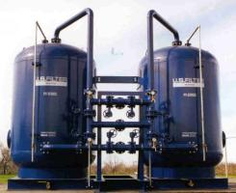
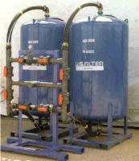
Granular Activated
Carbon Columns

Slide 20
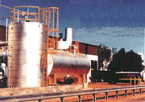
GAC Silos

Slide 21
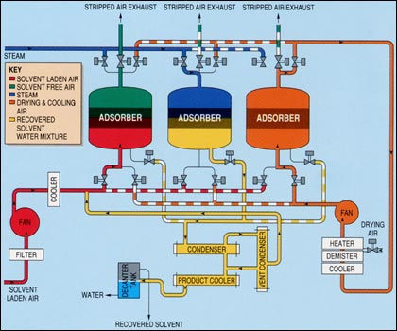
Gas Purification

Slide 22
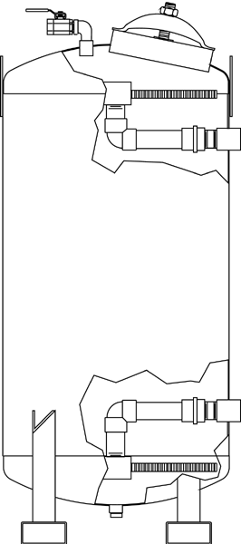
Contacting
Column
Internals

Slide 23
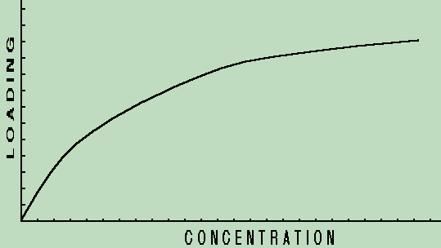
Typical isotherm
solid-phase concentration (y-axis) vs liquid phase concentration (x-axis)
This is a favorable isotherm: higher solid-phase concentration at low liquid concentrations

Slide 24
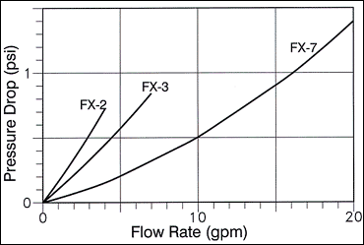
Column Hydraulics

Slide 25
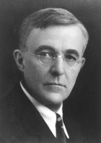

Which of these two “twins”
pioneered adsorption modeling?
Langmuir!

Slide 26
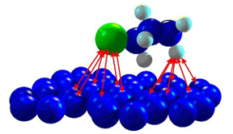
Adsorptive Forces

Slide 27
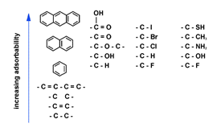
The effect of molecular size and functional groups on adsorbability

Slide 28
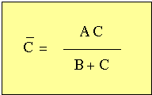
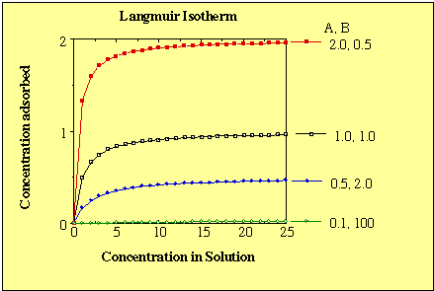
Langmuir isotherm

Slide 29
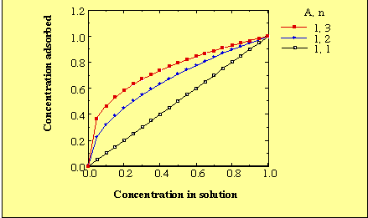
Freundlich isotherm (linear scale)

Slide 30
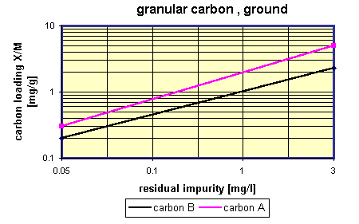
Freundlich isotherm, log-log scale

Slide 31
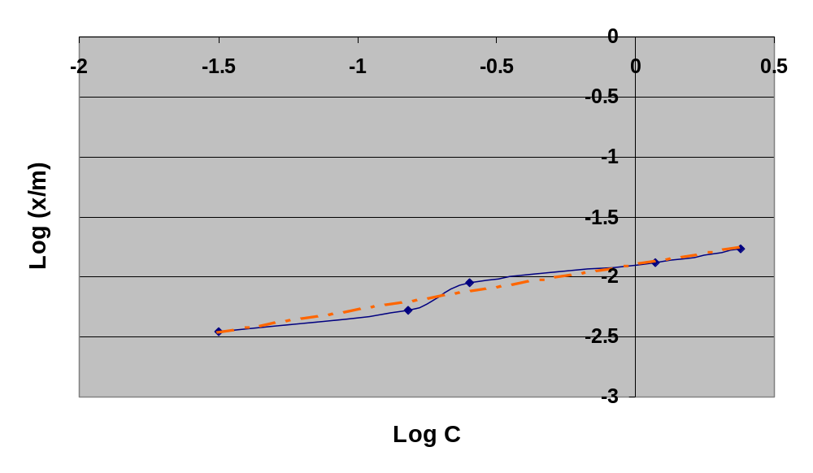
Freundlich isotherm, compared with real data

Slide 32
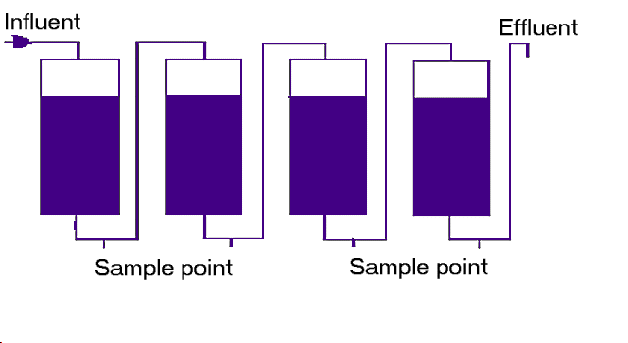
Four GAC columns in series

Slide 33
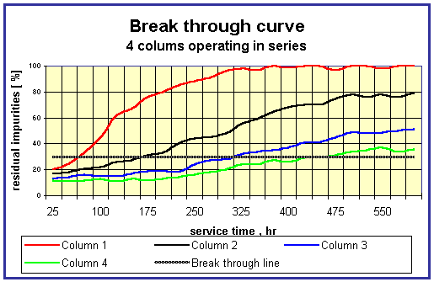

Slide 34
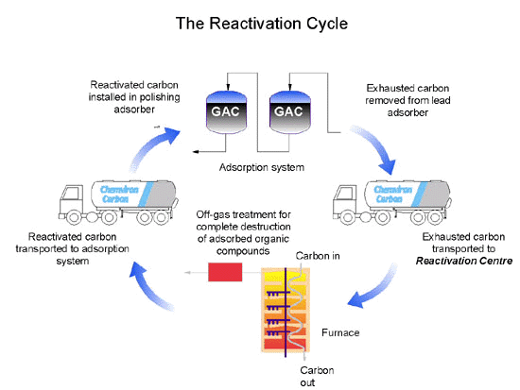
REACTIVATION OF ACTIVATED CARBON

Slide 35
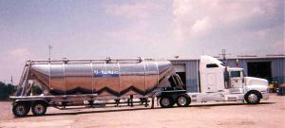
Transport of GAC

Slide 36
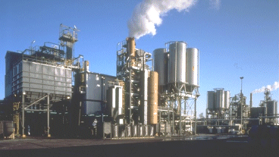
Decentralized Multiple Hearth
Regeneration Facility

