Slide 1
Disinfection

Slide 2
lecture outline
Purpose of disinfection
Types of disinfectants
Disinfection kinetics
Factors affecting disinfection

Slide 3
History of disinfection

Slide 4
History of disinfection
Ancient civilization (from 4000 BC)
  clear water = clean water
  Egypt: alum to remove suspended solids in water
  China: filters to remove suspended solids in water
  India: heat foul water by boiling and exposing to sunlight and by dipping seven times into a piece of hot copper, then to filter and cool in an earthen vessel.
The Roman Empire (27 BC – 476 AD)
  extensive aqueduct system to bring in pristine water from far away from city
  no major treatment was provided (other than the incidental mild disinfection effect of sunlight on water in open aqueducts)
1850, John Snow
  London, England
  one of the first known uses of chlorine for water disinfection
  attempted to disinfect the Broad Street Pump water supply in London after an outbreak of cholera.
1897, Sims Woodhead
  Kent, England
  One of the publicly approved use of chlorine for water disinfection
  used "bleach solution" as a temporary measure to sterilize potable water supply during a typhoid outbreak.

Slide 5
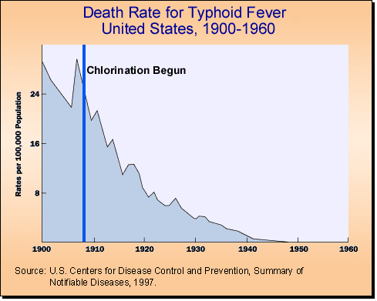
Reduction of typhoid fever mortality

Slide 6
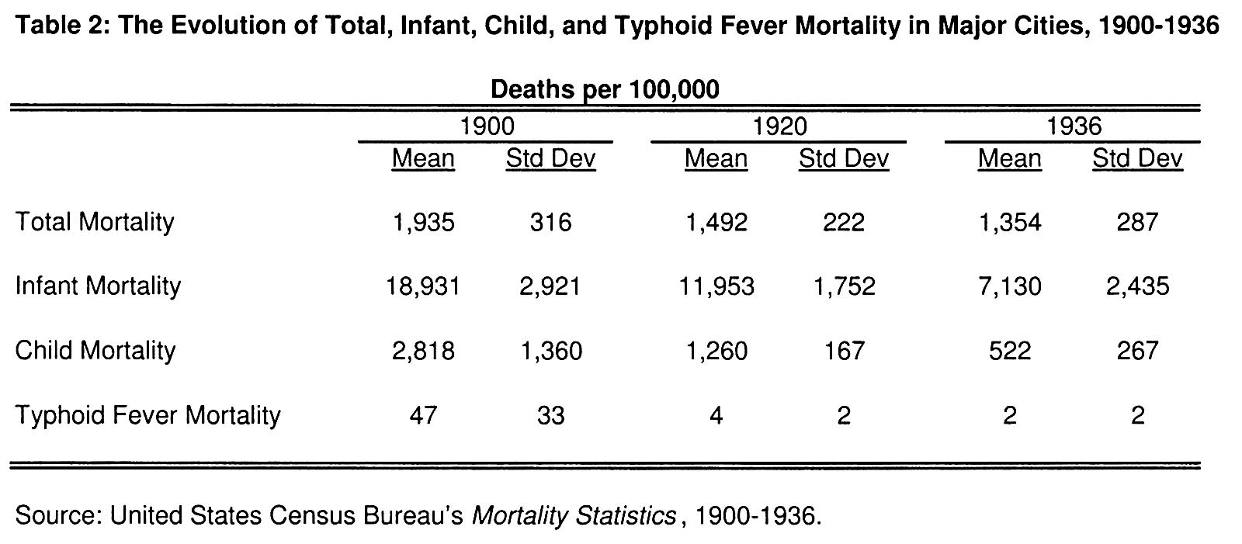
Total, infant, child, and typhoid mortality in major cities of USA (1900-1936)

Slide 7
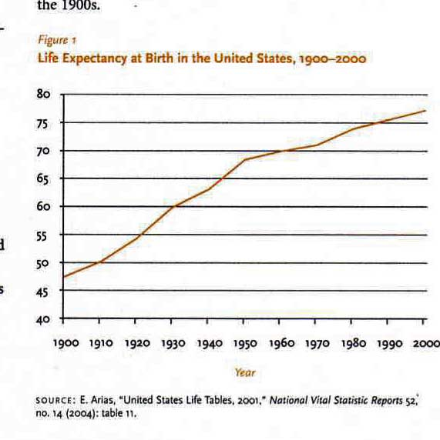
Life expectancy at birth in the United States (1900-2000)

Slide 8
Purpose of disinfection

Slide 9
Disinfection
to inactivate pathogens so that they are not infectious to humans and animals
achieved by altering or destroying structures or functions of essential components within the pathogens
  proteins (structural proteins, enzymes, transport proteins, etc)
  nucleic acids (genomic DNA or RNA, mRNA, tRNA, etc)
  lipids (lipid bi-layer membranes, other lipids)

Slide 10
Different disinfectants

Slide 11
Properties of an “ideal disinfectant”
Versatile: effective against all types of pathogens
Fast-acting: effective within short contact times
Robust: effective in the presence of interfering materials
  particulates, suspended solids and other organic and inorganic constituents

Slide 12
Properties of an “ideal disinfectant”
(O/M aspect)
Handy:
  easy to handle, generate, and apply (nontoxic, soluble, non-flammable, non-explosive)
Compatible with various materials/surfaces in WTPs (pipes, equipments)
Economical

Slide 13
Disinfectants in Water and Wastewater Treatment
Free chlorine
Chloramines (Monochloramine)
Ozone
Chlorine dioxide
Mixed oxidants
UV irradiation

Slide 14
Trend in disinfectant use (USA, % values)
Disinfectant | 1978 | 1989 | 1999
Chlorine gas | 91 | 87 | 83.8
NaClO₂ (bulk) | 6 | 7.1 | 18.3
NaClO₂ (on-site) | 0 | 0 | 2
Chlorine dioxide | 0 | 4.5 | 8.1
Ozone | 0 | 0.4 | 6.6
Chloramines | 0 | 20 | 28.4

Slide 15
Comparison of major disinfectants
Consideration |  | Disinfect | ants
 | Cl₂ | ClO₂ | O₃ | NH₂Cl
Oxidation potential | Strong | Stronger? | Strongest | Weak
Residuals | Yes | No | No | Yes
Mode of action | Proteins/NA | Proteins/NA | Proteins/NA | Proteins
Disinfecting efficacy | Good | Very good | Excellent | Moderate
By-products | Yes | Yes | Yes | No

Slide 16
Individual disinfectants

Slide 17
Free chlorine - Background and History
first used in 1905 in London, in Bubbly Creek in Chicago (in USA) in 1908
  followed by dramatic reduction of waterborne disease
  has been the “disinfectant of choice” in USA until recently
being replaced by alternative disinfectants after the discovery of its disinfection by-products (trihalomethanes and other chlorinated organics) during the 1970’s
  Recommended maximum residual concentration of free chlorine < 5 mg/L in drinking water (by US EPA)

Slide 18
Free chlorine - Chemistry
Three different methods of application
  Cl₂ (gas)
  NaOCl (liquid)
  Ca(OCl)₂ (solid)
Reactions for free chlorine formation:
Cl₂ (g) + H₂O <=> HOCl + Cl⁻ + H⁺
HOCl <=> OCl⁻ + H⁺ (at pH >7.6)

Slide 19
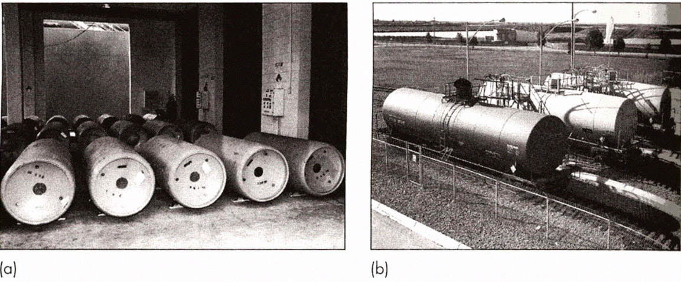
Chlorine application (I)

Slide 20
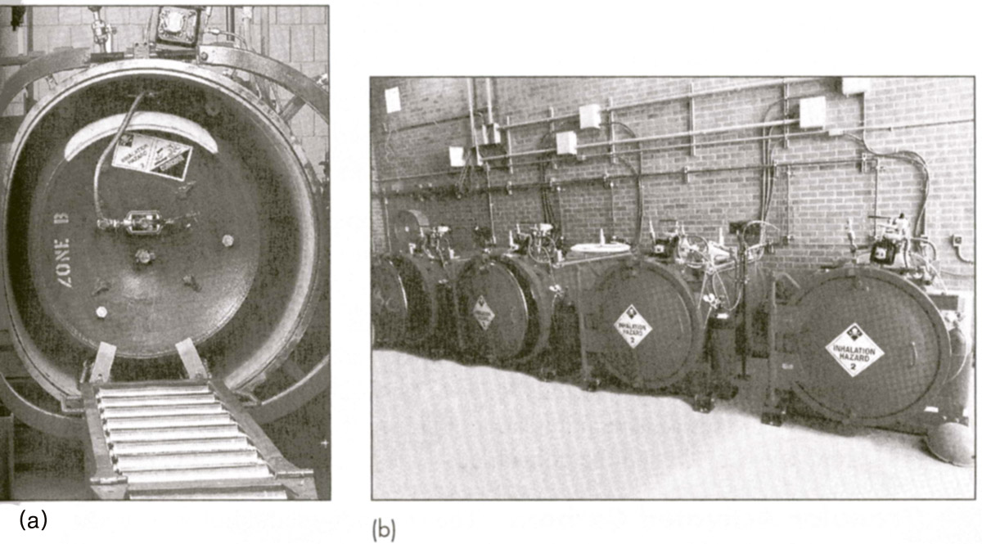
Chlorine application (II)

Slide 21
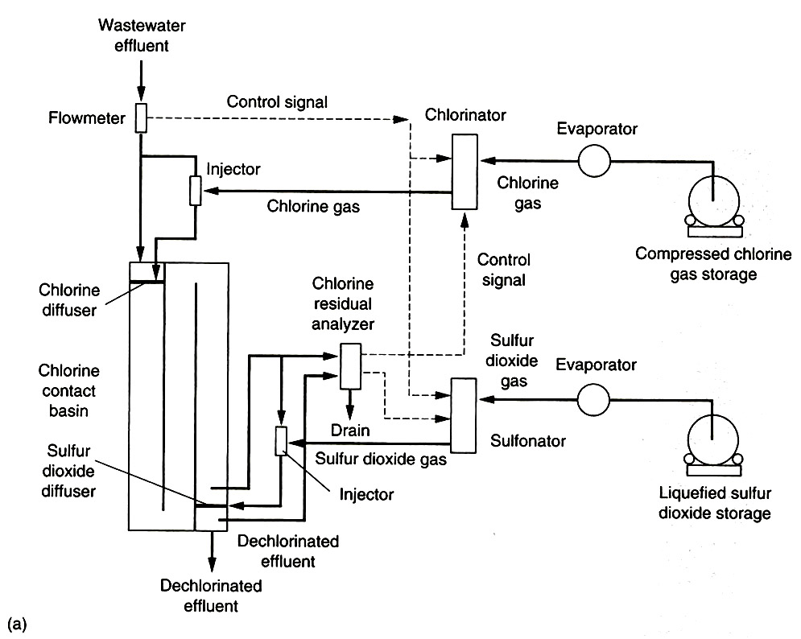
Chlorine application (III): Gas

Slide 22
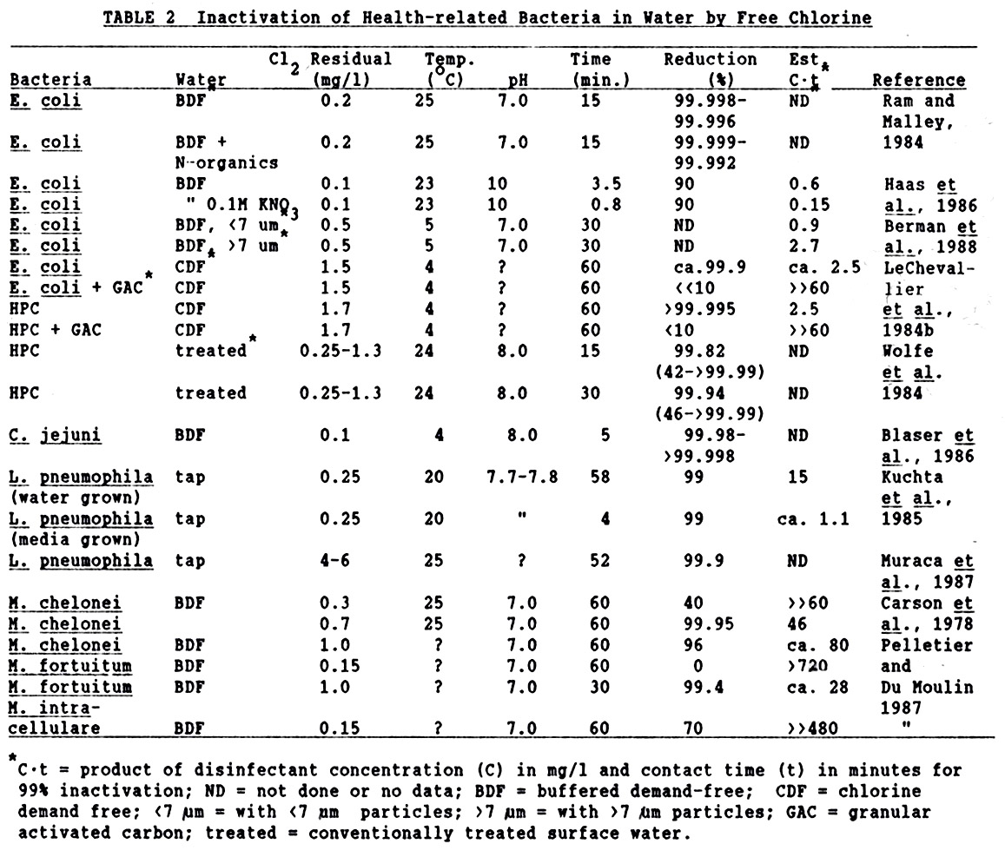
Chlorine (effectiveness (I))

Slide 23
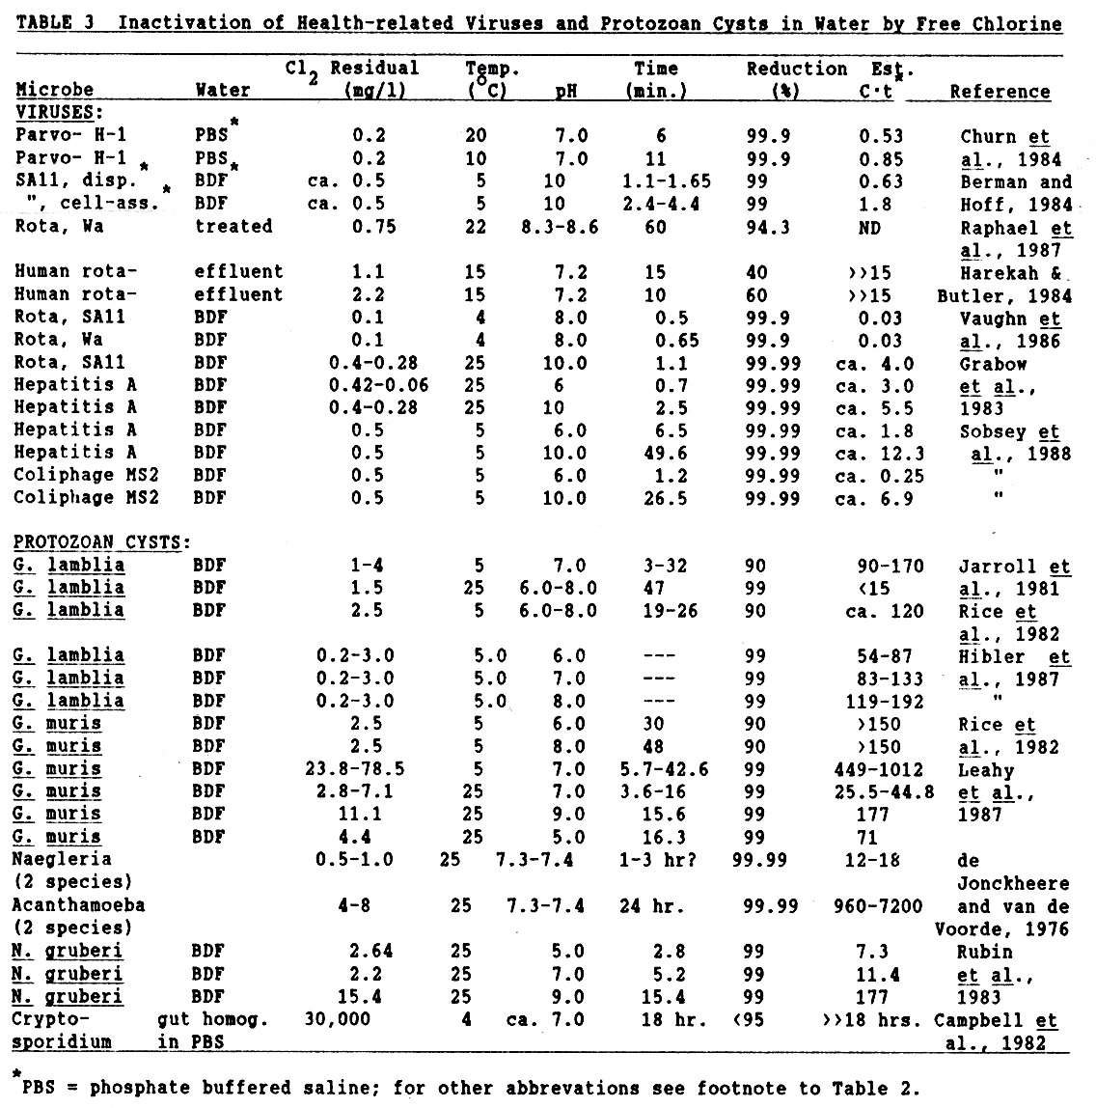
Chlorine (effectiveness (II))

Slide 24
Chlorine (advantages and disadvantages)
Advantages
  Effective against all types of microbes
  Relatively simple maintenance and operation
  Inexpensive
Disadvantages
  Corrosive
  High toxicity
  High chemical hazard
  Highly sensitive to inorganic and organic loads
  Formation of harmful disinfection by-products (DBP’s)

Slide 25
Chloramines - History and Background
first used in 1917 in Ottawa, Canada and in Denver, USA
became popular in 1930’s to control taste and odor problems and bacterial re-growth in distribution system
decreased usage due to ammonia shortage during World War II
increased interest due to the discovery of chlorination disinfection by-products during the 1970’s
  alternative primary disinfectant to free chlorine due to low DBP potential
  secondary disinfectant to ozone and chlorine dioxide disinfection to provide long-lasting residuals

Slide 26
Chloramines - Chemistry
Two different methods of application (generation)
  pre-formed chloramines (monochloramine)
    mix hypochlorite and ammonium chloride (NH₄Cl) solution at Cl₂ : N ratio at 4:1 by weight, 10:1 on a molar ratio at pH 7-9
  dynamic chloramination
    initial free chlorine addition, followed by ammonia addition
Chloramine formation
  HOCl + NH₃ <=> NH₂Cl + H₂O
  NH₂Cl + HOCl <=> NHCl₂ + H₂O
  NHCl₂ + HOCl <=> NCl₃ + H₂O

Slide 27
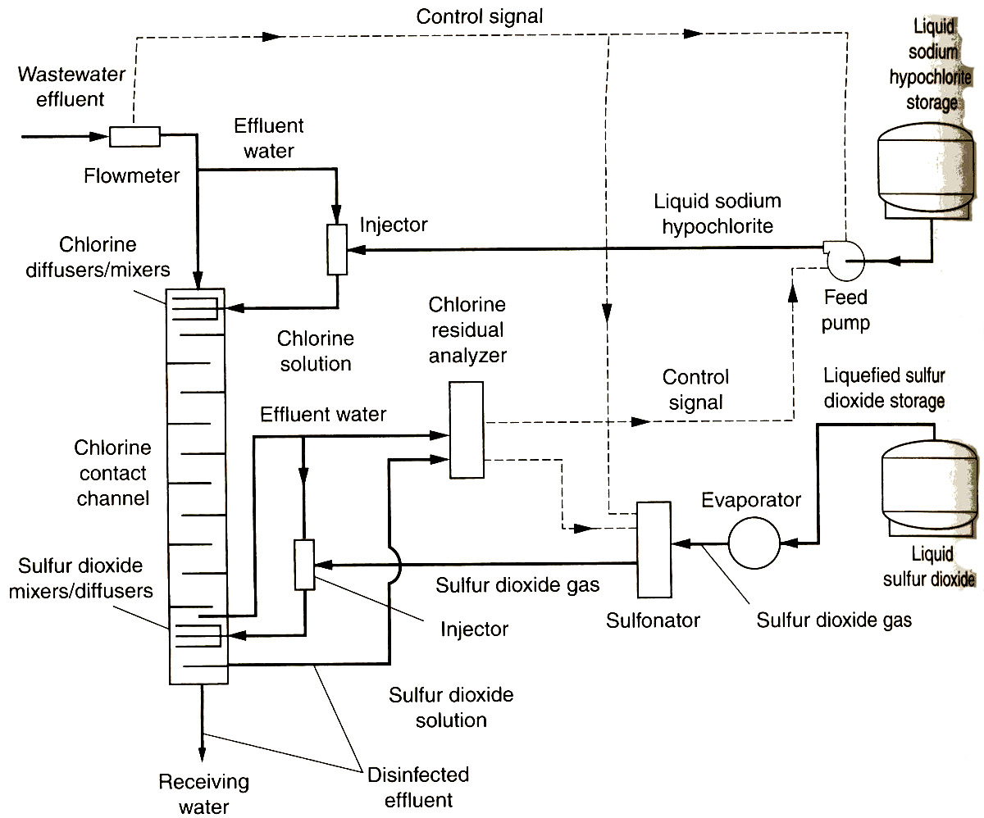
Application of chloramines:
Preformed monochloramines

Slide 28
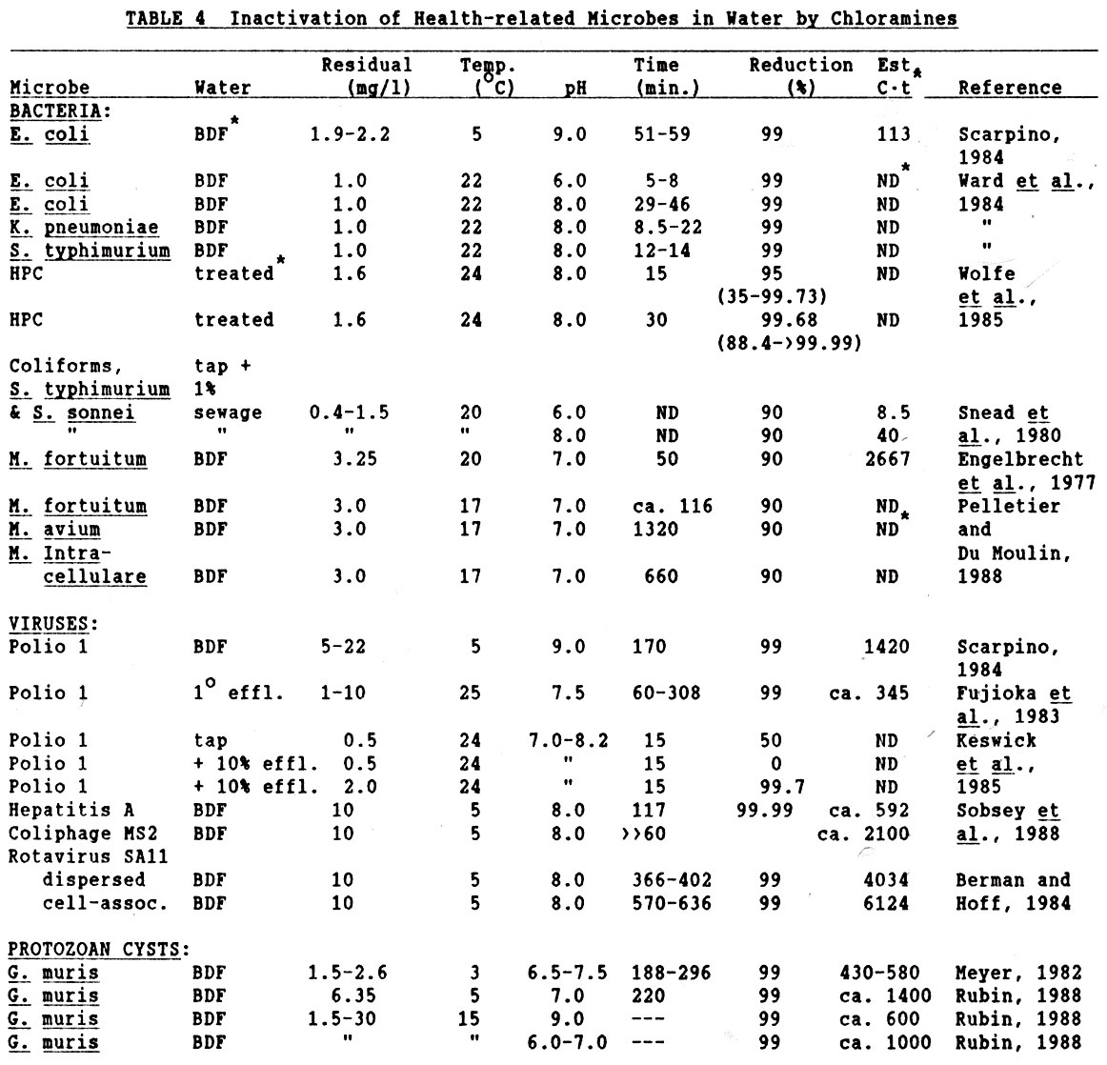
Chloramines (effectiveness)

Slide 29
Chloramines (advantages and disadvantages)
Advantages
  Less corrosive
  Less toxicity and chemical hazards
  Relatively tolerable to inorganic and organic loads
  No known formation of DBP
  Relatively long-lasting residuals
Disadvantages
  Not so effective against viruses, protozoan cysts, and bacterial spores

Slide 30
Chlorine Dioxide - History and Background
first used in Niagara Fall, NY in 1944
used in 84 WTPs in USA in 1970’s mostly for taste and odor control
increased usage due to the discovery of chlorination disinfection by-products
increased concern over it’s toxicity in 1970’s & 1980’s
  thyroid, neurological disorders and anemia in experimental animals by chlorate
  recommended maximum combined concentration of chlorine dioxide and it’s by-products < 0.5 mg/L (by US EPA in 1990’s)

Slide 31
Chlorine Dioxide - Chemistry
The method of application
  on-site generation by acid activation of chlorite or reaction of chlorine gas with chlorite
Chlorine dioxide
  very soluble in water
  generated as a gas or a liquid on-site: usually by reaction of Cl₂ gas with NaClO₂
    2 NaClO₂ + Cl₂ → 2 ClO₂ + 2 NaCl
    2ClO₂ + 2OH- = H₂O + ClO₃- (Chlorate) + ClO₂-(Chlorite) (in alkaline pH)
Strong Oxidant; high oxidative potentials
  2.63 times greater than free chlorine, but only 20 % available at neutral pH
  ClO₂ + 5e- + 4H+ = Cl- + 2H₂O (5 electron process)
  2ClO₂ +2OH- = H₂O +ClO₃- + ClO₂- (1 electron process)

Slide 32
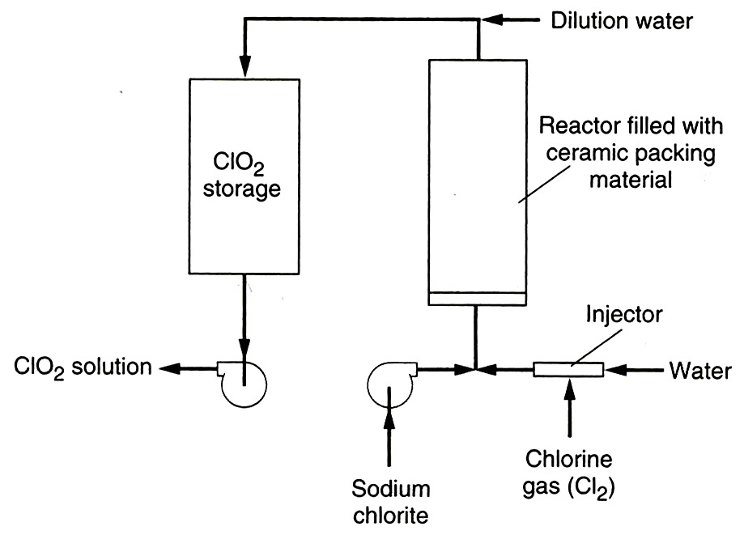
Generation of chlorine dioxide

Slide 33
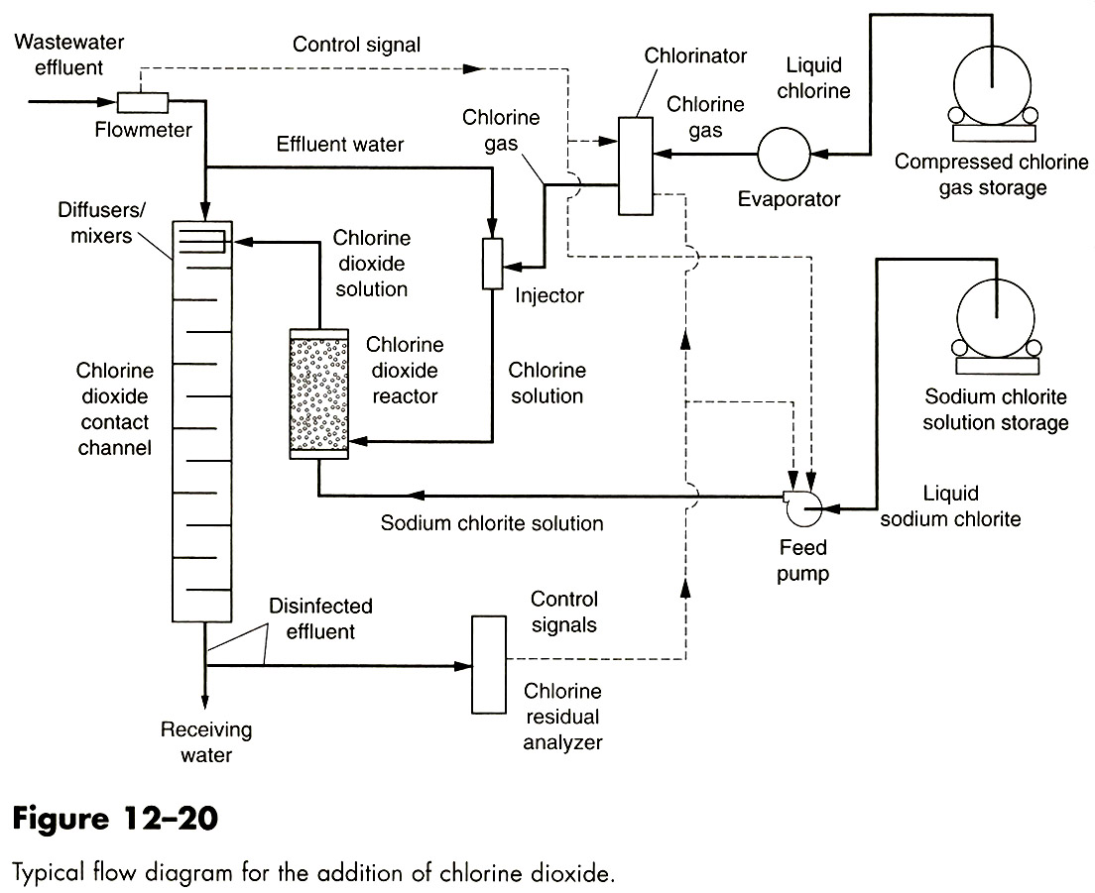
Application of chlorine dioxide

Slide 34
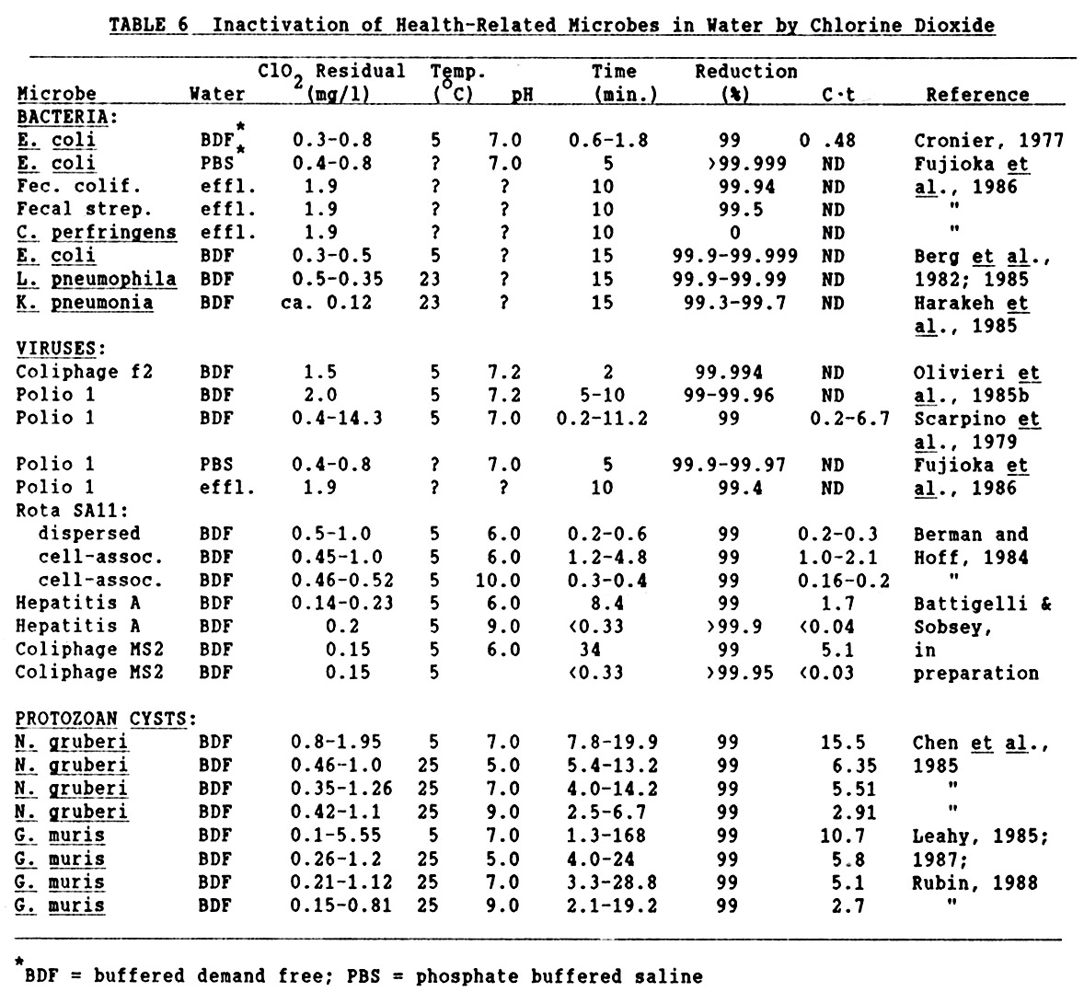
Chlorine dioxide (effectiveness)

Slide 35
Chlorine dioxide (advantages and disadvantages)
Advantages
  Very effective against all type of microbes
Disadvantages
  Expensive
  Unstable (must produced on-site)
  High toxicity
    2ClO₂ + 2OH⁻ = H₂O + ClO₃⁻ (Chlorate) + ClO₂⁻(Chlorite) (in alkaline pH)
  High chemical hazards
  Highly sensitive to inorganic and organic loads
  Formation of harmful disinfection by-products (DBP’s)
  No lasting residuals

Slide 36
Ozone - History and Background
first used in 1893 at Oudshoon, Netherlands and at Jerome Park Reservoir in NY (in USA) in 1906
used in more than 1000 WTPs in European countries, but was not so popular in USA
increased interest due to the discovery of chlorination disinfection by-products during the 1970’s
  an alternative primary disinfectant to free chlorine
    strong oxidant, strong microbiocidal activity, perhaps less toxic DBPs

Slide 37
Ozone - Chemistry
The method of application
  generated by passing dry air (or oxygen) through high voltage electrodes (Ozone generator)
  bubbled into the water to be treated.
Ozone
  colorless gas
  relatively unstable
  highly reactive
    reacts with itself and with OH⁻ in water

Slide 38
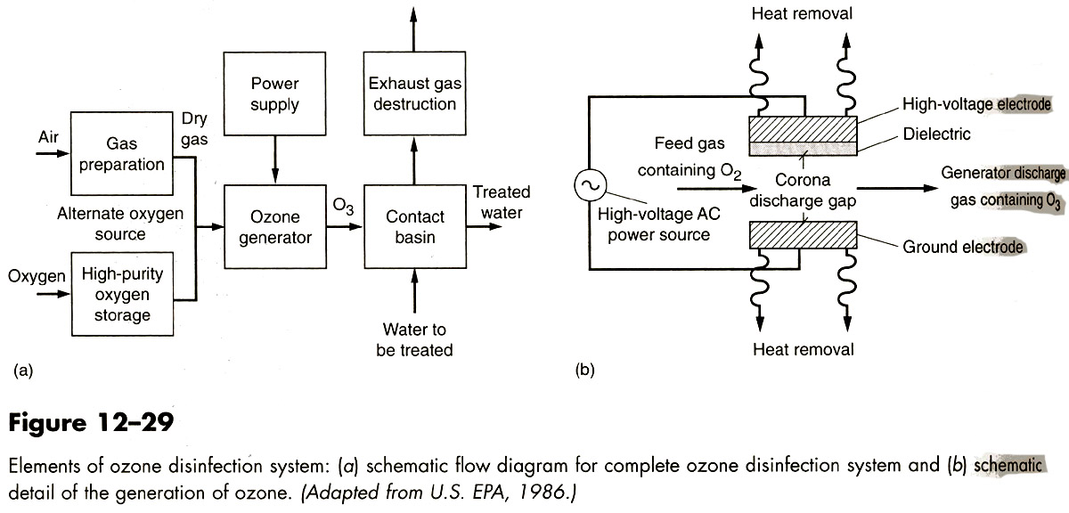
Generation of ozone

Slide 39
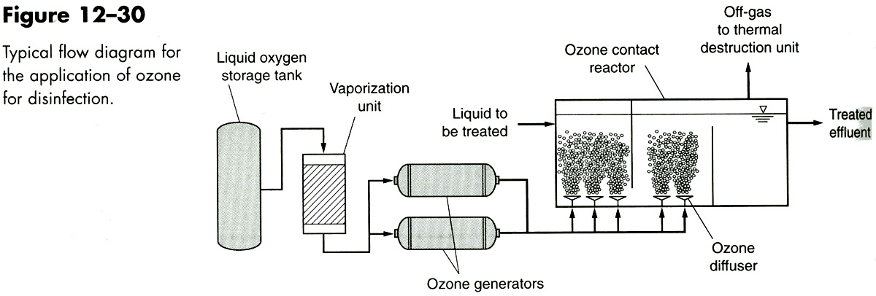
Application of ozone

Slide 40
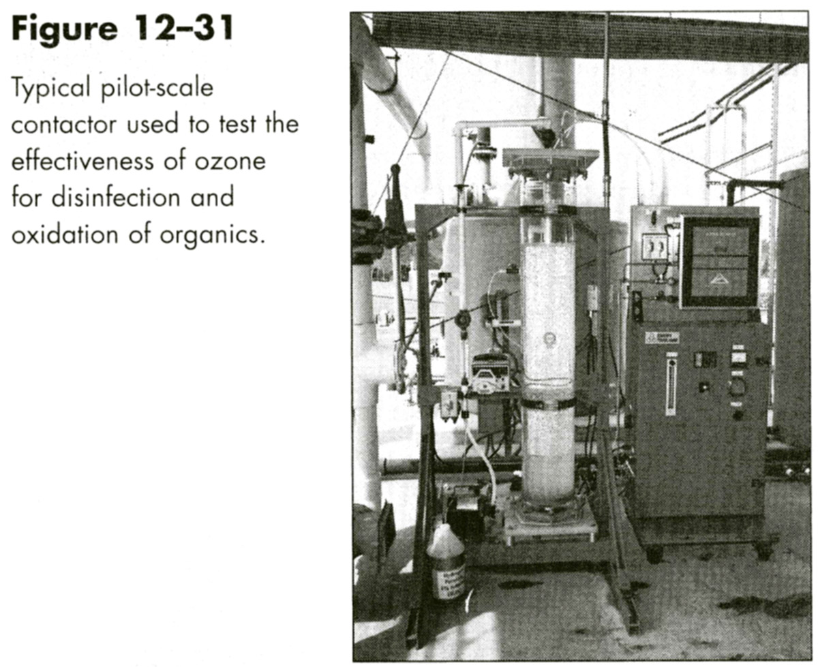
Application of ozone (II)

Slide 41
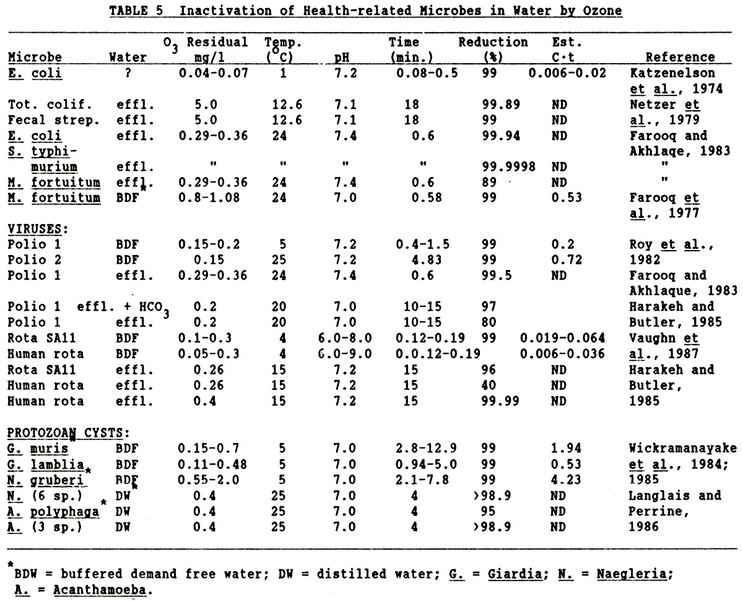
Ozone (effectiveness)

Slide 42
Ozone (advantages and disadvantages)
Advantages
  Highly effective against all type of microbes
Disadvantages
  Expensive
  Unstable (must produced on-site)
  High toxicity
  High chemical hazards
  Highly sensitive to inorganic and organic loads
  Formation of harmful disinfection by-products (DBP’s)
  Highly complicated maintenance and operation
  No lasting residuals

Slide 43
Ultraviolet irradiation
has been used in wastewater disinfection for more than 50 years
Increased interest after the discovery of its remarkable effectiveness against Cryptosporidium parvum and Giardia lamblia in late 1990’s

Slide 44
Ultraviolet irradiation
physical process
energy absorbed by DNA
  pyrimidine dimers, strand breaks, other damages
  inhibits replication
UV
A
C
T
C
A
A
T
G
G
DNA
G
T
T
A
C

Slide 45
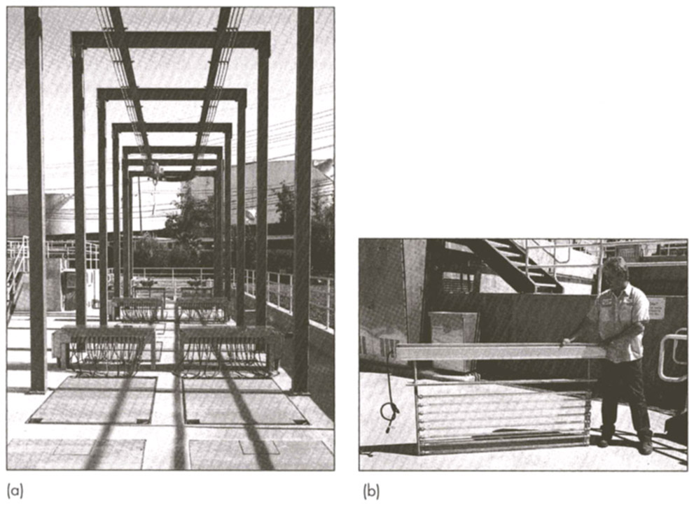
UV disinfection: wastewater

Slide 46
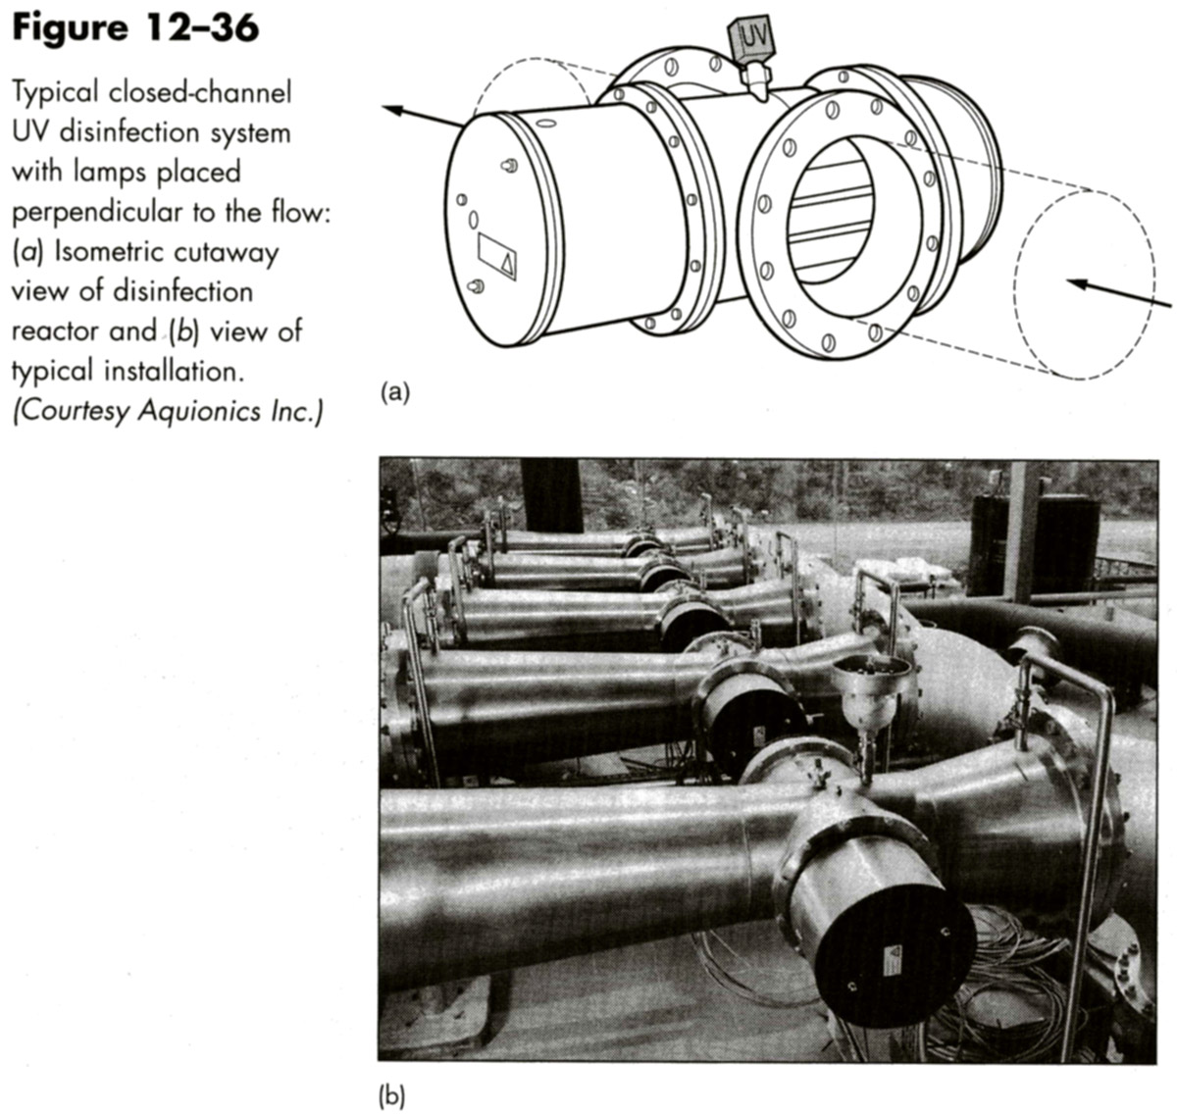
UV Disinfection: Drinking water

Slide 47
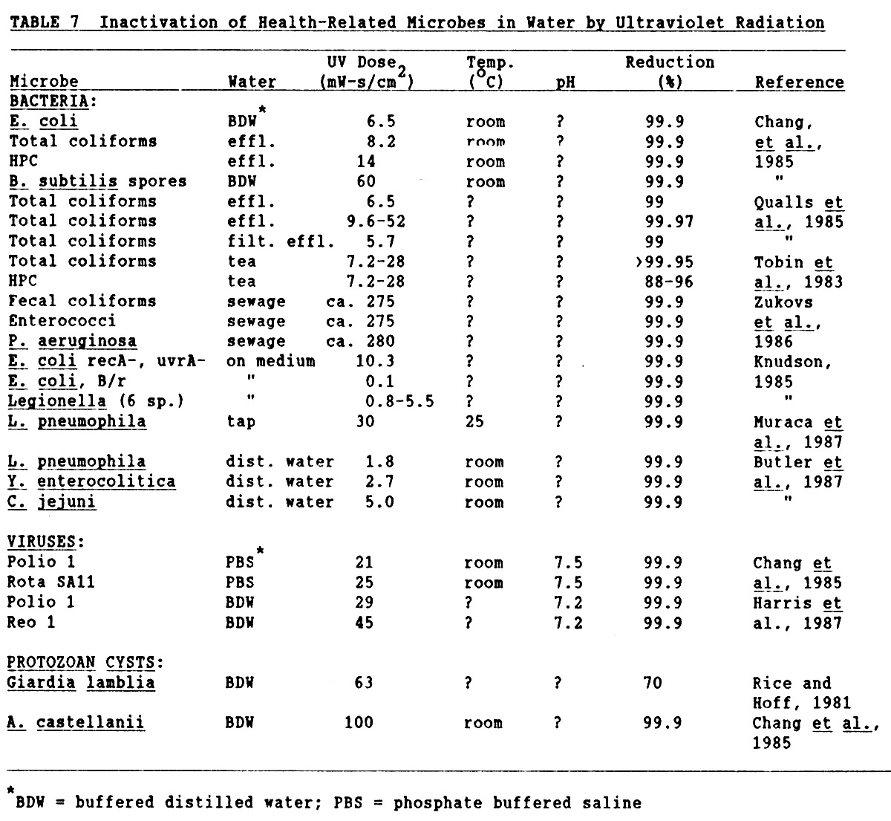
UV disinfection (effectiveness)

Slide 48
UV disinfection (advantages and disadvantages)
Advantages
  Very effective against bacteria, fungi, protozoa
  Independent on pH, temperature, and other materials in water
  No known formation of DBP
Disadvantages
  Not so effective against viruses
  No lasting residuals
  Expensive

Slide 49
Disinfection Kinetics

Slide 50
Disinfection Kinetics
Chick-Watson Law:
ln N_{t}/N_{o} = - kC^{n}t
where:
N_{o} = initial number of organisms
N_{t} = number of organisms remaining at time = t
k = rate constant of inactivation
C = disinfectant concentration
n = coefficient of dilution
t = (exposure) time
  Assumptions
    Homogenous microbe population: all microbes are identical
    “single-hit” inactivation: one hit is enough for inactivation
  When k, C, n are constant: first-order kinetics
Decreased disinfectant concentration over time or heterogeneous population
  “tailing-off” or concave down kinetics: initial fast rate that decreases over time
Multihit-hit inactivation
  “shoulder” or concave up kinetics: initial slow rate that increase over time

Slide 51
Chick-Watson Law and deviations
First
Order
Multihit
Log Survivors
Retardant
Contact Time (arithmetic scale)

Slide 52
CT Concept
Based on Chick-Watson Law
  disinfectant concentration and contact time have the same “weight” or contribution in the rate of inactivation and in contributing to CT
“Disinfection activity can be expressed as the product of disinfection concentration (C) and contact time (T)”
The same CT values will achieve the same amount of inactivation

Slide 53
Disinfection Activity and the CT Concept
Example: If CT = 100 mg/l-minutes, then
  If C = 1 mg/l, then T must = 100 min. to get CT = 100 mg/l-min.
  If C = 10 mg/l, T must = 10 min. in order to get CT = 100 mg/l-min.
  If C = 100 mg/l, then T must = 1 min. to get CT = 100 mg/l-min.
  So, any combination of C and T giving a product of 100 is acceptable because C and T are interchangeable

Slide 54
C*t₉₉ Values for Some Health-related Microorganisms (5 ºC, pH 6-7)
Organism |  | Disinfectant
 | Free chlorine | Chloramines | Chlorine dioxide | Ozone
E. coli | 0.03 – 0.05 | 95 - 180 | 0.4 – 0.75 | 0.03
Poliovirus | 1.1 – 2.5 | 768 - 3740 | 0.2 – 6.7 | 0.1 – 0.2
Rotavirus | 0.01 – 0.05 | 3806 - 6476 | 0.2 – 2.1 | 0.06-0.006
G. lamblia | 47 - 150 | 2200 | 26 | 0.5 – 0.6
C. parvum | 7200 | 7200 | 78 | 5 - 10

Slide 55
I*t_{99.99} Values for Some Health-Related Microorganisms
Organism | UV dose (mJ/cm2) | Reference
E.coli | 8 | Sommer et al, 1998
V. cholera | 3 | Wilson et al, 1992
Poliovirus | 21 | Meng and Gerba, 1996
Rotavirus-Wa | 50 | Snicer et al, 1998
Adenovirus 40 | 121 | Meng and Gerba, 1996
C. parvum | < 3 | Shin et al, 1999
G. lamblia | < 1 | Shin et al, 2001

Slide 56
Factors affecting disinfection efficacy

Slide 57
Factors Influencing Disinfection
Efficacy and Microbial Inactivation
Disinfectant type
Microbe type
Physical factors
Chemical factors

Slide 58
Physical factors
Aggregation
Particle-association
Protection within membranes and other solids

Slide 59
Chemical factors
pH:
  selecting the most predominant disinfecting species
Salts and ions
Soluble organic matter
Particulates
  reacting with chemical disinfectants or absorbing UV irradiation

