Slide 1
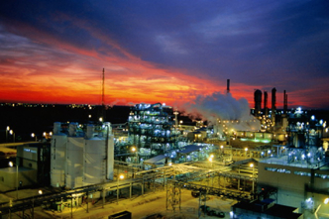
FILTRATION
Settling does not remove all flocs – further treatment is required
Filtration provides the additional opportunity for separation of small flocs or particles
This presentation is an introduction to filtration technology concepts
Water filtration

Slide 2
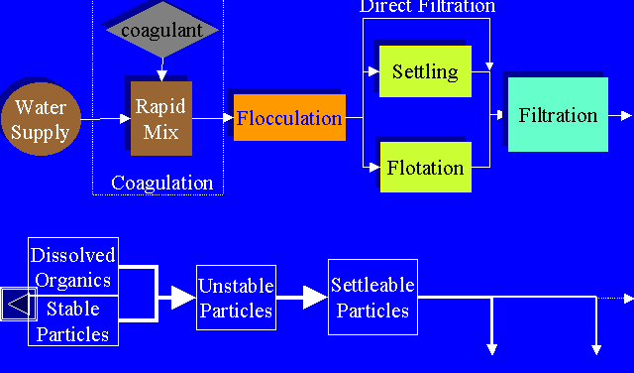
Overview of solid-liquid separation alternatives in water
Direct
Filtration
Water filtration

Slide 3
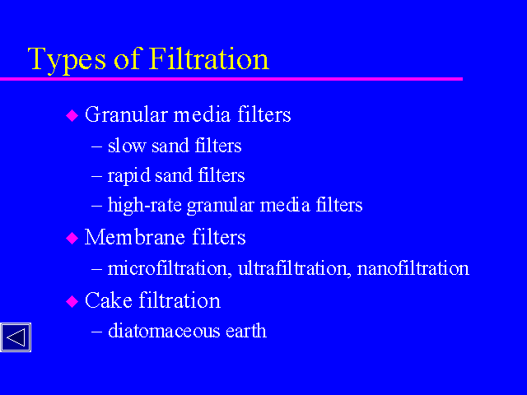
(precoat filtration)
or expanded perlite
Water filtration

Slide 4
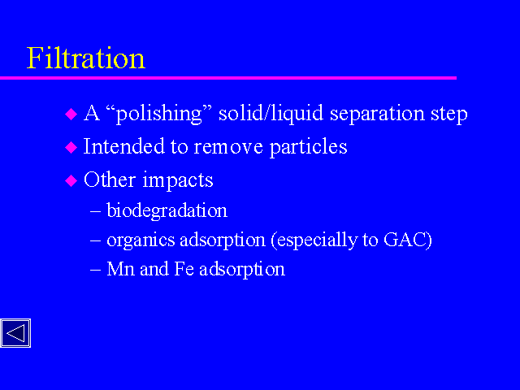
Water filtration

Slide 5
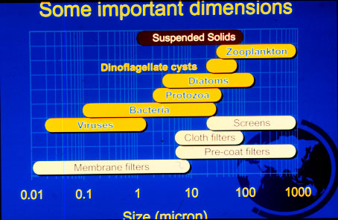
Particle size (micron)
Water filtration

Slide 6
Filtration Mechanisms
Important to understand the mechanisms
Settling, adsorption and diffusion
Not much screening
Water filtration

Slide 7
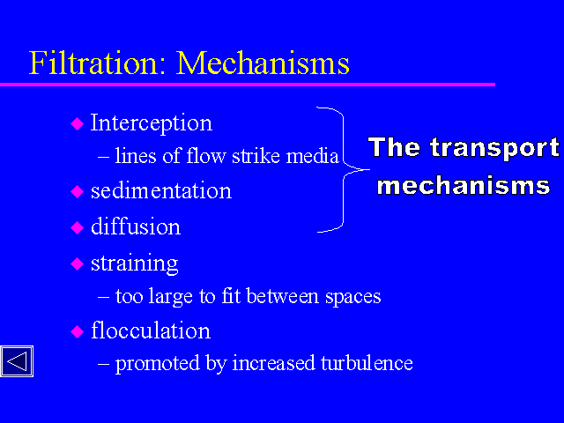
Water filtration

Slide 8
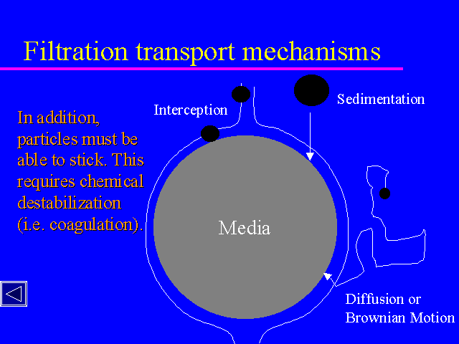
A
B
C
Water filtration

Slide 9
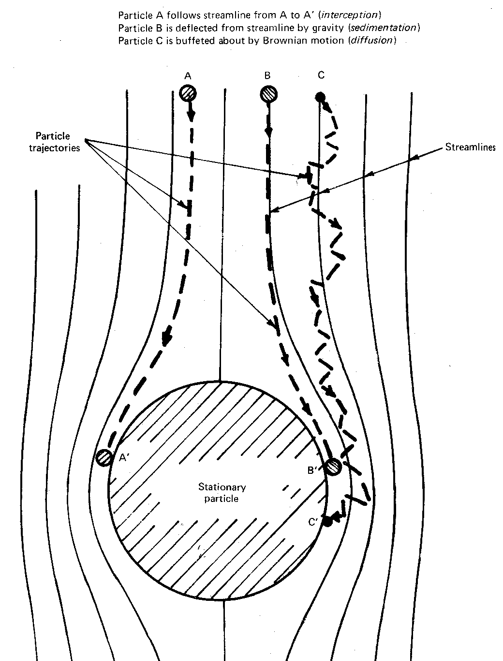
Water filtration

Slide 10
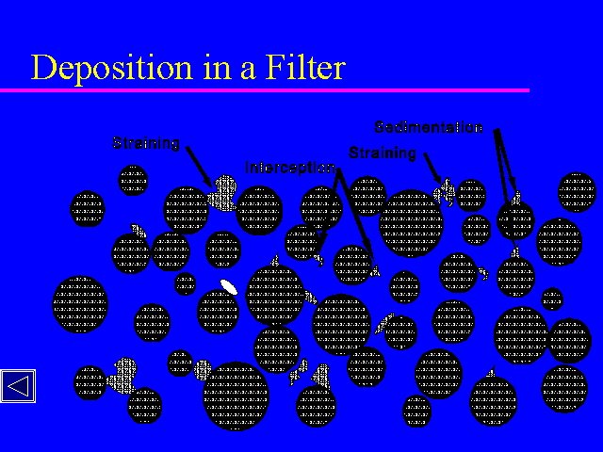
Water filtration

Slide 11
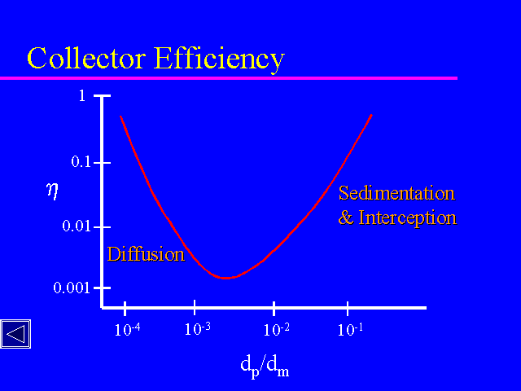
Water filtration

Slide 12
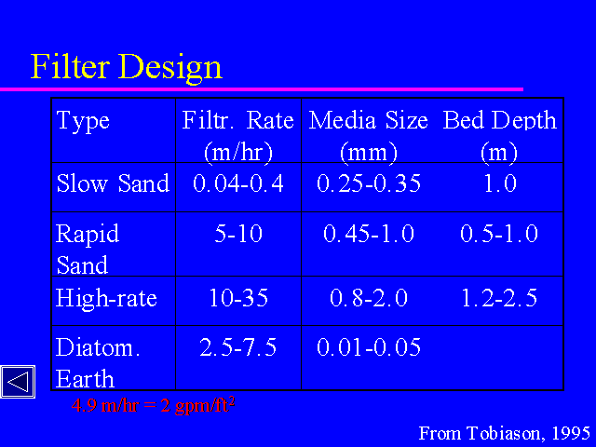
Filter Classification by Filtration Rate
2-4 gpm/ft²
18-40 thou 1.6-3.3 ft
1-3 gpm/ft²
0.5-2 thou
Water filtration

Slide 13
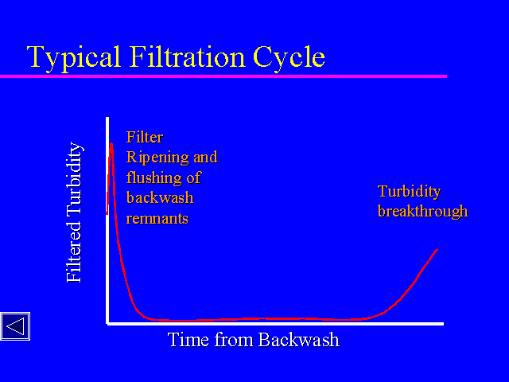
Water filtration

Slide 14
Diagrammatic layout of sand filters
Water filtration

Slide 15
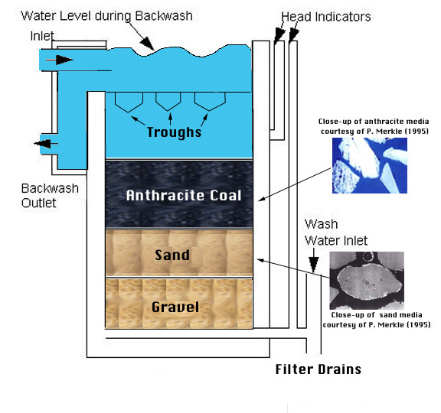
Typical multimedia filter
Water filtration

Slide 16
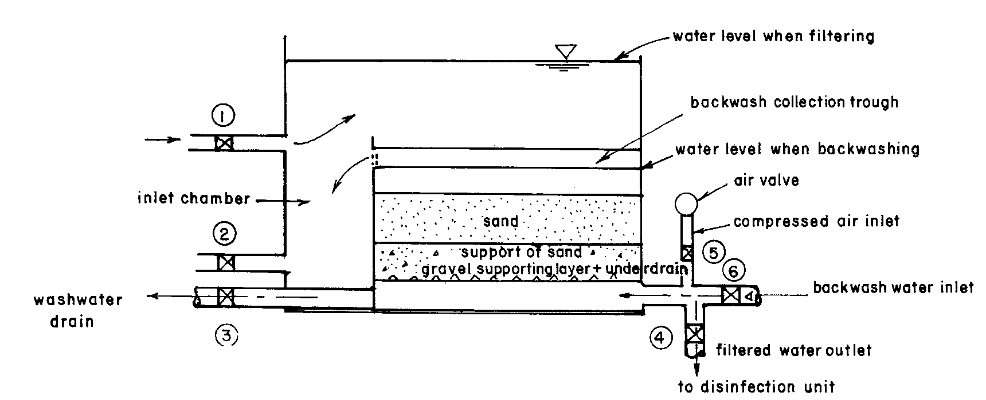
Construction details of sand filters
Water filtration

Slide 17
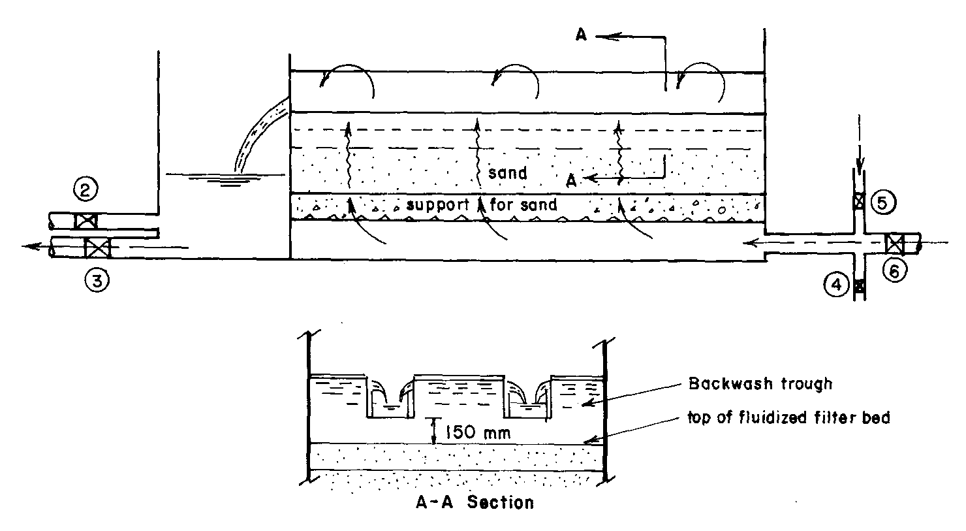
Construction details of sand filter
Water filtration

Slide 18
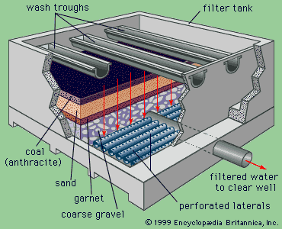
Water filtration

Slide 19
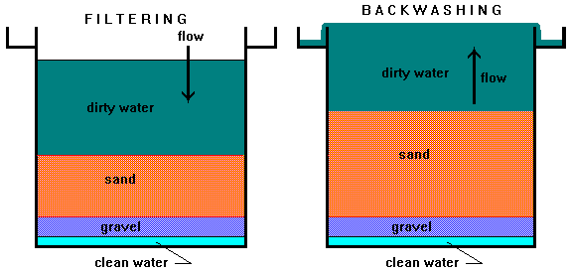
Filter operation
Water filtration

Slide 20
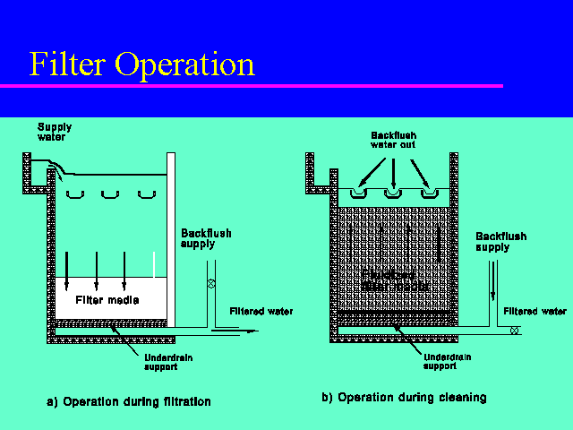
Water filtration

Slide 21
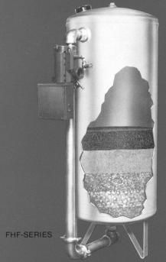
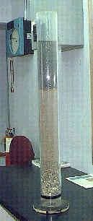
Some examples
of layout and
construction
details
Water filtration

Slide 22
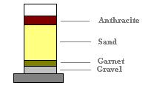
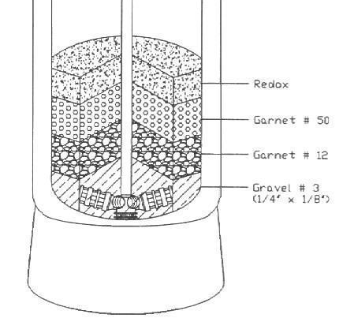
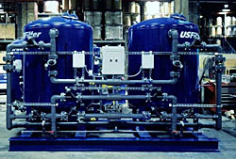
Multimedia filters
Water filtration

Slide 23
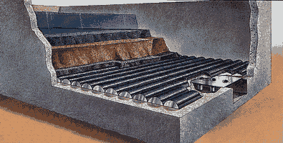
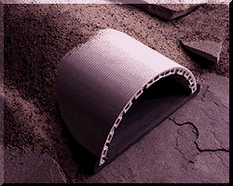
Water filtration

Slide 24
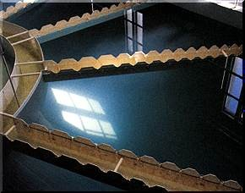
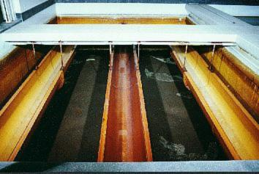
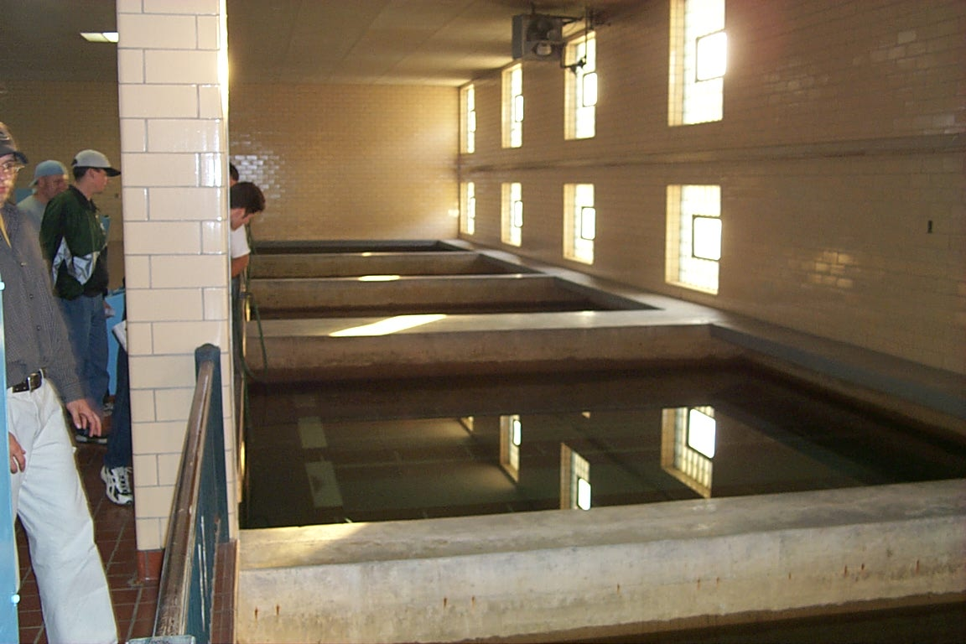
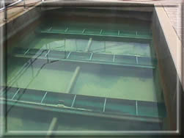
Water filtration

Slide 25
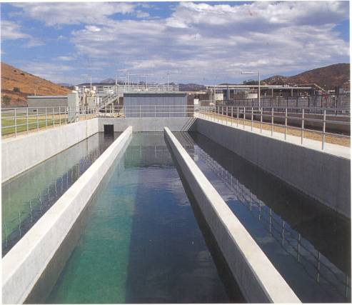
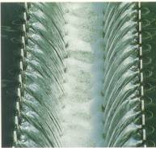
Water filtration

Slide 26
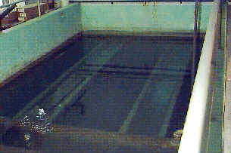
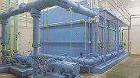
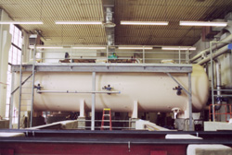
Water filtration

Slide 27
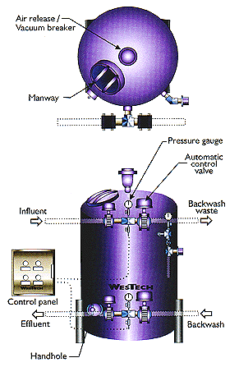
PRESSURE
FILTERS
Water filtration

Slide 28
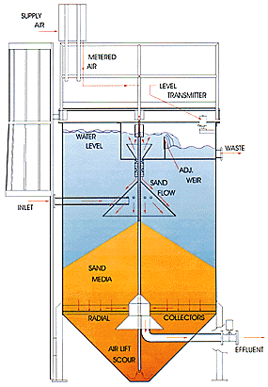
Water filtration

Slide 29
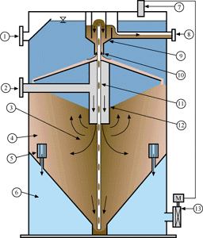
  Overflow
  Filter Influent
  Coarse Media
  Fine Media
  Filtrate Nozzles
  Filtrate Chamber
  Level Controller
  Filter Reject
  Wash box
  Counter-Current Washer
  Airlift
  Central Feed Chamber
  Actuated Valve
Water filtration

Slide 30
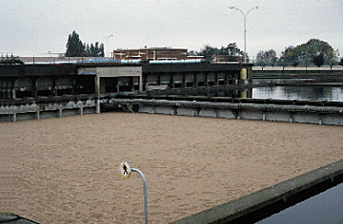
Slow Sand Filtration
Water filtration

Slide 31
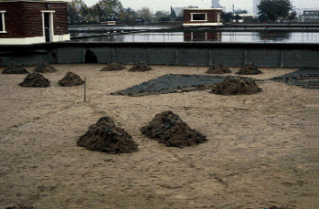
Slow Sand Filter Cleaning
Water filtration

Slide 32
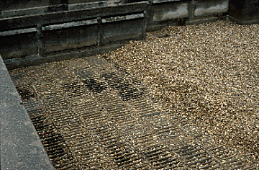
Slow Sand Filter Underdrain
Water filtration

