Slide 1
Bits Blog Engine
01/29/2014
by: tbrooks007

Slide 2
Outline
What is Bits Blog Engine?
Why create your own blogging engine?
Brief discussion: API / Service design.
API security (now and later).
Work in progress…what’s missing that will be implemented?

Slide 3
What is Bits Blog Engine?
A light weight .NET 4.0 based, open source blogging service that will manage content and service authentication. It leaves the interface / GUI management to another service to be created and managed by the user.
Modular in design with the hopes of being extended by a community of developers.
Will also offer Bits Blog as a service for users without the need for them to implement their own instance.

Slide 4
Motivations for creating a blogging service?
Initial motivation was to create a CMS that only handled content. Without the need to force my GUI interface into a template system.
Wanted an API that allowed for injecting content into any interface (mobile app, web site, desktop application etc)
Wanted a system that could be easily used in a shared and non-shared host environment. Where only support for the underlying platform was needed.
No good open source .Net blogging / CMS systems.
Good exercise in designing a service, that could be extended and scale. Also wanted my technology to drive my blog.

Slide 5
Design
Makes use of Factory and Repository patterns to support coding to an interface as well as dependency injection w/o the use of a framework.
Designed to support various DBMS systems (via DataAccessAgent).
API / Service libraries will reuse repositories and database access agent.

Slide 6
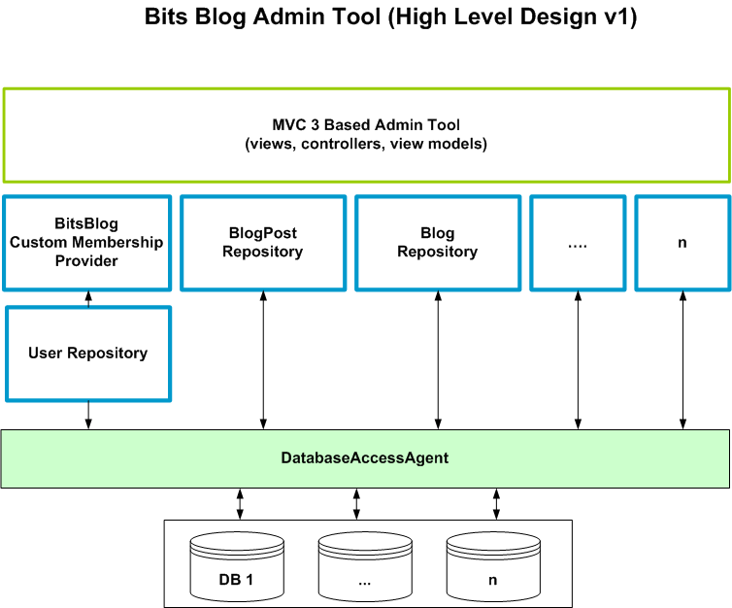

Slide 7
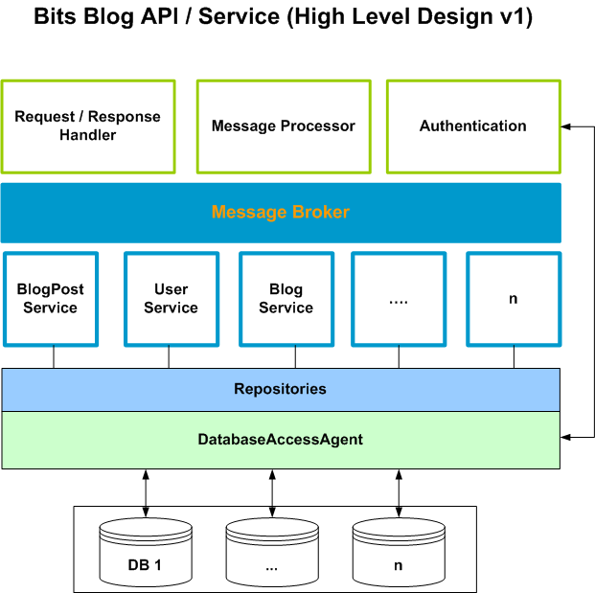

Slide 8
API Security (Now and Later)
Now…
Current API (read only access) modeled after Amazon web services’ use of symmetric key pairs for signing SNS and SQS service requests.
Secret key will be used to create a message signature, canonical string that is used will be built according to the API’s documentation.
Access key acts as a user’s unique identifier
Blog will be identified by name (unique UUID)
Will use HTTPS.
Later…
Support and use of OAuth framework or some other standard open source authentication framework

Slide 9
Still A Work In Progress..
Logging
Input validation, encoding, cleaning etc.
OAuth support
v1 features: content creation, editing are not complete.
Implement WCF services to support read only API access.
Add comments, documentation to all methods and classes.
Implement unit tests.
Ensure that all methods have parameter checking and catches / handles errors.
Command line utility to create default database and database users.

