Slide 1
Fitness
One minute at a time

Slide 2
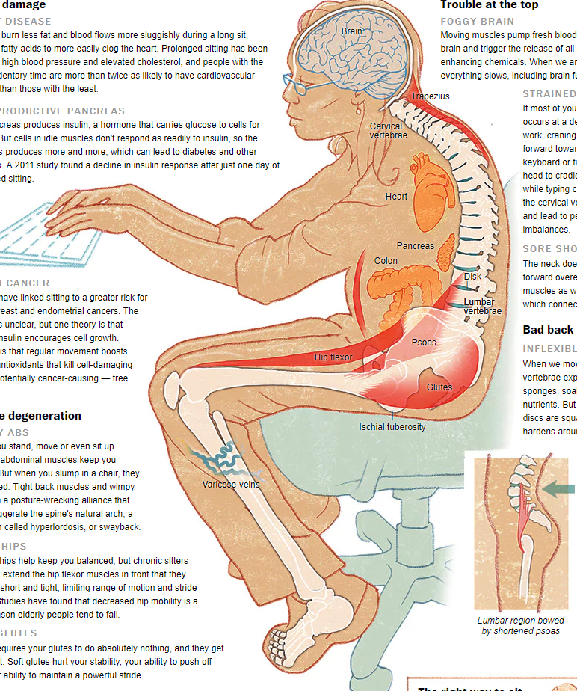
Washinton Post
January 20, 2014

Slide 3
Organ damage
Blood flow is sluggish allowing fatty acids to clog the heart
Prolonged sitting has been linked to high blood pressure
Elevated cholesterol
Greater risk of colon cancer
Greater risk of diabetes
Muscle degeneration
Foggy Brain – lack of oxygen flow
Strained neck
Bad back

Slide 4
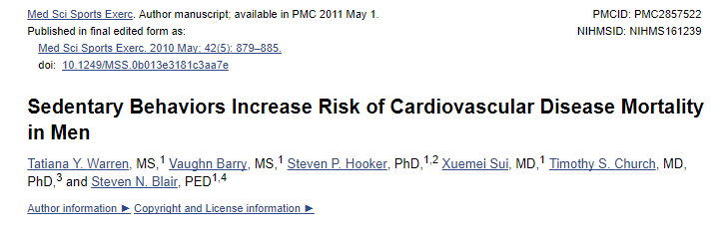
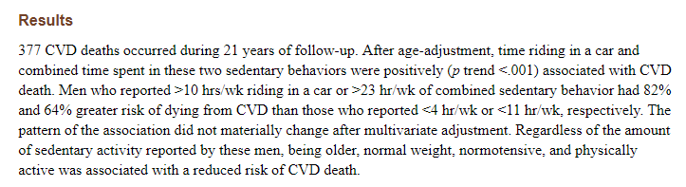

Slide 5
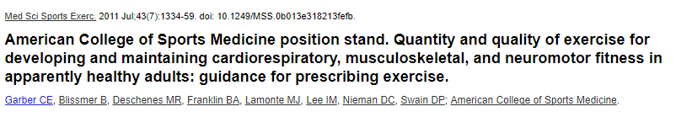
ACSM Position Statement on Exercise
…. The scientific evidence demonstrating the beneficial effect of exercise is indisputable, and the benefits of exercise far outweigh the risks in most adults. A program of regular exercise that includes cardiorespiratory, resistance, flexibliity and neuromotor exercise training beyond activities of daily living to improve and maintain physical fitness and health is essential for most adults. The ASCM recommends that most adults engage in moderate-intensity cardiorespiratory exercise training for at least 30 minutes 5 to 7 days of the week for a total of at least 150 minutes a week

Slide 6
BuTTTTTTT!!!!!!! I don’t have time to exercise!
I have a solution!

Slide 7
Some people are overwhelmed by the thought of joining a gym and working out for 30 minutes!
Some people think of fitness as all or nothing
---- > The people who sell fitness programs on TV are the
biggest deterrent for the average person!

Slide 8
Fitness one minute at a time
Instead of big blocks of time – break your WELNESS into little one minute bites.
You can do anything for one minute!

Slide 9
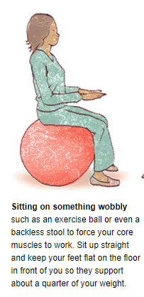
Sit on a Fitness Ball

Slide 10
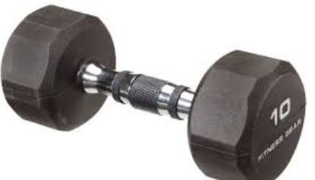
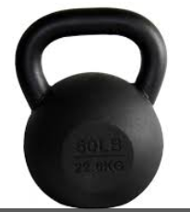
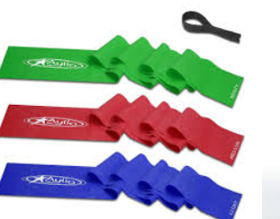
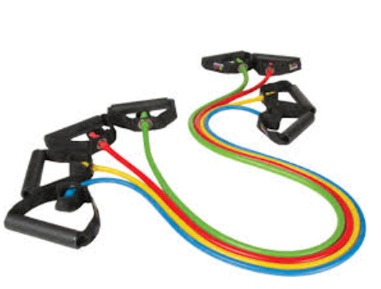
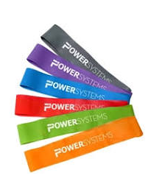
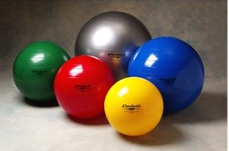
Equipment to leave under your desk

Slide 11
Now for the fun!
Dumbells
Triceps
Biceps
Sitting Fly's
Shoulder rolls
Lateral raises
Lateral side bends
Rear Lateral Raises

Slide 12
Resistance bands or tubes
Overhead Press
Chest Pull
Lat pull down
Leg press
Bicep curls
Triceps

Slide 13
Power Bands
Behind the back pulses
Overhead pulses
Outer thigh
Standing: Hamstring curls
Walking: Lateral Walks with band above ankles
Standing: Outer thigh lifts

Slide 14
swiss Ball
Inner Thigh squeeze
Squeeze between palms
Squeeze Release hand exercise
Use your hand to Roll on desk
Arm circles

Slide 15
Kettle Bell
Curl/Press
Squats
Swings
One arm row
Halo
Hip Halo

Slide 16
No equipment
Squats at your desk
Push ups on the wall
Wall squat
Raise up on toes
Tap toes
Wiggle fingers
Boxer punches
Foot circles
Arm circles
Sitting Knee to chest (abs)

Slide 17
Cardio
Jog at your desk – you can do this sitting or standing
Jumping Jack – you can do this sitting or standing
Skip down the hall (come on! Its fun!)
March down the hall (Pick up your knees!)
Clapping wall push ups
Walk the stairs
Walk around your building

Slide 18
Don’t forget to stretch!
Use the band to pull your toe toward you – calf stretch
Clasp your hands behind you pull up.
Cat – Cow – back stretch
Shoulder Stretch – cross arms in front pull one arm over
Wrist Stretch
Hand and finger stretch
Reach for the sky
Trunk twist
Standing thigh Stretch

Slide 19
If you work 8 hours a day that’s 8x60 = 480 minutes per day
That’s a lot of minutes! You only need 30 of them for fitness.
1 minute of exercise every 15 minutes
4 minutes per hour = 32 minutes of exercise

Slide 20
Cardiorespiratory Exercise
ASCM – recommendation
Moderate Intensity for 30 minutes
Vigorous Intensity for 20 minutes
3 days a week

Slide 21
Acsm guidelines
Good News!
Adults who are unable or unwilling to meet the exercise targets outlined can still benefit from engaging in amounts of exercise less than recommended. In addition to exercising regularly, there are health benefits in concurrently reducing total time engaged in sedentary pursuits and also by interspersing frequent, short bouts of standing and physical activity between periods of sedentary activity. https://www.ncbi.nlm.nih.gov/pubmed/21694556

