Slide 1
Computer Tech ’10
Subject:
“HOME WIRELESS NETWORKING
and YOU”
Notes:
Building LRC, room 131
1100-1200

Slide 2
Personal Introduction
Tom Browder (subbing for Bob Carney who’s in Haiti with FEMA)
Local Okaloosa County Resident
Senior Analyst with ManTech Intn’l (www.mantech.com)
Slides (from Expo ’08 edition) courtesy of Larry Wons, South Walton Computer Club
Notes:
Welcome, I’m Tom Browder, standing in for Bob Carney who was called up by FEMA for the relief effort in Haiti.
Thanks to Larry Wons for most of the slides. They are from a previous presentation at this event in 2009. Larry presented another session this year first period this morning (The Future of 3D Video).

Slide 3
Today’s Objectives
Why should you consider a Home wireless network?
Discuss wireless networking Basic capabilities and set up considerations
Overview several Advanced wireless network features that you might get into
Suggest Advanced Topics for the curious
Notes:
This is mostly Windows-centric, but I try to avoid Windows-only terminology when I can.
If we have time to demo a router set up, I’ll do it with Linux.

Slide 4
Why Wireless?
Convenience (no wires)
  Laptops
  Netbooks
  Streaming video to TV
Older homes are difficult to install network wiring in

Slide 5
Why Not Wireless?
Speed
Security
Router control

Slide 6
Wireless Alternative
Home power line network

Slide 7
Basic Wireless Networking
(requires DSL or cable service)
How to share your broadband service amongst your home computers
How to share information (files/folders/directories) amongst you home computers
How to share hardware components (e.g., printer) amongst your home computers
How to do the above securely
Notes:
Folders is Windows and Mac users, directories is for *nix users.

Slide 8
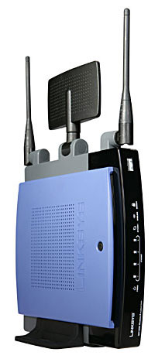
Typical Wireless Router
Antennas
(2.4 GHz)
Configured for
Stand up operation

Slide 9
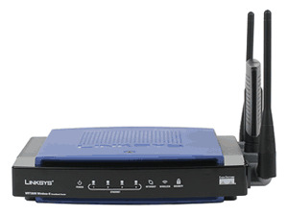
Typical Wireless Router (2)
Repositioned
antennas
Configured for
laid down operation
System Status
Indicators

Slide 10
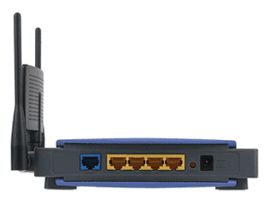
Typical Wireless Router (3)
Rear view
Power Connection
DSL or Cable
MODEM
(DHCP)
Up to 4 LAN 10/100
Connections (PC, etc.)

Slide 11
Terminology Catch Up
Dynamic Host Configuration Protocol (DHCP) is an Internet protocol for automating the configuration of computers (new cable and DSL MODEMS)
Ethernet 10/100 LAN card or motherboard component adds network capability to your computer

Slide 12
Wireless Protocols
Protocol | Release Date | Operating Frequency | Data Rate Maximum | Range (Radius Indoors) | Range (Radius Outdoors)
802.11b | 1999 | 2.4 GHZ | 11 Mbit/s [200 X Dial Up] | 300 Feet | 1000 Feet
802.11g | 2003 | 2.4 GHz | 54 Mbit/s | 300 Feet | 1000 Feet
802.11n (recently approved) | 2009 (est.) | 2.4 GHz 5.0 GHz | 248 Mbit/s | 700 Feet | 2000 Feet
Notes:
Note the 802.11n was very recently approved, but the draft version has been out a while and most routers using the draft standard should work fine.
Contact your manufacturer if there is a problem (may have a firmware upgrade).

Slide 13
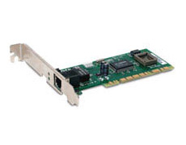
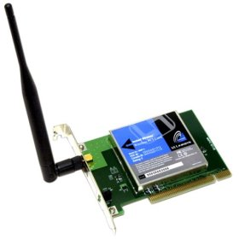


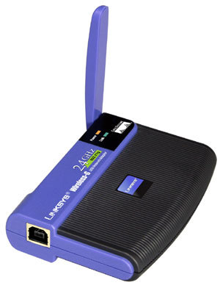

Computer Connectivity
Desktop
Laptop
LAN 10/100
Built In
PCI Card
Wireless
PCI Card
USB Unit
LAN 10/100
Built In
PCI Card
Wireless
Built In
PCI Card
USB Plug In
Notes:
I don’t recommend wireless for desktops—they ought to have wired access.
You need at least one wired connection to securely control the router.
Some routers will not allow wireless control at all.

Slide 14
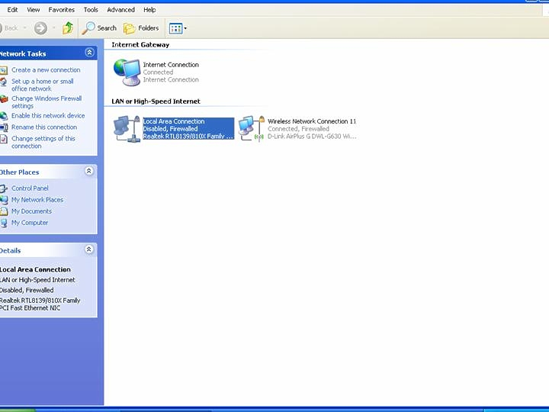
Last Step to the Internet
(wireless device - LAN view)
LAN 10/100 Disabled
Control Panel/Network Connections (XP)

Slide 15
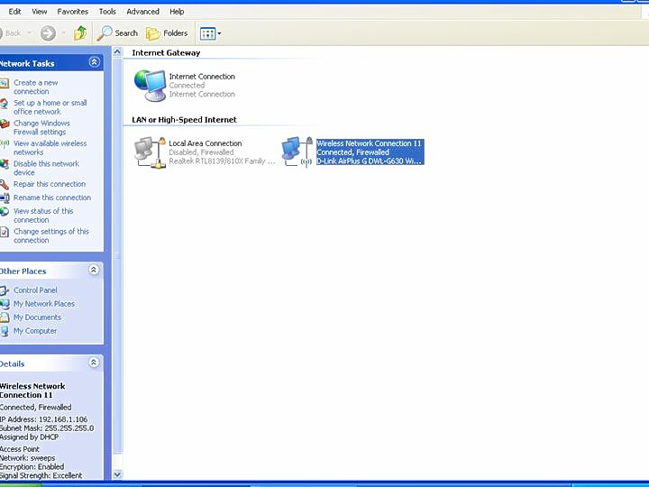
Last Step to the Internet
(wireless device - wireless view)
Wireless Enabled
Control Panel/Network Connections (XP)

Slide 16
ISP Network Sharing
(typical home router)
Share with several (100 or so) Computers wirelessly
Share with 4 using the LAN wired connectors
To set up turn your computer on!
  Not as easy with Linux
  Manual set up may be easier sometimes, especially for changes
Notes:
ISP – internet service provider
Take the 100 with a grain of salt.
Some automatic setups I’ve seen are horrible, but you can always fall back to manual control.
Make sure and get a user manual for your router.

Slide 17
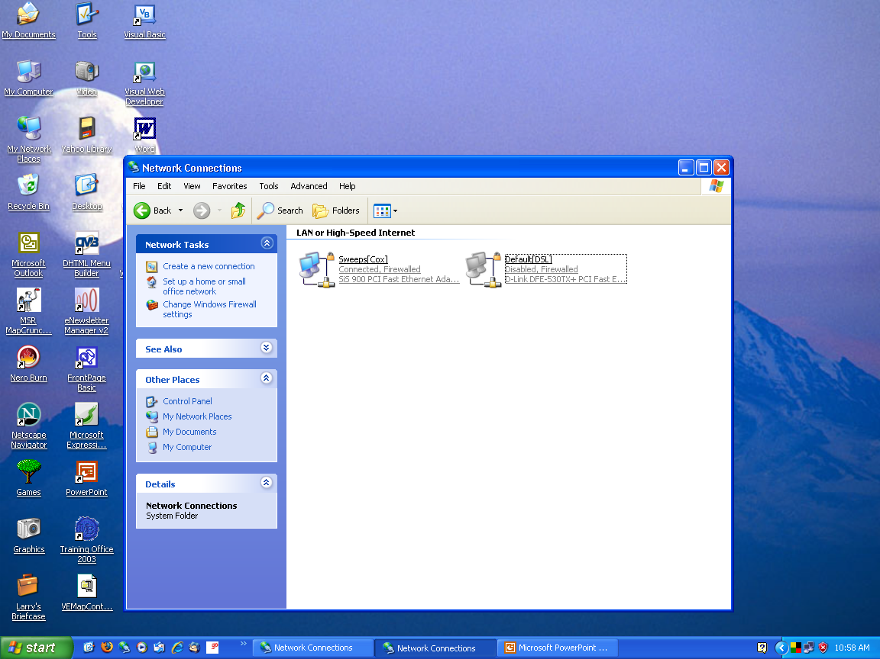
Setting Up a Local Area Network (LAN)
Control Panel/Network (XP)
(Slight Difference in Vista or Win 7)

Slide 18
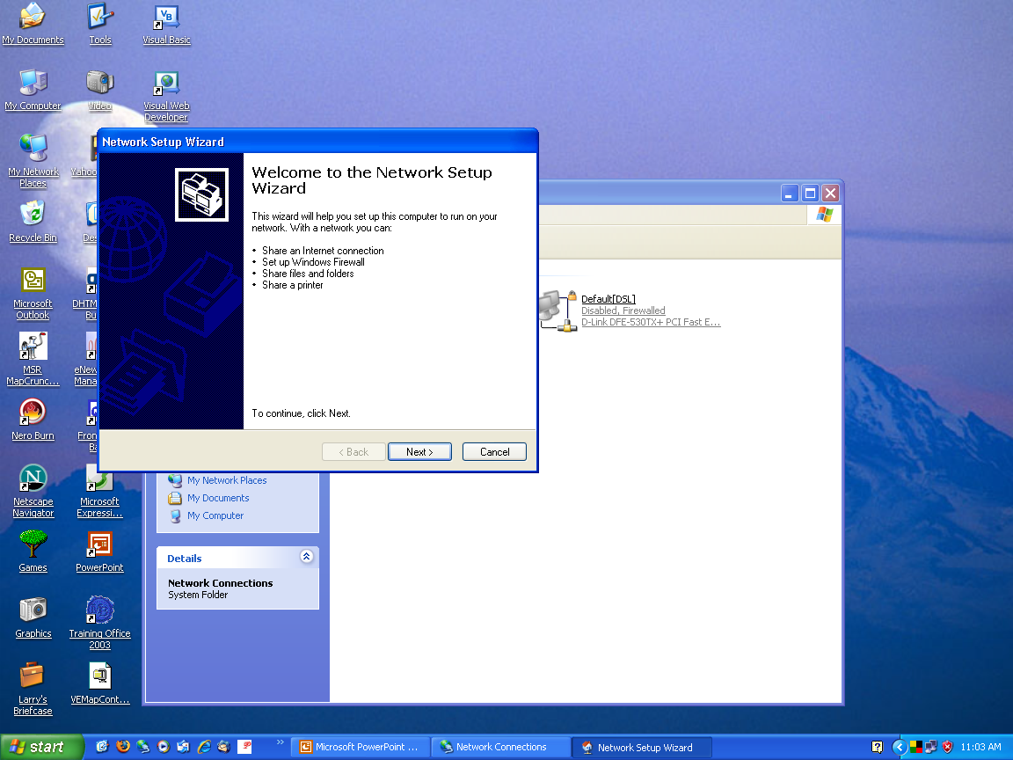
Windows Network Wizard
Follow wizard
Key - set up the network on all computers using the same workgroup

Slide 19
Viewing Shared Files and Folders (Directories)
Click on “My Network Places”
You will have access to all shared files and folders (directories) for those computers that are currently powered on.
What you can do with the capability depends on the setting you established when you allowed sharing (control panel/folder)
Notes:
I haven’t done sharing on my networks because I haven’t needed it—my scanner and printer are on the network as stand-alone devices.

Slide 20
Printer Sharing
Control panel/printers
After setting up the network available printers will appear when you run the printer wizard
Driver may be required.
If attached to a computer, the computer must be powered up (unless printer is stand alone)

Slide 21
Wireless Security = Encryption
The process of converting information into a form unintelligible to anyone except holders of a specific cryptographic key
You install the key in your router
All wireless computers must know the encryption key to access your router
Take the time to do this right—there are evil people about
Notes:
I’m not kidding about that.
Nearly everywhere I go with my laptop I see unsecured networks.

Slide 22
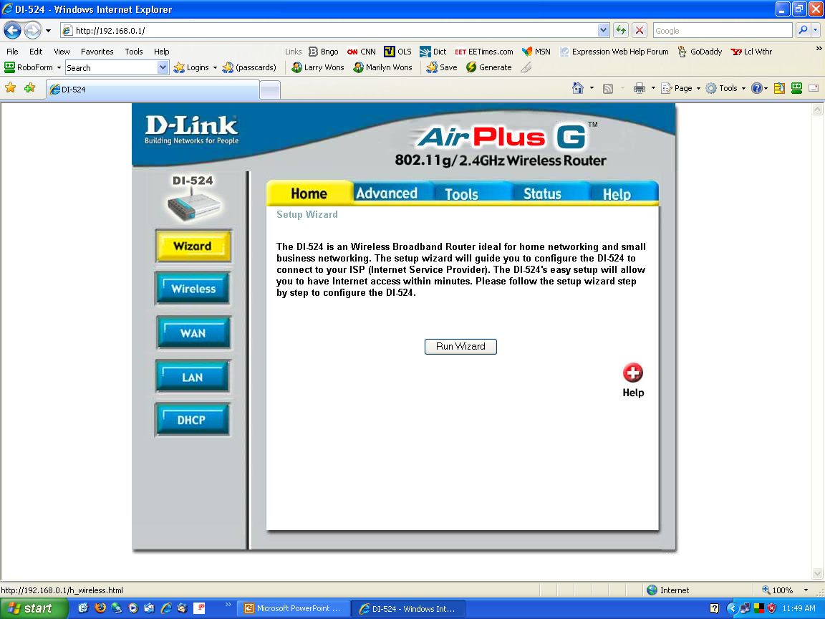
Setting Encryption
Browser access
198.168.0.1
Access Wireless

Slide 23
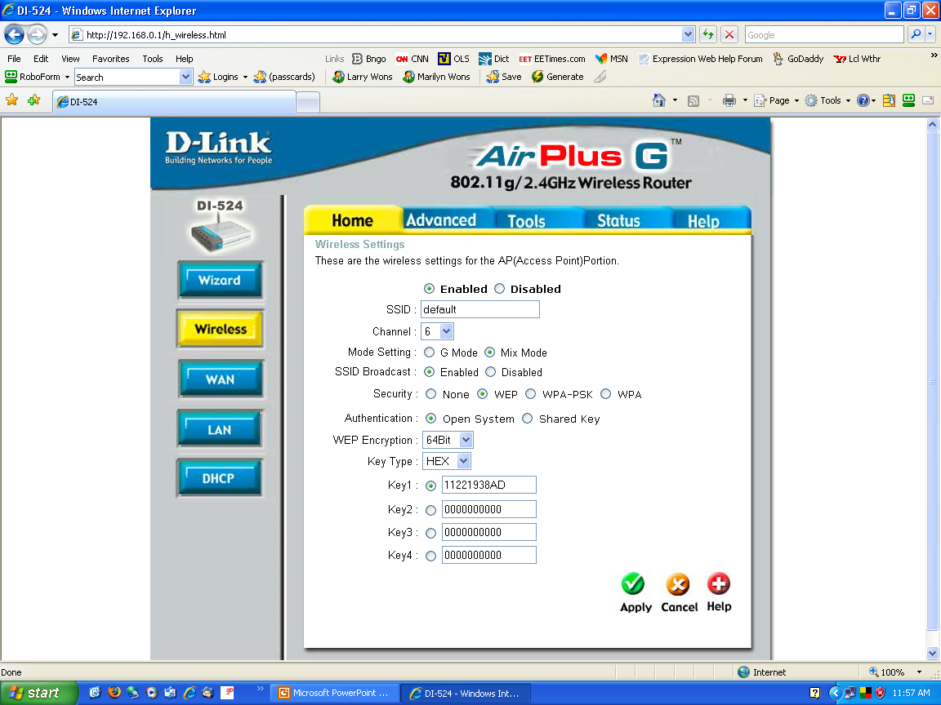
1.Give your networks a name
(see hints later)
note enabled
2. Select encryption type
3. Create a key
(see hints later)
4. Done

Slide 24
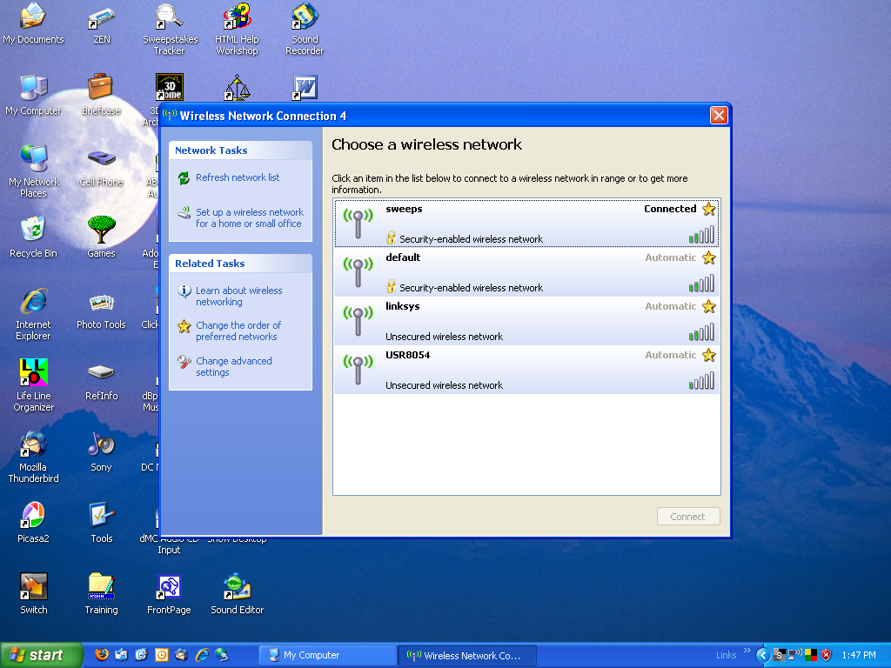
Wireless Access
(see active networks)

Slide 25
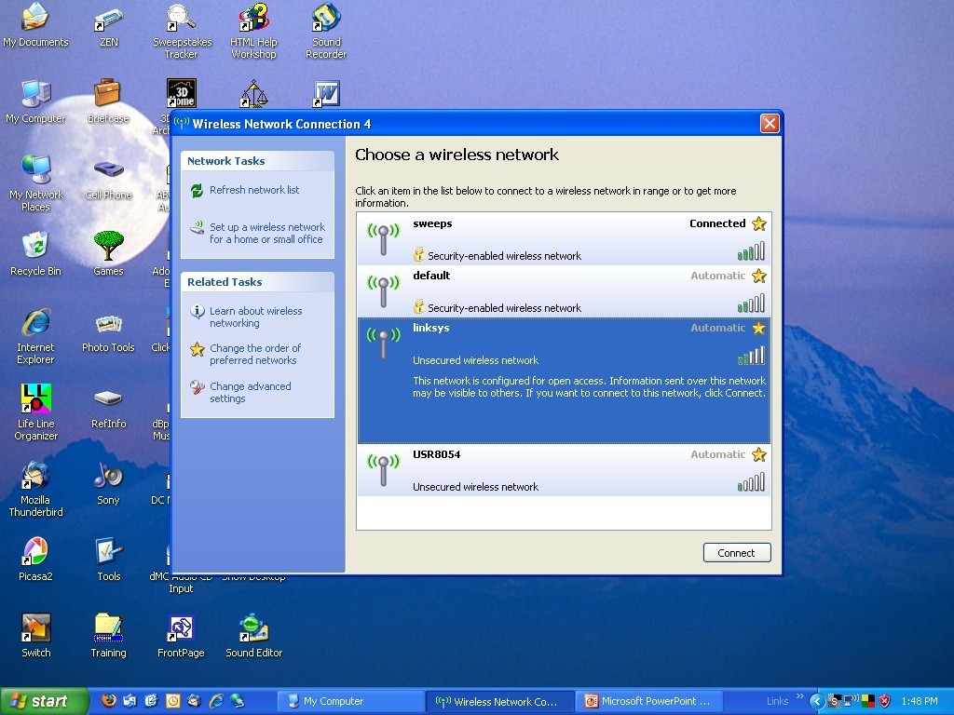
Wireless Access
(select a network)

Slide 26
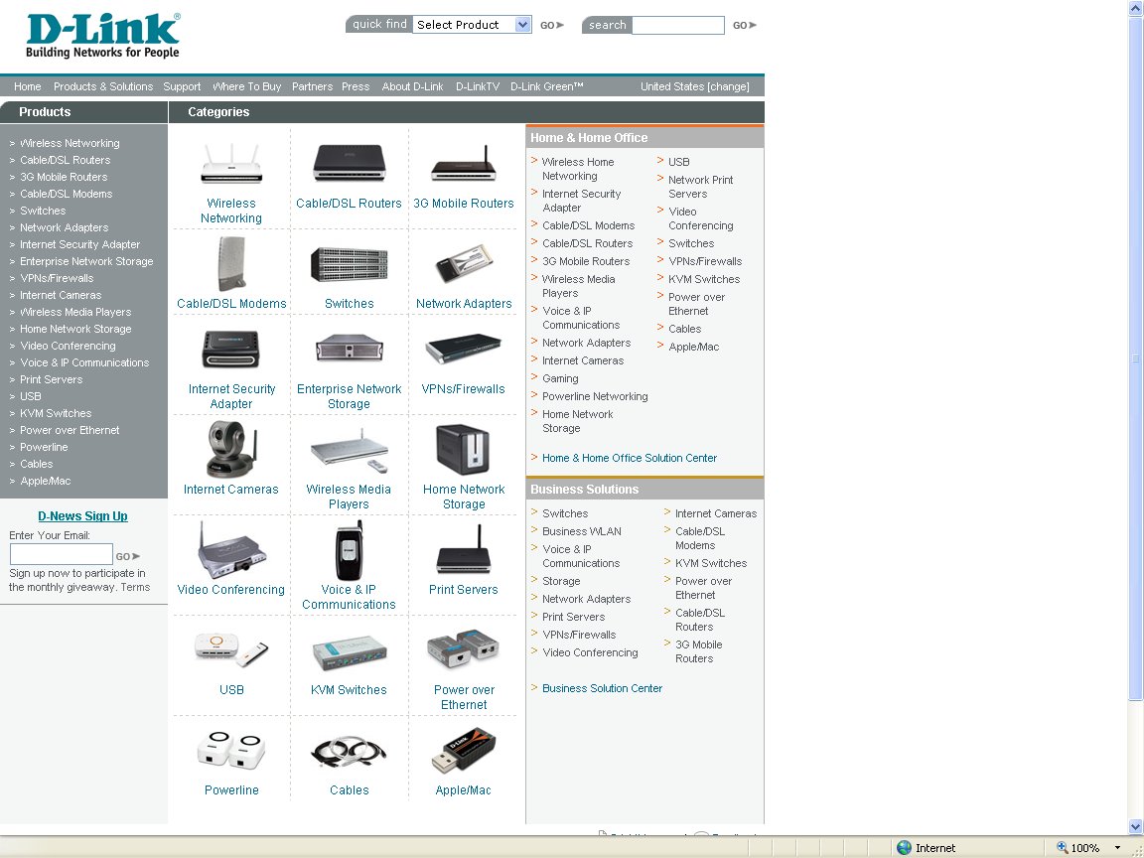
What’s
Next?

Slide 27
Hints
Mixed vintage wireless devices may require less secure encryption method, oldest to newest:
  WEP, WPA, WPA2, extensions to WPA[2]
  See “Wi-Fi Protected Acces” on Wikipedia
  See www.wigle.net/gps/gps/stat for stats on SSID names and router brands
I’ve had the best luck with Linksys, your mileage may vary
Notes:
My recent D-Link (which I turned back in for a Linksys) worked wired but wireless was dead.

Slide 28
Hints (2)
More expensive is not necessarily better, check reviews of routers
Don’t be in a hurry to change router user name, password, or IP address (if or when you do, write it down in a safe place)
Save settings if able (at least write them down, I keep a notebook just for computer notes and settings)

Slide 29
Hints (3)
More on encryption
  Don’t hide SSID, but use a unique SSID (doesn’t help security, but might avoid conflicts in the vicinity). Reports are that hiding SSID sometimes confuses Windows.
  Use strong pass phrase (at least 13 random characters is recommended)
  Use WPA2 if possible

Slide 30
Advanced Topics
Use Open DNS instead of ISP DSN (see www.opendns.com), requires changing router settings
  208.67.222.222
  208.67.220.220
Dynamic self-hosting
  Use your computer to host a web site (bing it: ”dynamic self-hosting”)
Notes:
I’ll try to demo that in a moment.

Slide 31
Advanced Topics (2)
Hack your router (don’t use your primary router; get one from eBay for this; use Linux OS, see my PM session)
  www.dd-wrt.com
  www.xorp.com (most interesting to me)
  www.openwrt.org (I tried this and made a paper weight of my router!)
  www.open-router.org

Slide 32
Thank You
For Your Interest
Tom Browder <tom.browder@gmail.com>
E-mail me with questions or suggestions, put “[computertech]” in the subject (without the quotes).
Notes:
Please don’t hesitate to e-mail me.
This presentation should be on t

