Slide 1

Estimation Part I:
Samplers
Module 5 Live Session (6/22/2022)
DS6040 Summer 2022
Taylor Brown

Slide 2

Course Updates
HW 1 has been successfully turned in!
  These will continue to be graded throughout the week
Project Proposals have been turned in!
  I’ll be reaching out with comments throughout the week.

Slide 3
Outline
Posterior Review
Monte Carlo Sampling
Markov Chain Monte Carlo Sampling
  Gibbs Samplers
  Random Walk Metropolis/-Hastings
  Hamiltonian MCMC

Slide 4
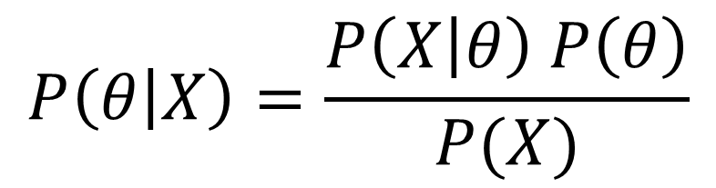

Review
Likelihood
We can evaluate this function
Posterior Distribution
Our Target Distribution
Prior Distribution
We can evaluate this function
Marginal Distribution
Can’t evaluate this because solving the integral is usually impossible

Slide 5
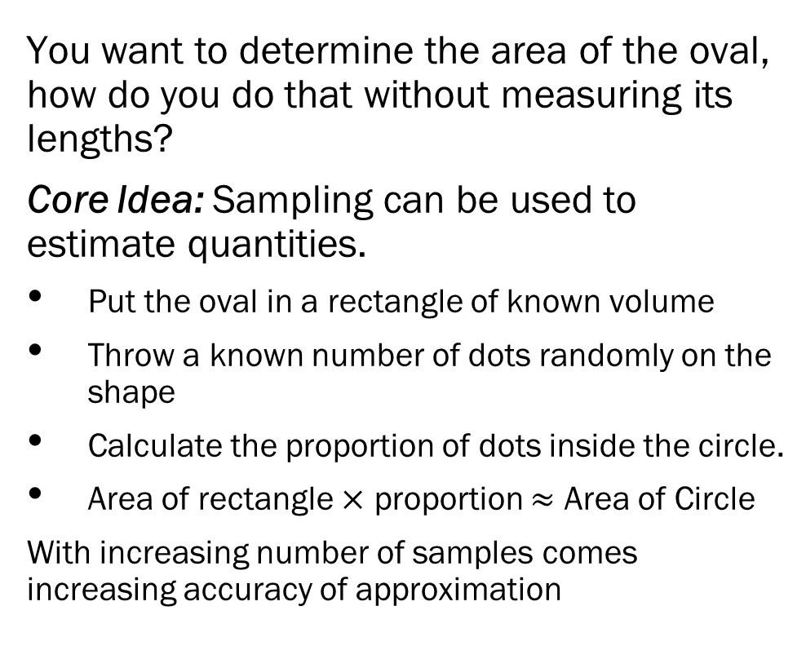
Sampling Parameters

Slide 6
Sampling – Approximating the Posterior
Posterior expectations (theoretical averages) get replaced by sample averages.
“Monte Carlo” just means “averaging samples”
Regular Monte Carlo isn’t possible when you don’t know your posterior exactly.
Fortunately, there are many algorithms that let you sample from the posterior, assuming you know only a little bit about your posterior.
Markov chain Monte Carlo algorithms generate *correlated* samples from a Markov chain. You average the samples so it’s a Monte Carlo algorithm. Hence: MCMC
The fact that the “long-run” distribution of this chain is the same as the posterior is difficult to prove theoretically, but easy to diagnose with software.

Slide 7
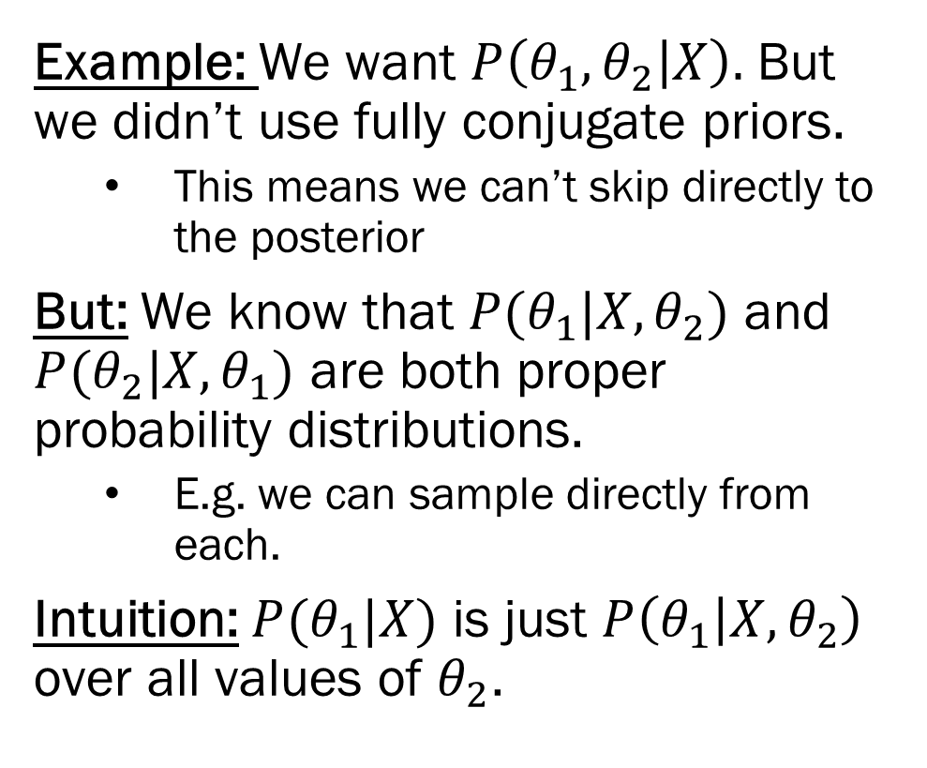
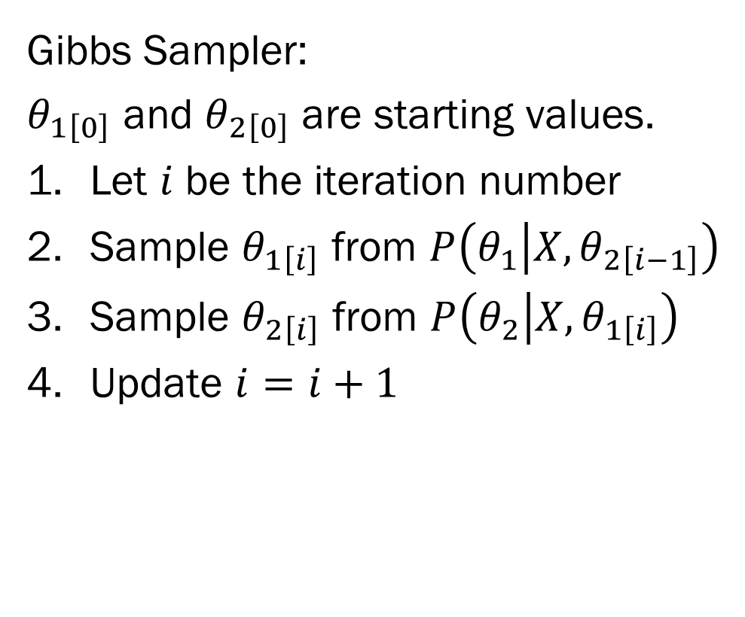
The Gibbs Sampler

Slide 8
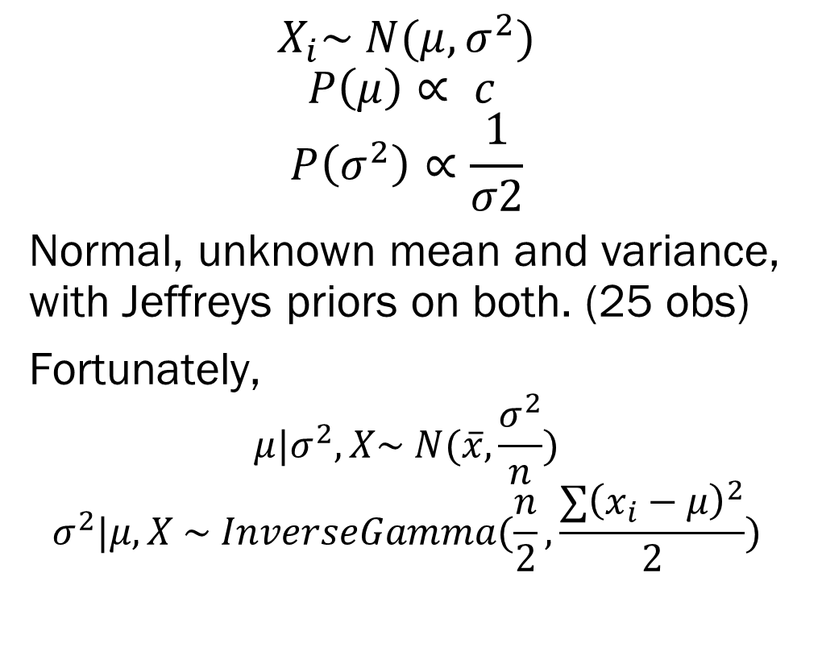
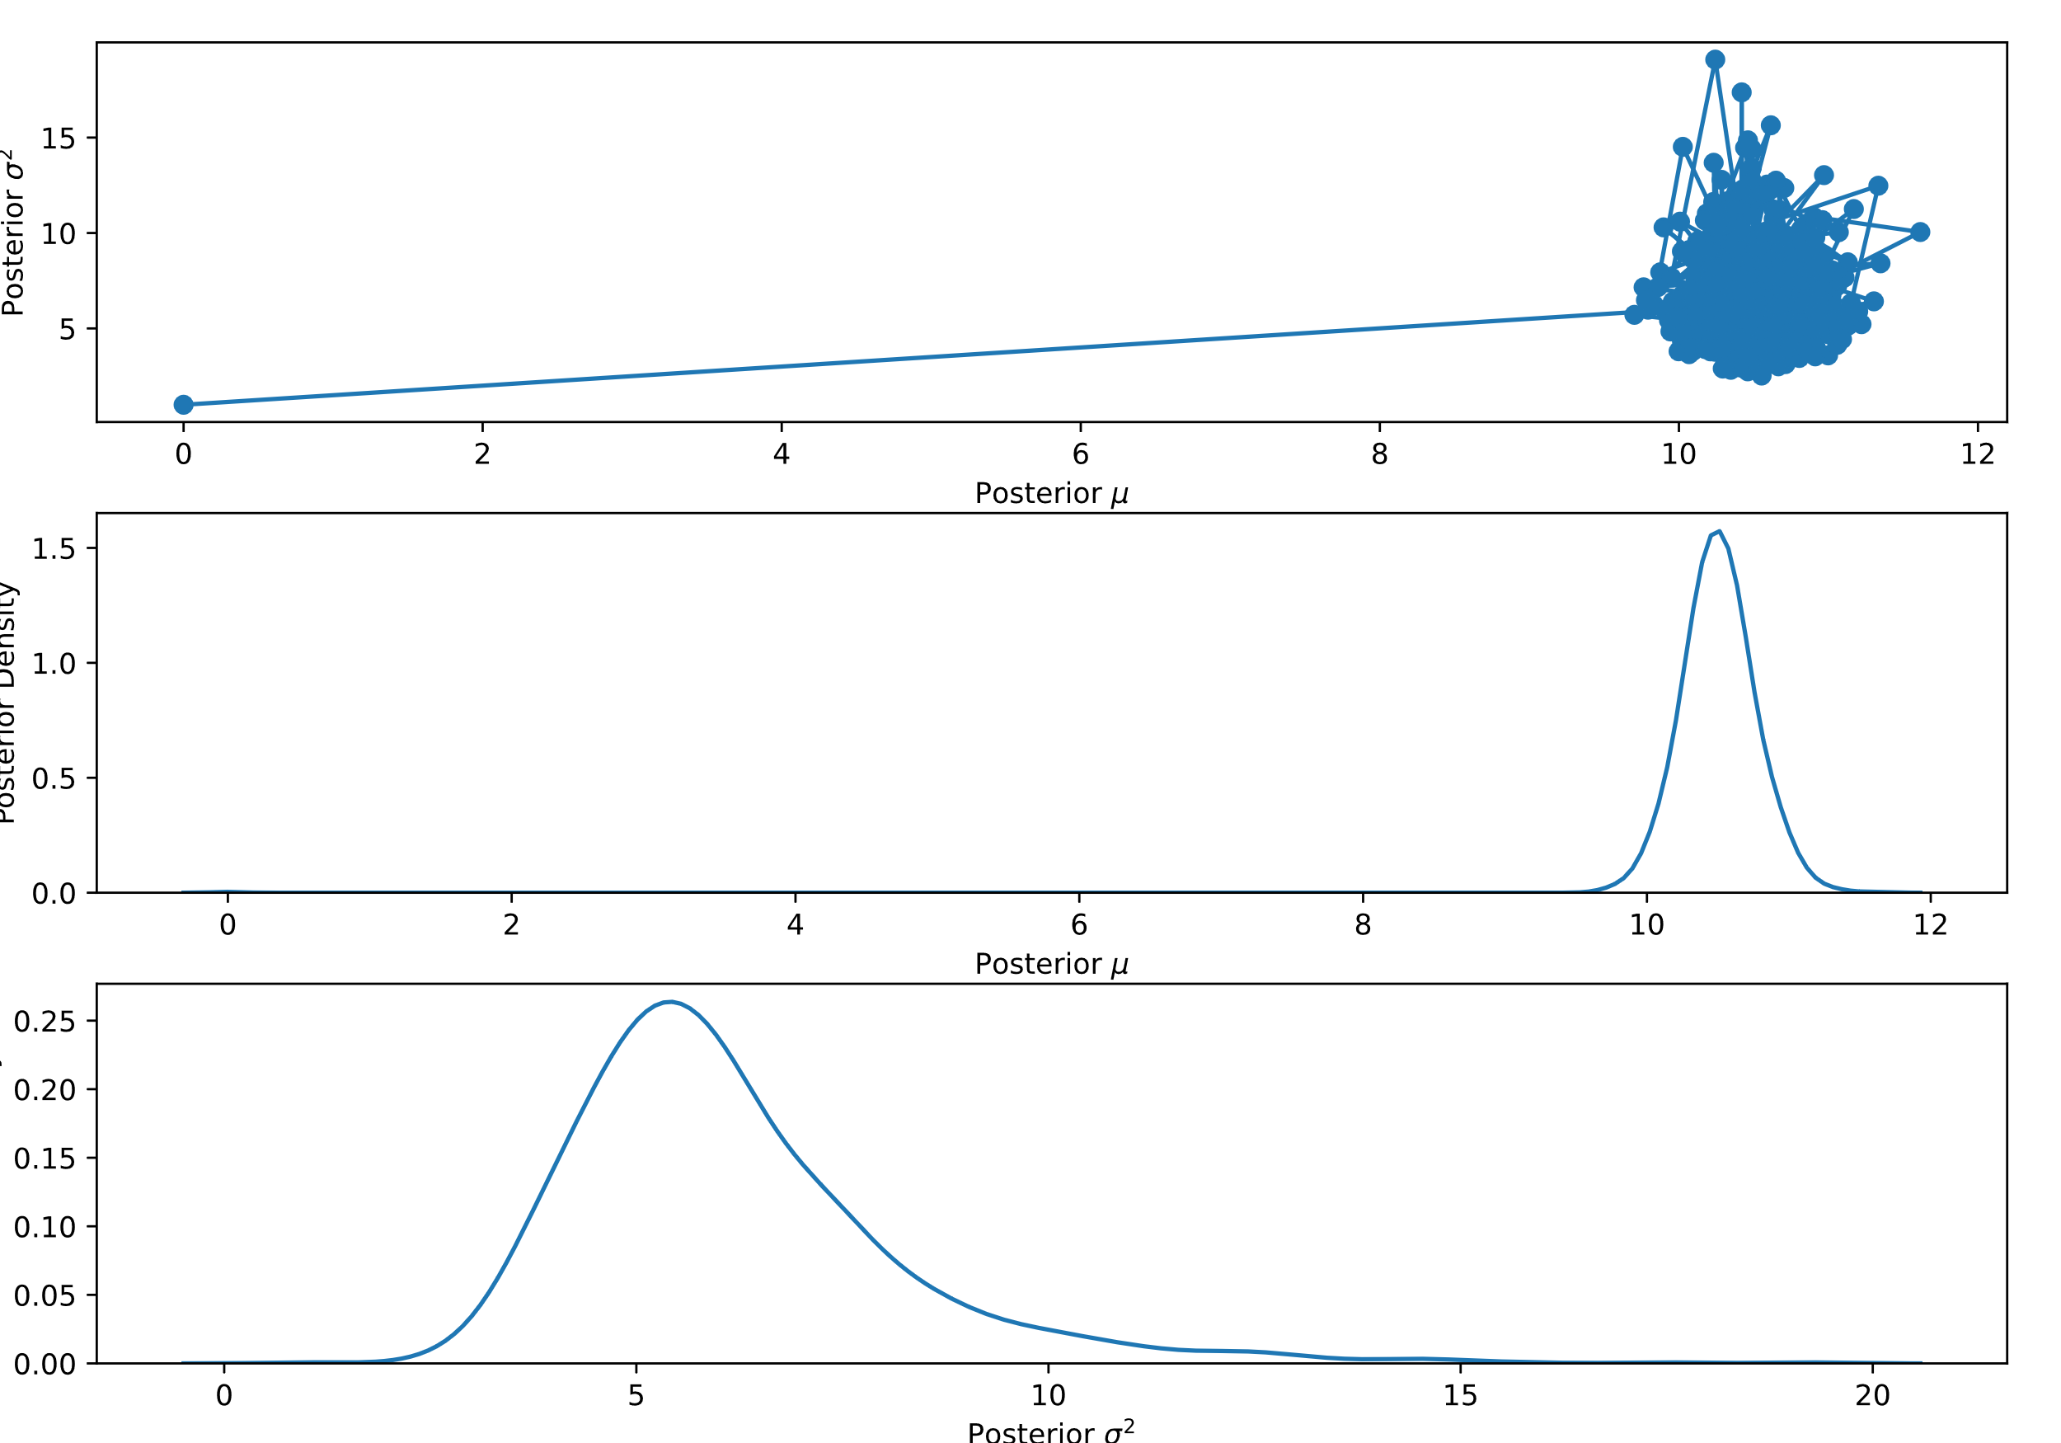
The Gibbs Sampler - Example

Slide 9
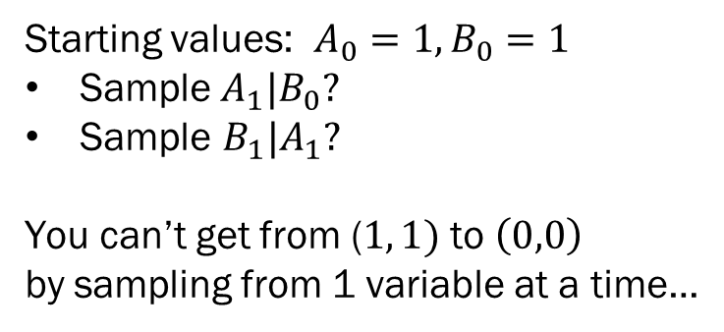
The Gibbs Sampler
Gibbs Sampling simplifies estimation by only requiring that the conditional densities are known distributions
  i.e. we can sample directly from them…
Probability Matrix for a 2 Dimensional State Variable
 | A = 1 | A = 0
B = 1 | .5 | 0
B = 0 | 0 | .5

Slide 10
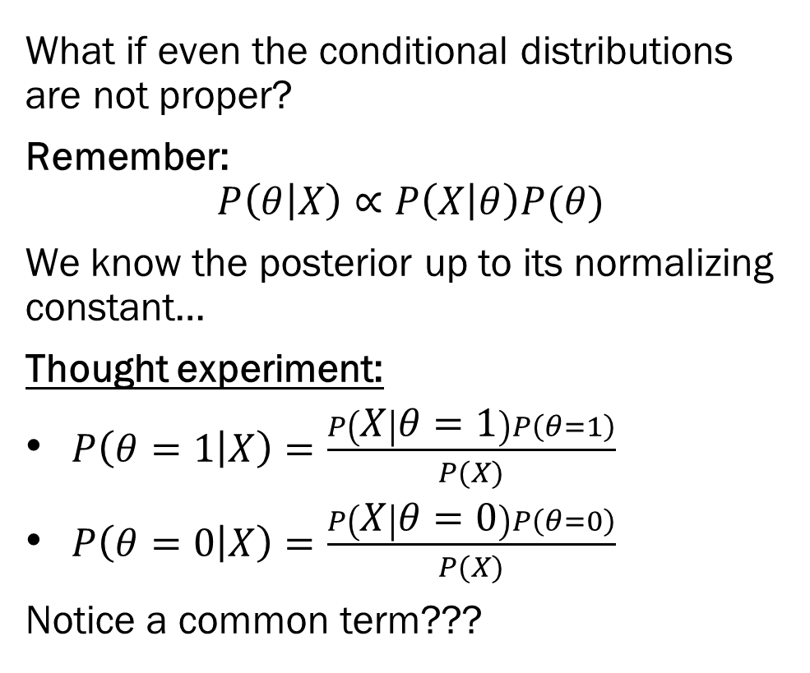
Into the Unknown

Slide 11
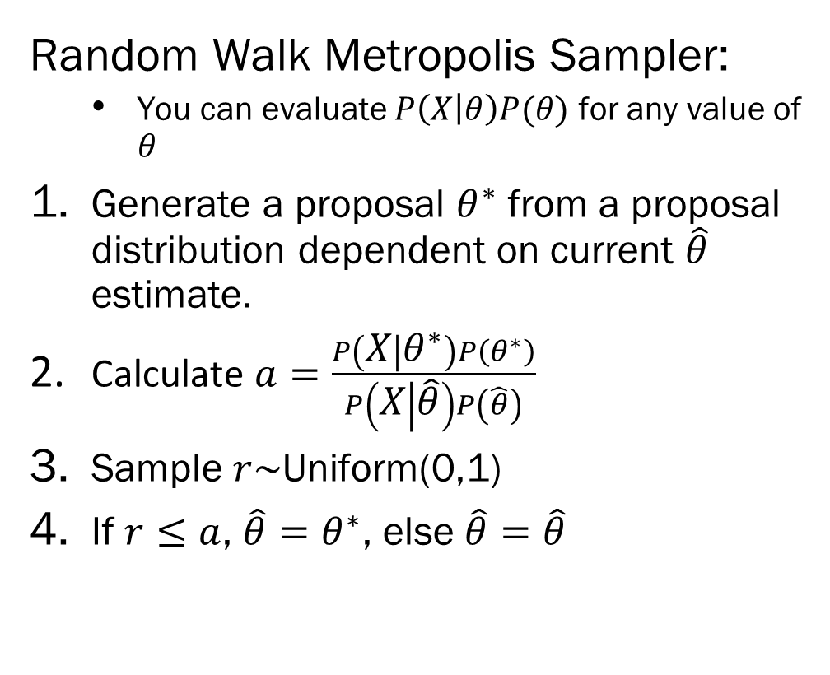
Random Walk Metropolis

Slide 12
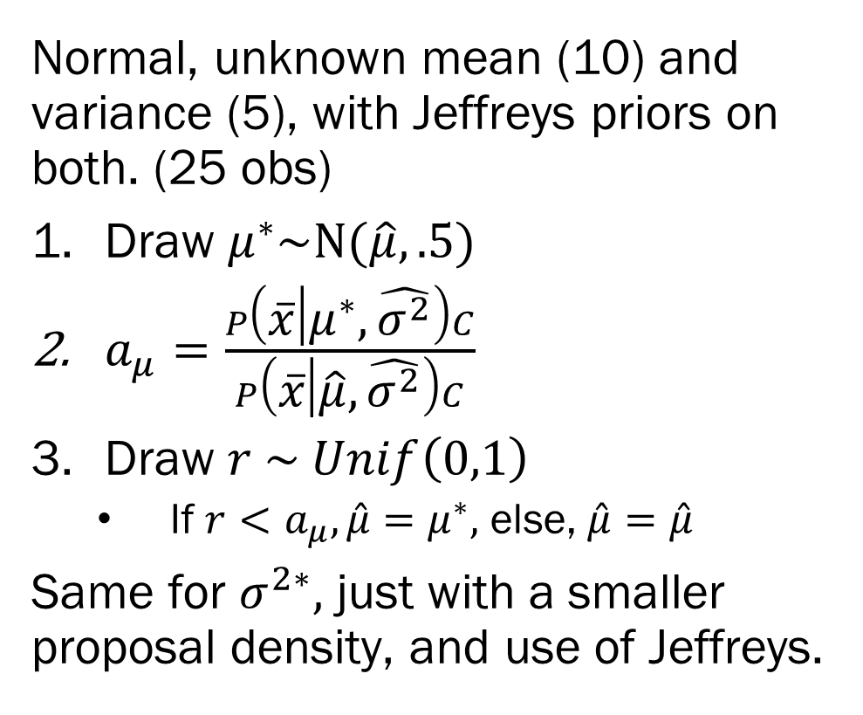
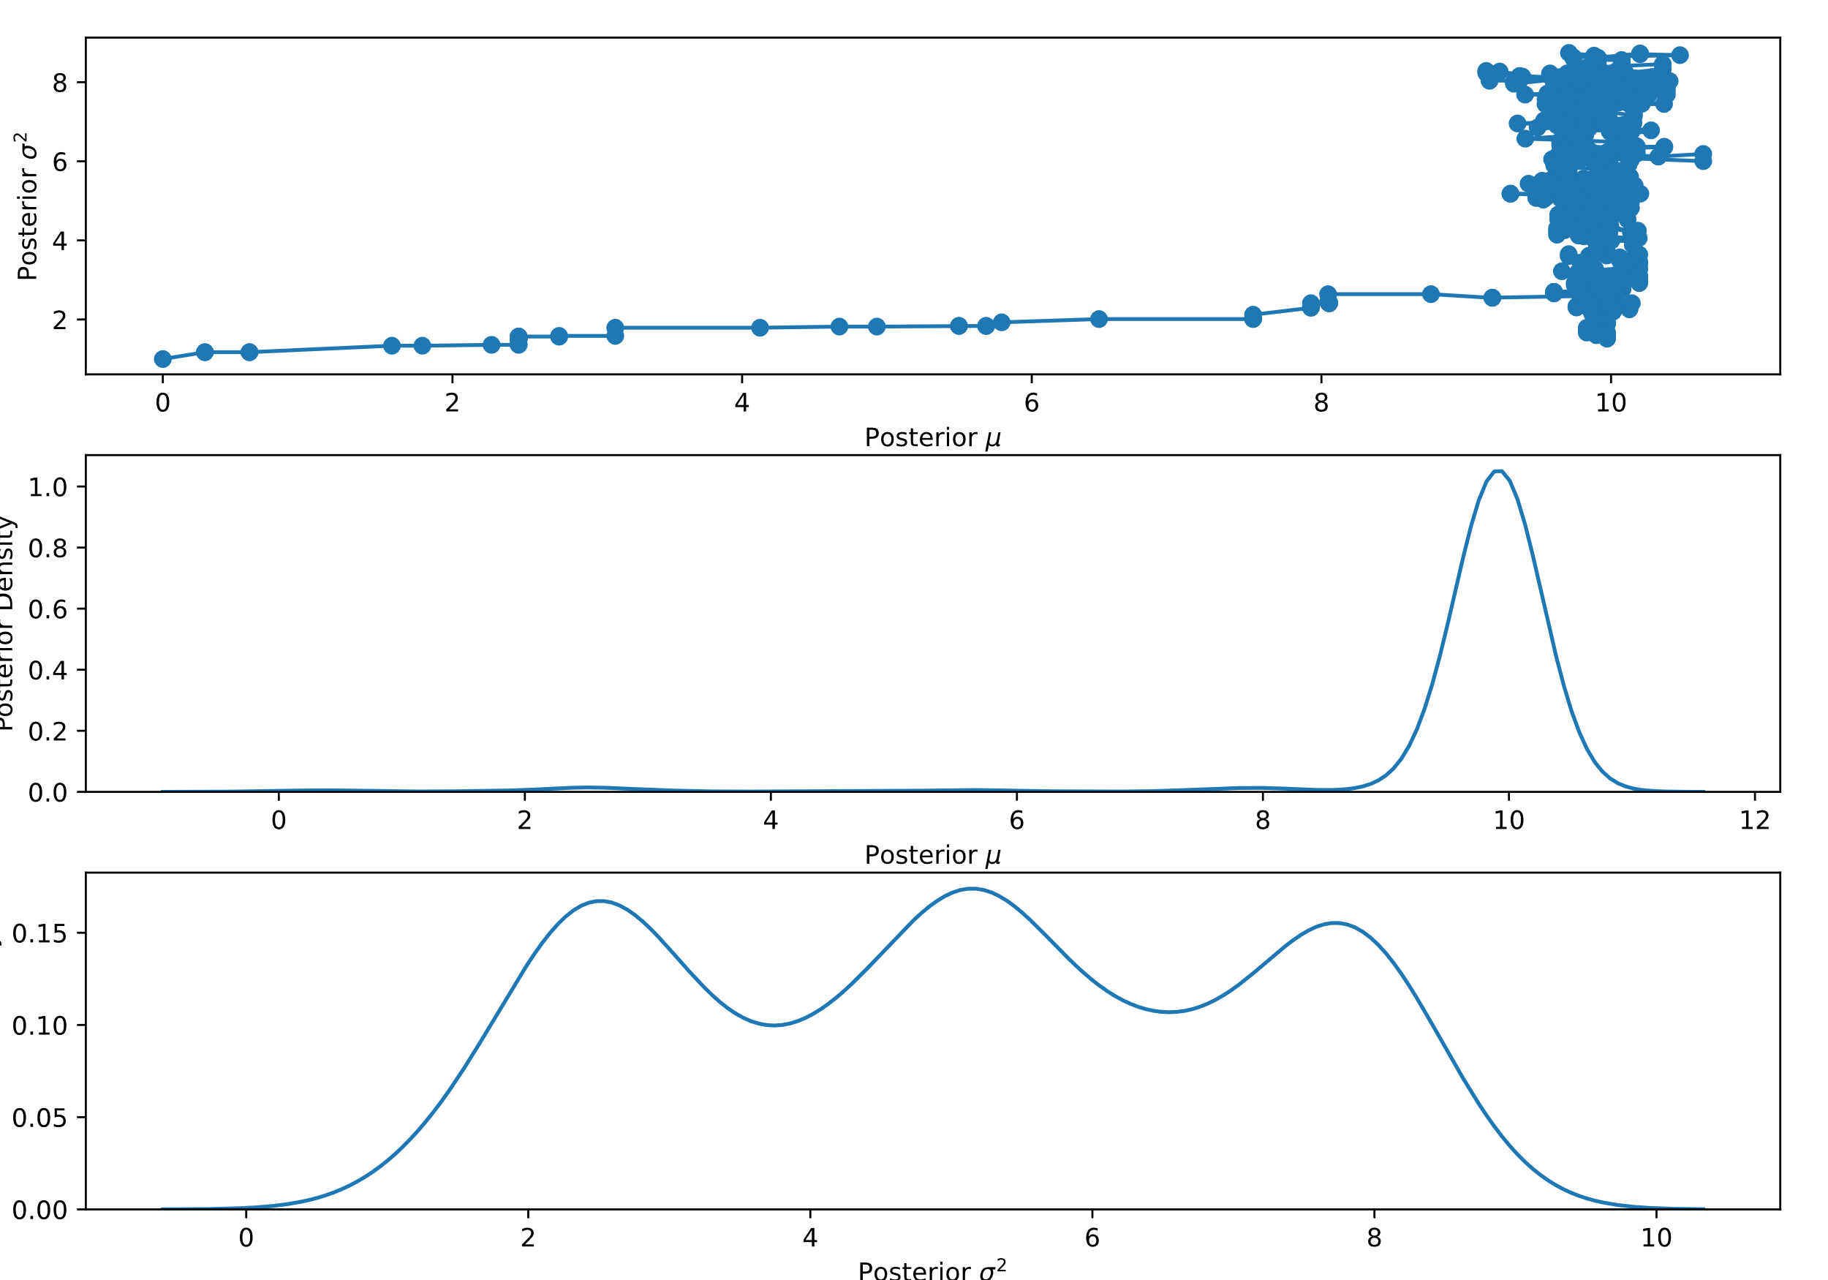
Metropolis Sampler - Example

Slide 13
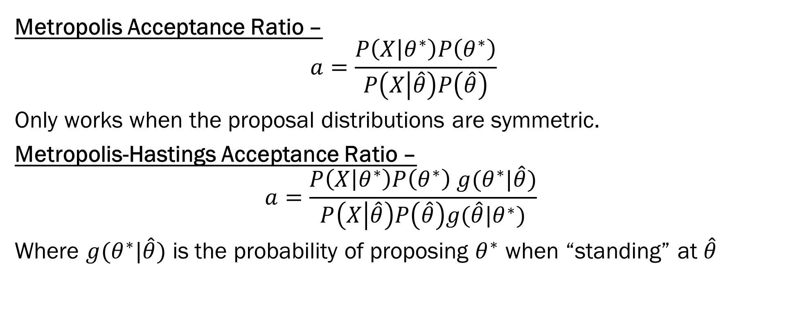
A General MH Sampler

Slide 14
Metropolis-Hastings vs. Gibbs
  Gibbs doesn’t need to be “tuned”...just derived
  Gibbs isn’t always available, but Metropolis-Hastings (almost always) is
  Gibbs doesn’t work well for correlated parameters (can’t move “diagonally” well)
  MH: how big of a jump do you propose? Too small and too big lead to correlated samples.

Slide 15
MH Sampler – Considerations
“Random walk” Metropolis/Metropolis-Hastings is sometimes difficult to tune. https://chi-feng.github.io/mcmc-demo/
Issues:
What your proposal density is matters a lot
  You don’t want to reject huge leaps, and you don’t want to crawl slowly
  aim for 22% acceptance rate
  there exist rules of thumb for proposal’s covariance matrix
Wait for the sampler to explore the whole parameter space
  You have to first reach the posterior, then you have to sample from it (burn-in?)
  if multimodal

Slide 16
Metropolis-Within-Gibbs
You don’t need to sample your whole joint posterior in one shot
Guideline: It tends to be easier to sample from smaller dimensional, conditional distributions, than it is to sample from high dimensional distributions
So, you don’t have nicely behaved conditionals (so no Gibbs) but you have many many parameters (so no one shot Metropolis-Hastings.).
Metropolis-in-Gibbs – Use Metropolis/Metropolis-Hastings to update each parameter conditional on the previous value of all other parameters.
  Instead of sampling directly from nicely behaved conditionals…

Slide 17

Hamiltonian (aka Hybrid) MC
Big issue: In high dimensions, most random walk proposals are in the “wrong” direction.
HMC –
  Uses gradient information about the target posterior (a topological map)
  Models our parameter estimates as “physical” particles moving along the posterior landscape
    Give our guesses momentum so they keep going in the same “direction”
From Fig 10 of “A Conceptual Introduction to
Hamiltonian Monte Carlo” by Michael Betancourt

Slide 18
No U-Turn Sampler – NUTS
HMC is sensitive to two tuning parameters set by the analyst
  The main one is the number of steps the “physical” simulation runs for any given update.
If tuning is set poorly, the HMC might loop back to where you started
  In essence, it was too enthusiastic following the gradients.
NUTS automatically tunes the HMC to avoid those sorts of issues.

Slide 19
Summary
Samplers attempt to sample from the posterior distribution
  Gibbs – When you have conjugate conditional distributions
  Random Walk Metropolis Hastings – For, well, almost anything
  Hamiltonian MC – A much better version of MH if you have the gradient
    For high dimensional continuous parameter sets
    Not much good for discrete parameters like mixtures (no gradient information)
  NUTS – An “auto-tuned” Hamiltonian MC method
    Integrated into PyMC3, STAN, etc.
Issues arise with samplers because of the geometry of the posterior (hills and valleys, flat plains, sharp corners all cause issues). There is no one-size-fits-all algorithm.
visualizations: https://chi-feng.github.io/mcmc-demo/

Slide 20
Next Week – Characterization and Computation
Diagnosing your Sampler –
  Multiple sampling chains
  Convergence/divergence statistics
  Eyeballing your traceplots
What’s the deal with categorical variables?
  Handling combinatorics
  Mixture models and label switching
Next, Next Week –
  Putting it all together with a Bayesian Logistic Regression…
HW3 will involve samplers!

