Slide 1

Estimation Part II:
Samplers Strike Back
Module 6 Live Session (6/29/2022)
DS6040 Summer 2022
Taylor Brown

Slide 2

Course Updates
Halfway through the course!
Check Gradescope for HW2 due dates
Keep working on the Projects
  I’m available for questions/concerns!
HW3 is out now!

Slide 3
Outline
Sampler Review
What could Possibly Go Wrong? (With Samplers)
What a Sampler Should Do
Eyeballing Your Sampler
Formal Diagnostics
Sampling Categorical Variables

Slide 4
Sampler Review
The basic ideas behind samplers are:
  Sample from the posterior’s high probability region
If all goes well, your set of samples can be used to characterize your posterior distribution.

Slide 5
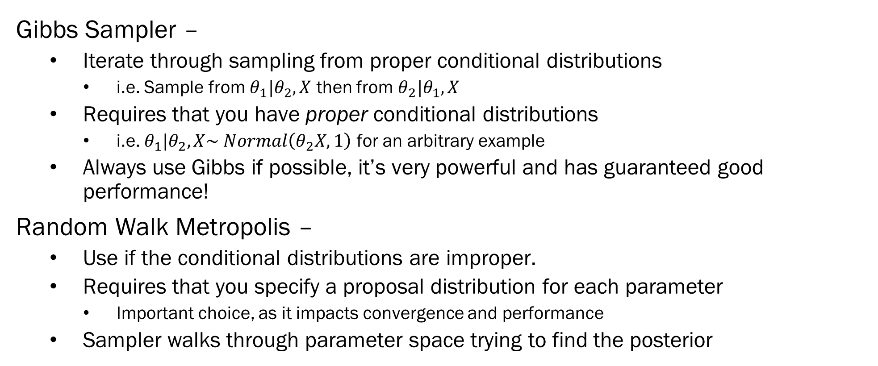
Sampler Review – Types of Samplers

Slide 6
Sampler Review – Types of Samplers
Random Walk Metropolis-Hastings –
  Slight modification to the acceptance ratio step of the Metropolis sampler to account for asymmetric proposal distributions
    Symmetry here refers to the probability of proposing values, not necessarily what the proposal distribution looks like.
Hamiltonian MC –
  (Usually) a more efficient version of Metropolis-Hastings
  Uses gradient information
  Very powerful for use in high dimensional problems
    Not appropriate for use on categorical variables
No U-Turn Sampler -
  Fixes issues in Hamiltonian MC

Slide 7
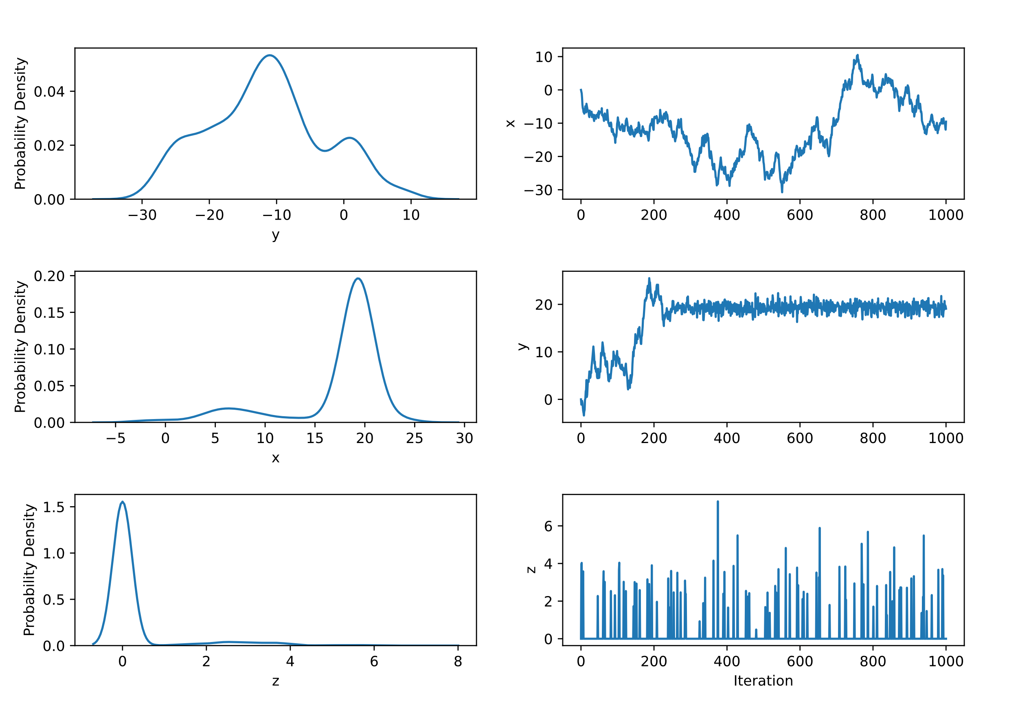
What MCMC Samplers Should Do
If everything goes right, samplers should converge to the posterior quickly and stay there forever.
Well-constructed samplers are ergodic
  They tend to find the posterior.
You can have an appropriate model, and still have sampler issues

Slide 8
What Goes Wrong with MCMC Samplers
Samplers are highly sensitive to the topology and geometry of the parameter space.
  They can get lost in valleys
  They can drop down holes
  They might not climb massive cliffs
If the space is nice, the sampler is ergodic, in that it will nicely ramble all around the space.
Like data itself, samplers can and will lie to you..
  The results you get can look completely reasonable, and be completely incorrect

Slide 9
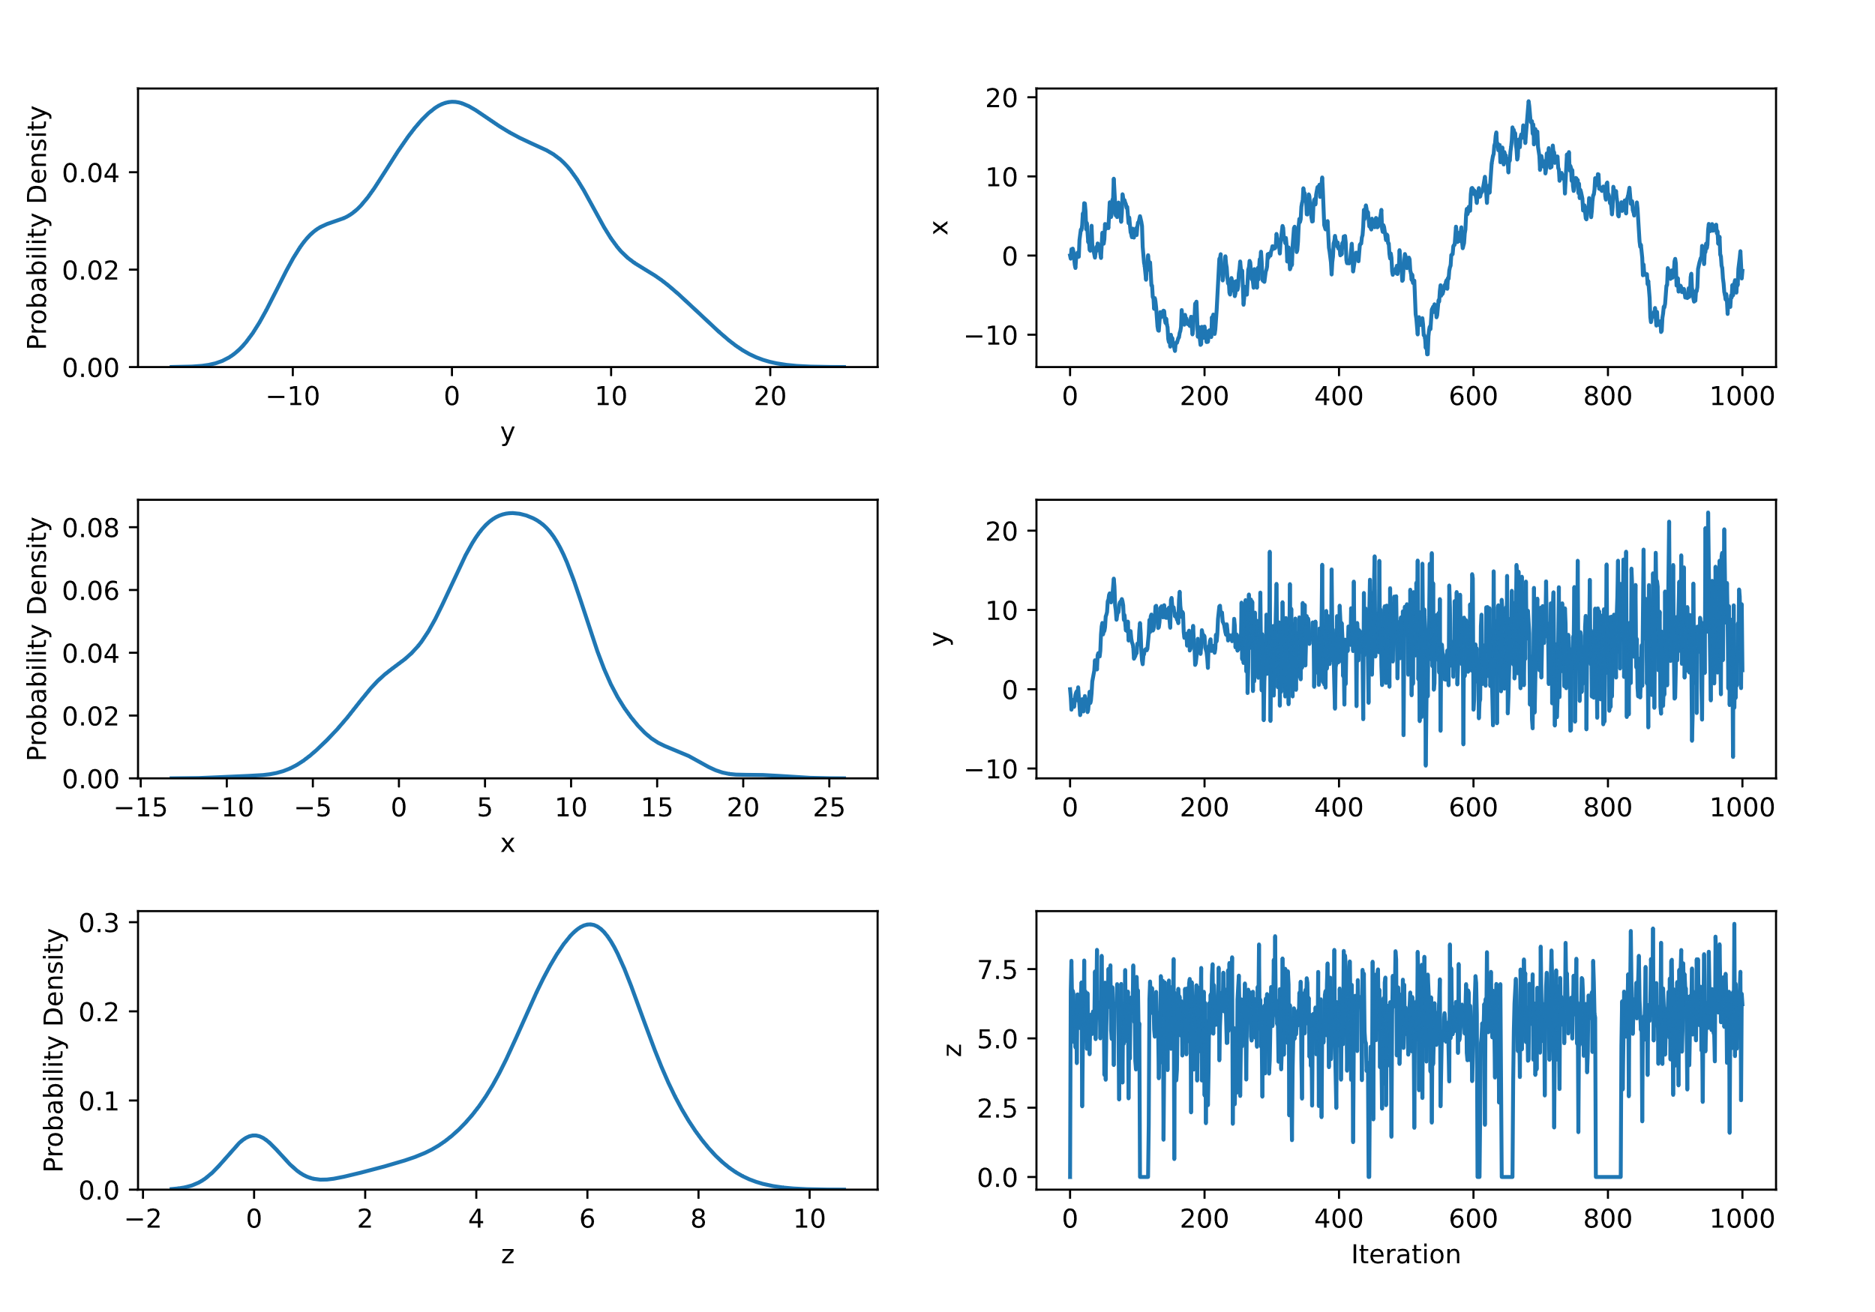
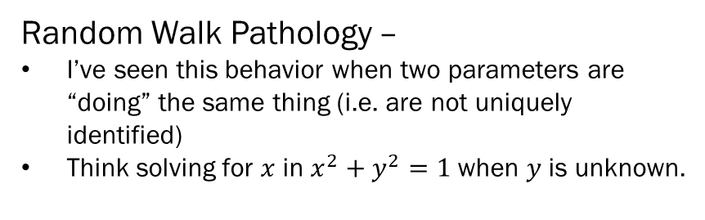
Sampler Pathologies – An Informal Guide
Funnel Pathology –
The walk’s variance is increasing (or changing more broadly)
Usually something do to with bad identification in other parts of the model.
Switching Pathology –
Usually a PEBCAK, you probably misspecified a mixture somewhere
e.g. the marginal mean of a mixture

Slide 10
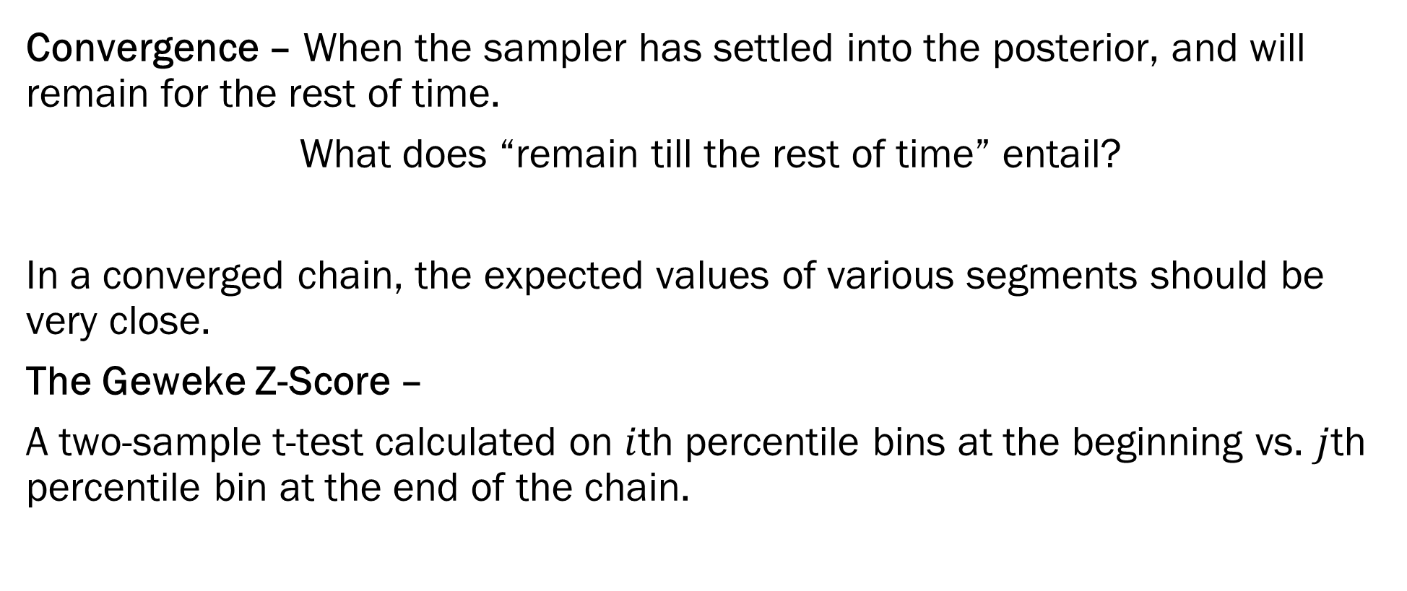
Geweke’s Z-score Diagnostic

Slide 11
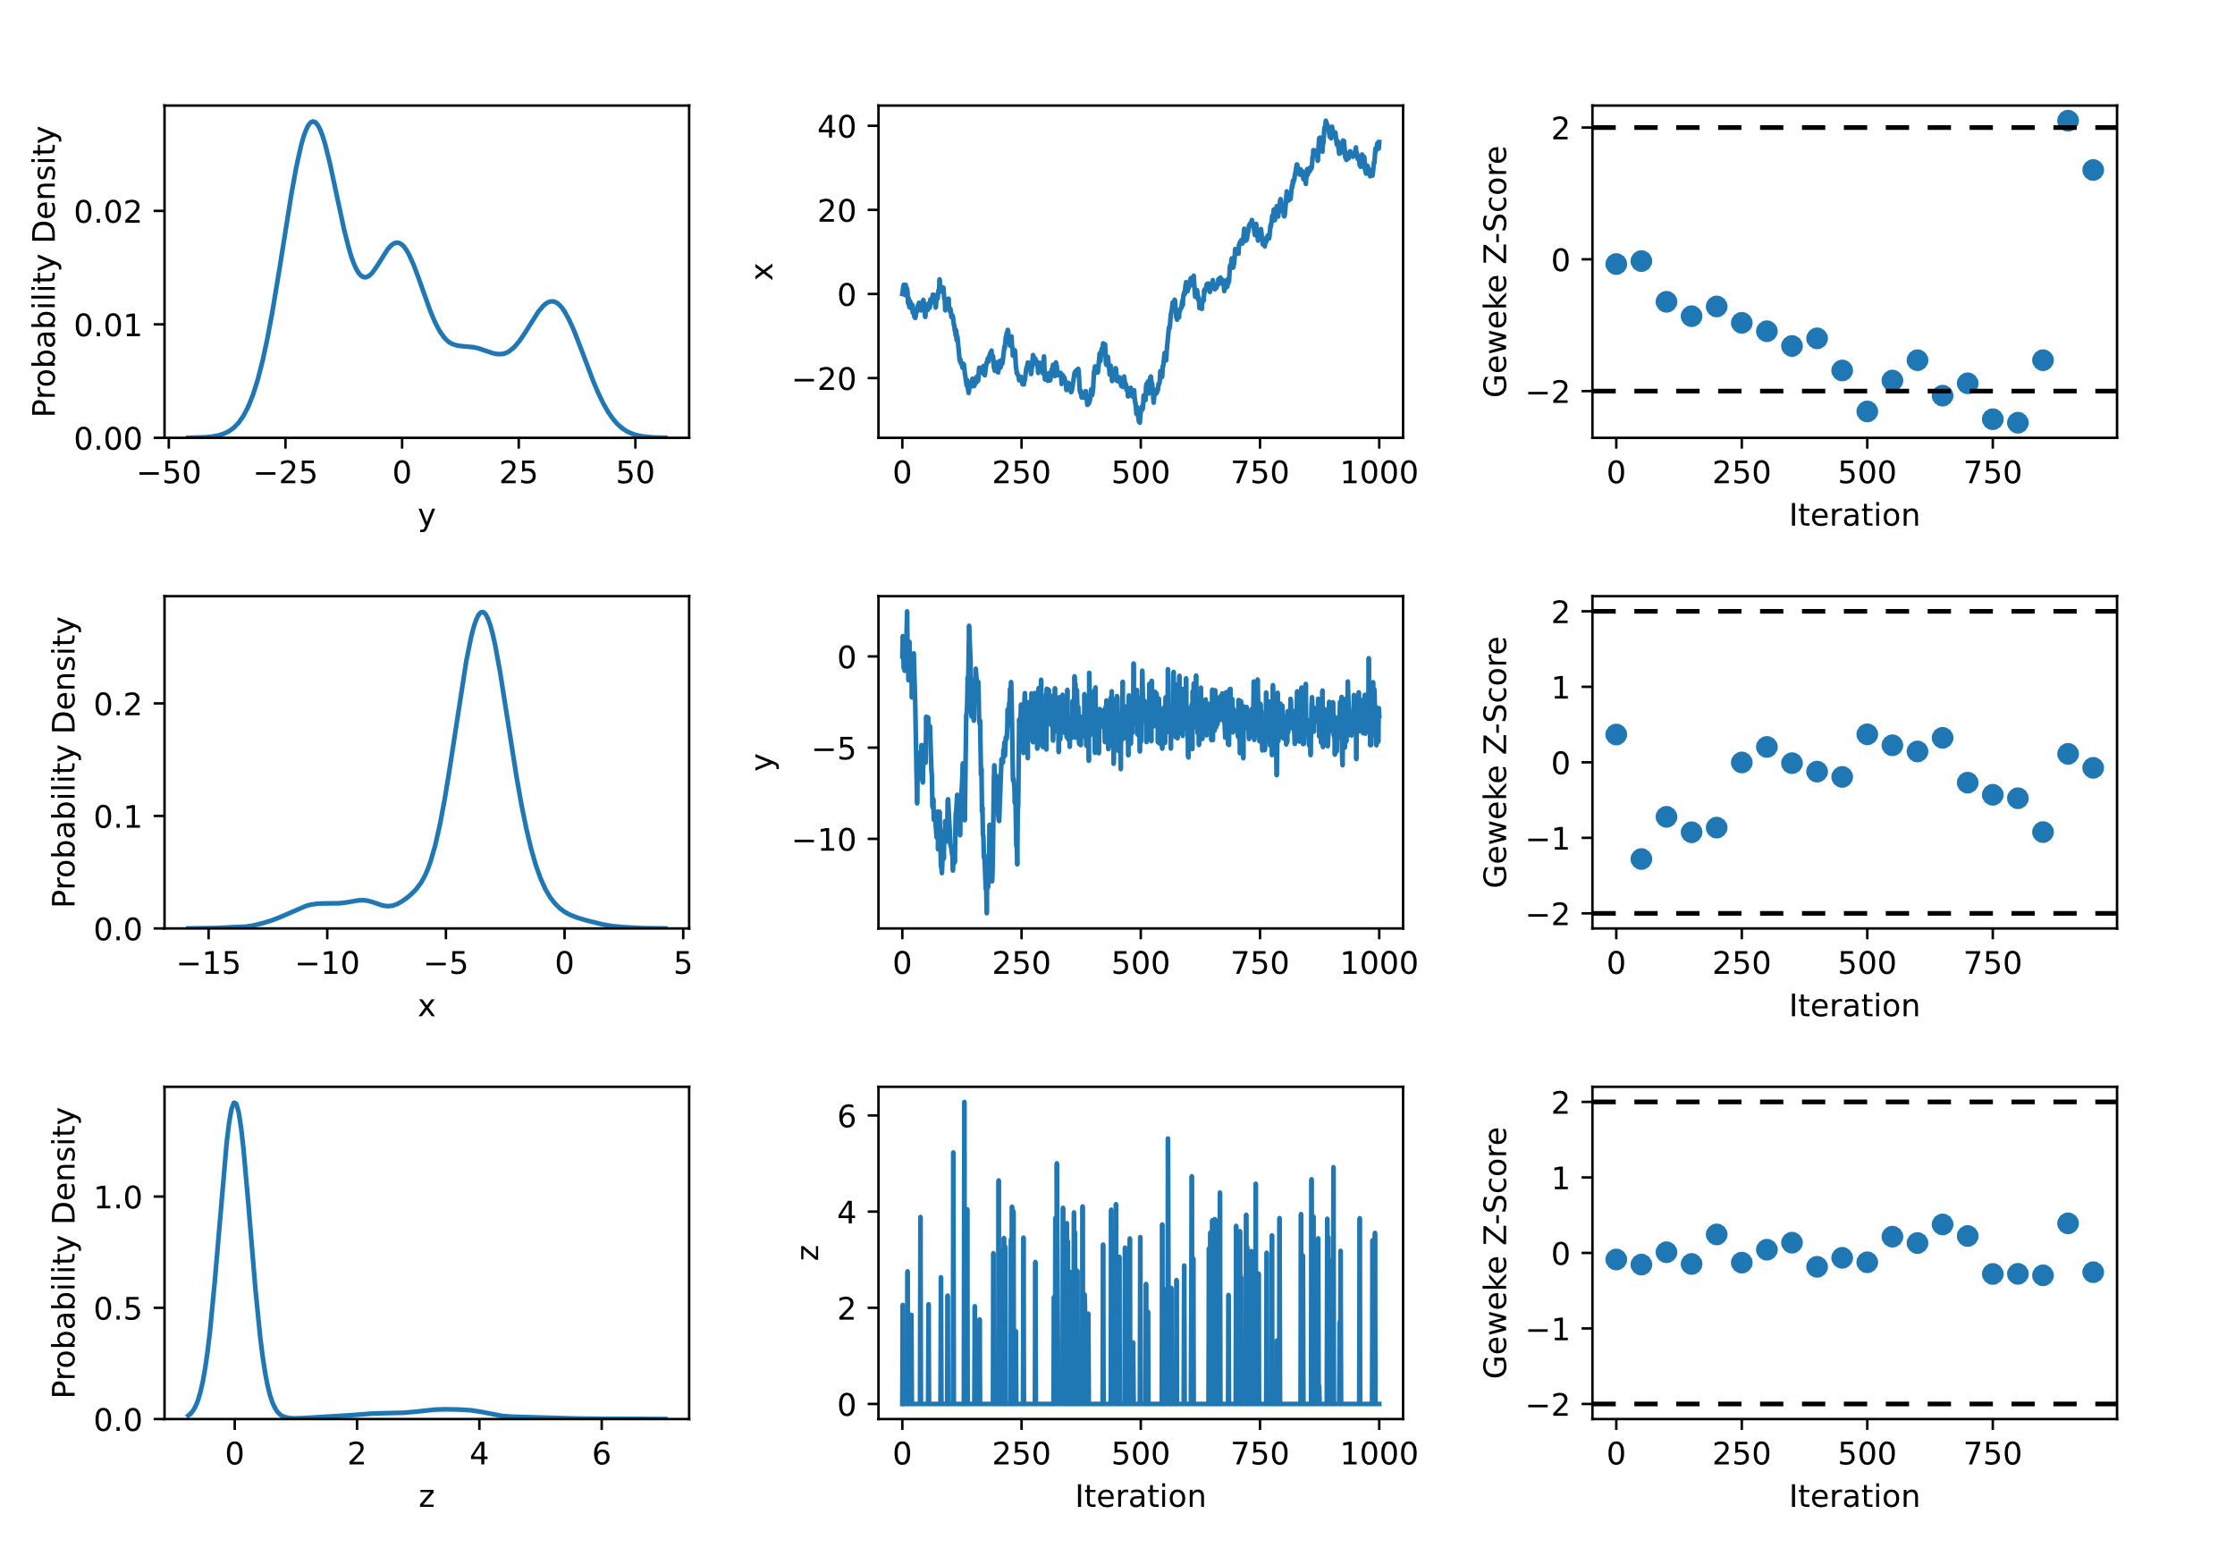
Geweke’s Z-score Diagnostic
Top Panel – Yes, bad convergence.
Mid Panel – Not an issue
Last Panel – No evidence, but bad chain.

Slide 12
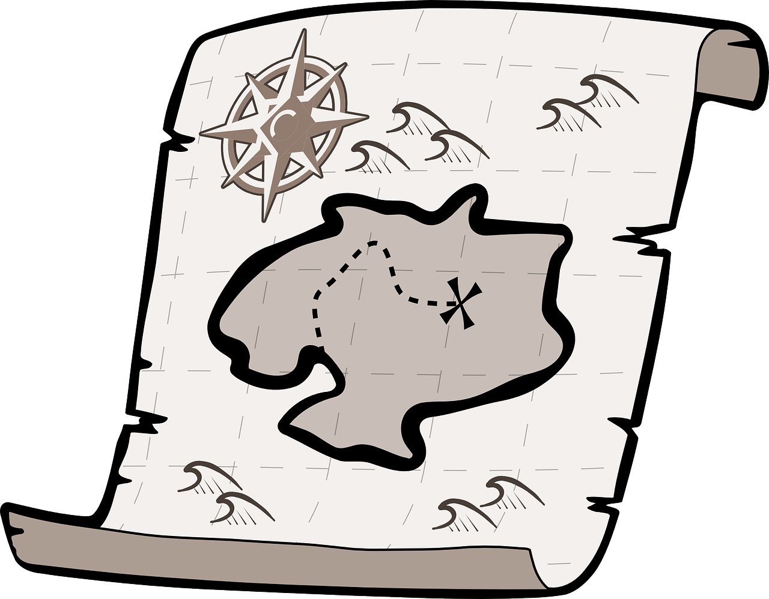
Sampler Diagnostics – An Informal Guide
Q: If you are digging for buried treasure, what’s better?
  Sending out 1 digger with a month’s supply of food?
  Sending out 30 diggers with a day’s supply of food?
Our sampler is in the space, and our goal is to map it. One powerful method is simply to have multiple chains going from different starting points.

Slide 13
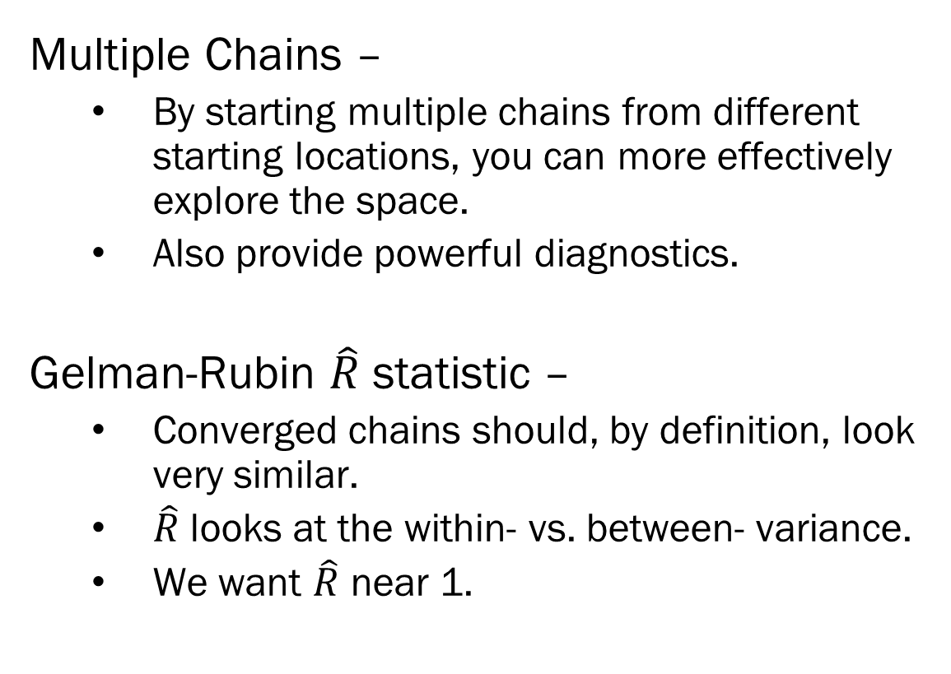
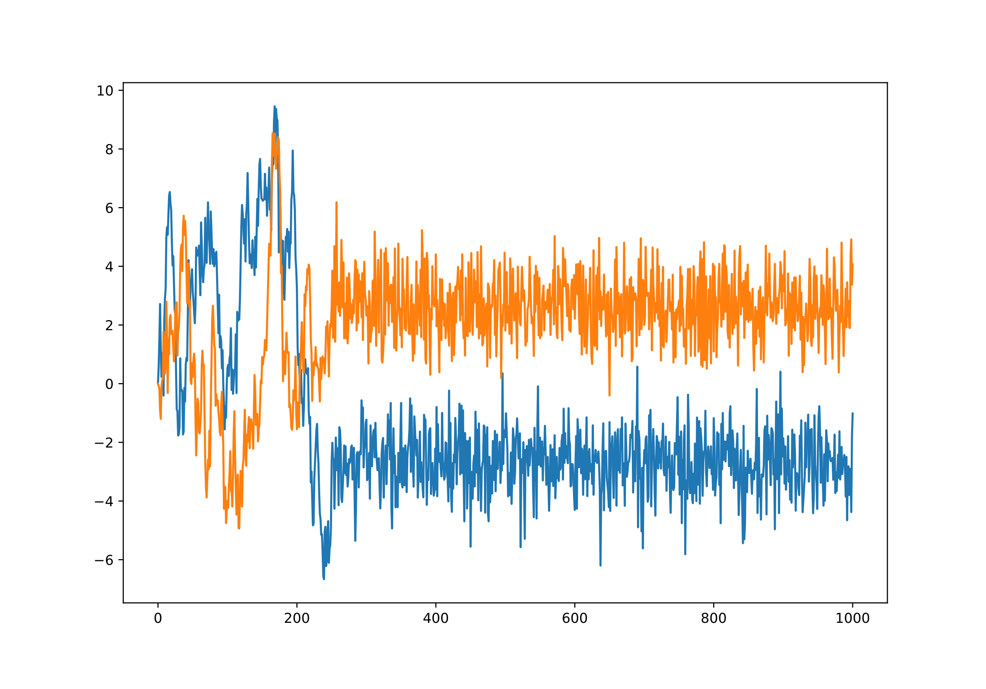
Sampler Diagnostics – An Informal Guide

Slide 14
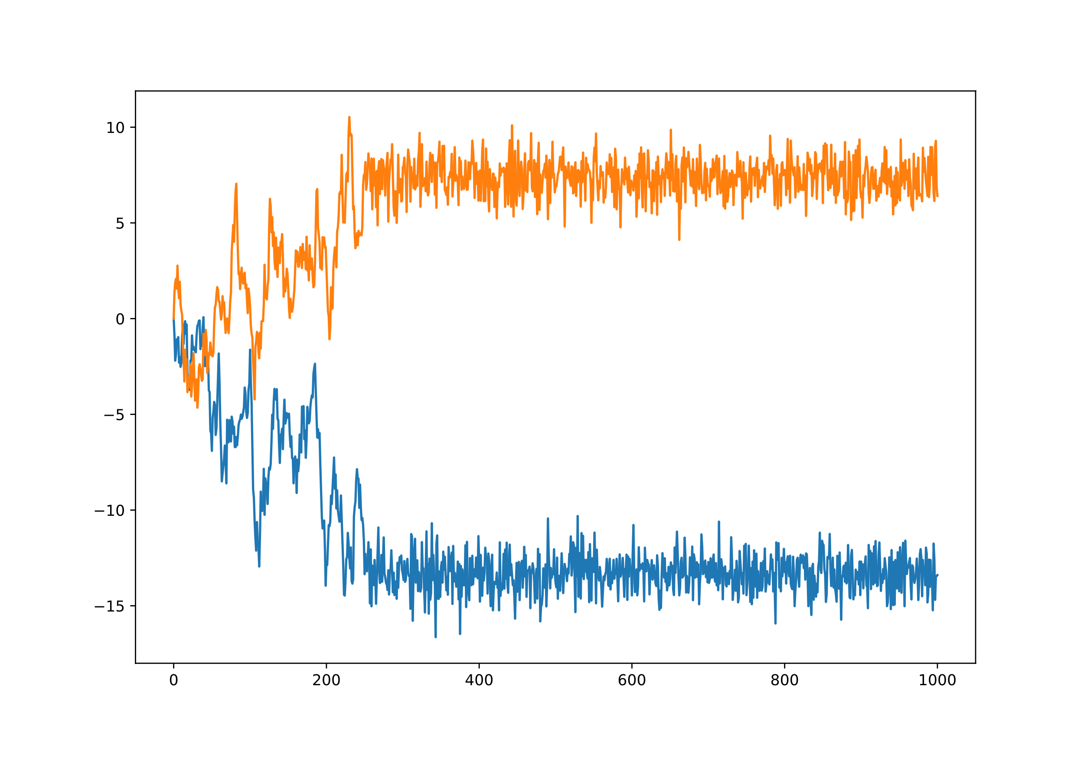
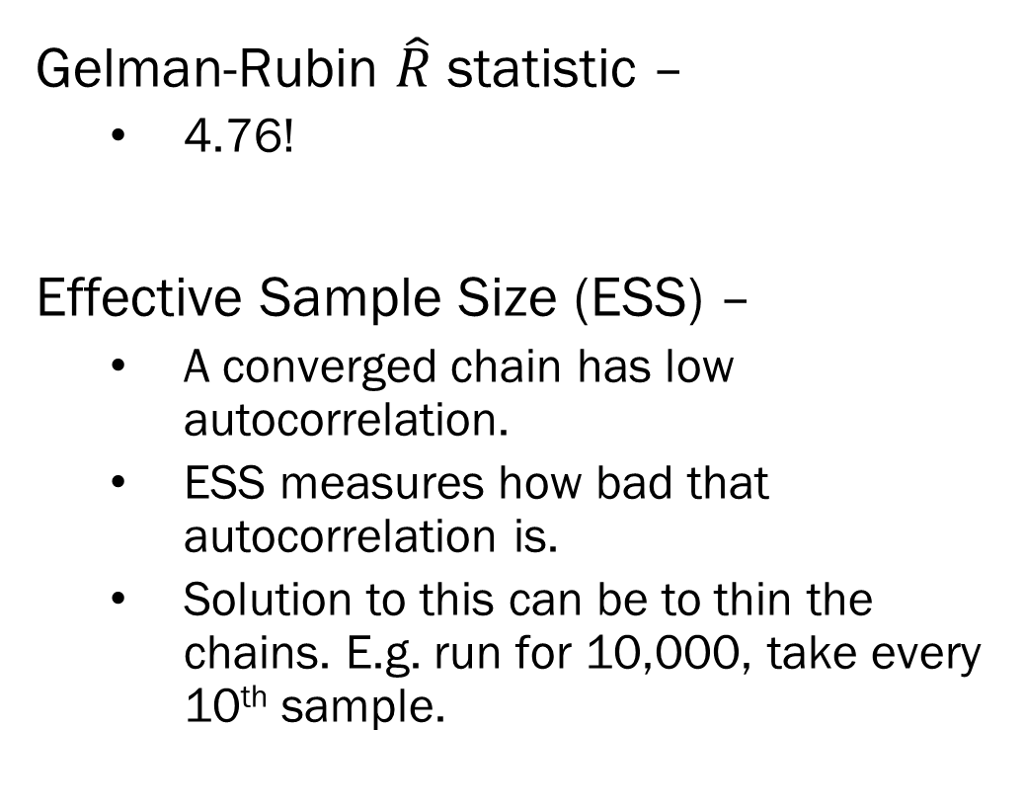
Sampler Diagnostics – An Informal Guide

Slide 15
NUTS Diagnostics– An Informal Guide
Recall that the NUTS sampler is using a “physical” simulation to, in essence, rollerblade around the space more effectively.
Divergence – When the sampler jumps too far from the target set.
  Indicates that the space has some pathological curvature.
  Possibly fixed by model reparameterization.

Slide 16
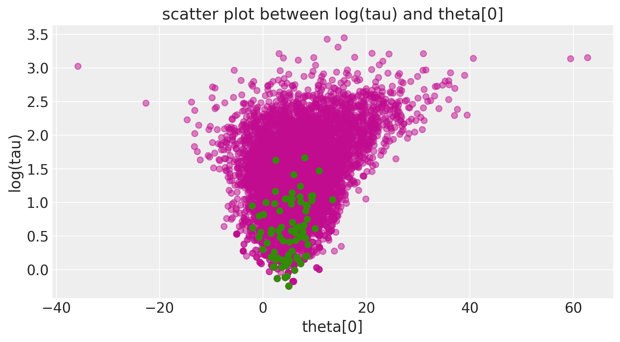
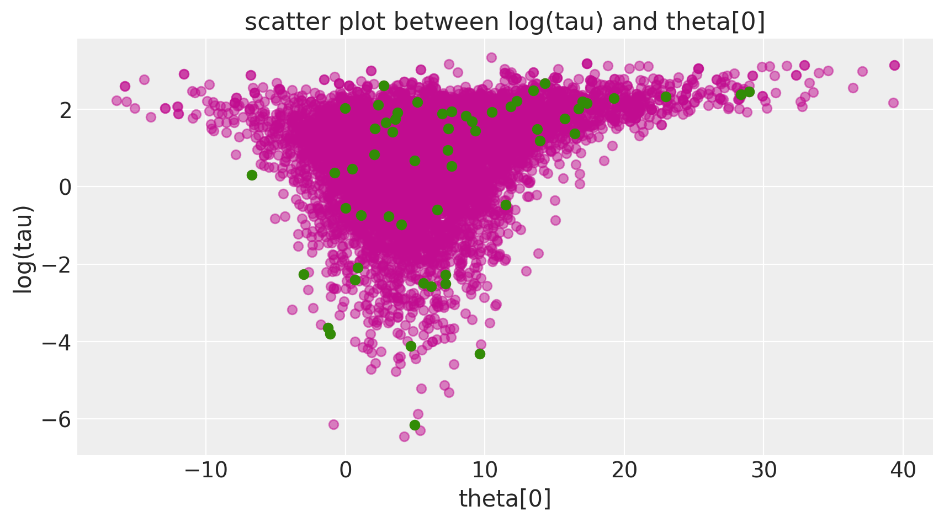
NUTS Diagnostics– An Informal Guide
Divergences indication where in the parameter space there might be problems.
  Clustered divergences are indicators!
But divergences can happen because the step size is too large.
  Then the divergences are more uniformly distributed.
Guideline: More divergences, more issues.
https://docs.pymc.io/en/v3/pymc-examples/examples/diagnostics_and_criticism/Diagnosing_biased_Inference_with_Divergences.html

Slide 17
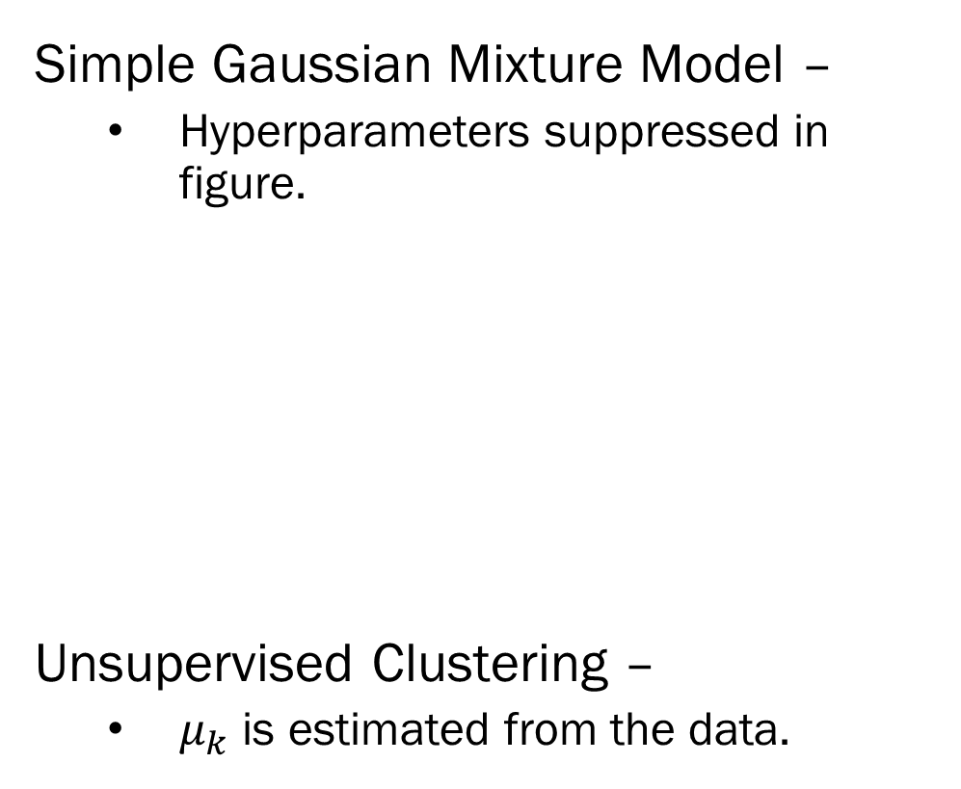

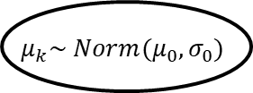



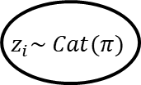
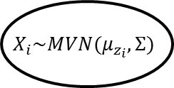



Sampling Categorical Variables
Consider a mixture model of 2 groups
  A and B, each having different means.
When you build your sampler, you create a variable z_i, which takes on values A and B.
Question: are there multiple parameter sets that produce the same likelihood?

Slide 18
Label Switching
Label switching – When the meaning of category (i.e. discrete classes) differs between AND WITHIN sampling runs/chains.
Why? – Reordered parameter/weight pairs produce same likelihood
  The definition of each cluster depends its parameters
  In one chain, True Group A could be labeled as Group 1, in another chain, Group 2.
  If the clusters are not well defined, then this switch can happen mid sample.
Problems – Can’t run label specific between chain diagnostics.

Slide 19
Combinatorics and Networks
Clustering –
  When categorical variables where the meaning of the categorical variable depends on the values across the entire sample (i.e. clustering), think carefully about how you update your cluster labels, and definitions of the clusters themselves.
Parametric Modeling –
  Consider estimating multiple categorical variables within an observation…
    It pains me to my core, but I’ll use the Myers-Briggs personality “test” as an example.
  If the meaning of the combination is highly specific to the exact combination, then each combination needs to be evaluated.
  Assumptions help:
    For example, define the combination of categories as an additive sum, e.g. mental health diagnoses.
Fairly niche topic yes, but when it comes up, it comes up bad…

Slide 20
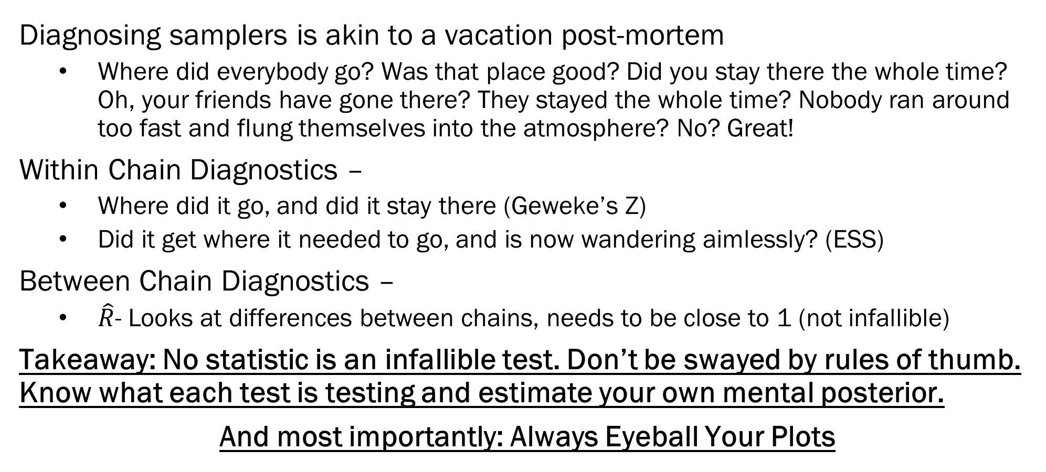
Summary

Slide 21
Next Time: Wrapping Up Samplers
Hierarchical Bayesian Models
  Nested Data – It’s everywhere. And not accounting for it is not an option.
    Sales within person
    Students in schools
    Time within patient within doctor crossed with hospital within state within country.
    Document within action with agent within country within region (for you GDELT fans)
  Bayes really shines with nested data.
Bayesian Model Averaging
  The Bayesian Ensemble Method
  Focus on computability, not complexity
HW4 will be on both of these.

