Slide 1
Project 3 Final
AI Boot Camp Project 3
Team Members:
Thomas Brown
Chris Covill
Ava Lee
Jed Murphy

Slide 2
Project Overview
Project Purpose / Description
Analyze a problem using machine learning (ML) or neural network:
We chose to analyze Colorado Traffic Data from Kaggle using
a neural network.

Slide 3
Project Goals
Goal/Questions to be addressed
Goals:
o Determine the best model to analyze all 90,885 Colorado crashes that were collected from February 2016 to March 2023.
o Analyze all Colorado traffic crash data, and record accuracy calculations for Weather, County and Street.
o Identify the different classifications of crashes and potential impact within each classification.

Slide 4
Data Sources
Our Data Source used was “US Accidents: A Countrywide Traffic Accident Dataset”
We used Colorado Accidents only
The Data
Clean and Consistent
Contains Colorado only
Update County to numeric
Calculate P values for streets
Encode top 30 streets by accidents
Inconsistent and Duplicative
Remove duplicates from Weather Conditions

Slide 5
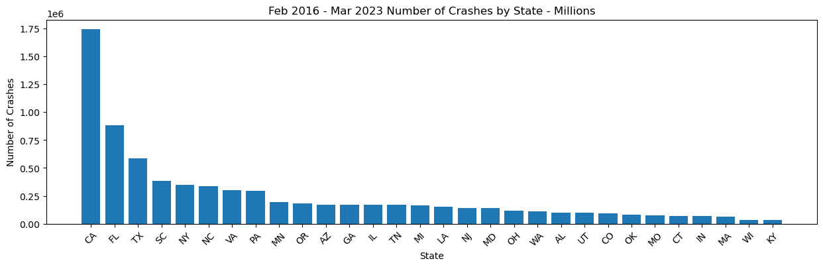
Data Sources
The Data

Slide 6
Approach taken to achieve goals
The analysis was broken into steps with a Jupiter notebook for each step:
Step1 Build base data
Step2 Analyze weather and county data
Step3 analyze street and county data
Performance was measured.
Best Model: Scikit-learn, Keras, TensorFlow
Performance:
Step 1 (noPyTorch): 1.83 seconds
Step 2 (PyTorch): 41.90 seconds
Step 2 (no PyTorch) 1 minute 51 seconds
Step 3 (PyTorch): 1 minute 14.06 seconds
Step 3 (noPyTorch): 3 minute 58 seconds
Approach
Project Milestones:
Project ideation – Complete 7/22
Data fetching – Complete 7/22
Data exploration – Complete 7/26
Data transformation – Complete 7/26
Data analysis – Complete 7/27
Testing – Complete 7/27
Creating documentation – Complete 7/29
Creating the presentation – Complete 7/30

Slide 7
Approach
Step 2: Street
Analysis
Approach taken Analyzing Weather and County Data
The weather analysis:
1. 66 weather categories were combined into 26 (top 10 are shown below)
2. FIPS county codes added.
3. The dense, keras, tensorflow model was compiled with an input and two
shared layers and two output layers.
4. Weather Accuracy: .356. County Accuracy .140
Weather Category | Crashes
Fair | 32024
Mostly Cloudy | 16447
Partly Cloudy | 13865
Cloudy | 12382
Light Snow | 6424
Snow | 1145
Fair _ Windy | 1064
Light Rain | 1024
Fog | 748
Mostly Cloudy _ Windy | 574
Total | 85697

Slide 8
Approach
Step3: Street
Analysis
Approach taken Analyzing Street and County Data
The street analysis was broken into several iterations:
1 Group streets by # accidents to identify top 30 streets
2 Model top 30 streets with county data (x=severity; y=street, y=county)
3 Obtain p-values for top 30 streets
4 Identified 13 streets with p-value <.05
5 Put each of the 13 streets through our model individually
The following slides depict this effort and outcome…..

Slide 9
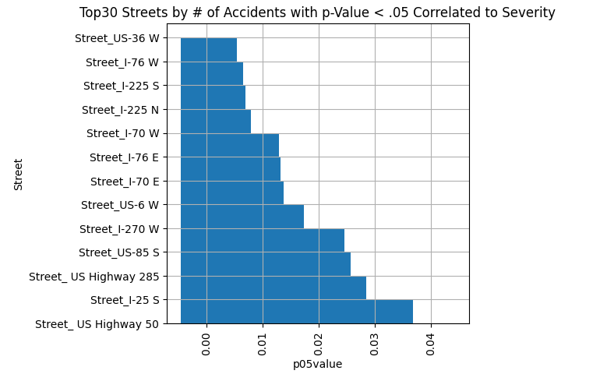
Approach
Step3: Street
Analysis
Approach taken Analyzing Street and County Data
o Model top 30 streets with county data – produced low accuracy
Street Accuracy on top30: 0.11454081535339355
County Accuracy: 0.059863947331905365
o Identified 13 streets with p-value <.05 from top 30 streets

Slide 10
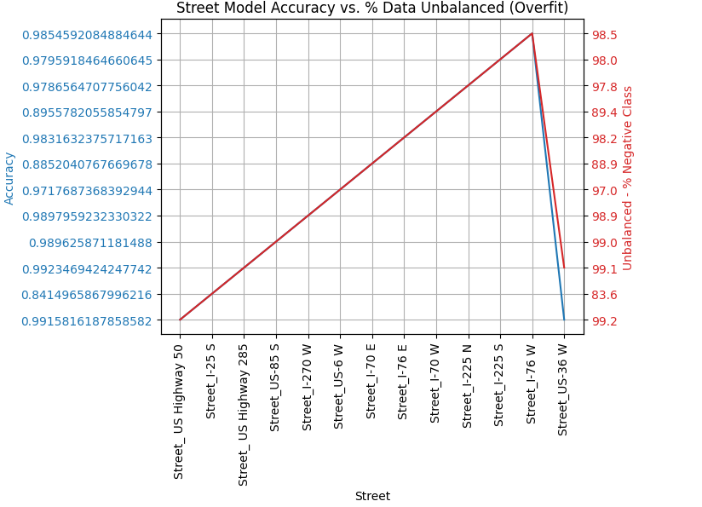
Approach
Step3: Street
Analysis
Approach taken Analyzing Street and County Data
Model each of the 13 streets through our model individually

Slide 11
PyTorch Setup:
You must use one additional library or technology NOT covered in class. We chose Windows 11 PyTorch running in Visual Studio with the following steps:
- Install and configure PyTorch on Windows 11 (follow instructions provided by PyTorch).
- This will enable GUP use by Python.
- Update GPU in Visual Studio:
- This will enable GPU graphics use wihin Visual Studio
- Select setting from File-->Preferences-->Settings
- Search for GPU
- Set GPU Acceleration = on
- Check Custom Glyphs
- Check Enable Images
PyTorch
PyTorch Test Run produced the following results based on the following code:
#GPU
b = torch.ones(4000,4000).cuda() # Create matrix on GPU memory
start_time = timer() ➔for _ in range(1000): ➔ b += b
elapsed_time = timer() - start_time ➔print('GPU time = ',elapsed_time)
#CPU
a = torch.ones(4000,4000) # Create matrix on CPU memory
start_time = timer()➔for _ in range(1000):➔ a += a
elapsed_time = timer() - start_time
Results:
GPU time = 0.007673599990084767 seconds
CPU time = 2.526412000064738 seconds

Slide 12
Result/Conclusion
The quality the data from Kaggle was inconsistent, causing many hours of rework and modeling for accident prediction.
Predicting accidents base on Weather Conditions in our model gave us a 35% accuracy when including all Colorado Accidents.
Predicting accidents base on County in our model gave us 14% accuracy when including all Colorado Accidents.
Predicting accidents for top 30 streets by accidents, in our model, produced 11% accuracy
Predicting accidents for 13 streets out of the top 30 that had P values < .05, produced accuracy ranging from 84% to 99%. However, all 13 showed being overfit. Further analysis to reduce the majority class of negative encoding to produce improved accuracy, is required.

Slide 13
Summary and Future Considerations
Using Colorado Traffic Accident Data from Kaggle only produces mixed accuracy results.
Additional data sets could be used to give a complete picture of all traffic (accidents or not) to improve model accuracy.
The team tried many model configurations the results presented here are representative of the best models created.
May be able to leverage other data in the Accidents table (Latitude and Longitude) to help improve accuracy.

