Slide 1
Ant Brains
Project 2 Instapram
Thomas Bruestle

Slide 2
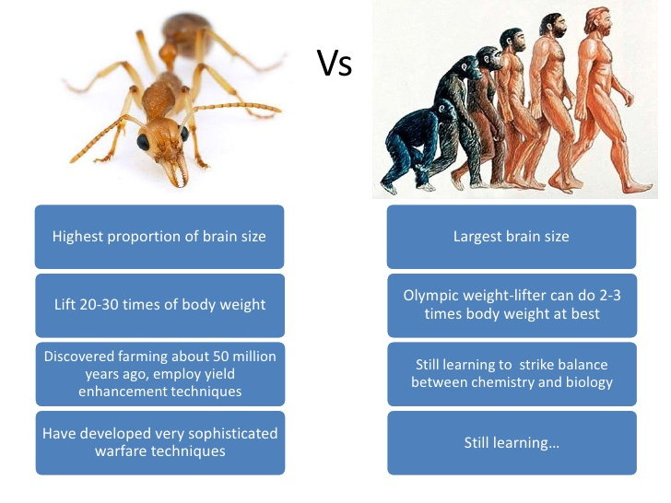
Ant Brains

Slide 3
Ant Brains
Ants have a neuron ratio of 1 neuron per 334,000 neurons in humans
Ants have a population ratio of 1.35 million ants per 1 human
Ants can act as a super-organism to find an optimal path to food
Ants use compound eyes to view motion detection and perform in the dark without large numbers of neurons or energy use.

Slide 4
References
[1] Hogenboom, Melissa. "Ants Can Navigate despite Tiny Brains." BBC Earth. BBC, 26 May 2015. Web. 21 Mar. 2016. <http://www.bbc.com/earth/story/20150526-ants-navigate-despite-tiny-brains>.
[2] Schatz, B., S. Chameron, G. Beugnon, and T. S. Collett. "The Use of Path Integration Toguide Route Learning in Ants." Nature.com. Nature Publishing Group, 24 June 1999. Web. 21 Mar. 2016. <http://www.nature.com/articles/21625.epdf>.
[3] Gronenberg, Wulfila. "Social Insects' Brains." Social Insect Lab. The University of Arizona. Web. 21 Mar. 2016. <http://eebweb.arizona.edu/faculty/dornhaus/courses/read_ECOL597S/Wulfi Soc Insect brain lecture Nov10 bw.pdf>.
[4] Gill, Victoria. "Robot Ants: Mini-machines Mimic Insect Colony." BBC News. BBC, 29 Mar. 2013. Web. 21 Mar. 2016. <http://www.bbc.com/news/21956795>.
[5] Simon. "Pheromone Trail Networks in Ants." Collective Animal Behavior RSS. Couzin Lab, 22 Sept. 2009. Web. 21 Mar. 2016. <http://icouzin.princeton.edu/pheromone-trail-networks-in-ants/>.
[6] "The Drosophila Eye - a Model to Study the Genetic and Cellular Basis of RP12 and LCA." Fruitfly Model. EU CRUMBS. Web. 21 Mar. 2016. <http://crfb.univ-mrs.fr/Crumbs/section/en/Fruitfly_model/107>.
[7] Mejia-Ortiz, Luis M., and Richard G. Hartnoll. "Modifications of Eye Structure and Integumental Pigment in Two Cave Crayfish." Research Gate. Journal of Crustacean Biology. Web. 21 Mar. 2016. <https://www.researchgate.net/publication/232694344_Modifications_of_Eye_Structure_and_Integumental_Pigment_in_Two_Cave_Crayfish>.

Slide 5
References
[8] Hauert, Sabine. "Plug-and-play Artificial Compound Eye for Robotic Applications." Robohub. 20 May 2013. Web. 21 Mar. 2016. <http://robohub.org/plug-and-play-artificial-compound-eye-for-robotic-applications/>.
[9] Stephens, Phil. "Zoo Trip and Questions for Guest Lecturer." Message to the author. 18 Mar. 2016. E-mail.
[10] Detrain, Claire, and Jean-Louis Deneubourg. "Self-organized Structures in a Superorganism: Do Ants “behave” like Molecules?" Physics of Life Reviews. Université Libre De Bruxelles, 27 Sept. 2006. Web. 21 Mar. 2016. <http://www.ulb.ac.be/sciences/use/publications/JLD/221.pdf>.
[11] Shurkin, Joel N. "When Ants Get Together to Make a Decision." Inside Science. Inside Science News Service, 05 Nov. 2012. Web. 21 Mar. 2016. <https://www.insidescience.org/content/when-ants-get-together-make-decision/834>.
[12] Whitman, Lloyd, Randy Bryant, and Tom Kalil. "A Nanotechnology-Inspired Grand Challenge for Future Computing." The White House. The White House, 20 Oct. 2015. Web. 22 Mar. 2016. <https://www.whitehouse.gov/blog/2015/10/15/nanotechnology-inspired-grand-challenge-future-computing>.
[13] Randerson, James. "How Many Neurons Make a Human Brain? Billions Fewer than We Thought | James Randerson." The Guardian. Guardian News and Media, 28 Feb. 2012. Web. 22 Mar. 2016. <https://www.theguardian.com/science/blog/2012/feb/28/how-many-neurons-human-brain>.
[14] "How Small Is an Ant's Brain Compared to an Elephant's Brain?" How Small Is an Ant's Brain Compared to an Elephant's Brain? Wonderopolis. Web. 22 Mar. 2016. <http://wonderopolis.org/wonder/how-small-is-an-ants-brain-compared-to-an-elephants-brain/>.
[15] Moore, Hannah. "Are All the Ants as Heavy as All the Humans? - BBC News." BBC News. 22 Sept. 2014. Web. 22 Mar. 2016. <http://www.bbc.com/news/magazine-29281253>..

Slide 6
References
[16] "Current World Population." World Population Clock: 7.4 Billion People (2016). 22 Mar. 2016. Web. 22 Mar. 2016. <http://www.worldometers.info/world-population/>

