Slide 1
Wooden Batteries
Instapram 11
Thomas Bruestle

Slide 2
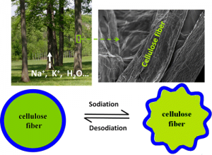
Wooden Batteries

Slide 3
Wooden Batteries
Lithium-ion batteries, while efficient, degrade over repeated charging and discharging.
This is because charging and discharging swells and contracts the battery, breaking down stiff materials.
Cellulose in trees stores energy without breaking down.
This is because the materials are more malleable and thus aren't destroyed by charging and discharging.
Researchers from the University of Maryland harvested cellulose fibers from yellow pine trees and coated them with tin to create a new nanobattery.
The nanobattery survives charging and discharging 400 times, more than any other nanobattery.
The nanobattery currently only stores 339 mAh/g with a theoretical limit of 847 mAh/g.

Slide 4
References
[1] Whitwam, Ryan. "Researchers Create Super-efficient, Long-lasting Battery from Wood | ExtremeTech." ExtremeTech. 20 June 2013. Web. 29 Mar. 2016. <http://www.extremetech.com/extreme/159256-researchers-create-super-efficient-long-lasting-battery-from-wood>.

