Slide 1
Bumblebee Crash Avoidance
Instapram 12
Thomas Bruestle

Slide 2
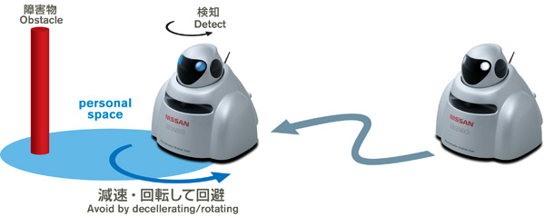
Bumblebee Crash Avoidance

Slide 3
Bumblebee Crash Avoidance
Bumblebees use compound eyes to detect if they are about to crash into an object an adjust their path to compensate.
Nissan Motor Corporation wants to adopt this for their cars.
The concept is do design a car that fluidly decelerates and adjusts heading in order to avoid crashes.
Nissan has successfully produced a miniature car, BR23C to test these biomimetic features.
The BR23C uses compound eyes and formulas based on analyzing bumblebee behavior to avoid more crashes.
Modern Nissan systems have “Forward Emergency Braking”, though I haven't found any direct link.

Slide 4
References
[1] "Crash Avoidance Robotic Car Inspired by Flight of the Bumblebee." Nissan Motor Corporation, 26 Sept. 2008. Web. 05 Apr. 2016. <http://www.nissan-global.com/EN/NEWS/2008/_STORY/080926-01-e.html>.
[2] "Forward Emergency Braking." NISSAN TECHNOLOGICAL DEVELOPMENT ACTIVITIES. Nissan Motor Corporation. Web. 05 Apr. 2016. <http://www.nissan-global.com/EN/TECHNOLOGY/OVERVIEW/emergency_brake.html>.

