Slide 1
Flexible Elephant Trunk Arm
Instapram 14
Thomas Bruestle

Slide 2
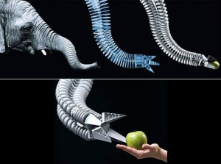
Flexible Elephant Trunk Arm

Slide 3
Flexible Elephant Trunk Arm
Festo, a German Pneumatics Company, has developed the Bionic Handling Assistant, a robotic arm based on the design of elephant trunks.
Instead of using metal parts and motors to move the robotic arm, Festo's Bionic Handling Assistant moves by inflating and deflating circular tubes along the arm.
The inflation of the tubes allow for precision movement, flexibility, and safety.
This arm is designed to mimic elephant trunks, that move with a similar mechanism.

Slide 4
References
[1] Saenz, Aaron Y. "Festo Turns Elephant's Trunk into Awesome Robot Arm (video)." Singularity HUB. 27 Sept. 2010. Web. 19 Apr. 2016. <http://singularityhub.com/2010/09/27/festo-turns-elephants-trunk-into-awesome-robot-arm-video/>.

