Slide 1
Swarming Behavior
Thomas Bruestle
Instapram 4

Slide 2
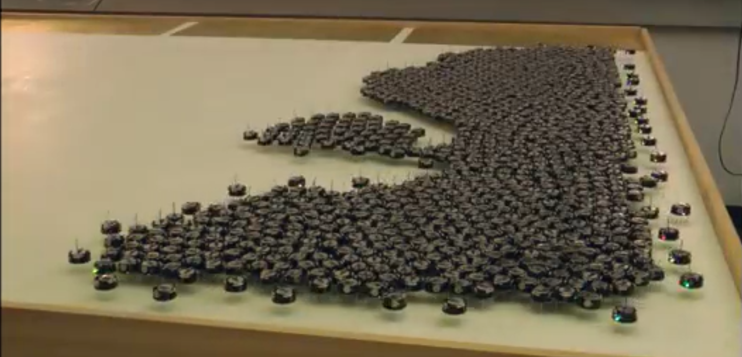
Swarming Behavior

Slide 3
Swarming Behavior
Robotics is looking to mimic the ability for nature to move individually to create swarms.
At Harvard, they developed a simple algorithm where robots would attempt to achieve a desired shape by moving until they detect they are in the shape then moving inside the shape until they are about to leave the shape.
Scientists are looking for more efficient algorithms.

Slide 4
References
http://news.harvard.edu/gazette/story/2014/08/the-1000-robot-swarm/

