Slide 1
Swarming Farming Robots
Thomas Bruestle
Instapram 7

Slide 2
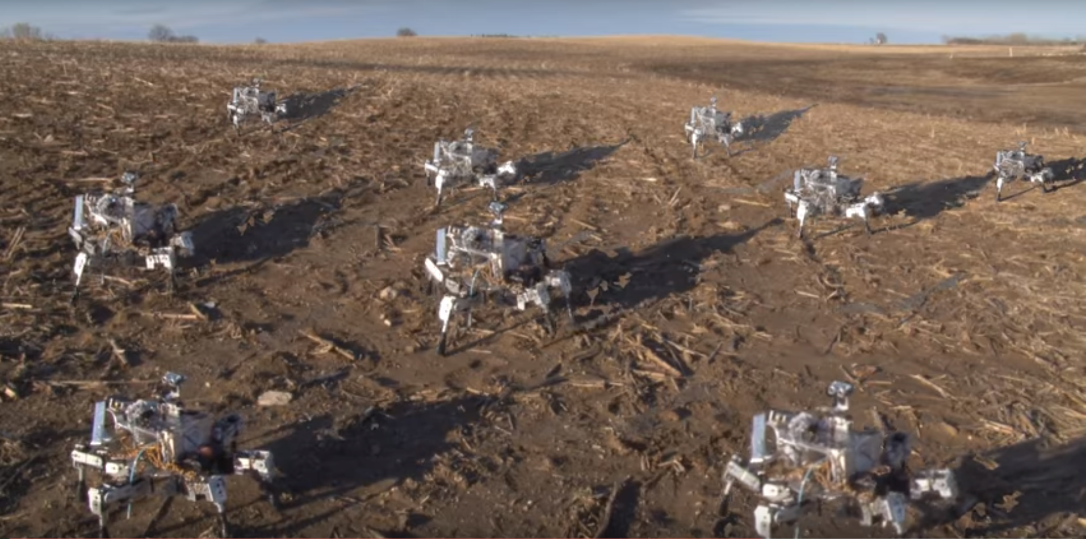
Swarming Farming Robots

Slide 3
Swarming Farming Robots
Prospero robot an innovation to improve farming.
Robotic farmers to keep pace with rising demand for food while minimizing human work.
Uses biomimicry innovations inspired by ants
  Stable 6 legged movement
  Plants pheromones to mark planted seeds
  Detects soil type, moisture levels, and light levels to decide the optimal plant to place at each location to avoid monocultures and plant optimal plant at a location

Slide 4
References
https://biomimicron.wordpress.com/2012/10/27/3-biomimicry-examples-in-one-farming-robot/

