Slide 1
Penicillin
Thomas Bruestle
Instapram 8

Slide 2
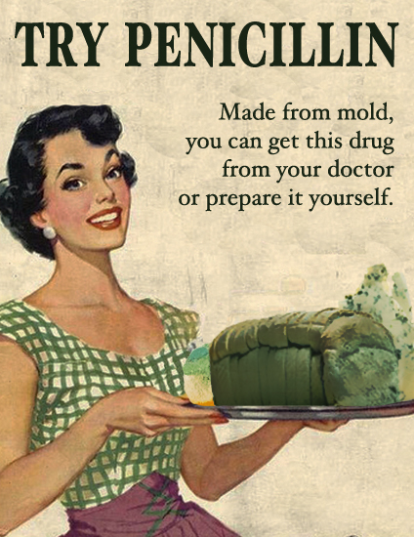
Penicillin

Slide 3
Penicillin
Penicillin is a well known antibiotic and a household name.
Produced from a strain of penicillium, a mold. Not all strains of penicillium are antibacterial and not all molds are penicillium.
Grows faster at warmer temperature.
Mostly non-toxic.
I looked into the original paper where Alexander Fleming introduced Penicillin.

Slide 4
References
http://www.ncbi.nlm.nih.gov/pmc/articles/PMC2048009/?page=1

