Slide 1
White Blood Cell Communication
Thomas Bruestle
Instapram 9

Slide 2
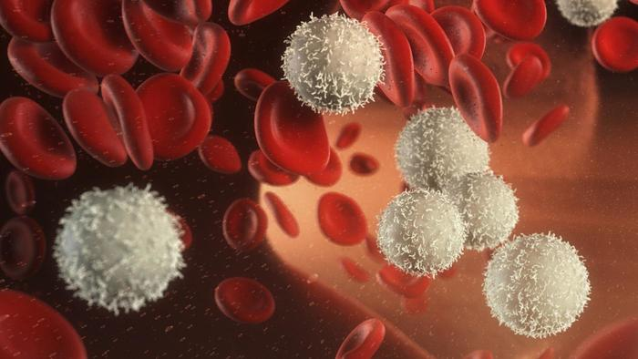
White Blood Cell Communication

Slide 3
White Blood Cell Communication
White blood cells constantly patrolling the body.
When an infection is detected, the white blood cells release a protein called chemokine.
Other white blood cells track the chemokine back to it's source by following the concentration gradient.
No interaction with the neurons in the brain as an intermediary is needed.
Pain still exists to inform the brain to be careful with a certain part of the body, or to rest.

Slide 4
References
Https://www.quora.com/When-a-part-of-the-body-is-injured-or-infected-how-is-the-signal-for-help-transmitted-to-white-blood-cells-etc
Http://www.cmi.ustc.edu.cn/1/2/95.pdf

