Slide 1
Facial Recognition
Thomas Bruestle
Reporting Assignment 1
Instapram

Slide 2
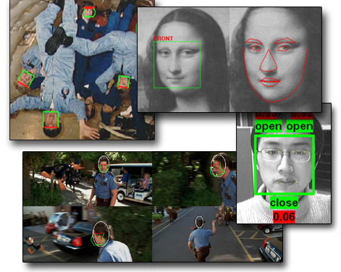

Slide 3
Key Benefits
Image processing reduces the need to employ humans to recognize objects. This increases productivity and decreases cost.
With the increased productivity and increased cost, many tasks that were originally seen as too expensive to perform may become feasable. This opens new markets and opportunities.
  Facial recognition can be used in law enforcement to match a list of known suspects quickly and compare an individual against a database of known criminals.
  Facial recognition can be used to verify someone's identity.
Facial recognition software can be used to match to image other than human faces, such as a sign or a specific feature on a map.
The multiple formulas available allow the user to trade attributes like storage space, processing time, likelihood of a false positive, and likelyhood of a false negative for eachother.

Slide 4
Key Issues
In order to match to someone's face, their face must be stored in a database. Many people will not consent to have their image stored in a database and many more will not consent to have that image shared with other interested parties.
When comparing against more images, more processing time is required.
When storing more images, more storage space is required.
Aging and outdoor lighting may make faces unrecognizable.
Biometric doubles may lead to false positives.
More processing power leads to more environmental waste.

