Slide 1
Adapting Insect Brains for Advanced Navigation
Thomas Bruestle
Project 3 Instapram

Slide 2
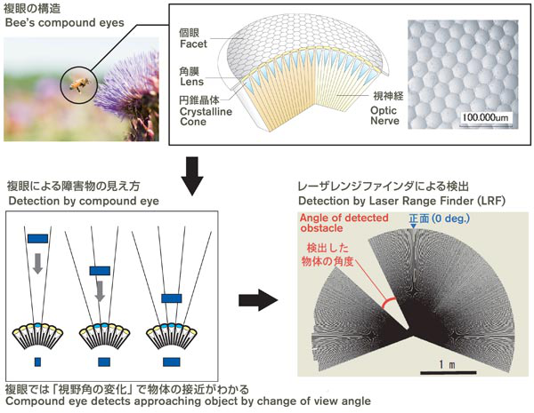
Adapting Insect Brains for Advanced Navigation

Slide 3
Adapting Insect Brains for Advanced Navigation
We should develop a more efficient computer vision program to improve computer vision by attempting to find the least amount of processing power and data storage needed. In order to accomplish this, we will base our formulas and cameras on a creature that has already figured this out, the insect. We can improve performance by adapting the color scheme from red, blue and green to colors appropriate for the environment and reduce the number of pixels and images stored to the bare minimum needed to accomplish the tasks at hand. We can base our formulas for object recognition off of ant brains and our formulas for collision detection off of bee brains. This should help us approach the operating efficiency of an insect brain.

Slide 4
References
[1] "About the BMVA." What Is Computer Vision? The British Machine Vision Association and Society for Pattern Recognition. Web. 24 Apr. 2016. <http://www.bmva.org/visionoverview>.
[2] Whitman, Lloyd, Randy Bryant, and Tom Kalil. "A Nanotechnology-Inspired Grand Challenge for Future Computing." The White House. The White House, 20 Oct. 2015. Web. 22 Mar. 2016. <https://www.whitehouse.gov/blog/2015/10/15/nanotechnology-inspired-grand-challenge-future-computing>.
[3] Randerson, James. "How Many Neurons Make a Human Brain? Billions Fewer than We Thought | James Randerson." The Guardian. Guardian News and Media, 28 Feb. 2012. Web. 22 Mar. 2016. <https://www.theguardian.com/science/blog/2012/feb/28/how-many-neurons-human-brain>.
[4] "How Small Is an Ant's Brain Compared to an Elephant's Brain?" How Small Is an Ant's Brain Compared to an Elephant's Brain? Wonderopolis. Web. 22 Mar. 2016. <http://wonderopolis.org/wonder/how-small-is-an-ants-brain-compared-to-an-elephants-brain/>.
[5] King, Paul, and Melinda T. Owens. "How Much of the Brain Is Involved with Vision?" Quora. 28 Sept. 2013. Web. 24 Apr. 2016. <https://www.quora.com/How-much-of-the-brain-is-involved-with-vision>.
[6] Hager, Gregory D. "Object Recognition Techniques." John Hopkins - Whiting School of Engineering, 3 Dec. 2003. Web. 24 Apr. 2016. <http://www.cs.jhu.edu/~hager/Public/teaching/cs461/ObjectRecognition.pdf>.
[7] Introna, Lucas D., and Helen Nissenbaum. "Facial Recognition Technology." The Center for Catastrophe Preparedness & Response. New York University. Web. 24 Apr. 2016. <https://www.nyu.edu/projects/nissenbaum/papers/facial_recognition_report.pdf>.
[8] Wickman, Forrest. "How Many Megabytes of Data Can the Human Brain Hold?" Slate Magazine. 24 Apr. 2012. Web. 24 Apr. 2016. <http://www.slate.com/articles/health_and_science/explainer/2012/04/north_korea_s_2_mb_of_knowledge_taunt_how_many_megabytes_does_the_human_brain_hold_.html>.

Slide 5
References (Cont.)
[9] Hogenboom, Melissa. "Ants Can Navigate despite Tiny Brains." BBC Earth. BBC, 26 May 2015. Web. 21 Mar. 2016. <http://www.bbc.com/earth/story/20150526-ants-navigate-despite-tiny-brains>.
[10] Schatz, B., S. Chameron, G. Beugnon, and T. S. Collett. "The Use of Path Integration Toguide Route Learning in Ants." Nature.com. Nature Publishing Group, 24 June 1999. Web. 21 Mar. 2016. <http://www.nature.com/articles/21625.epdf>.
[11] Stacey, David. "Ants Color Vision May Help March towards Robot Technology." Ants Color Vision May Help March towards Robot Technology. 20 May 2015. Web. 24 Apr. 2016. <http://phys.org/news/2015-05-ants-vision-robot-technology.html>.
[12] Hauert, Sabine. "Plug-and-play Artificial Compound Eye for Robotic Applications." Robohub. 20 May 2013. Web. 21 Mar. 2016. <http://robohub.org/plug-and-play-artificial-compound-eye-for-robotic-applications/>.
[13] "'Four-Eyed' Fish Sees Above and Below Water : DNews." DNews. The Discovery Channel, 20 July 2011. Web. 24 Apr. 2016. <http://news.discovery.com/animals/four-eyed-fish-110720.htm>.
[14] Mejia-Ortiz, Luis M., and Richard G. Hartnoll. "Modifications of Eye Structure and Integumental Pigment in Two Cave Crayfish." Research Gate. Journal of Crustacean Biology. Web. 21 Mar. 2016. <https://www.researchgate.net/publication/232694344_Modifications_of_Eye_Structure_and_Integumental_Pigment_in_Two_Cave_Crayfish>.
[15] Stephens, Phil. "Zoo Trip and Questions for Guest Lecturer." Message to the author. 18 Mar. 2016. E-mail.
[16] Weisberger, Mindy. "Underground Ants Regrew Brain Parts to See the Light." LiveScience. TechMedia Network, 11 Mar. 2016. Web. 25 Apr. 2016. <http://www.livescience.com/54027-ants-regrew-brain-parts.html>.
[17] Detrain, Claire, and Jean-Louis Deneubourg. "Self-organized Structures in a Superorganism: Do Ants “behave” like Molecules?" Physics of Life Reviews. Université Libre De Bruxelles, 27 Sept. 2006. Web. 21 Mar. 2016. <http://www.ulb.ac.be/sciences/use/publications/JLD/221.pdf>.

Slide 6
References (Cont.)
[18] Gill, Victoria. "Robot Ants: Mini-machines Mimic Insect Colony." BBC News. BBC, 29 Mar. 2013. Web. 21 Mar. 2016. <http://www.bbc.com/news/21956795>.
[19] Simon. "Pheromone Trail Networks in Ants." Collective Animal Behavior RSS. Couzin Lab, 22 Sept. 2009. Web. 21 Mar. 2016. <http://icouzin.princeton.edu/pheromone-trail-networks-in-ants/>.
[20] International Journal of Electronics and Communication Engineering & Technology (IJECET), ISSN 0976 – 6464(Print), ISSN 0976 – 6472(Online), Volume 5, Issue 2, February (2014), pp. 57-68 © IAEME
[21] "Crash Avoidance Robotic Car Inspired by Flight of the Bumblebee." Nissan Motor Corporation, 26 Sept. 2008. Web. 05 Apr. 2016. <http://www.nissan-global.com/EN/NEWS/2008/_STORY/080926-01-e.html>
[22] Hauert, Sabine. "Plug-and-play Artificial Compound Eye for Robotic Applications." Robohub. 20 May 2013. Web. 21 Mar. 2016. <http://robohub.org/plug-and-play-artificial-compound-eye-for-robotic-applications/>.
[23] Lieff, Jon, M.D. "The Remarkable Bee Brain | Jon Lieff, M.D." Searching for the Mind with Jon Lieff, M.D. 12 Nov. 2012. Web. 25 Apr. 2016. <http://jonlieffmd.com/blog/the-remarkable-bee-brain-2>.
[24] Walsh, Bryan. "The Surprisingly Large Energy Footprint of the Digital Economy [UPDATE] | TIME.com." TIME Magazine, 14 Aug. 2013. Web. 25 Apr. 2016. <http://science.time.com/2013/08/14/power-drain-the-digital-cloud-is-using-more-energy-than-you-think/>.
[25] McAuliffe, Joel. "Following The Trail Of Toxic E Waste - 60 Mins." YouTube. 60 Minutes, 04 Dec. 2013. Web. 25 Apr. 2016. <https://www.youtube.com/watch?v=25jyPURkJVM>.

