Slide 1
Visualizing Data with MatPlotLib

Slide 2
What is matplotlib?
An open-source Python graphing library officially launched in 2003.
Ability to generate a variety of different types of graphs from simple to complex, as well as drawing capabilities and interactive capabilities similar to MATLAB
Many third-party open-source Python libraries have a matplotlib dependancy as well, some of which we will cover in this tutorial
        Pandas
        Seaborn
        Sci-kit learn (great for machine learning)
        NetworkX
        ggplot (based on R’s ggplot2 library)
        IPython
        StarCluster
        Bokeh (interactive plots for web-dev; doesn’t require matplotlib but is compatible with it)

Slide 3
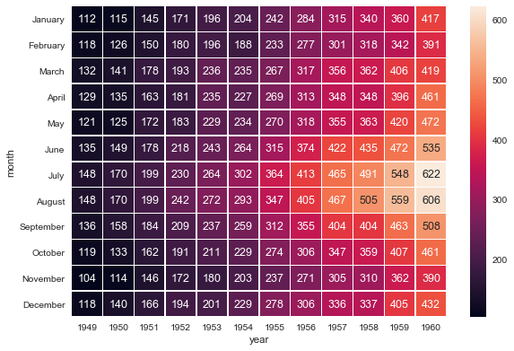
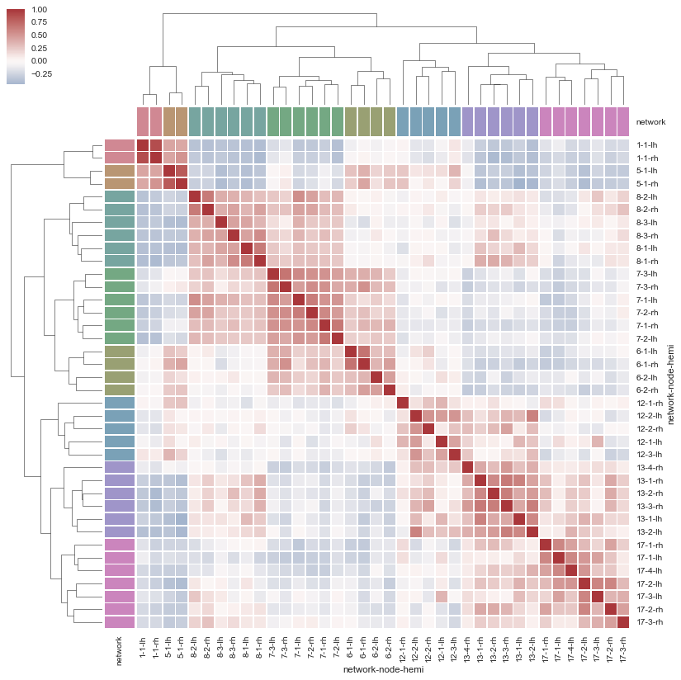
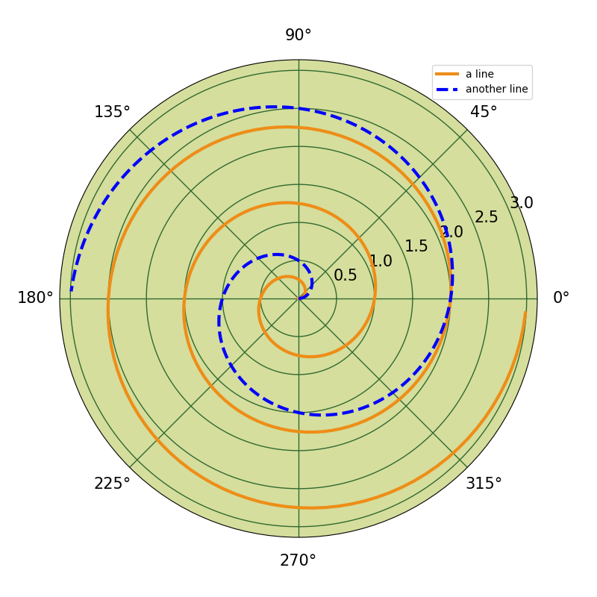
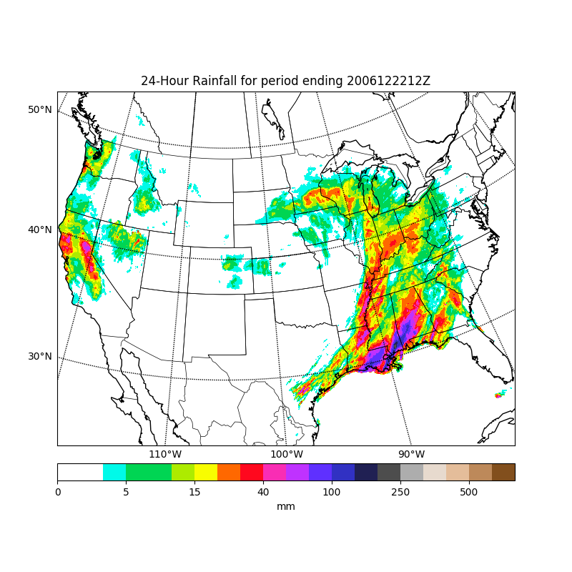
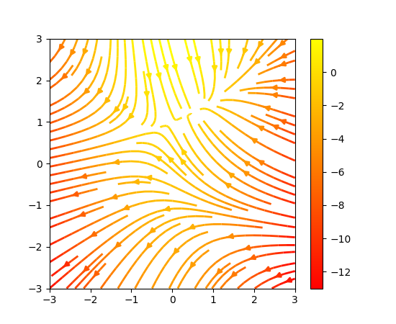
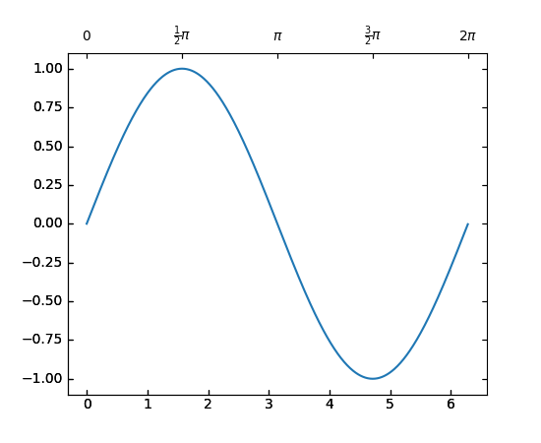
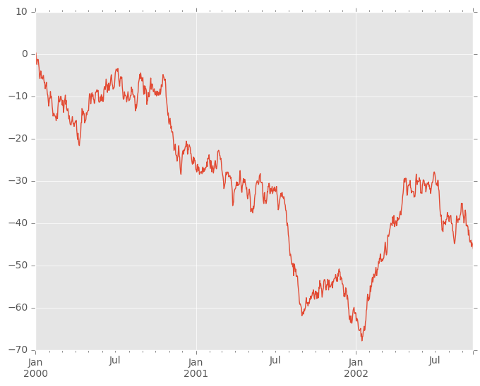
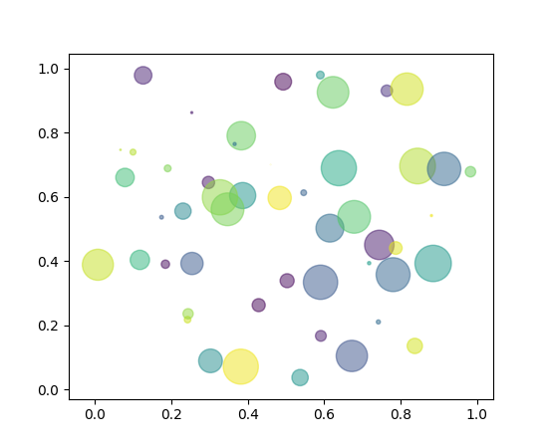
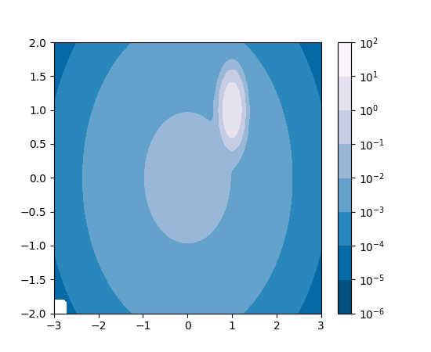
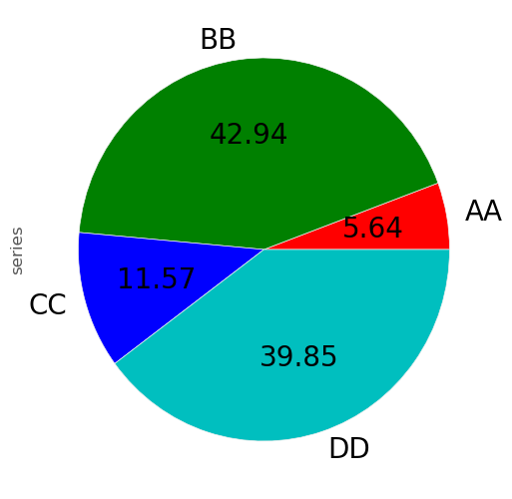

Slide 4
The matplotlib API
Essentially 3 different matplotlib APIs exist that make scripting in matplotlib easy for the user:
                1) pylab
                2) pyplot
                3) object-oriented interface
We are going to focusing on pyplot for this tutorial. Why?
First and foremost, pylab is deprecated. Additionally, the pyplot API is easy to use and is built to handle visualizations easily and quickly. Additionally it has similar behaviors as pylab which was meant to be used as a substitute for MATLAB graphing, with similar syntax format.
Although pyplot is also object-oriented, the API takes care of the direct creation of graphing objects on the backend so the user does not have to deal with scripting and building these objects, unlike the object-oriented interface where the user must create these objects manually and it is non-interactive, so it cannot be used with IPython or Jupyter. So unless you need super fine-artistic details and customization of your graphs, pyplot is much easier and will generally meet the needs of most users!

Slide 5
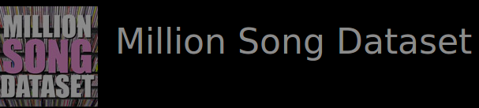

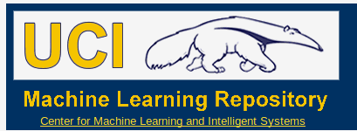
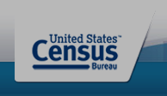
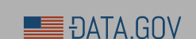
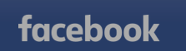
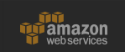
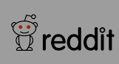
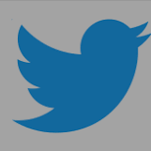
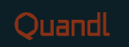
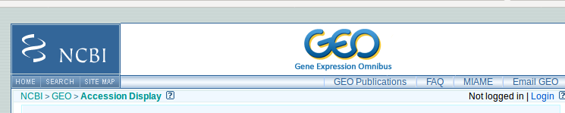
Data Sets
There are several free and publicly available complex dataset that can be used for prototyping code/algorithms/visualizations.
All data sets used in this tutorial have come from the one of the following websites:

Slide 6
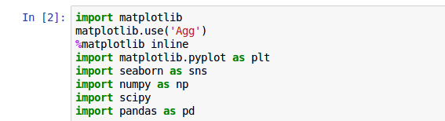
Installation and backend set up
For this tutorial all libraries will already be installed on the cluster, however for the future matplotlib requires the several dependencies. The easiest way to install this locally will be to use your OS package manager or pip.
https://matplotlib.org/users/installing.html
This list of imports should be placed at the top of your Python scripts or should be executed first:
important to include this on most clusters, less necessary on a local computer
Only required if using Ipython or Jupyter notebooks
Create a shorthand nickname for the library

Slide 7
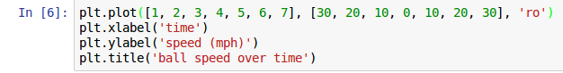
Generating simple plots
Open script basic_test_plots.py, run lines 10-14
x-coordinate values
y-coordinate values
marker shape and color
Python graphs the arrays in elemental order, so the first element of x-coordiate values matches the first element of y-coordiate values. Hence, the lists/arrays must be of same length. In this case, we could expect the following points plotted:
(1, 30), (2, 20), (3, 10), (4, 0), (5, 10), (6, 20), (7, 30) , the marker shape and color tells python to plot red (‘r’) circles (‘o’)
code | marker symbol
. | point
, | pixel
o | circle
^ | Up triangle
< | Right triange
+ | plus
x | x
D | diamond
H | Hexagon
s | square
8 | octagon
p | pentagon
* | star
P | Filled plus
code | color
b | blue
g | green
r | red
c | cyan
m | magenta
y | yellow
k | black
w | white
There are tables to the right that describes the keywords for some of the basic colors and symbols. There are many more and you can even use html hex strings and shades by specifying the ‘color’ keyword argument

Slide 8
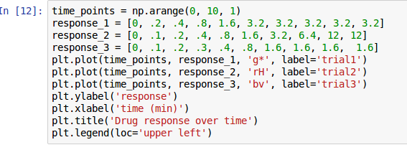
Generating simple plots
Now, run lines 17-28
How do we get dashed and continuous lines instead? Follow the directions on lines 31-34
Do you want to save your plot to a file?

Slide 9
Plotting large complex datasets
Many people will already have a spreadsheet or table of various metrics they may want to visualize so typing all of these into the code we have before is not a feasible option.
Additionally, they may want other graph styles besides basic scatter and line plots. What do we do?
Also, do we really want to hard code or loop through all data? Time consuming!

Slide 10
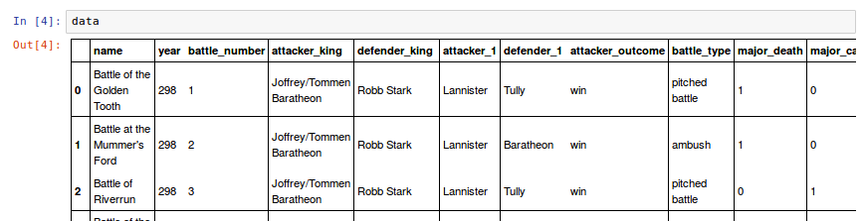
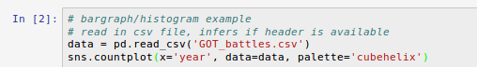
Histograms, bar graphs, and pie charts
Open the histogram_barplot_piechart.py script. Let’s use a modified and cleaned up dataset on the Game of Thrones
We are interested in knowing how many battles occurred per year. How do we do this? Run lines 13-14
Only x is required, no y values because sns.countplot() uses the total number of occurrences for each group of x
name of dataframe
color scheme (we will discuss this further later in the presentation)

Slide 11
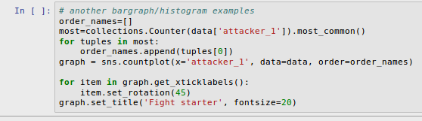
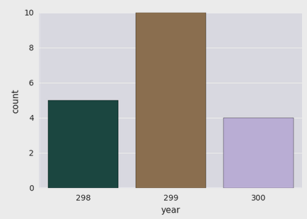
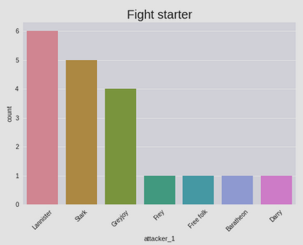
Histograms, bar graphs, and pie charts
What if we want to plot the graph in descending order? We will have to do a little coding...Run lines 16-24
Creates a dictionary of this in descending order or occurrences
Put keys in an ordered list
By specifying the order keyword pass in the list
Rotates the labels 45 degrees along the x-axis so not cluttered
When plotting with seaborn, unfortunately, setting the axis rotation can be a little tricker than with pandas since it does not have a rotation keyword
Exercise, reorder the x-axis in the year vs total battles plot to be in ascending order (Line 28)

Slide 12
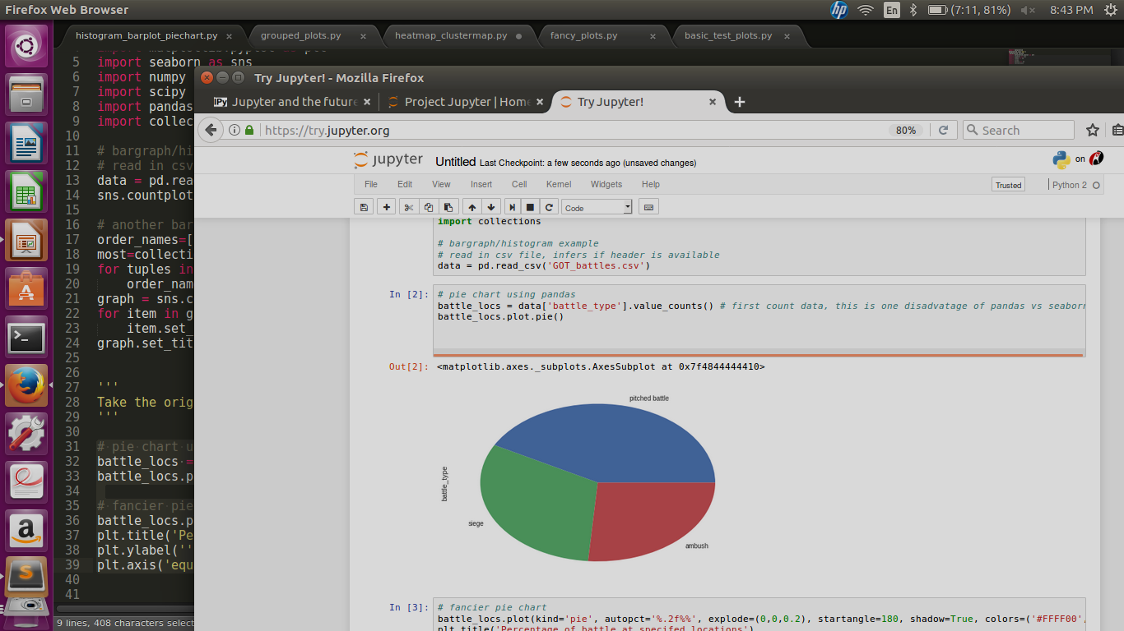
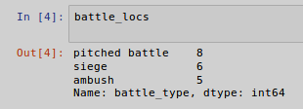
Pie charts in pandas
Using the same dataset, let’s make a pie chart of what percentage of battles of which type. Run lines 32-33. This will produce the most basic pie chart.
The pandas pie chart feature is not “smart” enough to actually count the occurrences of each battle type, so it is necessary to count the values and store it as a dataframe
This is the new data object after we apply .value_counts() to the column ‘battle_type’. Ultimately, this is the object where we apply the plot.pie() function
However, this does not tell us a lot of information and it is pretty plain and more of an oval shape. Can we do better?

Slide 13
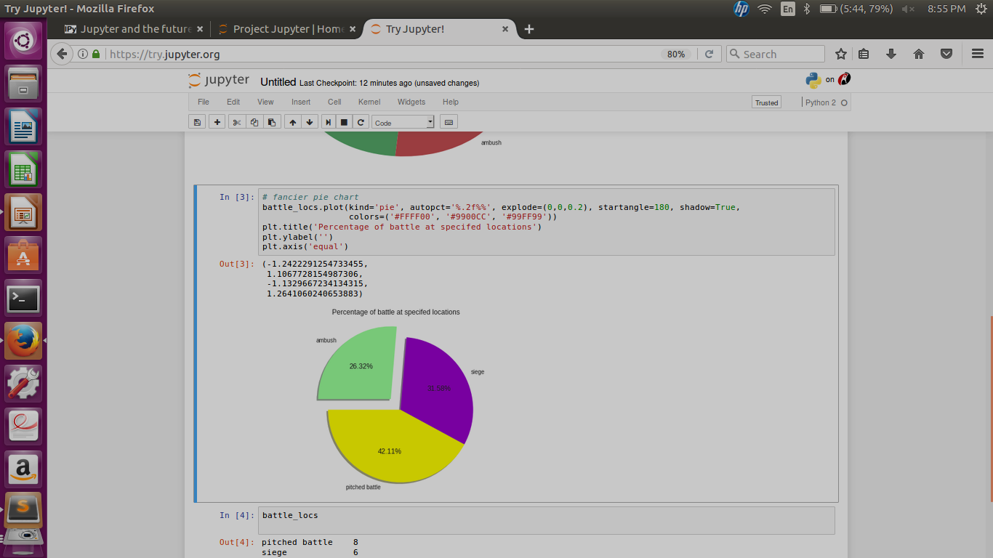
Pie charts in pandas...FANCY!
By adding a few built-in keywords, we can make the same pie chart with more information and more aesthetically pleasing. Run lines 36-39
Plot the percentage to 2 decimal places
Piece out a slice of the pie
Place a shadow
Degree of circle where you would like to start
Make graph look like a perfect circle
Color pieces of the circle
vs
Exercise Generate a new pie plot of wins vs losses when the attacker initiates a battle. See lines 43-44

Slide 14
General plotting syntax with pandas
The plotting functions used in pandas can all generally be called using the following command:
NameOfDataframe.plot(kind=”pickKeyword”)
The following keywords are acceptable for the “kind” parameter:
  line
  bar
  barh
  hist
  box
  kde
  density
  area
  pie
  scatter
  hexbin
No matter which kind of plot you choose, you can always add the following keywords (not an exhaustive list) : title, xticks, yticks, xlim, ylim, fontsize, colormap, legend, grid, style… and many others.
It gives the user the convenient option of making one command call (assuming the dataframe is configured and organized correctly)

Slide 15
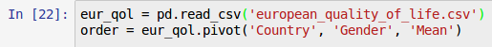
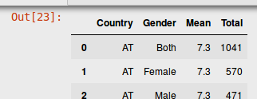
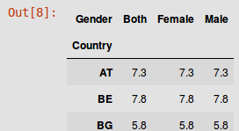
Heatmaps and clustermaps
Seaborn generates heatmaps and clustermaps with minimal code
To illustrate, will use a cleaned dataset of a quality-of-life survey from the European Foundation for the Improvement of Living and Working Conditions
Open script heatmap_clustermap.py and run lines 10-12
Reshapes dataframe for compatibility with seaborn graphs
Compare the difference between eur_qol and order:
Duplicate ‘Country’ rows are collapsed to represent the y-axis, similarly with ‘Gender’ to represent to x-axis
Mean is now structured to
represent the cells of the clustermap

Slide 16
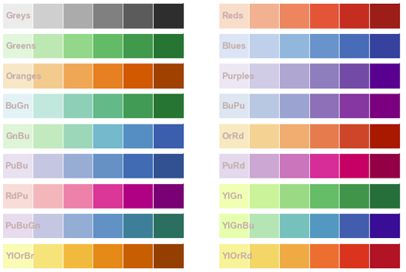
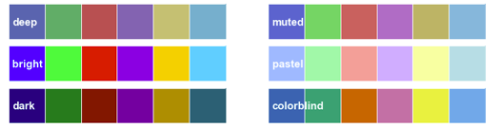
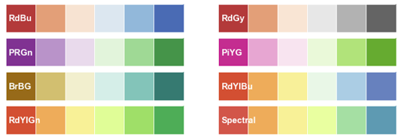
Heatmap and clustermap beautification and customization
Change font size
Choose color palettes
Change spacing and shape
Add cell annotation
Choose clustering method and distance metrics (clustermap)
Or create your own by creating a Python list of keyword colors or html codes and using:
sns.set_palette(your_list)
sns.palplot(sns.color_palette())
Palette images from http://jose-coto.com/styling-with-seaborn

Slide 17
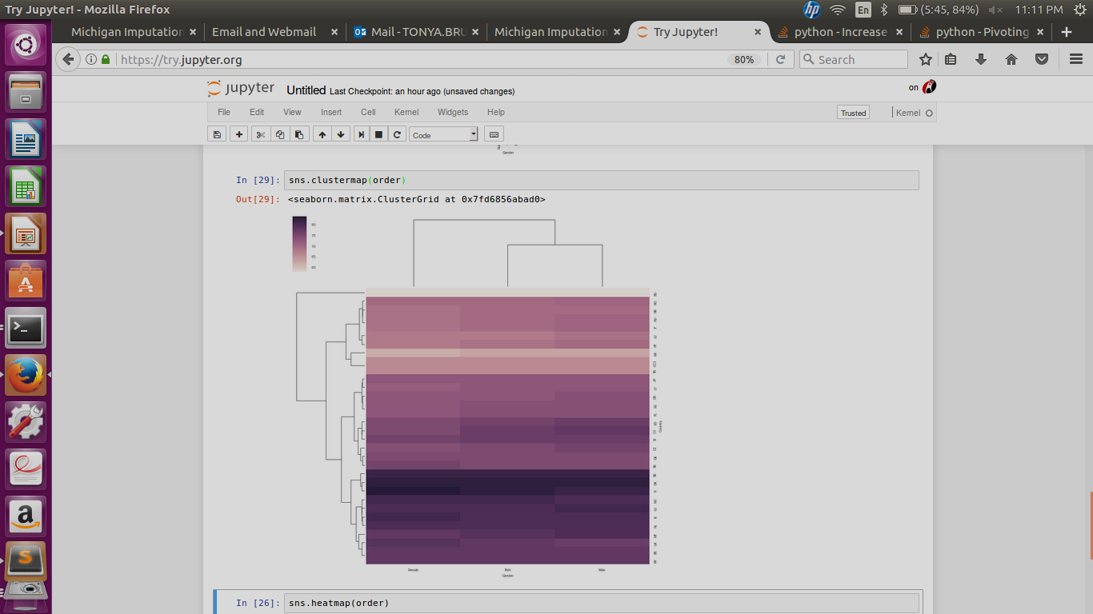
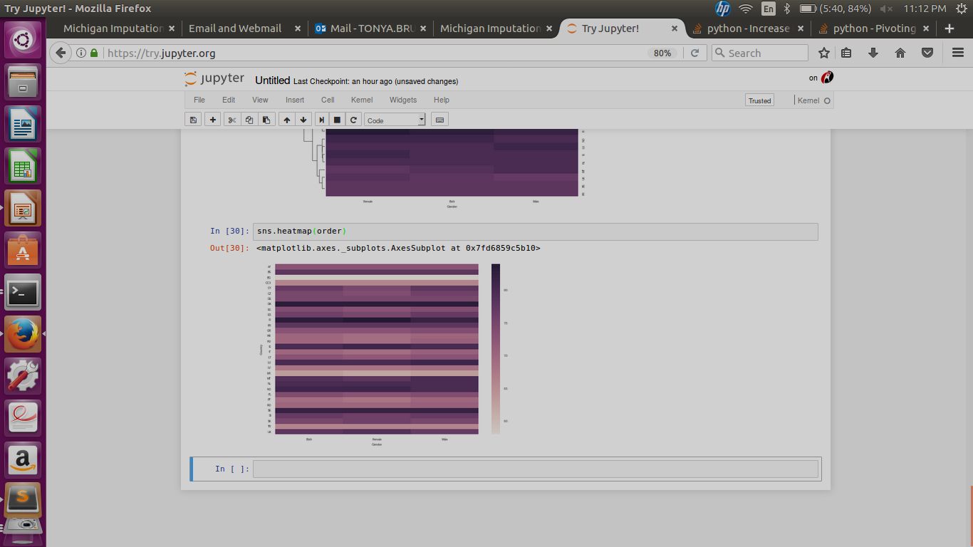
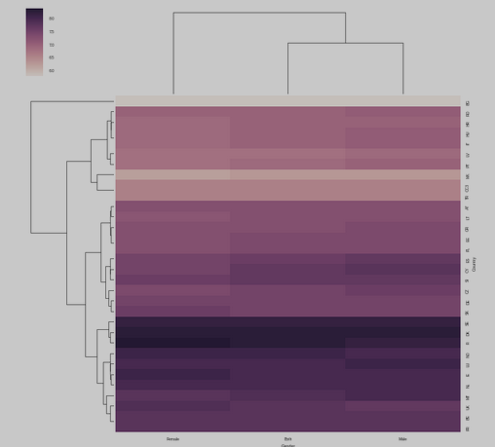
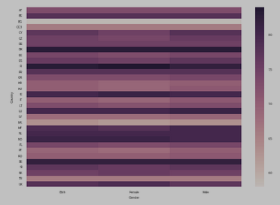
Heatmaps and clustermaps
Let’s generate the most basic heatmap and clustermap from this data
Open script heatmap_clustermap.py and run line 13 and then line 14
You can see the difference between the clustermap and the heatmap is the clustering of data with the most similar cells and including a dendrogram to illustrate this

Slide 18
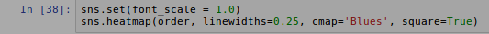
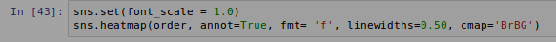
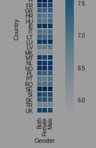
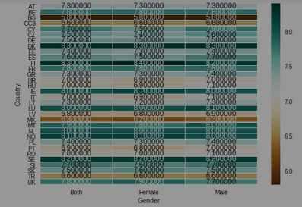
Example heatmaps
Run lines 18-19
Whitespace to leave between cells
Set colormap color
Draws cells perfectly square instead of rectangle
Run lines 22-23
Annotate cells with values
Tells Python how to format cells

Slide 19
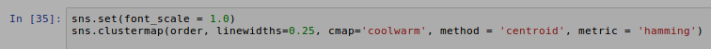
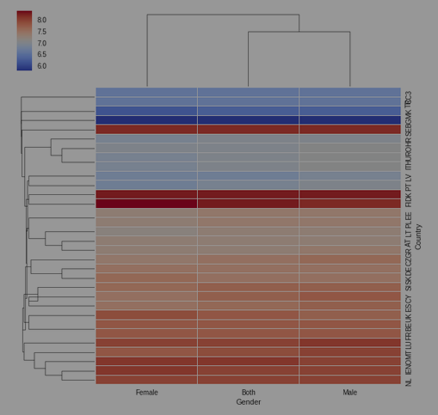
Example clustermaps
Run lines 25-27
Determine cluster membership method
Determine clustering method and sample similarity metric
metric
barycurtis | canberra
chebysev | cityblock
correlation | cosine
dice | euclidean
hamming | jaccard
kulsinski | mahalanobis
matching | minkowski
rogerstanimoto | russellrao
seuclidean | sokalmichener
sokalsneath | sqeuclidean
yule
method
single
complete
average
weighted
centroid
median
ward
Exercise line 30. Create your own heatmap using differential expression data from GEO (GSE27233_GEO_subset.txt) and use a diverging color palette centered around 0. Hint: use center=0 as a keyword argument

Slide 20
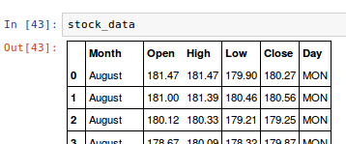
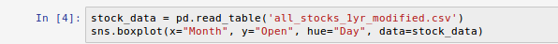
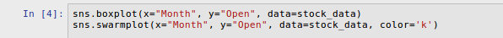
Grouped box plots
Let’s take a peek at a very small and modified version of stock market data.
Open the script grouped_plots.py and run lines 11-12
Main group categories
Dependent variable measurements
Determines how to subgroup data
Name of dataframe
Some other options you can include in the .boxplot() method are: orient, color, order, palette, saturation, width, dodge, fliersize, linewidth, whis, notch
Another cool thing you can do with the seaborn boxplot is to overlay a strip plot/swarm plot on top of the boxplots. Run lines 18-19 together.

Slide 21


Grouped boxplots in pandas vs seaborn
Open the script grouped_plots.py and run line 23
Graphs statistics for the y-axis and boxplot
Determines what groups to separate data out on the x-axis
Name of dataframe
Exercise on line 28. Read in the facebook dataset and create a set of box plots where the column ‘Type’ are the groups on the x-axis and the y-axis will represent the total number of people that have both liked and engaged with a post. Use the notch parameter and set it to true and use the orient parameter and set it to ‘h’. Use any color scheme you would like and set the font equal to 2.0 NOTE! This dataset is semi-colon delimited!!

Slide 22
Differences between Pandas and Seaborn
Pandas
Seaborn
Easier formatting axis positioning (fontsize and rotation)
Pie chart option is easier
Also capable of cleaning up “dirty data”
Can plot data in one command call with several built-in keyword arguments
No need to “count” data
Easy to get visually complex and pleasing graphs
Not made for cleaning data
Can create heatmaps and clustermaps

Slide 23



Fancier Plots (made easy!)
Open fancy_plots.py

