Slide 1
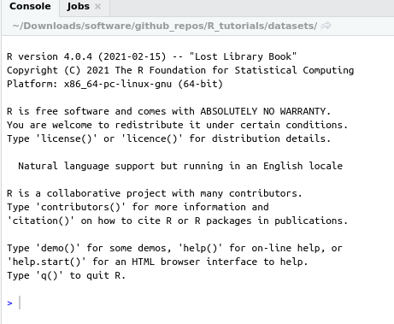
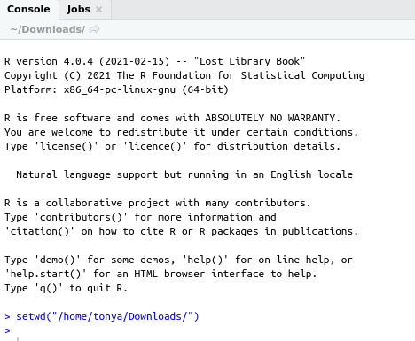
Before setwd() R location is default to location software was started, whereas, after setwd() now R starts saving files and importing file starting from new working directory

