Slide 1
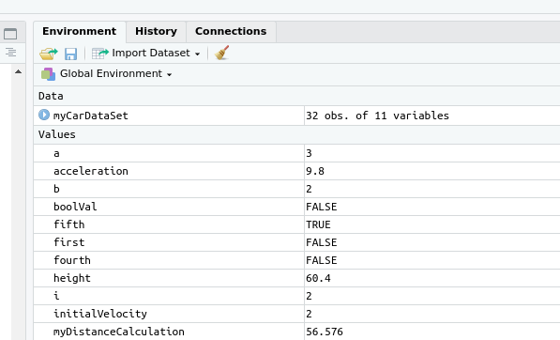

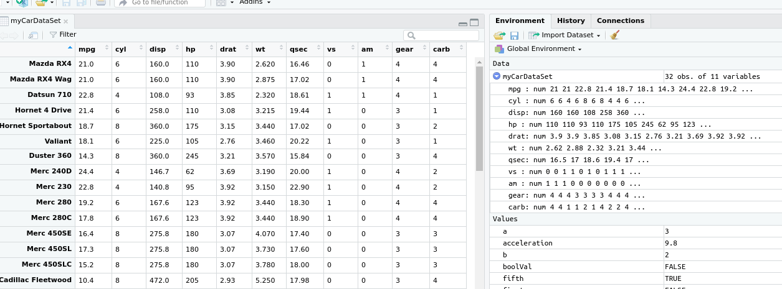
A
B
Notice dataframes populate under a new section called data
Clicking on the blue arrow expands the preview information
C
Clicking on the variable name shows the dataset in the script area

