Slide 1
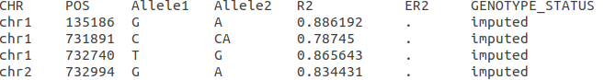
This header with the following names is required
This is the Rsquare value based on the imputation files for each snp/indel.
This value can be one of three string options: imputed, genotyped, imputed and genotyped
This is the Emprical Rsquared value based on the imputation files for each snp/indel that has a genotyping results. Use “.” when that value is missing/not calculated

