Slide 1
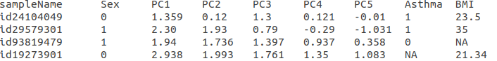
Header line can contain any number and any name of variable you want – the sampleID, phenotype and covariates to use will be specified by listing the names in the config file that match the header
Any categorical variables need to be re-coded using 0 and 1 format
If a sample is missing a phenotype or covariate value it can be replaced with an all capital NA or it can be left blank. Just be sure that the tabs line up appropriately.

