Slide 1
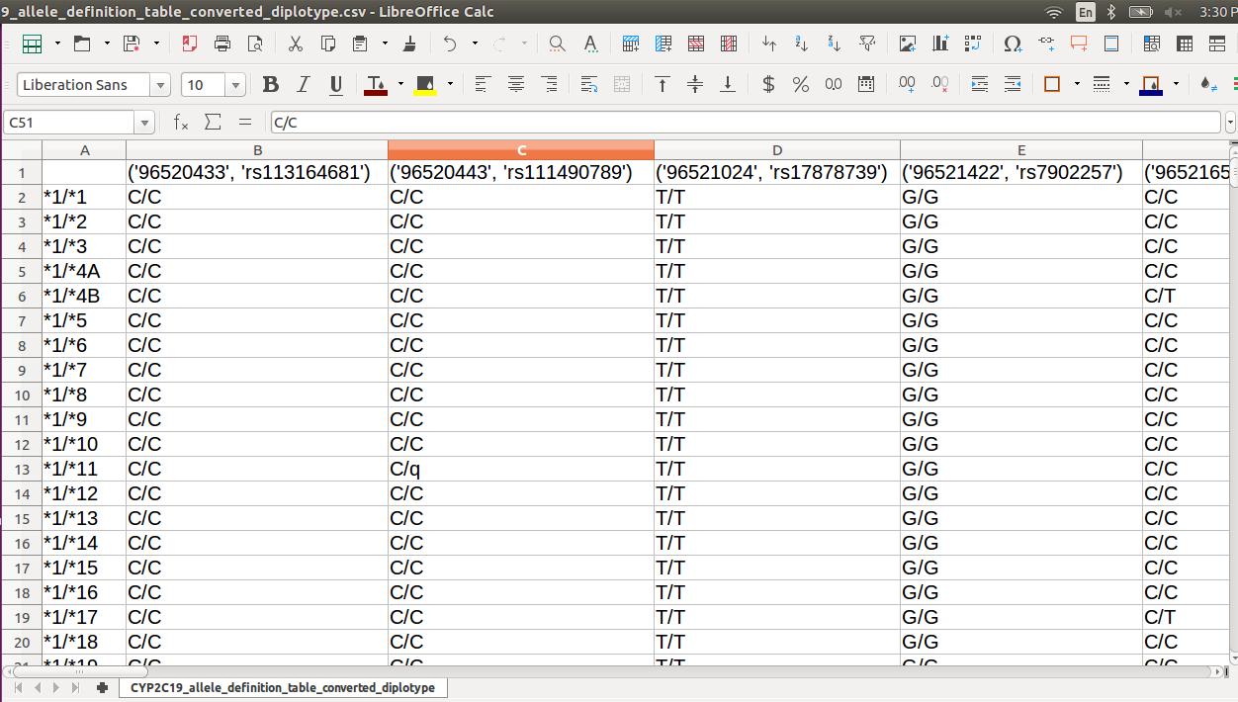
rsID
hg19 coordinate
diplotypes

