Slide 1

Learning PyTorch from Scratch

Slide 2
“LEARNING PYTORCH FROM SCRATCH”
Motivation
As AI/ML and software engineering becomes more and more democratized, what will set a developer apart is the ability to build from as close to bare metal as possible.
1 OF 11

Slide 3
“LEARNING PYTORCH FROM SCRATCH”
What does “from scratch” mean?
I have no experience with PyTorch prior to this video.
I am a solid Python developer with surface level AI / ML understanding.
Technical but never taken a Linear Algebra class.
2 OF 11

Slide 4
“LEARNING PYTORCH FROM SCRATCH”
At its core, PyTorch is a Tensor library. What is a Tensor?
Tensors are a mathematical construct used to represent data.
In the context of machine learning, they can represent the data used to train and test the model and the weights and biases that make up the model.
Why Tensors?
Tensors are the same as arrays in nearly every way except that they can run on the GPU – this enables massive model scaling and speed.
3 OF 11

Slide 5

“LEARNING PYTORCH FROM SCRATCH”
Scalar (single number)
$$\left[1\right]$$
Vector
$$[1, 2, 3]$$
Matrix
$$[\left[1,2,3\right],\left[4,5,6\right]]$$
Tensor
$$\left[\begin{aligned}\left[1,2\right],[3,2] \\ \left[4,2\right],[5,1]\end{aligned}\right]$$
4 OF 11

Slide 6
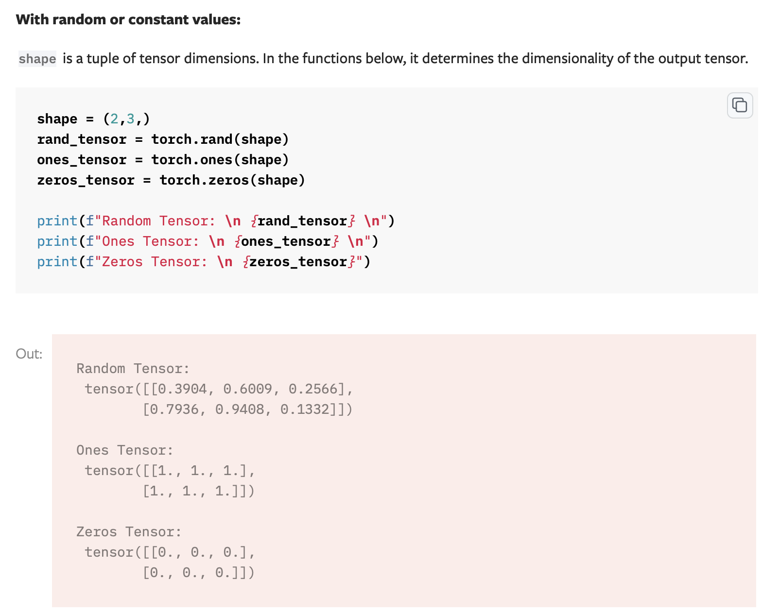
“LEARNING PYTORCH FROM SCRATCH”
5 OF 11

Slide 7
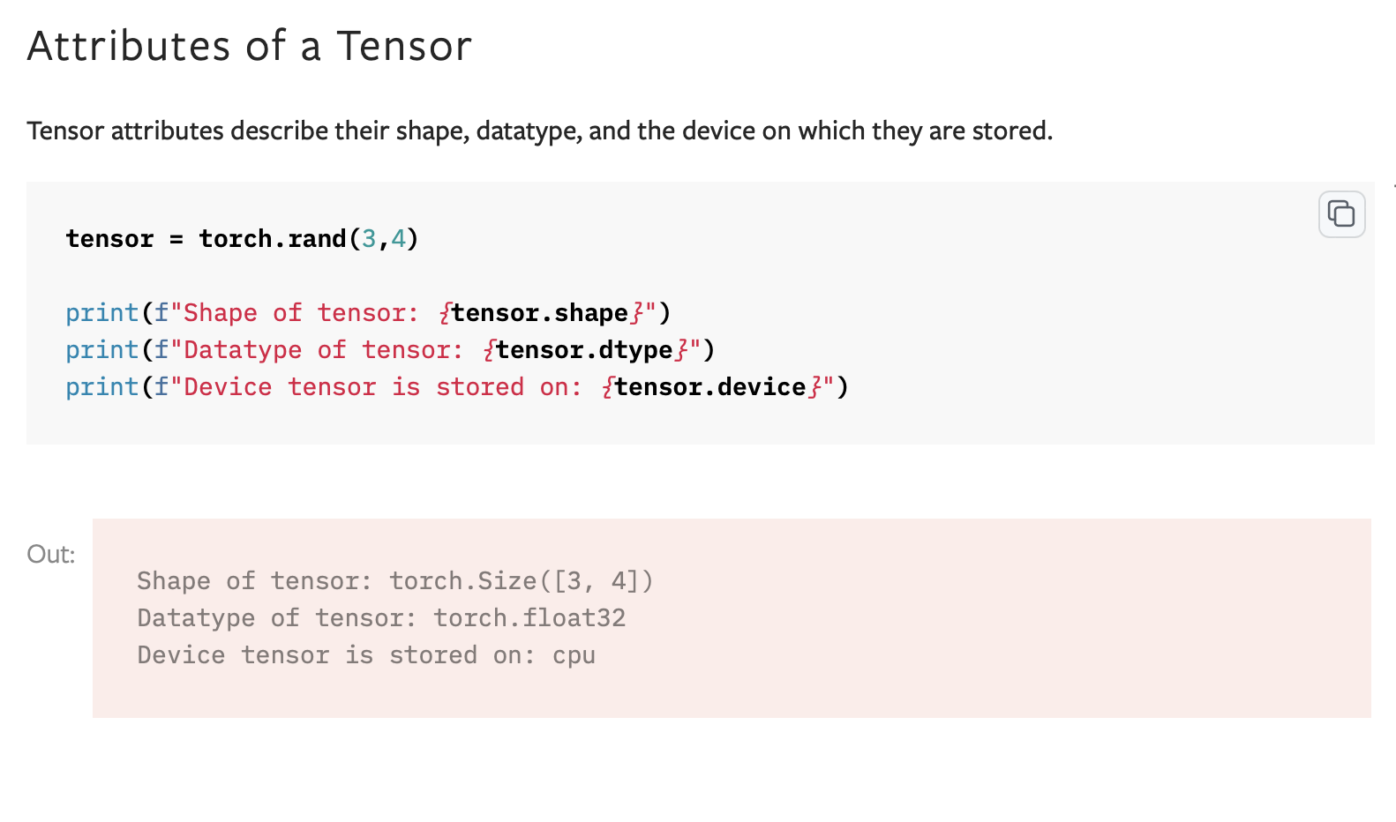
“LEARNING PYTORCH FROM SCRATCH”
6 OF 11

Slide 8
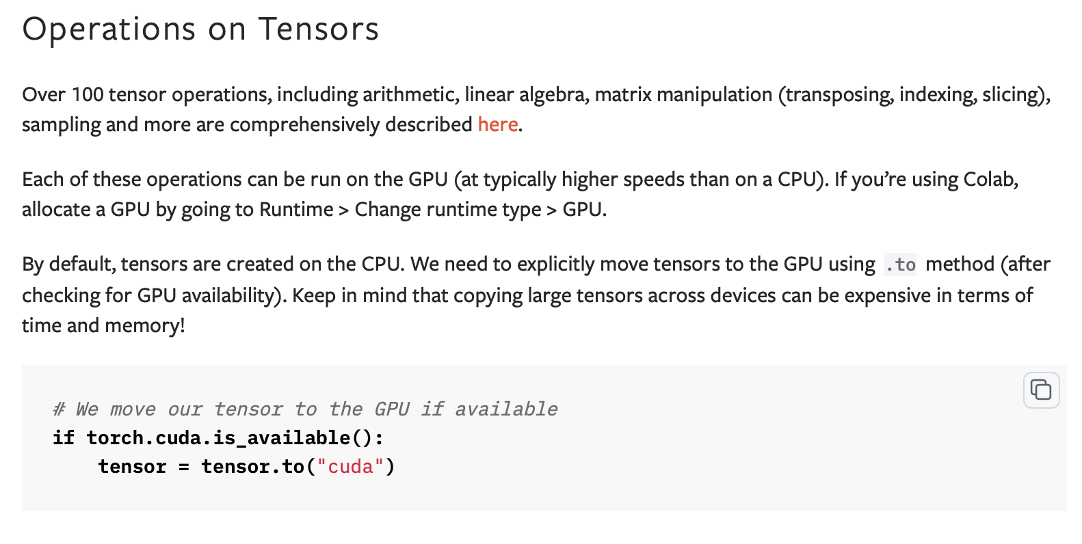
“LEARNING PYTORCH FROM SCRATCH”
7 OF 11

Slide 9
“LEARNING PYTORCH FROM SCRATCH”
Datasets & Dataloaders
torch.utils.data.Datasets and torch.utils.data.Dataloaders in PyTorch are defined prior to model training. They are both called as objects for modularity purposes –
You can quickly modify the parameters of how the dataset is defined or loaded by instantiating a new object and seeing how that effects model training.
8 OF 11

Slide 10
“LEARNING PYTORCH FROM SCRATCH”
torch.utils.data.Dataset
There’s three components to the Dataset object: __init__, __len__, and __getItem__.
__init__ – Data definitions are made here; how to load the data (i.e. file path), how to transform the data, metadata, any stateful elements
__len__ – Length of the dataset defined here
__getItem__ – This is where the loading process is defined; how to fetch a single data point from the dataset which makes the Dataset object iterable
9 OF 11

Slide 11
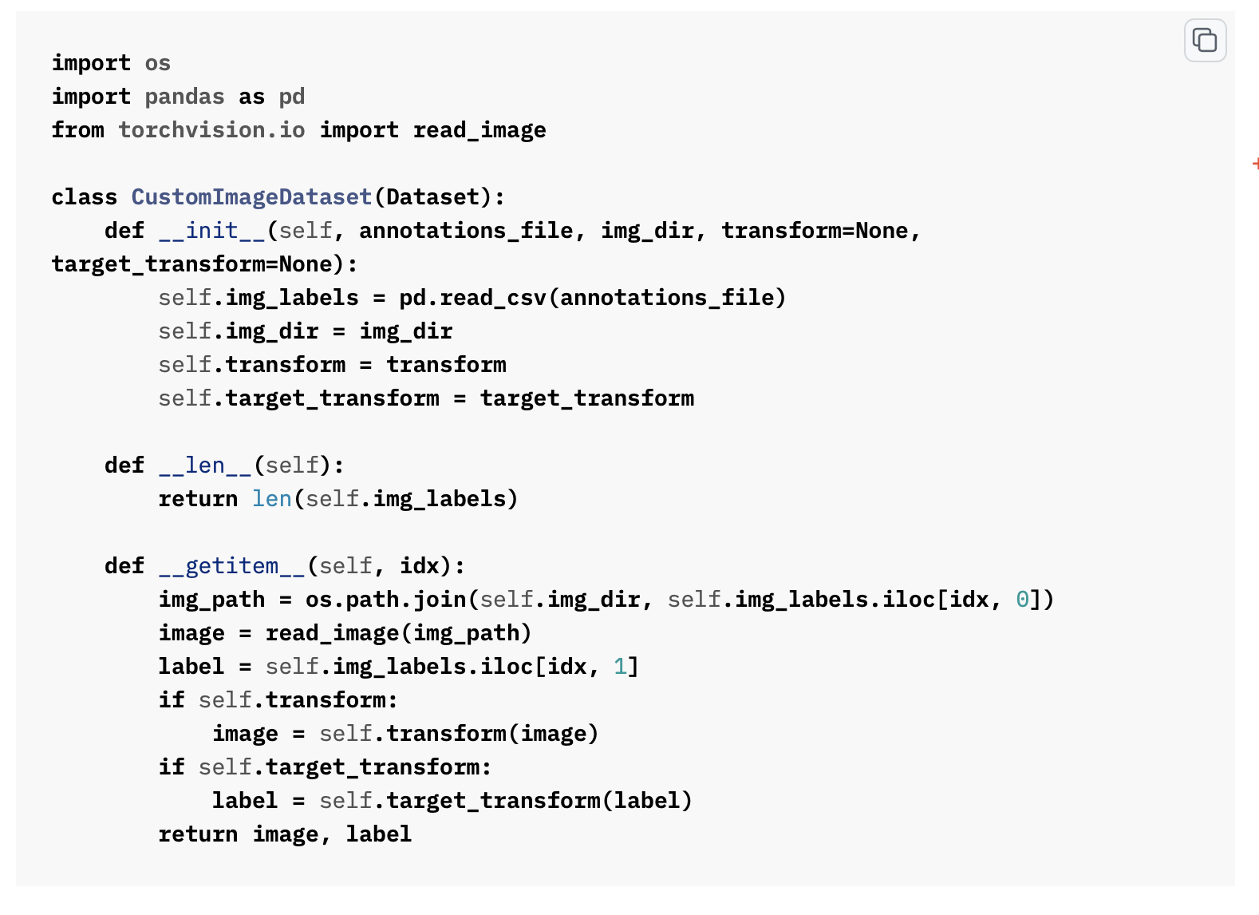
10 OF 11

Slide 12
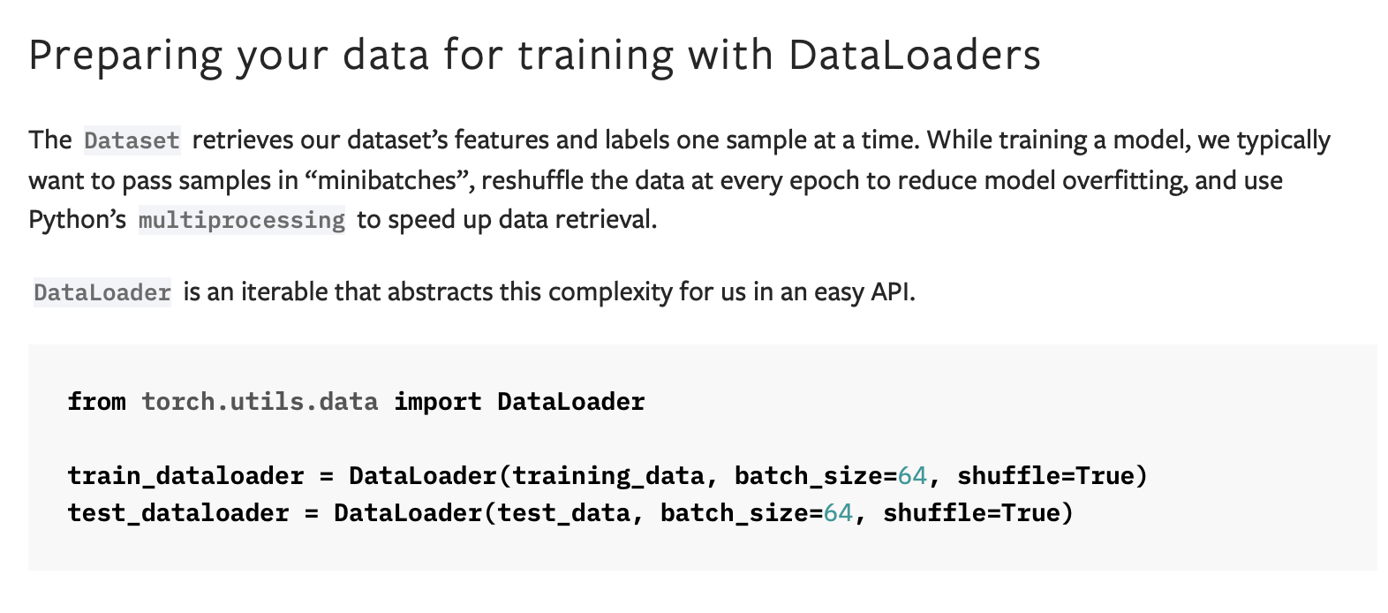
“LEARNING PYTORCH FROM SCRATCH”
torch.utils.data.Dataloader
The Dataloader class allows us to iterate over the data during model training or evaluation. We can define the batch size, number of workers (i.e. parallel processing on GPUs), and how to shuffle the data.
11 OF 11

