Slide 1
Git & Azure DevOps for Data Science
Keeping your code safe

Slide 2
My assumptions about you:
You might not be doing any formal version control right now
You aren't developing a system with a large team that's being deployed frequently

Slide 3
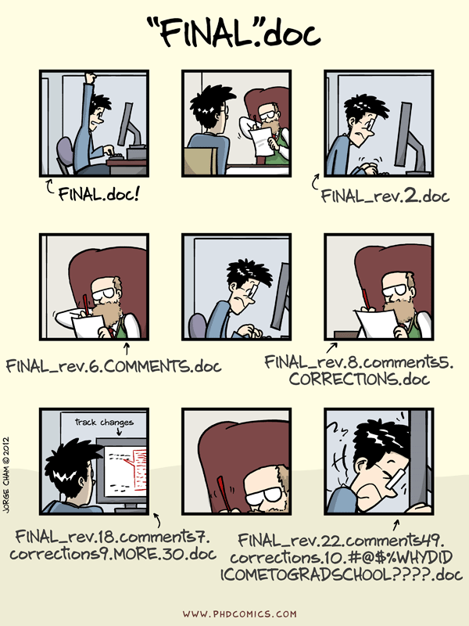
What is version control?

Slide 4
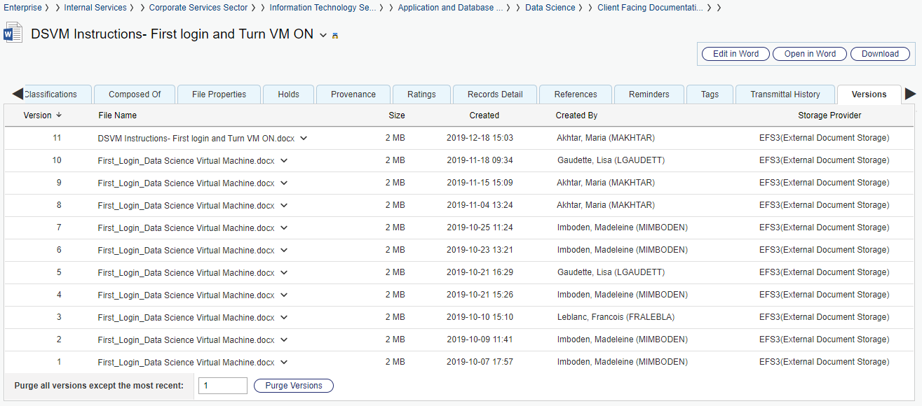
What is version control?

Slide 5
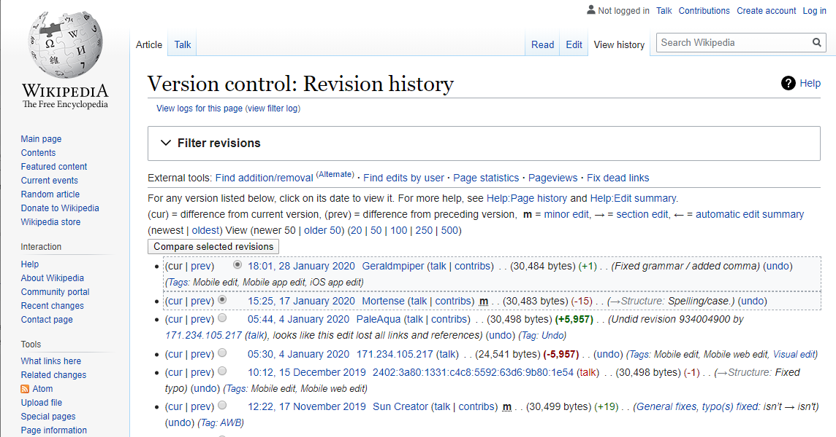
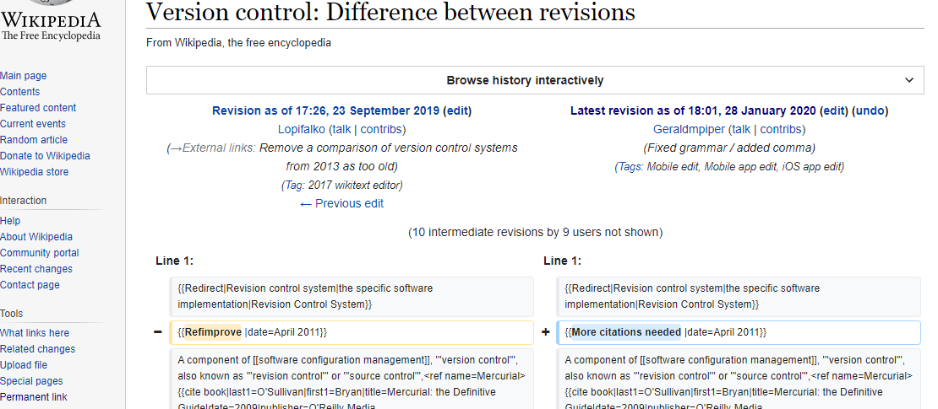
What is version control?

Slide 6
But I just work on my own code
Have you ever gotten to a state where you had something working, went to change it, something broke, and you couldn't get back to a working state?
Have you ever wanted to compare your code today to a version you had months ago? For example, to figure out why the results are different?
Have you ever been working on a bigger change and then suddenly priorities change and you want to make a completely different small change?

Slide 7
What is Git?
A decentralized version control system
Everyone has a copy of the full history
It doesn't require one centralized server
The most commonly used version control system for software development
Primarily a command line based tool
Many tools including Visual Studio Code, R Studio, and SAS have some integration

Slide 8
What is Azure DevOps Repos?
A Git server, Similar to GitHub, GitLab (GCCode), and BitBucket
This is your hub where you share code with your team
https://dev.azure.com/tbs-sct/
You can connect from the Protected B VMs
Send us an email if your account isn't activated
You can import repositories from public sources like GitHub

Slide 9
Interactive Demo

Slide 10
A few notes on formatting
Commands to type in are in Courier
Values to change are highlighted

Slide 11
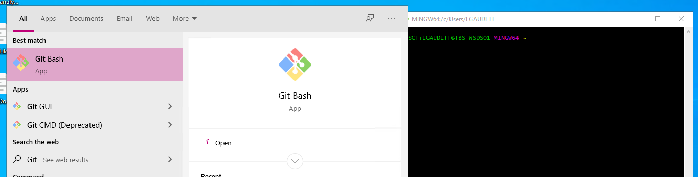
Bash
A command line interface common on Linux and Mac Systems
On Windows, use a tool called Git Bash (Installed on DSVMs)
A few useful commands:
ls : List directory
cd : Change directory
mkdir : Make directory

Slide 12
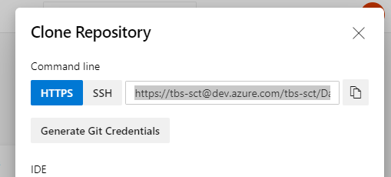
Getting Started with Git
To Initialize a new repository: Init
Inside the folder you want: git init
From a parent folder (creates the directory for you): git init my-repo
To make a local copy of an existing repository: Clone
git clone https://tbs-sct@dev.azure.com/tbs-sct/Data%20Science%20Projects/_git/testing

Slide 13
Making some changes
Git tracks changes to the level of a “commit”
Tell git what you want to commit
To add everything: git add .
A specific file: git add my-new-file.txt
Save it to your local history, with a short comment:
git commit –m "adding my new file"
“Push” your changes to a remote
To origin (most of the time): git push
To a different remote: git push my-remote

Slide 14
Your Local Repository
Working Tree
Index
Repository
Current state of files in your working directory
commit
Staged changes
The full history of commits
add
commit
git status
git log

Slide 15
Congratulations!
You now know enough for simple projects!
Where mostly one person is editing a file at any time
Only one major change at a time
Don't need to be able to release at any time

Slide 16
Branches
Branches can help you:
Keep your working code working while you make changes
Experiment with things you may throw away
Branches are easy and lightweight in git
Every git repository has at least one branch, master
The workflow we described before just uses master
There are many different branching strategies
No one strategy is right for every project

Slide 17
Working with Branches
Create & start working in a new branch
Create a branch: git branch branch-name
Switch to it: git checkout branch-name
In one command: git checkout –b branch-name
Add & commit as before to make changes in your branch
When you're ready to share your code
Initialize branch in remote
Push branch to remote
Create a pull request to merge changes to master

Slide 18
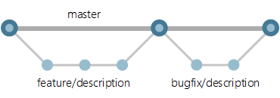
Feature Branches: A simple branching strategy
Create a new branch for each "feature"
Keep your work in progress separate from completed work
Keep your changes separate from other people's changes
Often combined with using pull requests to review changes going into master

Slide 19
Merging
When you're ready to share your changes:
git checkout master (The branch you want to merge to)
git merge branch-name (The branch where you've made your changes)
Scenarios:
Only one branch changed; "Fast Forward Merge"
Git will just do it
Both branches changed, but no conflicts; "3 way merge"
You'll need to make a commit with a comment for the merge
There are conflicting changes; "3 way merge with conflict"
Git will mark up the file(s) with conflicting changes
You need to resolve the conflicts then commit

Slide 20
Avoiding Merge conflicts
Keep feature branches small
Regularly pull from master into your feature
Not all conflicts are avoidable, but it's easier to deal with small merges!

Slide 21
Pull Request & Code Review
Pull requests help you:
Catch mistakes (we all make them!)
Ensure more than one person is familiar with code
Improve the overall quality of the code
Strongly recommended to protect a branch with pull requests when you want to always have a working version

Slide 22
End Demo

Slide 23
What should go in Git
Git is designed around text files like:
Code
Configuration files for the project
Supporting documentation, particularly in text formats (.md)

Slide 24
Proceed with caution
Generally OK:
Small binary files that don’t change often (e.g. a logo image)
Small, non-sensitive datasets or samples of larger ones (e.g. to test code)
Keep outside of Git
large files
frequently changing binary files of any size: e.g. Excel, PowerPoint, PowerBI files

Slide 25
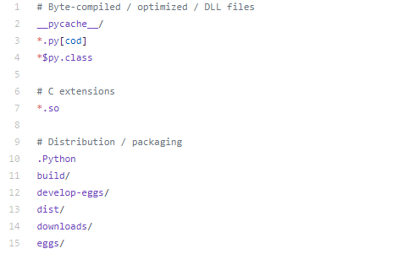
What should definitely NOT go in Git
Generally avoid:
Outputs
Editor configuration
Local settings
Definitely avoid
“Secrets” (like passwords, authentication tokens)
Protected data
Use a .gitignore file to
exclude these files
and folders

Slide 26
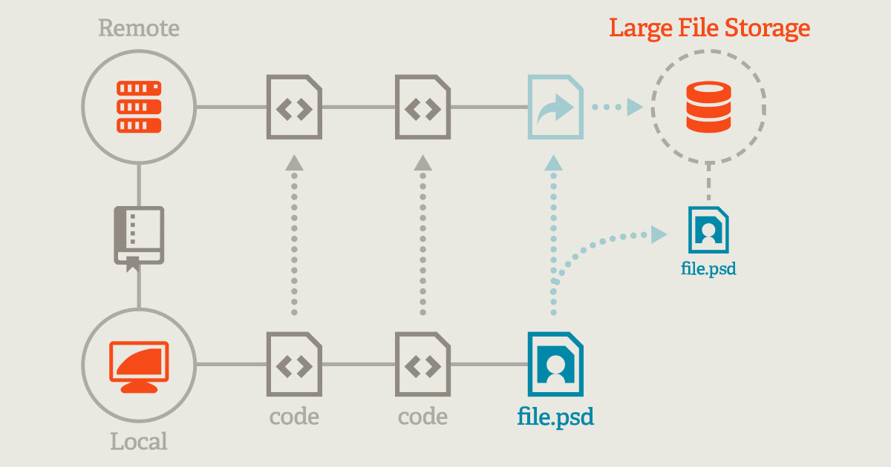
Git Large File Storage
Because everyone has a copy of the whole history, you want to make sure it doesn’t grow unnecessarily.
Git LFS adds a one time setup step to seamlessly store certain files like large files and binary files outside Git
git lfs track "*.pbix“
git add .gitattributes

Slide 27





Azure DevOps – Beyond Git
Repos:
What we've been talking about so far
Boards:
Track your tasks Agile style
Pipelines:
Build & deploy code through Continuous Integration & Continuous Deployment
Artifacts
Store build packages (e.g. your team could build a pip package and share it with others)
Test Plans
Not part of the basic license

Slide 28
Interactive Tutorials
Visualizing Git:
http://git-school.github.io/visualizing-git/
Learn Git Branching
https://learngitbranching.js.org/

Slide 29
Resources
Azure DevOps Intro to Git
https://docs.microsoft.com/en-us/azure/devops/repos/get-started/code-with-git?view=azure-devops
Pro Git – Free e-book, aussi disponible en Français
https://git-scm.com/book/en/v2
For when you get off the happy path:
https://dangitgit.com/
Development Workflows for Data Scientists
https://resources.github.com/downloads/development-workflows-data-scientists.pdf

