Slide 1
Data Science Talk Public Service Employee Survey (PSES) Power BI Project
Lessons learned, tips & tricks and how to improve accessibility
Notes:
As a member of the Analytics and Data Science team, I was asked by my colleagues Lisa and Francois to give a presentation on what our team learned while developing the PSES 2018 Power BI dashboard, with a focus around accessibility. I’m hoping that is what you are expecting from my today. What I would suggest you not expect from us today is a session on how to use the Power BI tool.
I do have some slides to get through but I think its likely best that we save most of our time here this morning for an open question/answer session, and for some demos within the Power BI tool.
A few others that were part of this project team that are here as well and that I’ll introduce in case you have any specific questions that might be best addressed by them. My colleague Gajanee who worked along with me to develop these dashboards.
Eric Martel, who led on getting the infrastructure in place for TBS, and who can speak to the publishing and licensing side of things.
Michelle Fougere – the team lead from OCHRO who, along with her team, we worked with as they are the owners of the PSES data.

Slide 2
Agenda
Overview of Power BI tool
Connections, data structures, types of visualizations
Accessibility
Areas of accessibility
Power BI accessibility features
First steps you can take to include accessibility into your dashboard
Our lessons learned: Public Service Employee Survey (PSES) 2018 Power BI dashboard
WCAG guidelines and other helpful links
Notes:
(read)

Slide 3
Overview of Power BI Tool
Data connections ( import mode versus direct query )
Data structures ( basic excel files, to snowflake & star schema data models)
you will need at least one value or measurement (facts). IE: total, count, sum, average, …
and other categories or groupings (dimensions) IE: departments, occupational group, language, region, province,…
Data visualizations ( the types, what is recommended based on what you want to display)
Comparison, Change over time, Ranking, Distribution
Notes:
(read)
I’m pointing out some areas to think about with Power BI tool to make sure that everyone has an idea of the basic functionality, but for the sake of time here today it will not be in any great detail on how to use the tool so I’ll refer you to the Power BI website from Microsoft for anything more in depth.

Slide 4
Data connections & structures
Data connections ( import mode versus direct query )
Be aware of all types and confirm how often you need your data refreshed
Refer to Microsoft documentation that will fully explain all the connectivity options, the best practices and draw backs of each type.
https://docs.microsoft.com/en-us/power-bi/desktop-directquery-about
Data structures ( basic excel files to snowflake & star schema data models)
you will need at least one value or measurement (fact). IE: total, count, sum, average, …
and other categories or groupings (dimension) IE: departments, occupational group, language, region, province,…
Notes:
The Power BI tool has 2 different ways of connecting to data. 1) IMPORT mode - we physically bring in the data directly into the PowerBI file. This way is quick and easy and is perfect for those fast, one off reports but do know that it limits you when it comes time to refresh your data. Use this method when you do not need a frequent update of your data ie: you are reporting on a yearly snapshot, your data is as of a certain point in time.
The 2nd method, 2) is Direct query. This method is used when you require your data to be updated more often. Daily, weekly or even monthly refreshes should consider this direct connection. So before you start your Power BI project, confirm how often you will need your dashboard updated with the latest data. Note: You can go from Direct Query to Import mode,…but you CANNOT change your connection type from Import Mode back to a direct query.
There is also a ‘Mixed-mode’ option as well that I won’t get into but just be aware of these types and determine your data refresh rate to help you decide.
The data structures – here just touching on the fact that you will need to have in your data source at least one measurement or fact and one or more groups or dimensions in order to use a visualization. Your data source can be a simple excel file, or you can be connecting to a SQL datamart with your all your fact and dimension tables in a star or snow-flake schema.

Slide 5
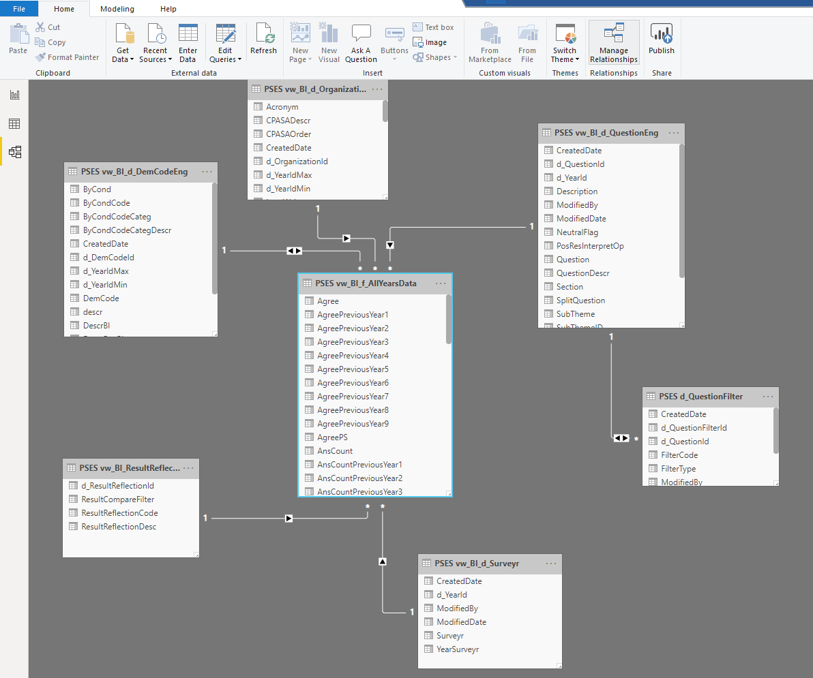
Data connections & structures
The data structure behind the PSES dashboard (star schema)
Notes:
A view of what the data structure is behind the PSES dashboard.
A star schema with your main fact table ( that has all you measures) in the middles, with your links to all you dimension tables ( these are you categories like Demographic code, Dept, year, Question )

Slide 6
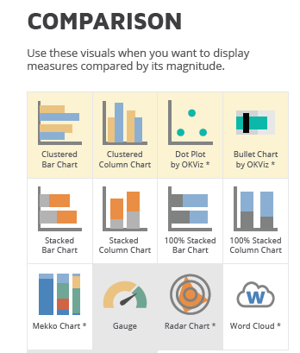
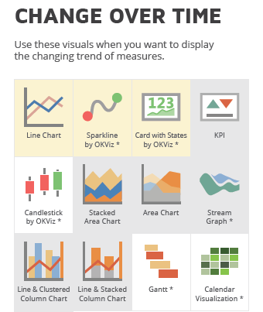
Data visualizations
Notes:
Here are a few recommended visuals for the type of display you want to show. This is from a link that I have included in this presentation.
It shows the yellow highlighted visuals as the preferred ones for dashboards, the white are neutral and the grey are deemed not the best for dashboards.
I’m not limiting our recommendations on this one specific site I found on visual types, but wanted to include it as an example of the grouping of visuals you can use to help guide you in your visualization selection.

Slide 7
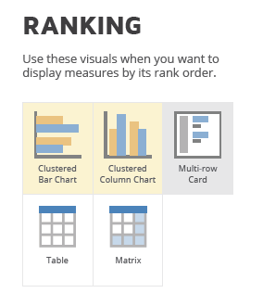
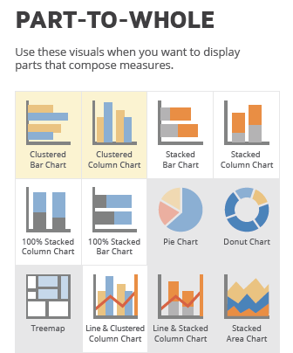
Data visualizations (con’t)
Notes:
Just a note: You will notice that the preferred visuals have the 2 distinct values side-by-side versus the stacked column visuals.

Slide 8
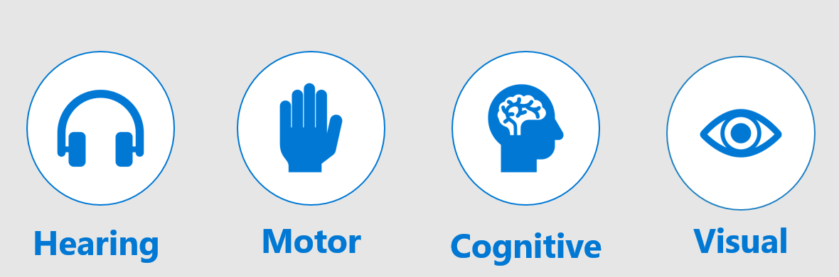
Areas of accessibility
Notes:
The 4 areas of accessibility to be aware of. Hearing –
Motor –
Cognitive –
Visual -
We will talk about accessibility features and improvements that will address all accessibility areas.

Slide 9
Power BI – Accessibility features
Within Power BI, there are 3 categories of accessibility features
Built-In (requires no developer effort)
General keyboard navigation
High contrast colors view
Screen-reader compatibility (JAWS)
Accessible Show Data table
Focus mode
Built-In ( requires some configuration)
ALT text
Tab order
Chart titles
Header tooltips
Achievable only by report developer efforts
Color contrast
Colorblind-friendly colors
Report themes
Notes:
(read)
After the slide show, we can open the Power BI tool and we can show you where you can access some of these features.
I’ll focus on the Accessible Show Data table / Focus mode / ALT text features that are found on every visual.
The Tab Order and Layer Order that are located in the Selection Pane.
I can run thru the existing PSES embedded dashboard that is live and published to show the Power BI Keyboard short cuts that we included in our PSES dashboards.
Also, using the JAWS screen reader to demo how the screen reader is used to read thru the dashboard.

Slide 10
Power BI - Accessibility first steps
If you do nothing else, at least do these minimum steps:
Ensure charts and text have sufficient color contrast
Use descriptive, purposeful chart titles
Avoid using color as the ONLY means of conveying information
Set tab order on all visuals in each page
Remove unnecessary acronyms and jargon from all charts
Notes:
(read)

Slide 11
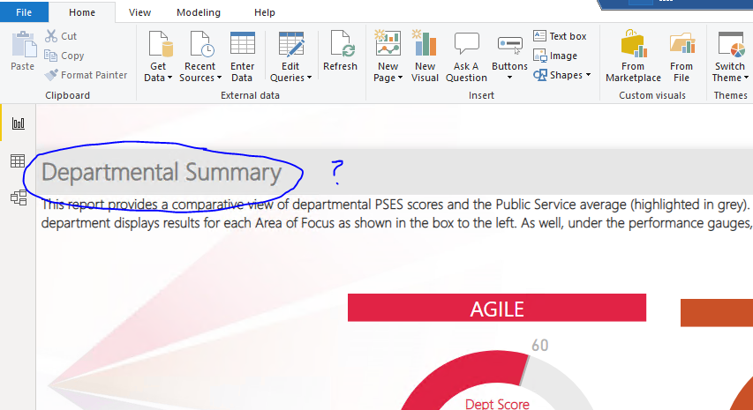
Power BI - Accessibility - Color Contrast
Is this report title WCAG 2.0 compliant ?

Slide 12
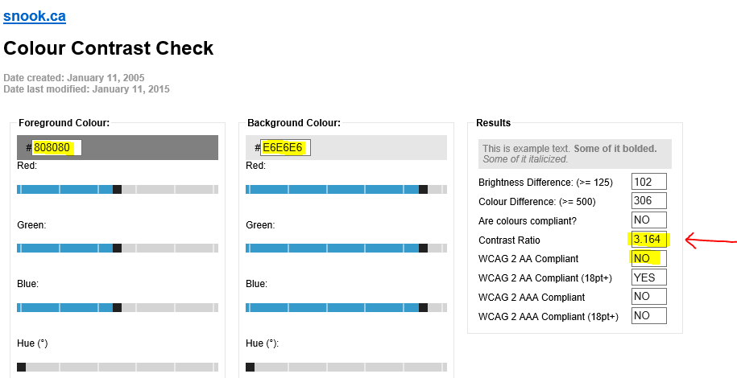
Power BI - Accessibility - Color Contrast
No, it failed. The Color Contrast ratio needs to be minimum 4.5 : 1
link: https://snook.ca/technical/colour_contrast/colour.html#fg=33FF33,bg=333333
Notes:
(read)
TBS needs to comply with WCAG 2.0 AA, so we need to either make the foreground( text) darker, or we need to lighten the background until we meet the minimum 4.5 : 1 ratio.
Helpful hint here: just ensure that all your text is the color black from the beginning. Create a dashboard template with default colors, text size, etc so you never have to go into each visual and update. I find that PowerBI uses a dark grey for its default text for some reason, I would recommend changing it before development starts.

Slide 13
Power BI – Lessons learned on the PSES (Public Service Employee Survey) dashboard
Build your dashboard with accessibility in mind from the very beginning and test throughout
Have a consistent look from page to page (titles, labels, logos, filters always in the same spot) to ensure user experience consistency.
Choose the proper visual based on the display you want:
Comparison, Change over time, Ranking, etc,…
Minimize, if possible, the categories along the X- Axis

Slide 14
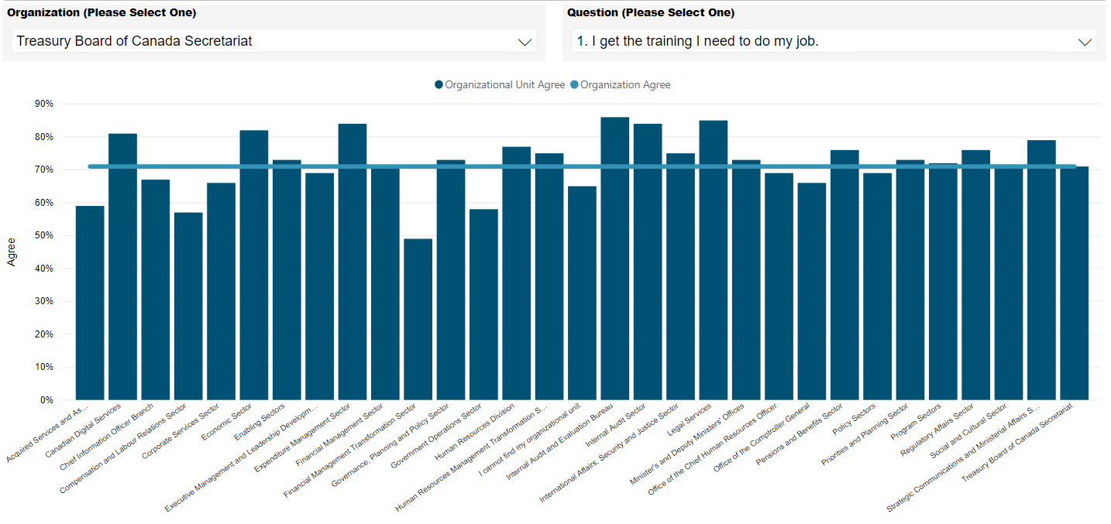
Power BI – Lessons learned on the PSES (Public Service Employee Survey) dashboard Before:
Notes:
An example of too many dimensions or categories along the chart’s X Axis. A rather long chart to fit in all the categories, in this case the organizational units.

Slide 15
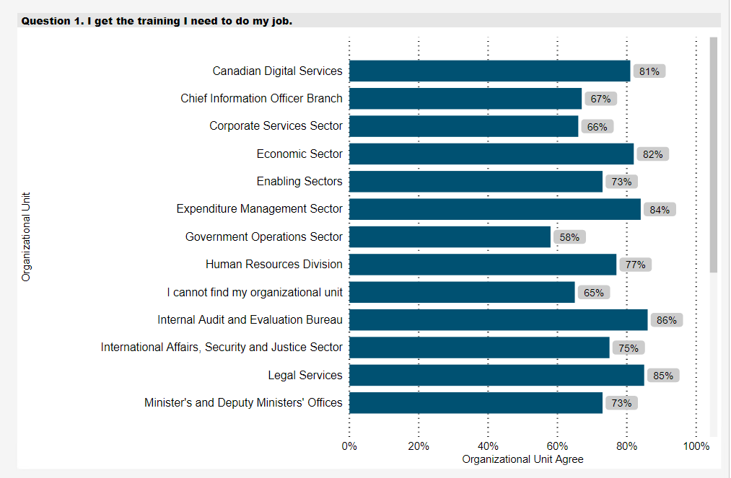
Power BI – Lessons learned on the PSES (Public Service Employee Survey) dashboard After:
Notes:
After being reviewed by Microsoft, their suggestion was to place the category on the Y axis to be more visually appealing and easier to consume.
I’m including this example as we had a few visuals that were like this, so something to think about for your next Power BI development.
Thoughts anyone ? Do you agree this is the better visual for this data, or is the first one better ?

Slide 16
Power BI – Lessons learned on the PSES dashboard (con’t)
Specific functionality that we recommend you have available / enabled within Power BI
Selection Pane – provides the ‘Tab Order’ and ‘Layer Order’ of all your visuals
Tab Order - creates the tab order of all visuals for keyboard users
Layer Order – you can use this to hide visuals / images that are not important data elements (ie: company logos) so as to remove them from the path of a keyboard user.
Enable Filter Pane – have a consistent filtering experience for your end users. Also, ensure to display the ‘Apply filter’ button as this will notify keyboard users that they are changing the filter and they should expect the visualizations to change.
ALT text – ensure you use the ALT text functionality on ALL visuals as this is what the screen reader will read out additional info to visually impaired users. Use very precise wording here. ALT text now allows for dynamic text
Notes:
Here I’ve highlighted a few specific items that we feel should be always used within your Power BI dashboards:
(read)
Tab Order – when our team first started working with PowerBI, there was no tab order, so we had to create and place each visual on the dashboard in the order we wanted the user to go through them. Thankfully this did not last long as Microsoft updated the tool with this Tab order functionality.
Layer Order ( read)
Enable Filter Pane (read)
ALT text (read) (also)…. an example of using precise wording, …if you have ALT text on a visual that reads “This bar chart displays the total public service population as compared to the selected government department” replace it with something more along the lines of “ total public service population compared to department”. Make it short and sweet. Get your message across in the least amount of words if possible. All 3 of these I will demo within the Power BI tool after this slide show.

Slide 17
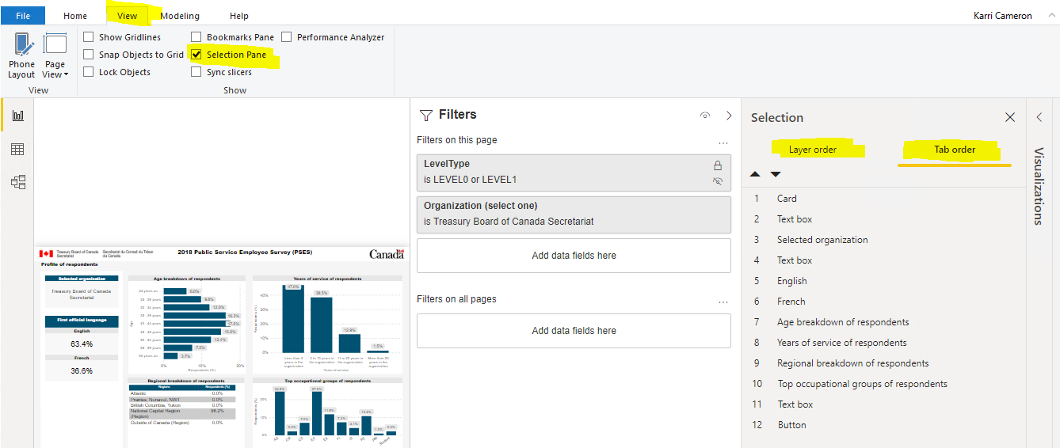
Power BI – Lessons learned on the PSES dashboard (con’t)
Selection Pane – Layer and Tab Order:

Slide 18
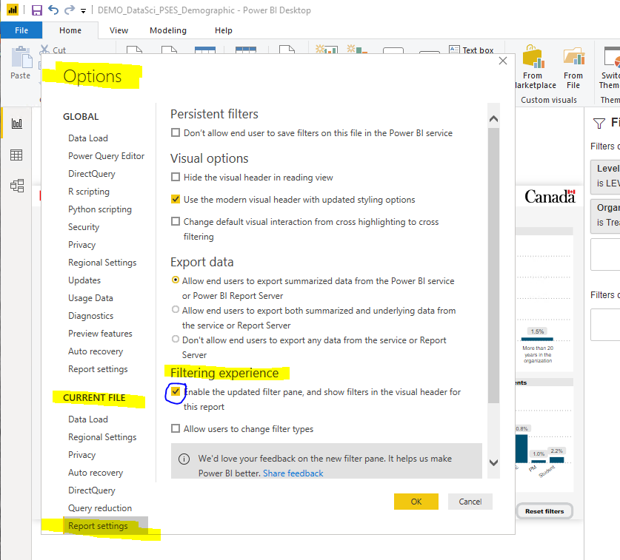
Power BI – Lessons learned on the PSES dashboard (con’t)
Enable Filter Pane: (to set up, go to File / Options and settings / Options )

Slide 19
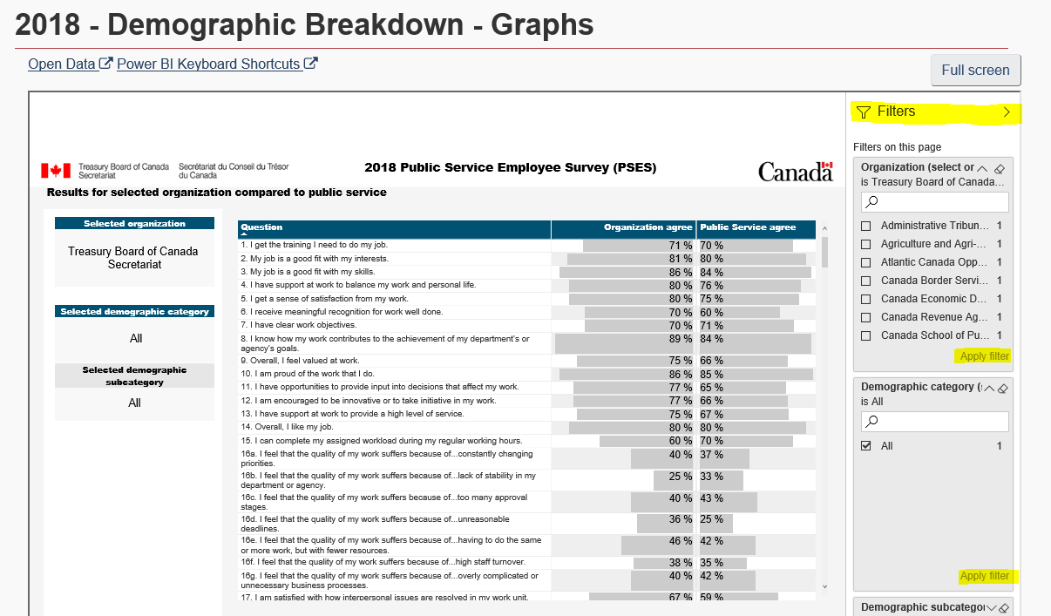
Power BI – Lessons learned on the PSES dashboard (con’t)
Filter Pane: include the ‘apply filter’ button to allow keyboard users to know when they are changing the data in the visual

Slide 20
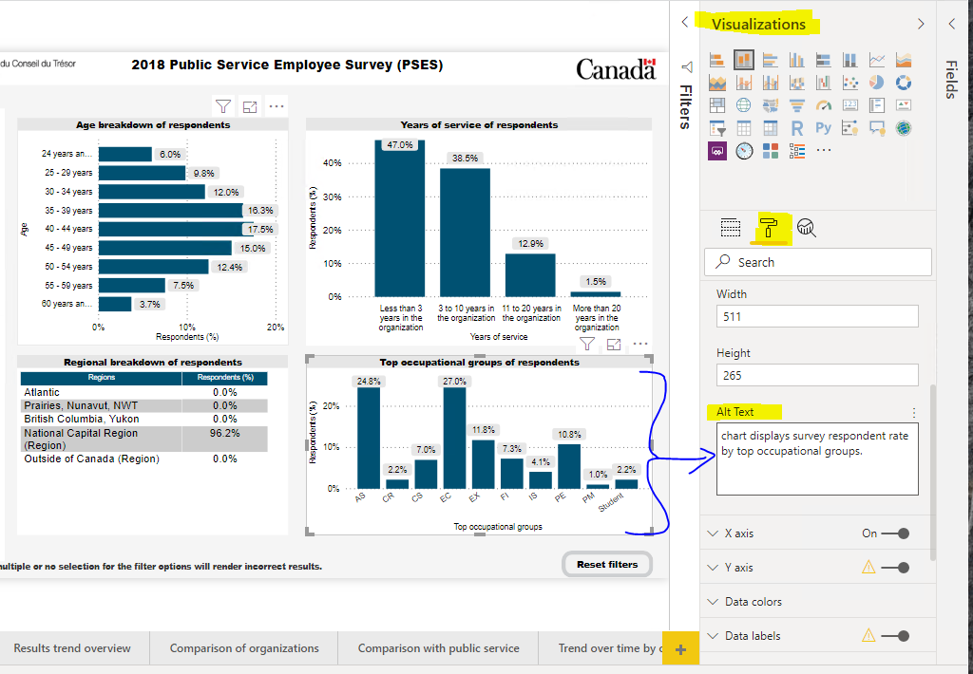
Power BI – Lessons learned on the PSES dashboard (con’t)
ALT text: ensure to use this feature on all visuals, as this is text that will be read by the screen readers

Slide 21
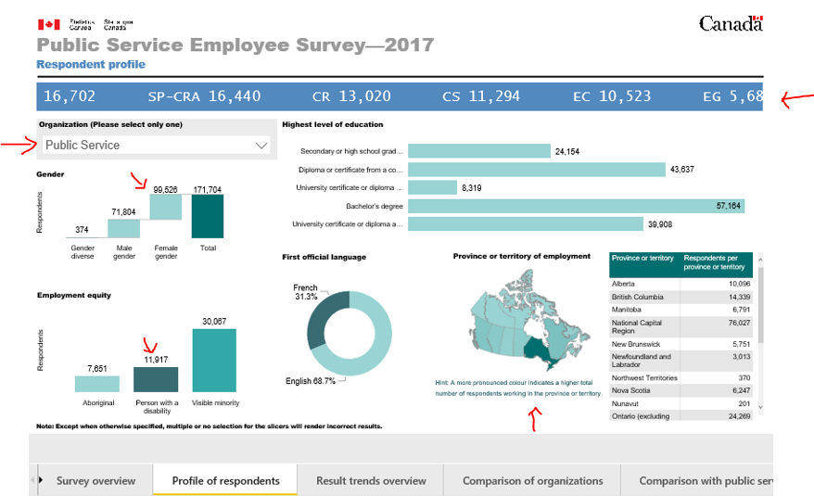
Power BI – the evolution of the PSES dashboard
The very beginning:
Notes:
I thought it might be interesting to show you how our project morphed into the finished product it is today.
(however, when I say finished product – its not really, as we know that these dashboards should always be updated /upgraded, apply more functionality, improve accessibility, etc. ). For this evolution I am using just one tab – the profile of respondents. The very first version of this PSES Power BI file was created in beta mode with few WCAG guidelines applied and without any accessibility features applied at all.
This was very representative of our starting point. I point out on this screenshot some of the issues that we needed to address:
-the scrolling ticker tape at the top, that moved across the top displaying the various occupational groups and their totals.
-the Organization Filter was within the dashboard itself, but depending on the page/tab the user was on, it was found in different locations.
-the map using only color to show higher population values.
-visuals using totals which are not overly useful to consumers

Slide 22
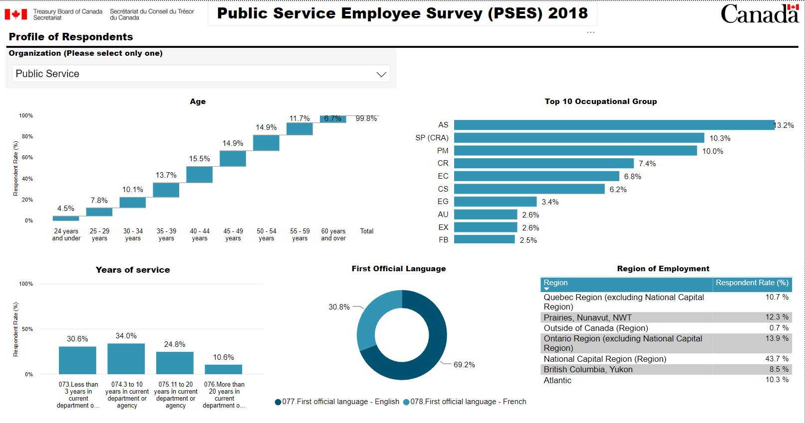
Power BI – the evolution of the PSES dashboard
A work in progress:
Notes:
Some of our first updates to the Profile of Respondents. A few improvements - changing totals to percentages in the visuals, removing the map and using instead just its related table as a visual.
Still work was needed to be done here so during the Power BI project we enlisted the help of a top Microsoft Power BI specialist who took our files and re worked some of the visuals.

Slide 23
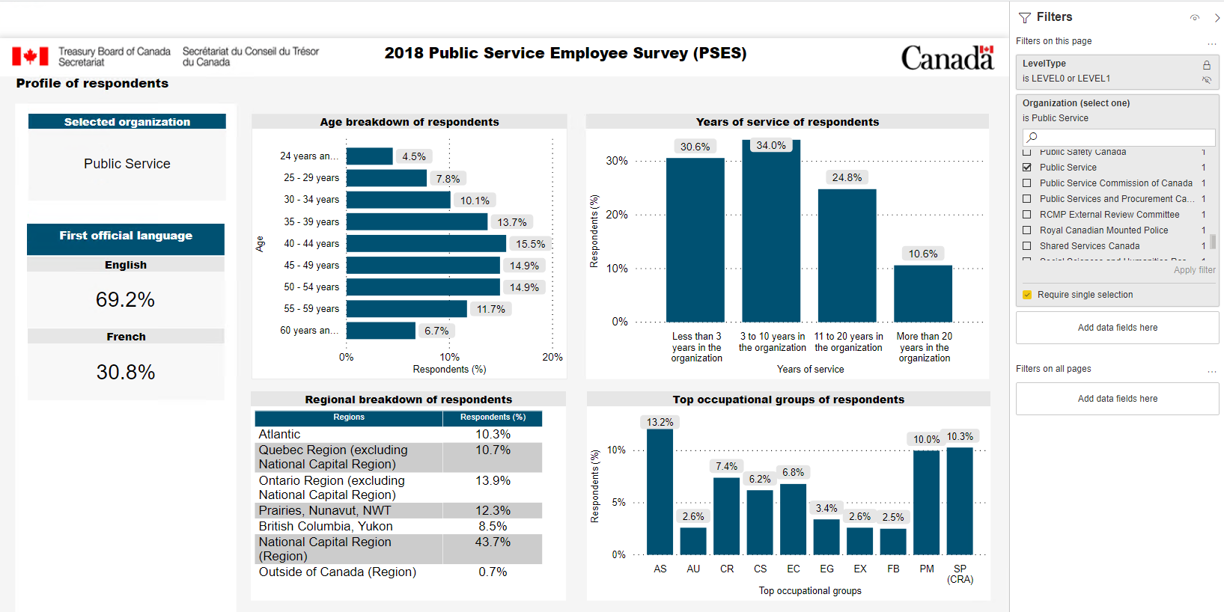
Power BI – the evolution of the PSES dashboard
Final result:
Notes:
And this is the Final version of this particular page, after incorporating some of Microsoft’s senior Power BI specialist’s recommendations.
Most notably – the consistent Filter pane on right hand side / bolder colors / larger font / and this consistent look and feel is carried throughout every page / tab within all the PSES dashboards.

Slide 24
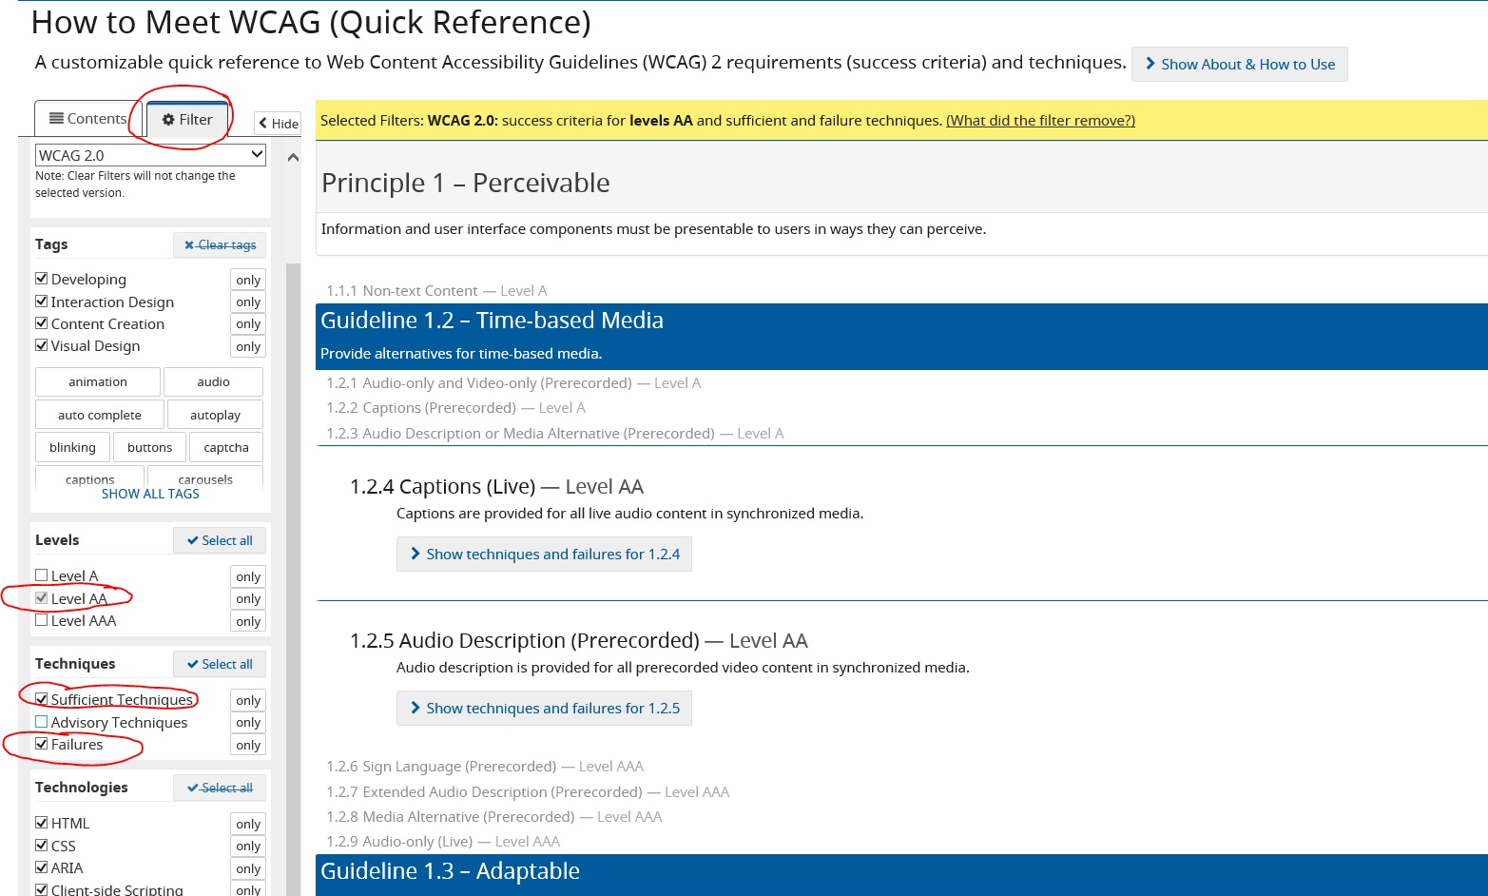
Power BI – Web Content Accessibility Guidelines (WCAG) 2.0
Full guidelines: http://www.w3.org/TR/WCAG20/
Quick reference: http://www.w3.org/WAI/WCAG21/quickref/?versions=2.0#principle1
Notes:
I’ve included the full guidelines for WCAG but I think that you will find that if anything, you will use the quick reference, with its filtering ability, to find out about each requirement and how to successfully meet the criteria.

Slide 25
Power BI – Helpful links & sources for this presentation
The Power BI PSES 2018 reports in production https://hranalytics-analytiquerh.tbs-sct.gc.ca/Home/Index?GoCTemplateCulture=en-CA
Microsoft - accessibility https://docs.microsoft.com/en-ca/power-bi/desktop-accessibility-overview
Microsoft – accessible themes https://community.powerbi.com/t5/Themes-Gallery/bd-p/ThemesGallery?filter=accessible
DataSavvy – accessible report design in PowerBI https://datasavvy.me/category/power-bi/
Color Contrasting: https://snook.ca/technical/colour_contrast/colour.html#fg=33FF33,bg=333333
Recommended visuals for your data:
https://www.sqlbi.com/wp-content/uploads/videotrainings/dashboarddesign/visuals-reference-may2017-A3.pdf
Notes:
Here are a few other links that I have found myself going to more than once.
I also included the actual live PSES report link – for those that may not know how to access these Power BI dashboards that I have been referring to.

Slide 26
Power BI – Questions ?
Notes:
Before we wrap up the slide show and jump into the tool for a few demos, are there any questions / comments on the presentation content ?

