Slide 1
Fairness in AI and Analytics

Slide 2
Outline
Why it matters
Definitions
How we can (try to) measure fairness
Steps to make datasets and algorithms more fair
Not included:
A general discussion of Ethics in AI
Explainability
Privacy

Slide 3
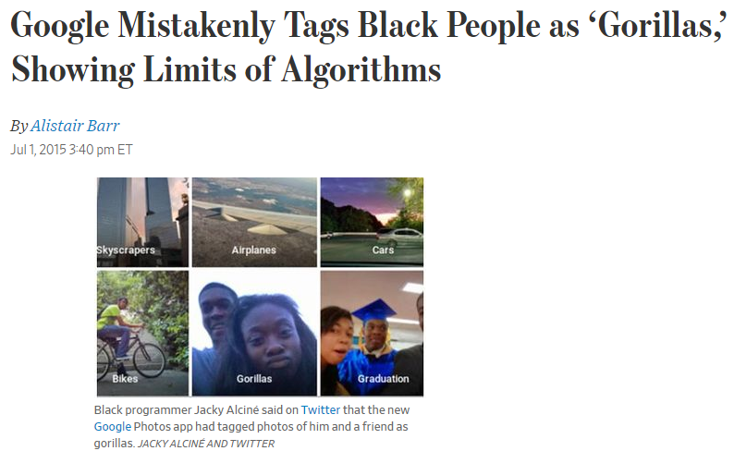
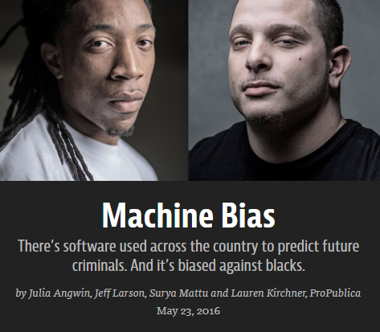
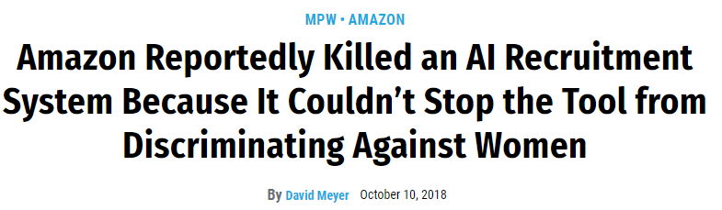
Examples of Unfair Algorithms

Slide 4
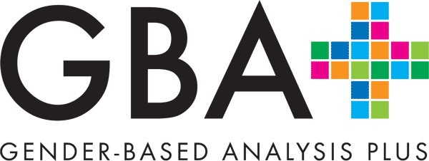
Government of Canada
Government of Canada Digital Standards
Design ethical services
Make sure that everyone receives fair treatment. Comply with ethical guidelines in the design and use of systems which automate decision making (such as the use of artificial intelligence).

Slide 5
Directive on Automated Decision-Making
Key Requirements relating to fairness:
Conduct Algorithmic Impact Assessments
Provide notice when an automated decision system is used
Provide meaningful explanations
Testing and monitoring outcomes for unintended bias
Defines 4 impact levels, with requirements for each
Scope:
Applies to external services
any system, tool, or statistical models used to recommend or make an administrative decision about a client
Links:
Directive on Automated Decision Making
Digital Government: Responsible use of artificial intelligence
Impact Assessment Tool

Slide 6
What is fairness?
“Fairness is a multifaceted, context-dependent social construct that defies simple definition.” (AI Fairness 360 toolkit, IBM)

Slide 7
What is Fairness in the context of AI?
“absence of any prejudice or favoritism toward an individual or a group based on their inherent or acquired characteristics” (A Survey on Bias and Fairness in Machine Learning, Mehrabi et al)
“Any case where AI/ML systems perform differently for different groups in ways that may be considered undesirable.” (Improving fairness in machine learning systems: What do industry practitioners need?, Holstein et al)
Protected groups may be defined in human rights or anti-discrimination laws; e.g. in Canada the Canadian Human Rights Act and the Employment Equity Act.

Slide 8
Some complications
“discriminating in advertising for hair products makes perfect sense in a way that discriminating in advertising for financial products is completely illegal.”, Interview with Cynthia Dwork, 2016
“[ML] models’ main assumption [is] that
the past is similar to the future. [...] if I don’t want to have the
same future, am I in the position to define the future for society
or not?” (Subject in Improving fairness in machine learning systems: What do industry practitioners need?, Holstein et al)
Notes:
In the context of AI, interest in fairness has exploded in the past few years, but this is a problem that far predates AI

Slide 9
Why it’s relevant to AI
Automated decision systems have the potential to reduce bias…
… but they also have the potential to scale up existing biases
Any decision process can be unfair or biased, from judgement of individuals, simple rules, to complex AI systems.
Automated Systems are not inherently more or less fair than human decision makers – but they may be unfair in different ways, while having the appearance of being objective.

Slide 10
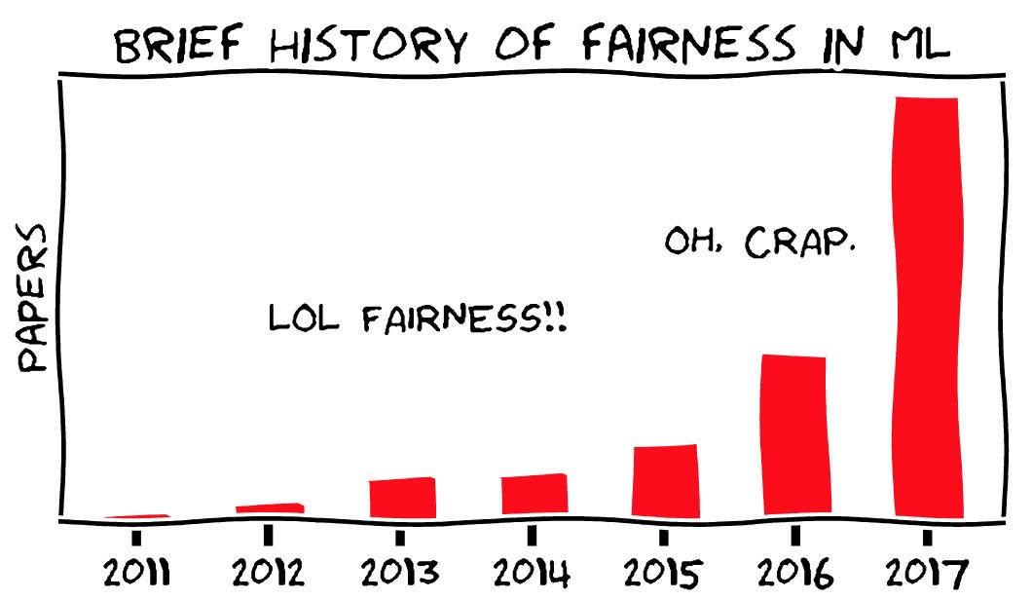

Slide 11
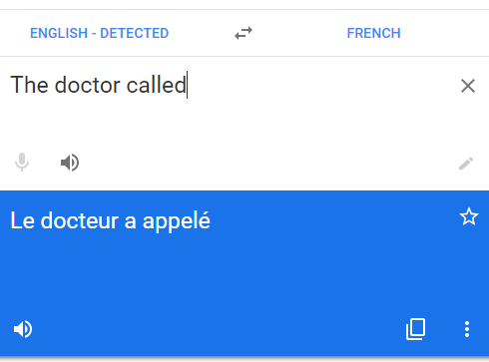
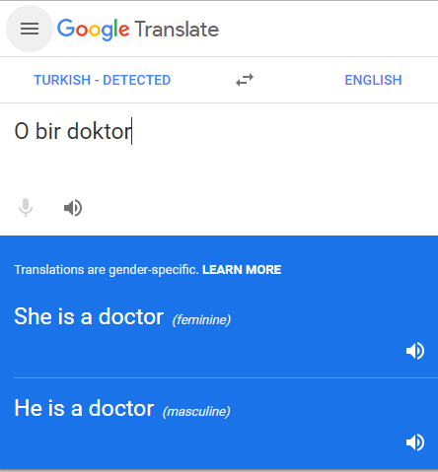
Types of Harms
Allocative Harms
When a system is used to make a decision, but unfairly denies them to a certain group
Representational Harms
When a system perpetuates stereotypes or otherwise reinforces the subordination of some groups
Most often in natural language or vision systems

Slide 12
Main problem sources for automated systems
Datasets
the data may be biased
The metric may not be exactly what we care about
Less data about minority groups
Transparency
Lack of transparency
People may assume that algorithms can’t be biased
Lack of mechanism to appeal
Algorithms may be flawed
Models used in contexts for which they were not designed
Feedback loops where a model gets more biased over time
Notes:
Flawed algorithms: Value added models for teacher performance expecting some students to do better than perfect, or punishing teachers because other teachers cheat

Slide 13
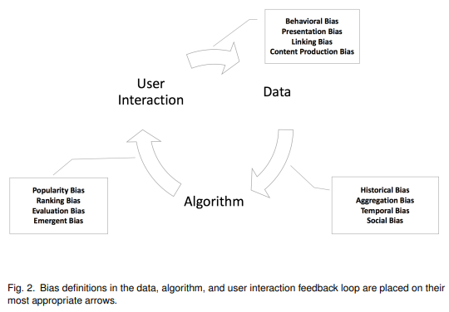
Different Sources of Bias
A Survey on Bias and Fairness in Machine Learning
Notes:
Historical bias: How the world is, or was when the data was collected. There are more white male CEOs so image search for CEOs is mostly white males
Temporal Bias. Temporal bias arises from differences in populations and behaviors over time
Aggregation Bias: When subgroups really should be treated differently but are not (particularly in medical contexts)
Social Bias. Social bias happens when other people’s actions or content coming from them affect our judgment.
Popularity Bias. Items that are more popular tend to be exposed more. However, popularity metrics are subject to manipulation—for example, by fake reviews or social bots [
Emergent Bias. Emergent bias happens as a result of use and interaction with real users. This bias arises as a result of change in population, cultural values, or societal knowledge usually some time after the completion of design
Evaluation bias: Inappropriate benchmark?
Behavioral Bias: User behavior varies across platforms, contexts, and datasets
Presentation Bias. Presentation bias is a result of how information is presented
Content production bias: differences in use of language across different gender and age groups
Population bias: The user population is different from the population as a whole
Representation bias: Image data collected primarily in North America may not represent a global picture.
Measurement bias: What we can measure may not be what we really care about. We can measure arrests, but what we care about is crimes committed.

Slide 14
Negative Feedback Loops
Self-fulfilling predictions: When a system collects data that is then used to redirect resources that collect data for the system
Example: A predictive policing algorithm assigns more resources to high crime neighborhoods, then finds even more crime in those neighborhoods because there are more police
Predictions that affect the training set for future models in a lopsided way
A predictive hiring system can’t learn about great candidates it didn’t recommend (but maybe can about bad ones it did)

Slide 15
Audience Participation Time!
If I search for images of ‘CEOs’, is it more fair to:
Over-represent the most common group
Represent the current race/gender distribution of CEOs?
Represent a diverse set of CEOs?
Represent to the demographics of the whole population?

Slide 16
Fairness Metrics
Many metrics have been proposed
It’s impossible to satisfy all of them at once
Different stakeholders may care more about different metrics
Most metrics assume access to the sensitive group(s), which may not always be available
There is not, and probably never will be, a universal metric
This goes back at least to work in the Civil Rights era in the US in the context of educational and employment testing, see 50 Years of Test (Un)fairness: Lessons for Machine Learning
Too much focus on metrics can be a bad thing

Slide 17
Types of Metrics
Group Fairness
Split the population into groups defined by protected attributes
Some statistical measures should be the same across groups
Individual Fairness
Similar Individuals should be treated similarly
Or, the protected attributes shouldn’t matter

Slide 18
Demographic Parity
Group Metrics
“Membership in a protected class should have no correlation with the decision”
Example
the fraction of group members that qualify for loans is the same across all groups
Drawbacks Details
Can be achieved through randomly selecting people in one group
An objectively perfect classifier may not satisfy it
Also known as:
Equal Parity, Statistical Parity

Slide 19
Equalized Odds
Group Metrics
“The protected and unprotected groups should have equal rates for true positives and false positives”
Example
The fraction of non-defaulters that qualify for loans and the fraction of defaulters that qualify for loans is constant across groups.
Drawbacks
Considerably reduces utility (performance) of the classifier
Also known as:
Positive Rate Parity

Slide 20
Equalized Opportunity
Group Metrics
“Protected and unprotected groups should have equal true positive rates.” – a relaxed version of Equalized Odds
Example
people who pay back their loan, have an equal opportunity of getting the loan in the first place
Best when
The positive outcome is desirable – the harm comes from false negatives
Also Known As:
Equal Opportunity, True Positive Parity

Slide 21
Predictive Value Parity
Group Metrics
When considering people who have a positive outcome, Positive PVP is when the probabilities of a true prediction are the same across groups. Negative PVP is when the probabilities of a negative prediction are the same across groups. PVP is when both are the same.
Example
People who don’t default are granted and/or denied loans at the same rate across groups
Drawbacks
In our loan example, we wouldn’t know whether people we didn’t give a loan to would default

Slide 22
Fairness through unawareness
Individual Metrics
“An algorithm is fair as long as any protected attributes are not explicitly used in the decision-making process”
Example:
We shouldn’t use race as an attribute in deciding who gets a loan
Drawbacks:
Under many circumstances, algorithms will find correlations in other variables that predict sensitive attributes
Under other circumstances, sensitive variables can be used to make models better for protected groups
Also known as:
Blinding
Notes:
Machine learning models are great at picking up correlations from other variables. If the data is biased, and some combination of other variables is correlated, the ML model will find it.
Conversely, in some cases, the sensitive variable can be used by the model in a way that benefits the disadvantaged group. If women are less likely to commit crimes than men, and gender is not considered in a risk model, the model will discriminate against women

Slide 23
Fairness through awareness
Individual Metrics
Any two individuals who are similar with respect to a similarity metric defined for a particular task should receive a similar outcome.
Drawbacks:
How do you define similarity?

Slide 24
Counterfactual Fairness
Individual Metrics
A decision is fair towards an individual if it is the same in both the actual world and a counterfactual world where the individual belonged to a different demographic group.
Drawbacks:
Requires a causal model
Counterfactual scenario may be unrealistic

Slide 25
Mitigation Approaches
Mitigate Bias in Data (pre-process)
Gather more data
Modify training data features and/or labels
Weight examples differently
Obfuscate protected attributes
Mitigate Bias in classifiers (in-process)
Optimize the classifier in part based on fairness
Examples: Adversarial Debiasing, discrimination aware regularization, optimize for the fairness metric
Mitigate Bias in predictions (post-process)
Apply some sort of transformation to the output of a classifier
Can work with any classifier

Slide 26
Practical Steps
Start having the discussions!
Conduct algorithmic impact assessments where appropriate
Document datasets and models, e.g. Model Cards for Model Reporting, Datasheets for Datasets
Open the system up to scrutiny
Decide on metrics to monitor, but be aware of their flaws
Can you collect better data?
Can you change the design of your system?
Know the limits of the algorithms.
Consider how to avoid feedback loops
Notes:
Change in system design: An example is an image tagging system which changed some labels to be more generic, like ‘Healthcare Professional’ instead of ‘Doctor’ vs ‘Nurse’.

Slide 27
In conclusion
It is important to think about fairness…
… but there are no magic bullets
Automated Systems are not inherently fair or unfair…
… but they can scale up unfairness and be more opaque
There are metrics to measure unfairness…
… but there is no one metric that always applies

Slide 28
Software Tools
AI Fairness 360 Open Source Toolkit (IBM): http://aif360.mybluemix.net/
Various fairness metrics and debiasing algorithms
Implemented in Python, sklearn style API
Aequitas: http://www.datasciencepublicpolicy.org/projects/aequitas/
Web Audit Tool
Python Library
Command Line Tool
Audit AI
https://github.com/pymetrics/audit-ai

Slide 29
High Level Overviews
Responsible Artificial Intelligence in the Government of Canada: Digital Disruption White Paper Series
Tackling bias in artificial intelligence (and in humans) (McKinsey Global Institute)
Algorithmic Impact Assessments: A Practical Framework for Public Agency Accountability (AI Now Institute)

Slide 30
Research Papers and Books
Fairness and Accountability Design Needs for Algorithmic Support in High-Stakes Public Sector Decision-Making
Approaching Fairness in Machine Learning (Blog)
Fairness and Machine Learning (draft): https://fairmlbook.org/

Slide 31
Talks
21 Definitions of Fairness (Arvind Narayanan) – FAT* 2019
The Trouble with Bias (Kate Crawford) – NIPS 2017 Keynote

