Slide 1
INTRODUKTION
AAPL tradingstrategi
Mål: At teste en 200 dages SMA trading strategi på AAPL og vurdere dens historiske performance og robusthed gennem backtest og walk forward test.
AAPL
12+ år
Aktie
Dataperiode hentet fra yfinance
Regler
Kun én åben position ad gangen
200 dages
$10000
SMA strategi
Startkapital
Køb: Hvis AAPL kursen ligger over 200 dages SMA
Sælg: Hvis AAPL kursen ligger under 200 dages SMA
Vi går kun lang. At gå kort er ikke tilladt
GitHub repo:
https://github.com/tbs7a2013areeb/Backtest-and-Forward-test-of-a-trading-stragy
Datakilde: yfinance | Kode og output findes på GitHub

Slide 2
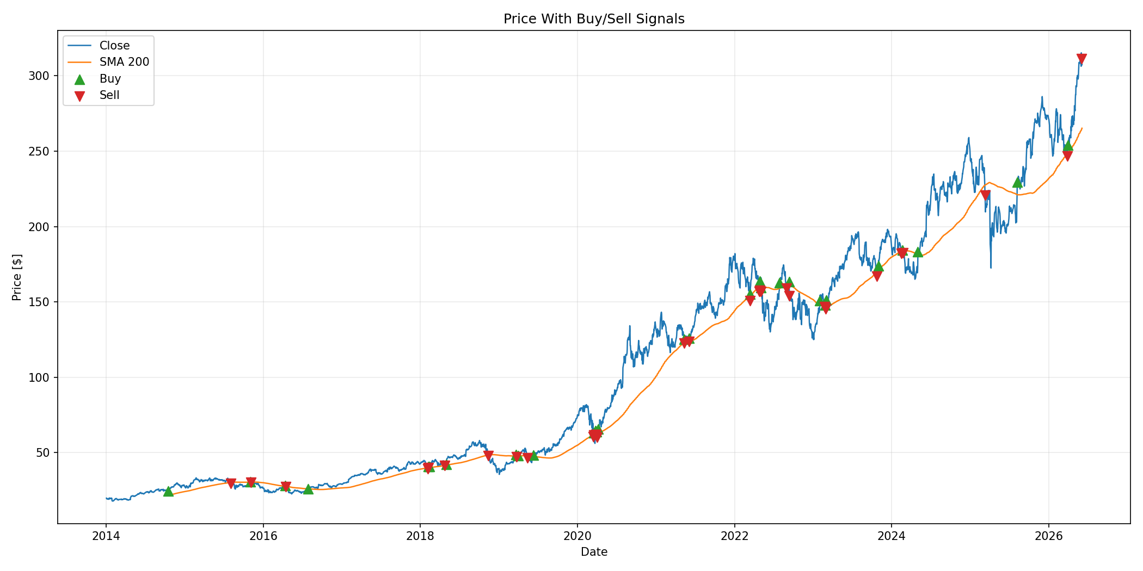
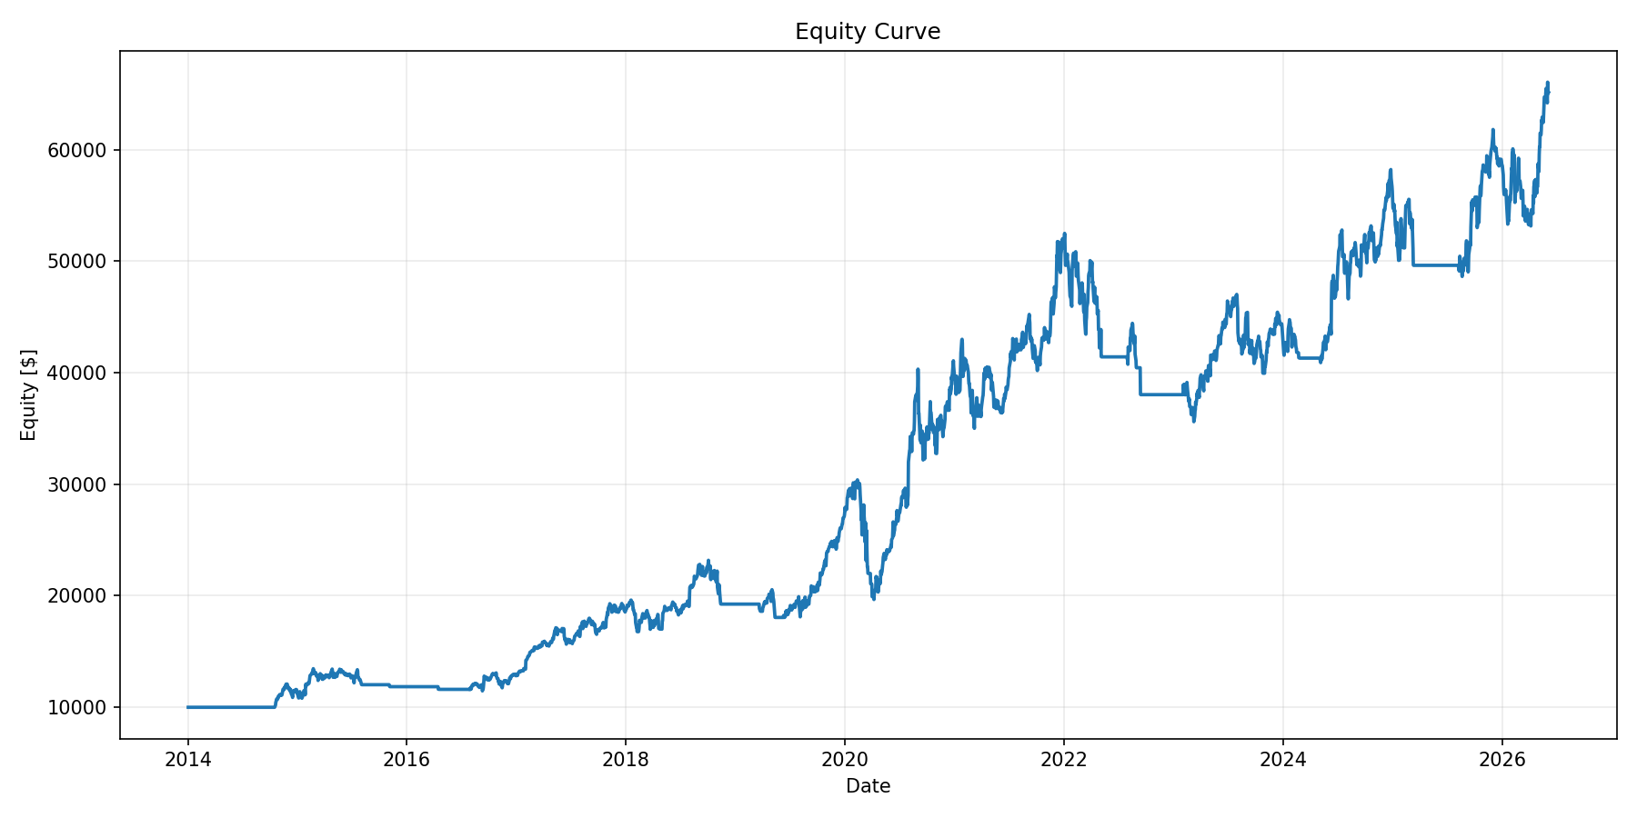
BACKTEST
Backtesten viser stærk vækst, men også drawdown risiko
2014-2026
PRIS OG HANDELSSIGNALER
$64.4k
543.6%
Slutkapital
Samlet afkast
1,202.7%
-35.3%
Køb og hold
Maks. drawdown
29
44.8%
KAPITALKURVE
Handler
Gevinstrate
6.10
71.7%
Profitfaktor
Eksponeringstid
Køb og hold viser AAPL afkastet, hvis aktien blev holdt i hele perioden.

Slide 3
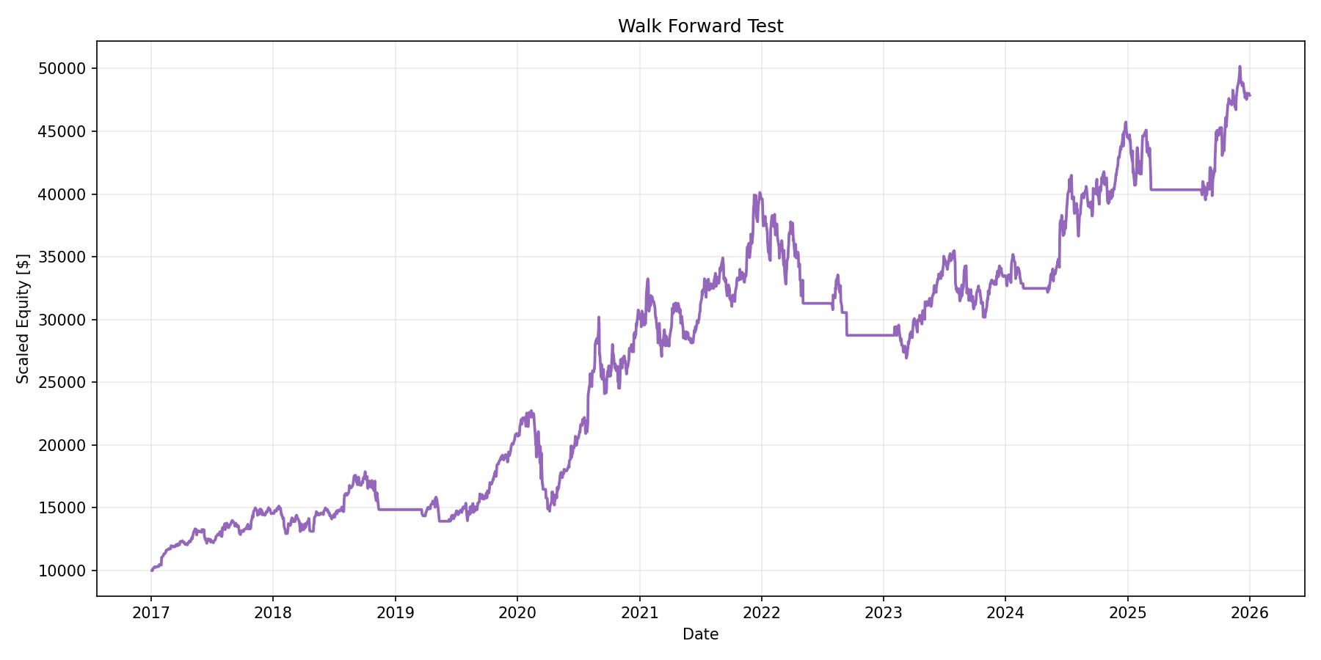
FORWARD TEST
Rolling out-of-sample periods stayed positive in 8 of 9 years
WALK FORWARD EQUITY
378.6%
21.5%
Compounded OOS return
Average OOS period
8 / 9
-27.5%
Positive periods
Worst period
ALL PERIOD RESULTS
Year
Return
Trades
2017
45.6%
1
2018
2.0%
4
2019
40.7%
3
2020
43.9%
5
2021
31.8%
3
The same fixed 200 day SMA rule is used in each test period. The forward test checks if performance remains reasonable outside one single full-history backtest.
2022
-27.5%
6
2023
16.5%
4
2024
32.9%
3
2025
7.5%
2
Walk forward setup: 3 years in sample, then 1 year out of sample

Slide 4
CONCLUSION
The strategy appears effective as a demo, but it is not complete
The fixed 200 day SMA strategy showed strong historical performance in both the full backtest and walk forward test.
543.6%
378.6%
200 day
Backtest return
Walk forward OOS
Fixed SMA
Still missing
Future improvements
Risk management such as stop loss, position sizing, and max drawdown limits.
Test the same rule on several stocks and market regimes.
More complete transaction cost modelling, including spread and slippage.
Add risk controls and compare risk adjusted performance.
Parameter optimization and more robust validation across more stocks.
Run paper trading before considering any live use.
Bottom line: good demo results, but not enough for real trading decisions without stronger controls and validation.
This project is for research and demonstration only. It is not investment advice.

