Slide 1
Chapter 3
VE216 RC3

Slide 2
Fourier Series for periodic signals
General introduction
CTFS (continuous time fourier series)
DTFS (discrete time fourier series)

Slide 3
Eigenfunctions & Eigenvalues
Eigenfunctions & Eigenvalues
  the output is a scaled version of its input
  input: Eigenfunctions
  scaling factor: Eigenvalues

Slide 4

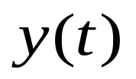

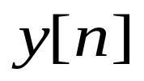
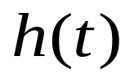

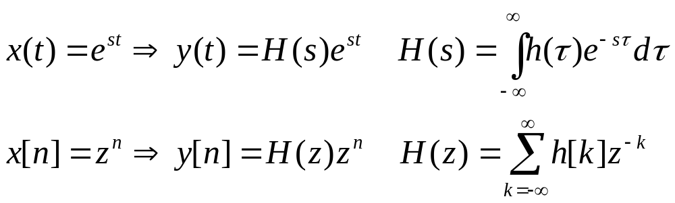
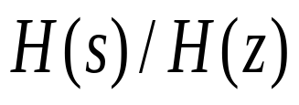
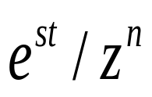
Eigenfunctions & Eigenvalues
transfer function/eigenvalue
eigenfunction

Slide 5
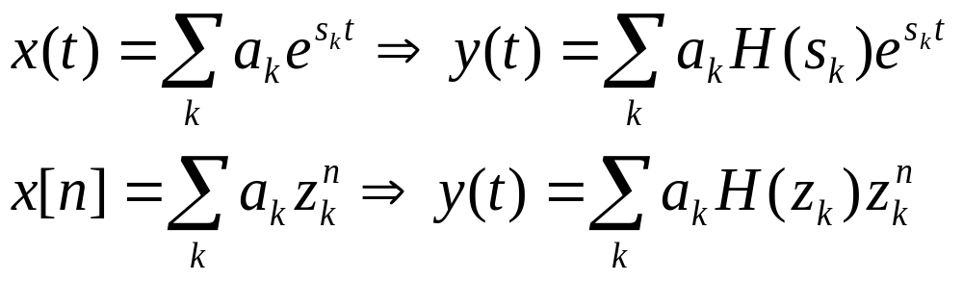

Superposition Principle for LTI System
are complex numbers

Slide 6
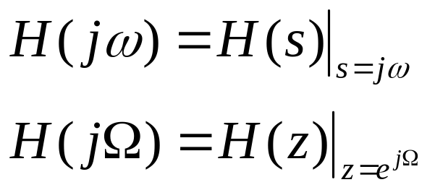
Fourier Analysis
H(s): Laplace transform of h(t)
H(z): z-transform of h[n]
Frequency Response of the system:
fourier transform of h(t)
fourier transform of h[n]

Slide 7
Continuous Time Fourier Series
CTFS
  Definition & Fourier coefficients
  Trigonometric forms of FS
  Dirichlet Conditions & Gibbs Phenomenon
  Properties of FS/FC
  Common FS pairs

Slide 8

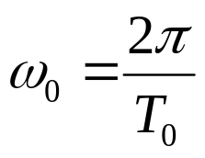
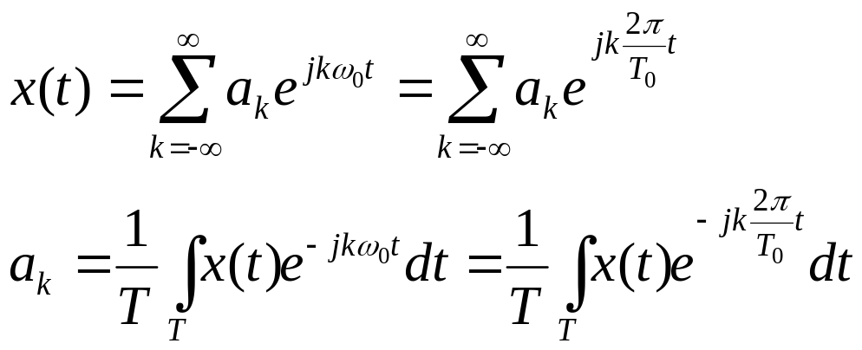

Definition & Fourier Coefficient
For a periodic signal x(t)
  fundamental period
  fundamental radian frequency
  Fourier Series & Fourier Coefficients
Watch out for
k=0!
N th harmonic component

Slide 9
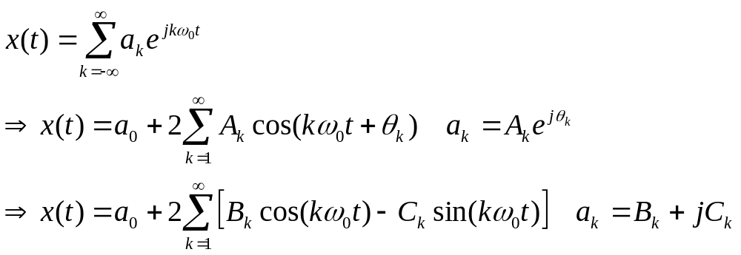
Trigonometric forms
For real valued signal x(t)

Slide 10
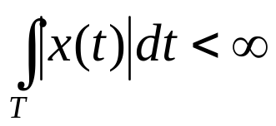
Dirichlet Conditions
Conditions for a periodic signal to be representable by Fourier series
  x(t) is absolutely integrable
  finite number of maximum and minimum points in one period
  at most finite discontinuous poles in one period

Slide 11
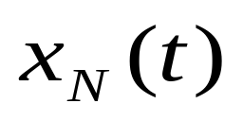
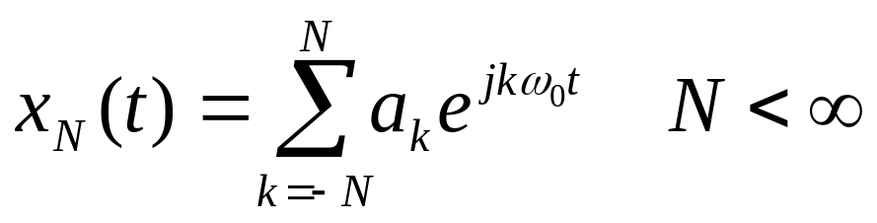
Gibb's Phenomenon
for periodic signal x(t) with discontinuities in a interval, plot
As N increase:
  peak amplitudes of ripples in does not change
  ripples compresses to discontinuity points
  Lecture 7 Page 10-11

Slide 12
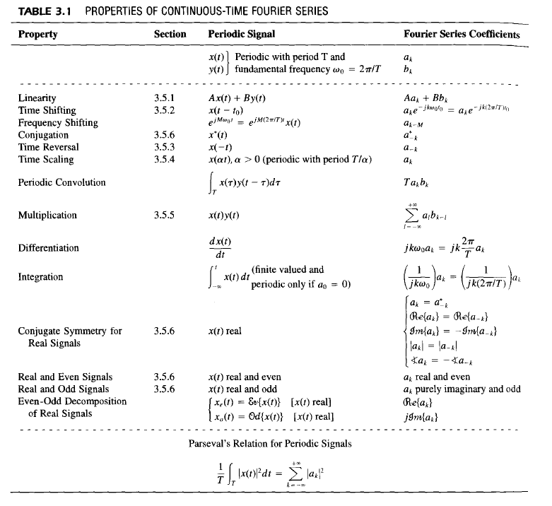
Properties of Fourier Series

Slide 13
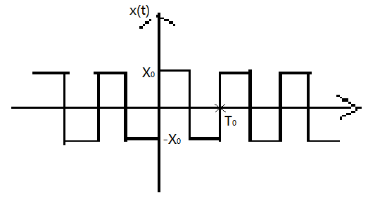
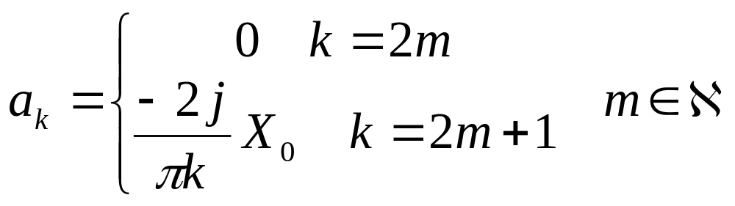
Common CTFS Pairs
Ex1:

Slide 14
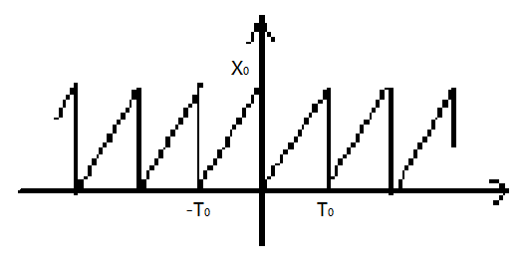
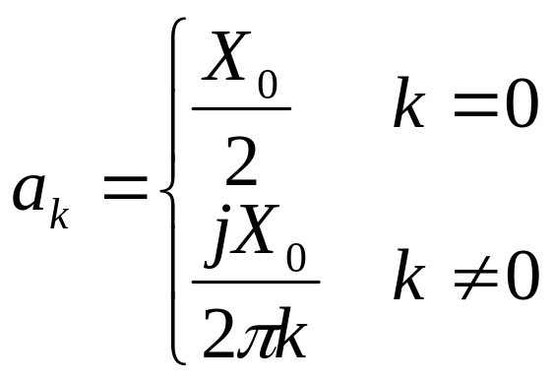
Common CTFS Pairs
Ex2:

Slide 15
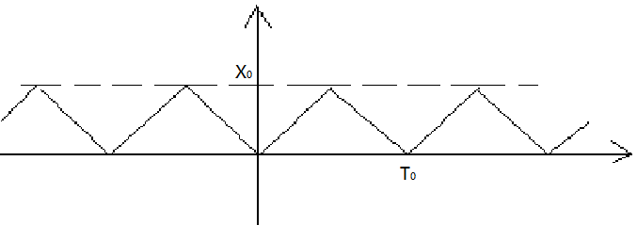
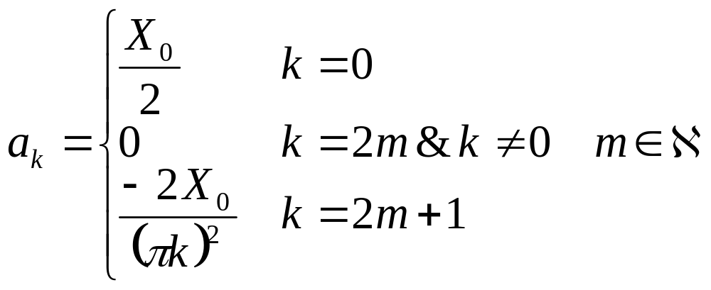
Common CTFS Pairs
Ex3:

Slide 16
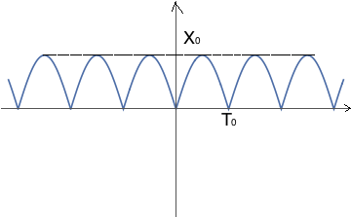
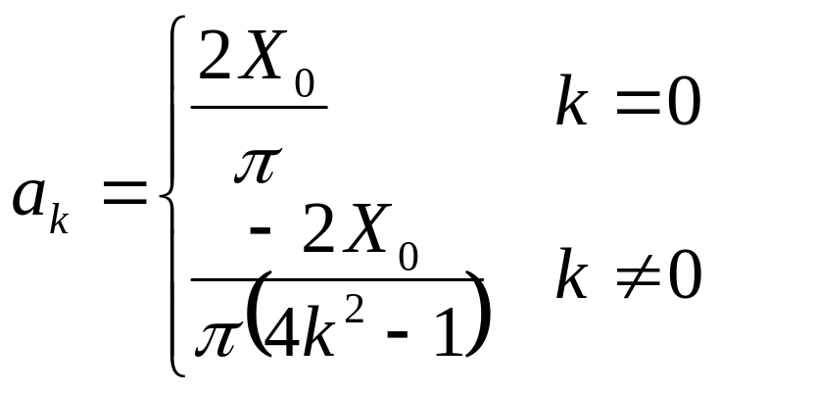
Common CTFS Pairs
Ex4:

Slide 17
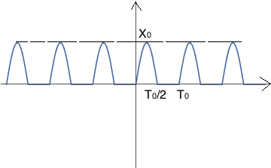
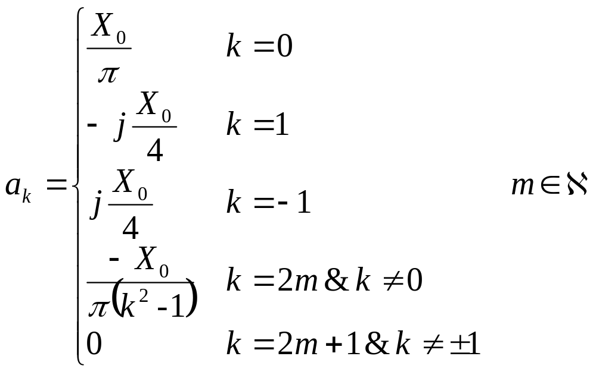
Common CTFS Pairs
Ex5:

Slide 18
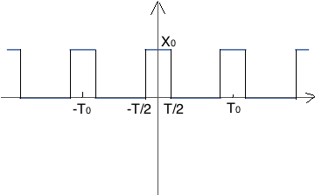
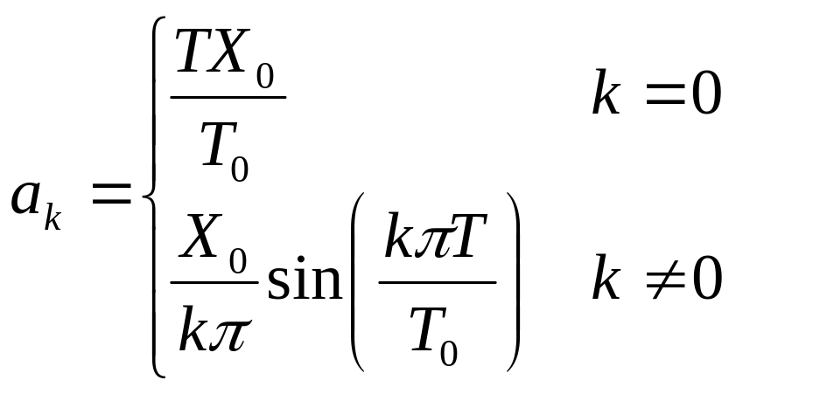
Common CTFS Pairs
Ex6:

Slide 19
Discrete Time Fourier Series
DTFS
  Definition & Fourier coefficients
  Properties of FS/FC

Slide 20
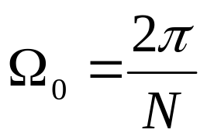
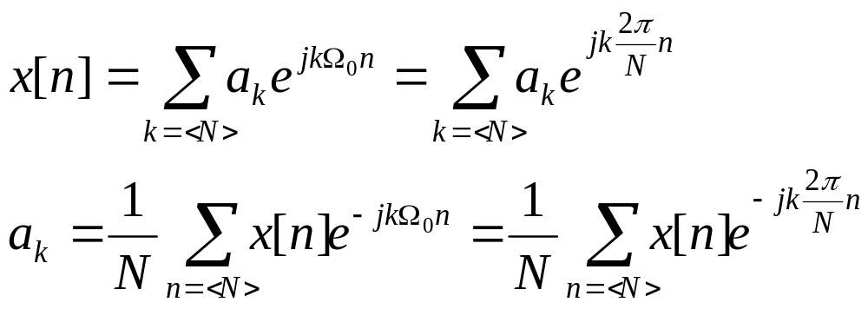
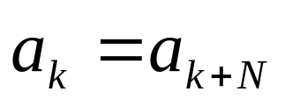
Definition & Fourier coefficients
For a periodic signal x[n]
  fundamental period N
  fundamental radian frequency
  Fourier Series & Fourier Coefficients
No Dirichlet
Conditions
for DTFS!
DTFC is also periodic with period N

Slide 21
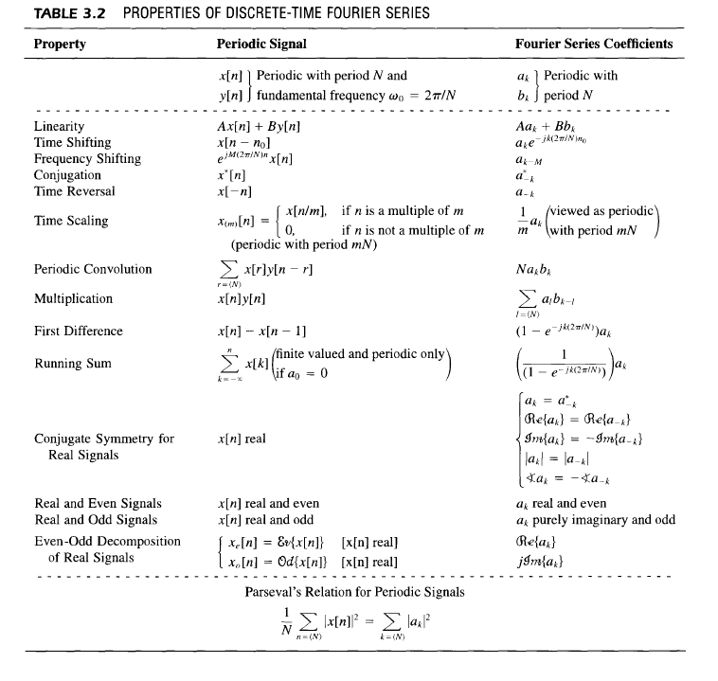
Properties of DTFS/FC

