Slide 1
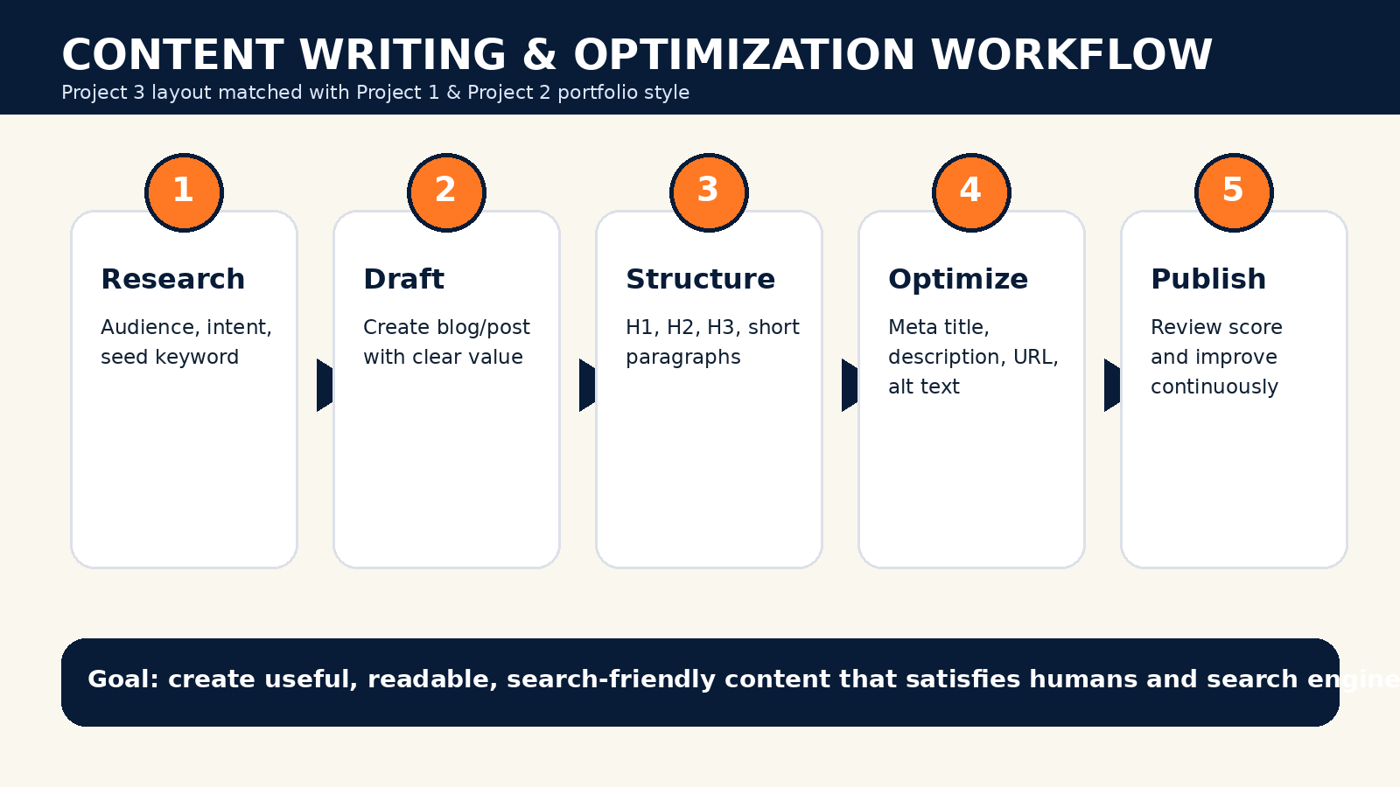
Tanya Chauhan • Project 3 • Content Writing & Optimization
Project 3 UI Matched Version
Same layout language as Project 1 and Project 2
Premium navy/orange dashboard design
Responsive website with working JavaScript
Prepared by Tanya Chauhan

Slide 2
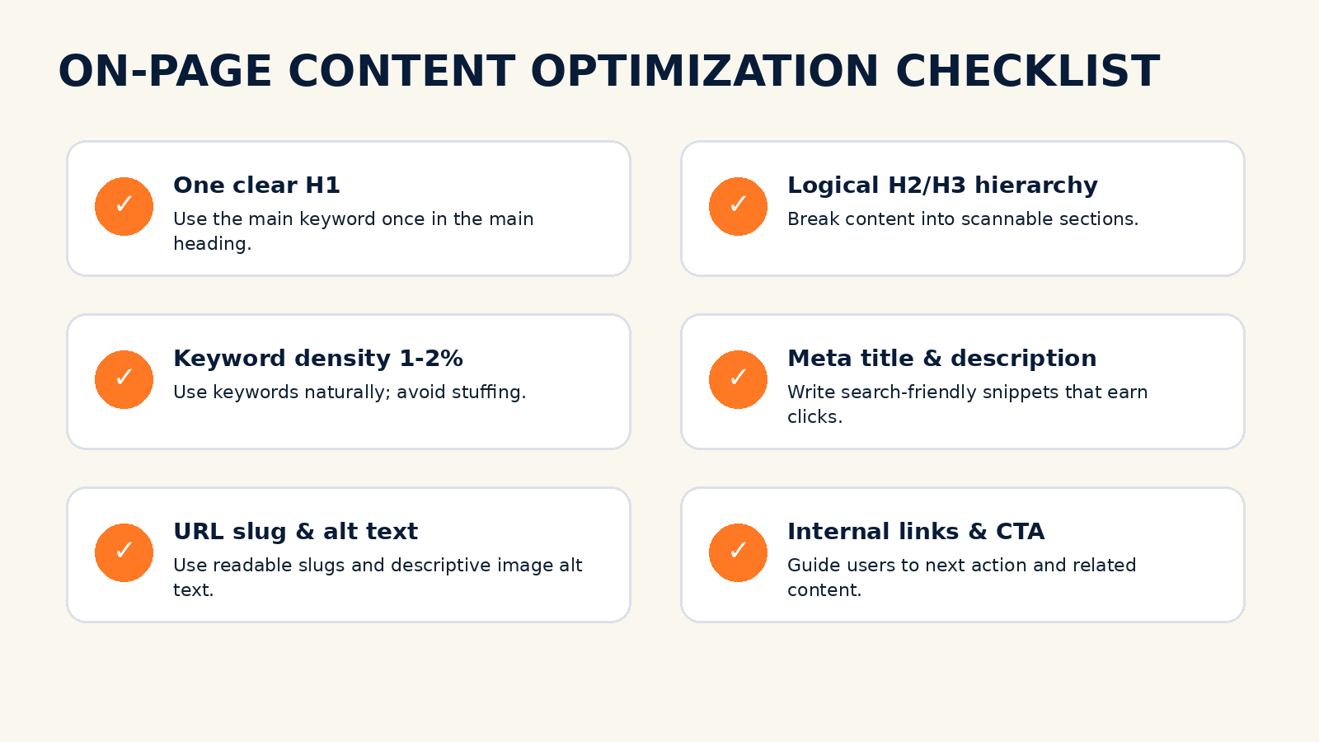
Tanya Chauhan • Project 3 • Content Writing & Optimization
Content Writing Objective
Write SEO-friendly content for digital platforms
Use keywords naturally, not mechanically
Optimize H1, H2, H3, metadata, URL, alt text
Improve readability and conversion intent

Slide 3
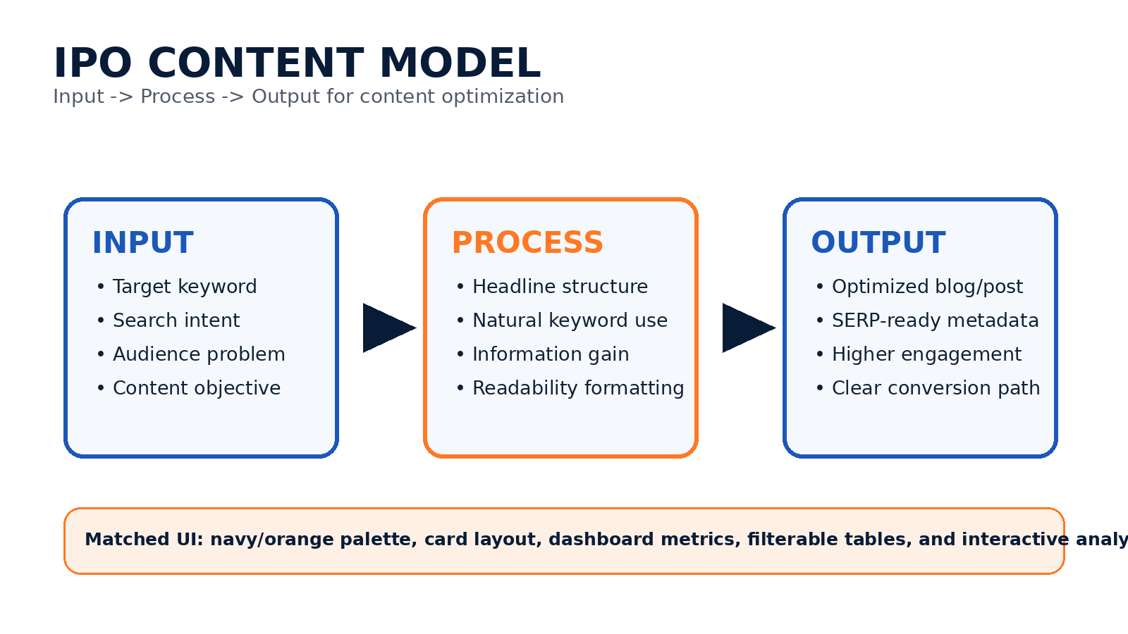
Tanya Chauhan • Project 3 • Content Writing & Optimization
IPO Content Model
Input: keyword, user intent, audience problem
Process: structure, keyword placement, readability
Output: optimized content asset ready to publish

Slide 4
Tanya Chauhan • Project 3 • Content Writing & Optimization
Website Working Features
Theme toggle
Article tabs
Keyword filter table
Content analyzer
Search preview
Workflow timeline

Slide 5
Tanya Chauhan • Project 3 • Content Writing & Optimization
Final Deliverables
HTML, CSS, JavaScript source code
Keyword JSON and CSV database
DOCX and PDF report
PowerPoint presentation
Workflow and infographic images

