Slide 1
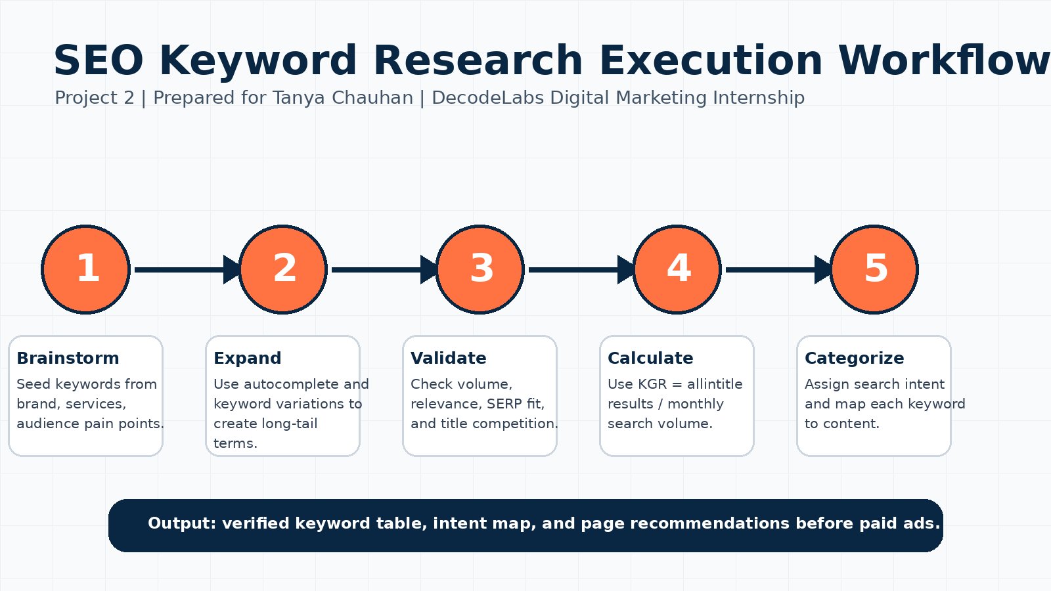
SEO Basics & Keyword Research
Digital Marketing Project 2 | Prepared by Tanya Chauhan

Slide 2
Project Objective
Build a data-driven keyword strategy for a website or blog.
Requirements
• Find relevant keywords
• Identify search intent
• Suggest content topics
• Prepare meta title and meta description
• Validate keywords using KGR
Skills Demonstrated
• SEO fundamentals
• Keyword research
• Intent classification
• Content mapping
• Beginner-friendly reporting

Slide 3
SEO Logic: Input - Process - Output
Input
• User Query
• Demand signal
• Search language
Process
• Relevance check
• Authority check
• Content quality
Output
• SERP position
• Clicks
• Qualified leads

Slide 4
Execution Workflow

Slide 5
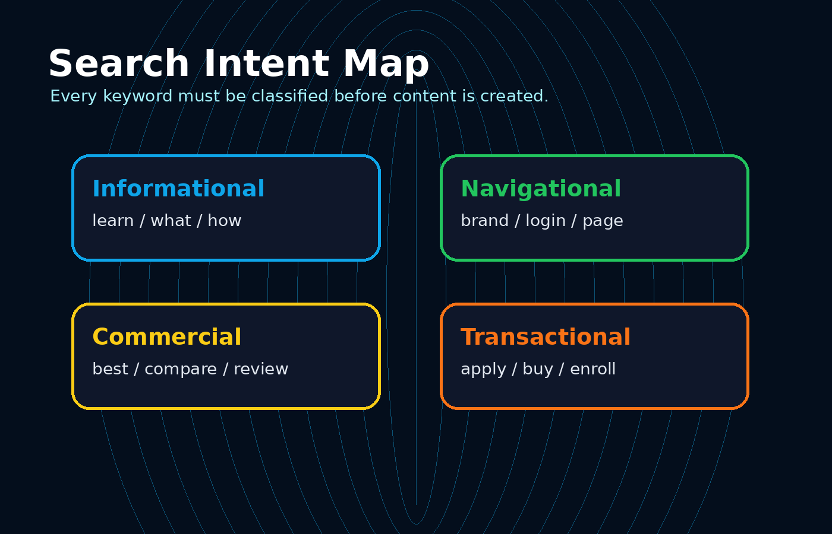
Search Intent Map
The Four Intent Types
• Informational: user wants to learn
• Navigational: user wants a specific page
• Commercial: user compares options
• Transactional: user is ready to act

Slide 6
Keyword Research Table
Keyword | Volume | KGR | Intent | Content
remote data science internship 2026 | 320 | 0.14 | Transactional | Internship landing page
python internship for btech students | 590 | 0.20 | Commercial | Comparison blog + CTA
best digital marketing internship 2026 | 480 | 0.23 | Commercial | Program landing page
seo basics for beginners internship | 170 | 0.16 | Informational | Educational blog
keyword research project example | 210 | 0.17 | Informational | Portfolio article
full stack internship with projects | 390 | 0.22 | Commercial | Service page

Slide 7
Meta Title and Description Planning
On-page SEO Beacons
• Put main keyword near the beginning of title tag.
• Keep URL slug short and descriptive.
• Use meta description to communicate benefit and CTA.
• Avoid keyword stuffing; write for users first.
Example
• Title: Remote Data Science Internship 2026 | SkillForge
• Slug: /data-science-internship
• Description: Apply for a remote data science internship built for B.Tech students.

Slide 8
Conclusion
SEO becomes effective when keyword evidence guides content decisions.
Final Takeaway
• Long-tail keywords reduce competition and improve conversion probability.
• Intent mapping ensures every page matches the user need.
• KGR validation helps prioritize low-resistance opportunities.
• The strategy is ready for implementation before paid ads.

