Slide 1
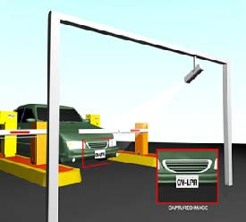
Introduction
Smart Parking Lot
Goals
Automation
Collecting Data
Integrate with Other Systems
< 200$ CAD

Slide 2

Budget

Slide 3
Schedule

Slide 4
Build Video

Slide 5

Course knowledge
Unix Systems
Android System
Hardware Knowledge
Mainly Based on
https://github.com/openalpr/openalpr/wiki/Compilation-instructions-(Ubuntu-Linux)

