Slide 1
Certified Moody Friendly Program
Think Tank Group: Tyler Cabutto, Arron Croft, Carlton Thomas

Slide 2
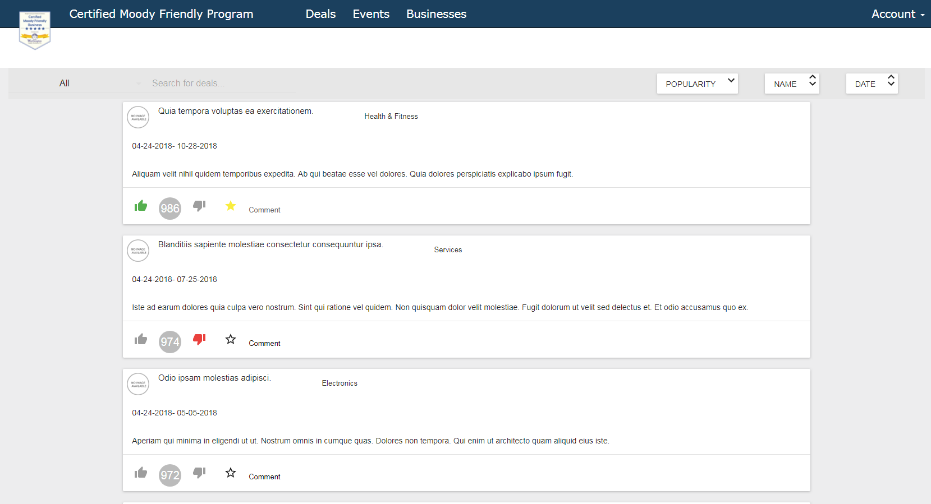
What is the Certified Moody Friendly program all about?
This application is designed to help Military families reach out to these military friendly companies, and see what deals they have to offer.
It is also designed in a way to help businesses grow and develop a web driven military community to have that closer digital connection, which in return, builds a better relationship with the military families.
url: http://cmfp-e.herokuapp.com
Notes:
May split into two separate slides.

Slide 3
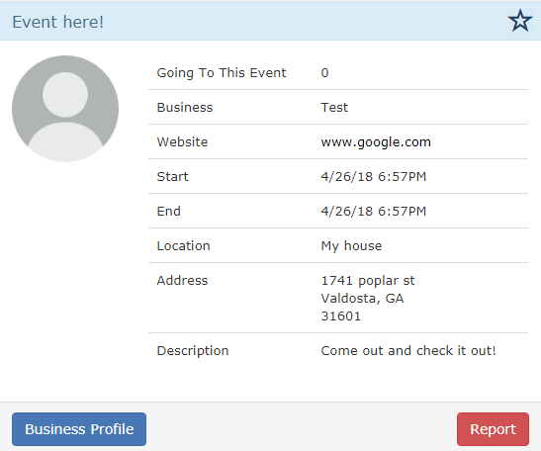
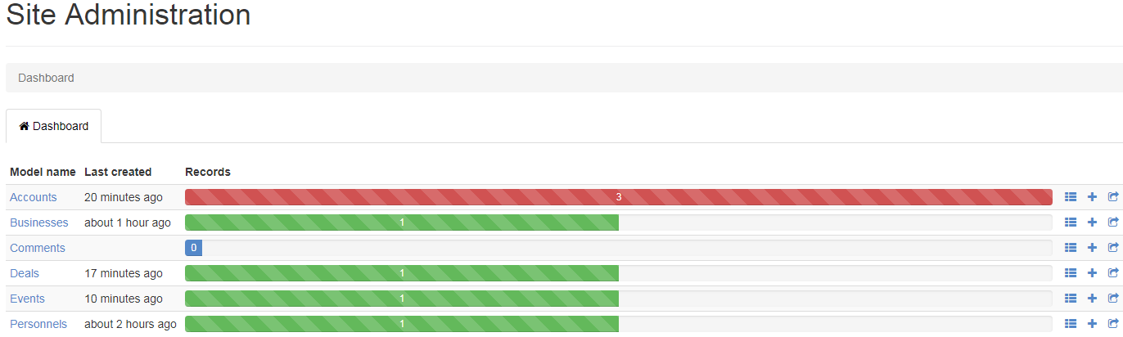
Unique features of our app

Slide 4
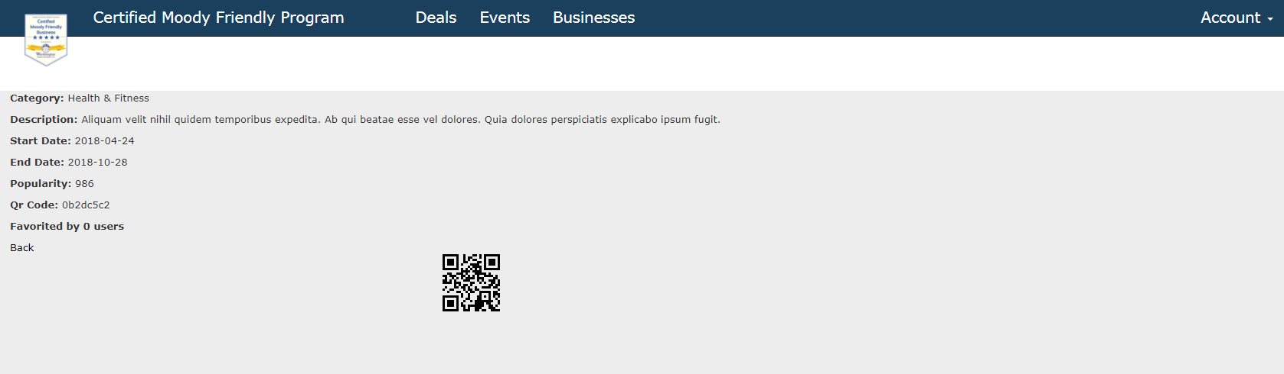
QR scanner
The QR scanner will be the main way that the military families will be able to access the deals. The business itself will be generated a qr code, and can print it out, or have it on the screen, for it to be scanned, once they have verified they are military with proper identification.
If the personnel does not have a camera scanner, they will also have a code that is generated for them to give to the business upon visiting.

Slide 5
Now for some demo!
Login Personnel/Business
We shall showcase the flow on how to sign up as both account types and the process they have to go through.
Like and dislike deal
We will show how a personnel account can choose to like or dislike a deal if they feel it deserves more/less attention
Favorite a deal
Show how to favorite a deal and where it updates on the deals page.
Deals page
Show the different elements on the deals page such as the google maps add-in, comments, etc.
RSVP an event
We will showcase the process of how to RSVP to a business event and where it updates on the events page.
Business Directory
We will showcase the business directory and explain how the CMF businesses work.
Admin dashboard
We will showcase the admin dashboard and what all data that you as the chamber account holder will have access to.
Analytics dashboard
We will showcase the analytics dashboard and what you can do to manage the date from the site

