Slide 1

ECU Software Development
The focus is on Software Development Process

Slide 2
ECU - Electronic Control Unit
An Electronic Control Unit (ECU) is any embedded system in automotive electronics that controls one or more of the electrical systems or subsystems in a vehicle.

Slide 3
Type of ECU
Today Types of ECU include:
Engine Control Module (ECM)
Powertrain Control Module (PCM)
Transmission Control Module (TCM)
Brake Control Module (BCM or EBCM)
Central Control Module (CCM)
Central Timing Module (CTM)
General Electronic Module (GEM)
Body Control Module (BCM)
Suspension Control Module (SCM)

Slide 4
We are going to develop ECUng that controls our mechanical subsystem
ECUng include underlined ECUs:
Engine Control Module (ECM)
Powertrain Control Module (PCM)
Transmission Control Module (TCM)
Brake Control Module (BCM or EBCM)
Central Control Module (CCM)
Central Timing Module (CTM)
General Electronic Module (GEM)
Body Control Module (BCM)
Suspension Control Module (SCM)

Slide 5
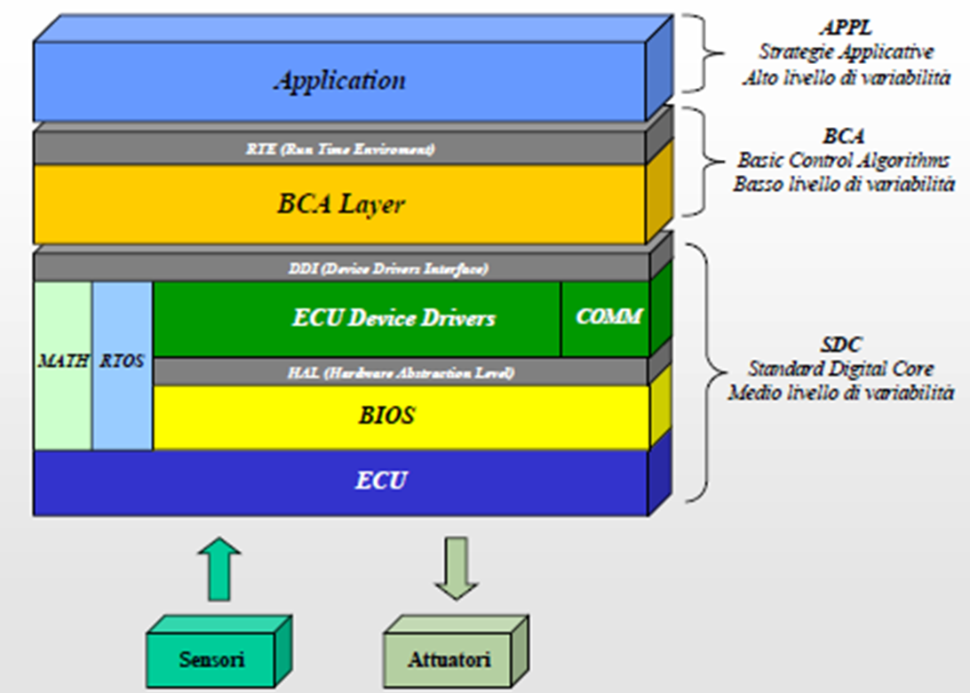
ECUng Software Architecture

Slide 6
ECUfoo Implementation (Live Demo)
ECU for Throttle control

Slide 7
ECU Software Development adopting the ISO/IEC 12207,15504 standards
Quality orientated process approaches and standards are maturing and gaining acceptance in many companies
Standards emphasize communication and shared understanding
For example: if one person says, “Testing is complete”, will all affected bodies understand what those words mean?
This kind of understanding is not only important in a global development environment; even a small group working in the same office might have difficulties in communication and understanding of shared issues
Standards can help in these and other areas to make the business more profitable because less time is spent on non-productive work

Slide 8
Benefits
The use of standards has many potential benefits for any organization
Improved management of software
Schedules and budgets are more likely to be met
Quality goals are likely to be reached
Employee training and turnover can be managed
Visible certification can attract new customers or be required by existing ones
Partnerships and co-development, particularly in a global environment, are enhanced

Slide 9
Importance of standards
Encapsulation of best practice
Avoids repetition of past mistakes
Framework for quality assurance process (Must be implemented)
It involves checking standard compliance (Must be implemented)
Provide continuity
New staff can understand the organization by the standards applied

Slide 10
ISO/IEC 12207
Is an international software engineering standard that defines the software engineering process, activity, and tasks that are associated with a software life cycle process from conception through retirement
The standard has the main objective of supplying a common structure so that the buyers, suppliers, developers, maintainers, operators, managers and technicians involved with the software development use a common language
It aims to be 'the' standard that defines all the tasks required for developing and maintaining software

Slide 11
ISO/IEC 15504
ISO/IEC 15504, also known as SPICE (Software Process Improvement and Capability Determination), is a framework for the assessment of processes

