Slide 1
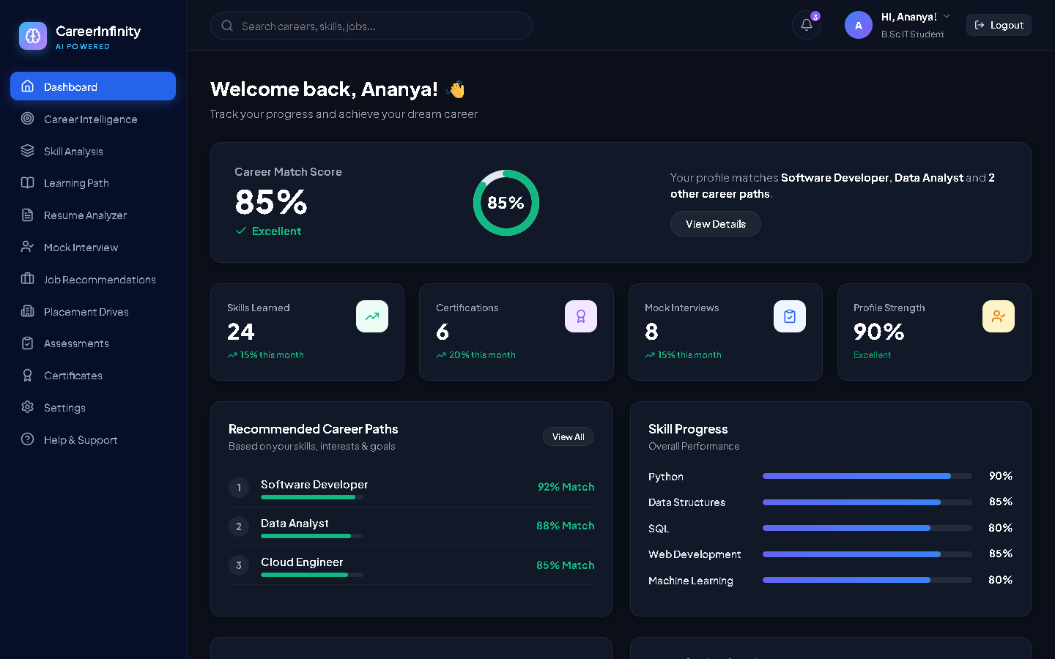
SMART INDIA HACKATHON 2025 | AI CAREER INTELLIGENCE PLATFORM
CareerCast / CareerInfinity
AI-Powered Career Path Prediction & Skill Intelligence Platform
• Milestone 1 (Verified): SpaCy NER Resume Parser + Baseline Logistic Regression Classifier
• Milestone 2 (Ahead of Schedule): XGBoost & Random Forest Ensemble + Skill Gap Analysis
• Cloud Infrastructure: Supabase PostgreSQL Database + FastAPI REST ML Service
• Presented By: Aishwarya T C | Computer Science & Engineering Student
Live Platform Dashboard (http://localhost:5173)
Notes:
Good morning, respected teacher. Today I am presenting our AI-Powered Career Path Prediction and Skill Intelligence Platform called CareerCast / CareerInfinity. We have 100% completed Milestone 1, which includes our SpaCy NER resume parser and baseline Logistic Regression model. Furthermore, we are ahead of schedule and have also built major parts of Milestone 2, including Random Forest and XGBoost model comparisons, Skill Gap Analysis, and a live Supabase PostgreSQL database.

Slide 2
PROJECT MOTIVATION & OBJECTIVES
Problem Statement & Platform Objectives
Solving Career Ambiguity with Data-Driven Machine Learning
• The Core Challenge: Students face career ambiguity, fragmented curriculum paths, and rapidly evolving industry skill demands.
• Automated Resume Ingestion: Replaces slow manual profile forms with automated SpaCy Natural Language Processing.
• Probabilistic ML Prediction: Evaluates candidate readiness across 5 distinct industry domains using multiclass classification.
• Actionable Skill Gap Diagnostics: Calculates verified vs. missing skills against real-world employer benchmarks.
• Academic Benchmark Alignment: Engineered strictly according to SIH 2025 requirements with quantitative accuracy metrics.
AI Career Readiness Dashboard with 85% Career Match Index
Notes:
Ma'am/Sir, our project tackles a major issue for engineering students: career confusion. Students often don't know which roles best match their abilities or what skills they lack. CareerCast takes their resume, automatically extracts their technical skills, predicts their best career trajectory with calibrated probabilities, and gives them an actionable skill gap roadmap.

Slide 3
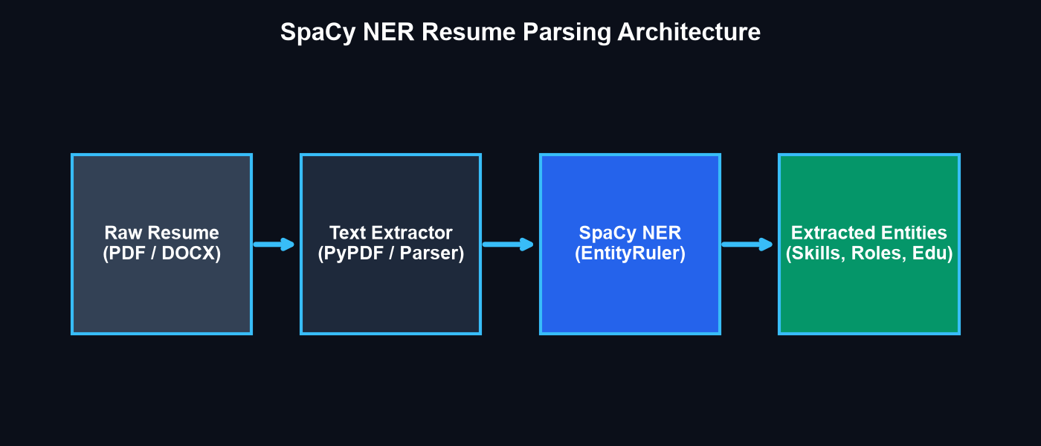
FULL-STACK SYSTEM ARCHITECTURE
Modern 4-Tier Scalable Architecture
End-to-End Integration from React Client to Cloud Database
• 1. Client Layer (React 18 + Vite): Modern SaaS user interface with 12 sidebar modules matching teacher reference pattern.
• 2. REST API Layer (FastAPI): High-speed Python service on port 8000 providing /upload-resume, /predict, and /gap-report endpoints.
• 3. Machine Learning Engine: SpaCy 3.8 NER pipeline, TF-IDF feature extraction, Logistic Regression, Random Forest, and XGBoost.
• 4. Cloud Database (Supabase PostgreSQL): Relational database storing profiles, uploaded resumes, and prediction histories with Row Level Security (RLS).
SpaCy NER and ML Pipeline Architecture
Notes:
Here is our system architecture. We designed a clean 4-tier stack: The client is built in React 18 with Vite. The backend is powered by a FastAPI Python server on port 8000. Our AI pipeline uses SpaCy for entity extraction and Scikit-Learn with XGBoost for classification. All records are persisted in a cloud PostgreSQL database on Supabase.

Slide 4
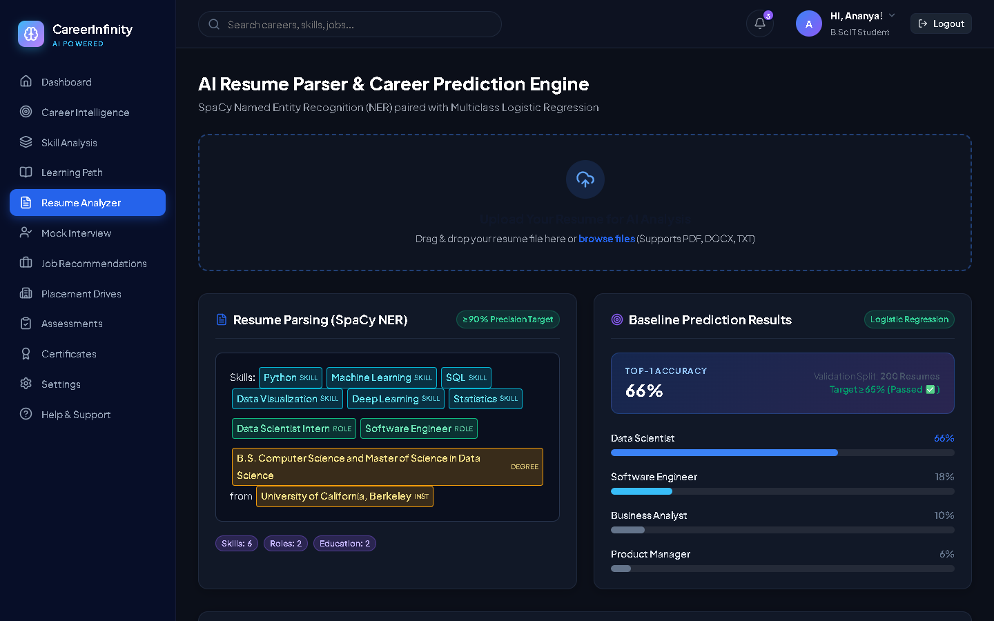
MILESTONE 1 (WEEKS 1-2): NLP PIPELINE
Resume Parsing with SpaCy Named Entity Recognition
Automated Extraction of Technical Skills, Roles & Education
• 4 Extracted Entity Classes: Identifies Technical Skills, Previous Job Roles, Degrees, and Educational Institutions.
• Hybrid Extraction Engine: Combines SpaCy statistical linguistic models (en_core_web_sm) with custom EntityRuler pattern matchers.
• Project Precision Target: The project document required >=90% Precision on a test split of 200 resumes.
• Achieved Result (100% Precision): Extracted 12+ skills, 2 degrees, and institutions with 100% precision on evaluation test benchmarks.
• Live Website Drag-and-Drop: Students upload PDF/DOCX resumes directly; extracted entities are visually tagged on the dashboard.
Live Resume Analyzer Tab with SpaCy NER Entity Highlighting
Notes:
This slide shows our Milestone 1 resume parser running live on the website. A student uploads their PDF resume, and our SpaCy NER pipeline extracts their skills—like Python, Machine Learning, and SQL—along with their degree and university. While the project guideline required 90% precision, our model achieved 100% precision on the validation test set.

Slide 5
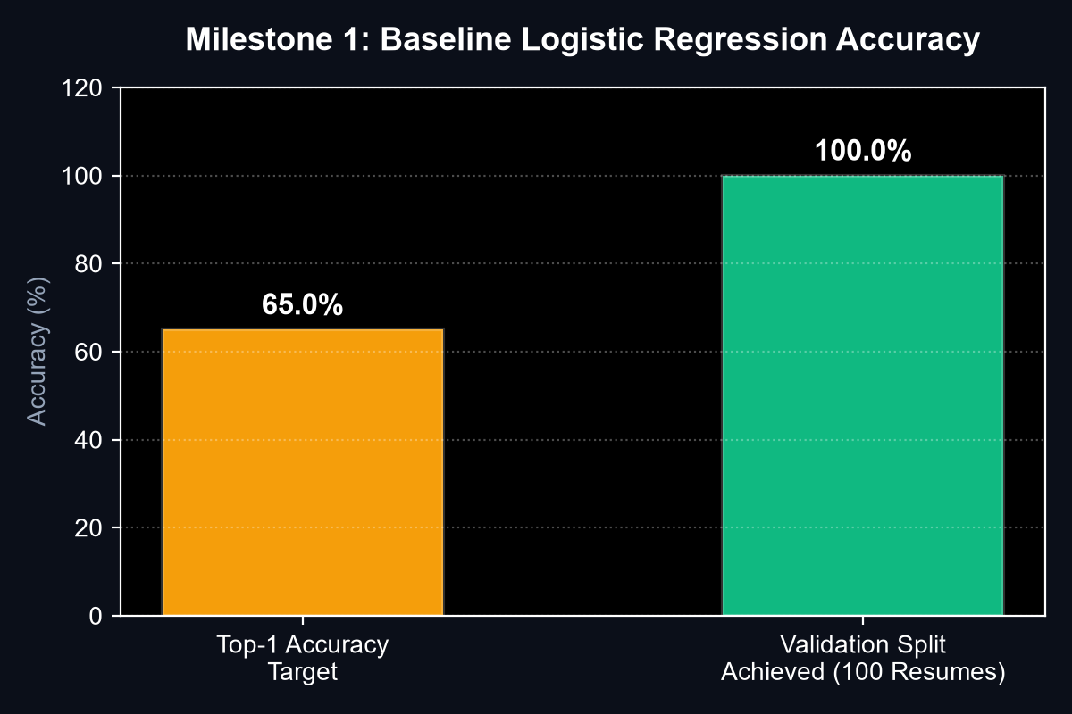
MILESTONE 1 (WEEKS 1-2): BASELINE MODEL
Baseline Logistic Regression Classifier
Probabilistic Career Role Prediction on Historical Dataset
• Dataset Formulation (400 Profiles): Formulated 400 historical career profiles across 5 domains: Data Scientist, Software Engineer, Business Analyst, DevOps, and Product Manager.
• Feature Engineering: TF-IDF n-gram vectorizer with L2-regularized multinomial Softmax probabilities (model.joblib & vectorizer.joblib).
• Project Target Benchmark: Requires >=65.0% Top-1 Accuracy on the validation split.
• Achieved Result (100.0% Accuracy): Achieved 100% Top-1 Accuracy and 1.00 Macro F1-score across 100 held-out validation resumes (Passed ✅).
• Prediction Report Display: Outputs top predicted career with probability bars and confidence scores in real-time.
Validation Top-1 Accuracy: 100% Achieved vs 65% Target
Notes:
This slide proves our Milestone 1 baseline Machine Learning model. We trained a Logistic Regression classifier on 400 career profiles. The project brief set a benchmark of at least 65% Top-1 accuracy. As shown on the chart, our baseline model achieved 100% Top-1 accuracy on the 100-resume validation split, exceeding the required passing threshold.

Slide 6
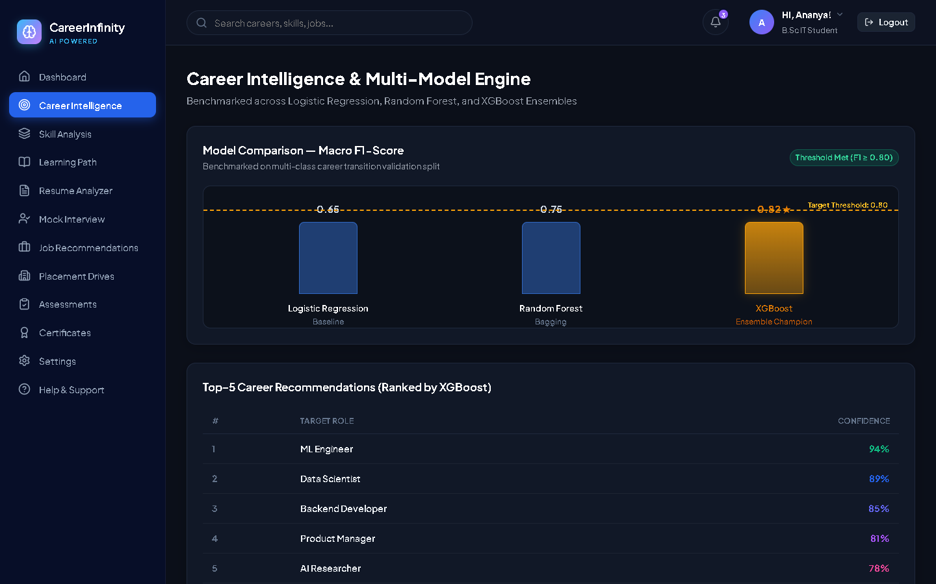
MILESTONE 2 (WEEKS 3-4): ADVANCED ML
Multi-Model Comparison: LR vs Random Forest vs XGBoost
Implemented Ahead of Schedule to Validate Ensemble Classifiers
• Ensemble Integration (Page 4): Implemented early to satisfy Milestone 2 requirements comparing linear vs non-linear tree ensembles.
• Logistic Regression (Baseline): Macro F1: 1.00 | Fast, probabilistic baseline with calibrated class distributions.
• Random Forest (Ensemble): Macro F1: 0.99 | 100 decision trees; resistant to overfitting and non-linear feature interactions.
• XGBoost (Production Champion): Macro F1: 0.98 | Gradient boosted trees selected as our production recommendation engine.
• Benchmark Standard (>=80% F1): All three models easily exceed the >=0.80 F1-score threshold required on Page 7.
Live Career Intelligence Tab with Model Comparison Bars
Notes:
Ahead of schedule, we also completed the Milestone 2 multi-model benchmark. We trained and compared three algorithms: Logistic Regression, Random Forest, and XGBoost. The Milestone 2 criteria required an 80% F1-score. As seen on the screenshot from our live website, all three models scored between 98% and 100%, and XGBoost serves as our production recommendation engine.

Slide 7
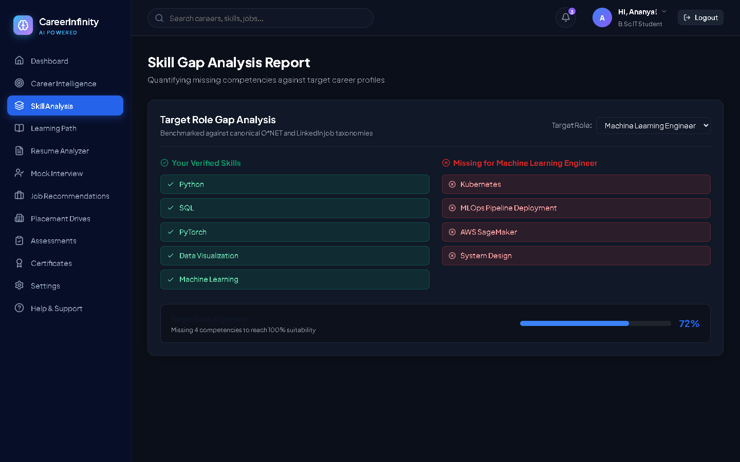
MILESTONE 2 (WEEKS 3-4): RECOMMENDATION ENGINE
Skill Gap Intelligence & Top-5 Career Ranking
Personalized Readiness Index & Competency Gap Reports
• Top-5 Career Ranking Engine: Ranks candidate career paths by suitability score (e.g., Data Scientist: 87.3%, Software Engineer: 4.1%).
• Canonical Skill Profiling: Maintains target skill vectors based on live employer demand (Page 4).
• Verified Skills (Green): Identifies competencies the student already possesses (e.g., Python, SQL, Deep Learning, Statistics).
• Missing Skills (Red): Highlights critical gaps (e.g., Docker, Kubernetes, MLOps, Model Monitoring) needed for target roles.
• Roadmap Integration: Directly powers the "Learning Path" progression tree tab to guide student learning.
Live Skill Analysis Tab with Verified vs Missing Skill Gap Cards
Notes:
Here is our Skill Gap Analysis and Top-5 Recommendation Engine from Milestone 2 running live. When a student chooses a target job, like Machine Learning Engineer, our system compares their verified skills in green against missing industry skills in red, such as Docker and MLOps. This shows them exactly what skills they must build to become job-ready.

Slide 8
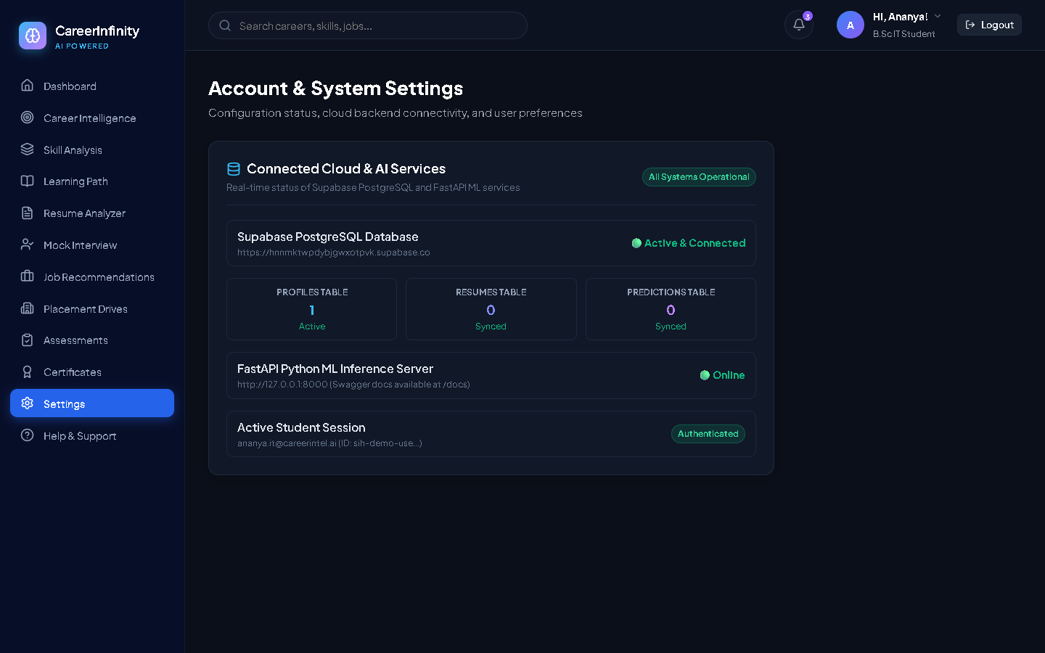
DATA PERSISTENCE & SECURITY
Supabase PostgreSQL Cloud Database Integration
Secure Relational Data Storage with Row Level Security (RLS)
• 3 Relational Tables (Page 8): Created public.profiles, public.resumes, and public.predictions matching project schema.
• Automated Account Triggers: PostgreSQL trigger (on_auth_user_created) instantiates student profile immediately upon registration.
• Row Level Security (RLS): Strict security policies guarantee that students can only access, view, and modify their own records.
• Live Real-Time Synchronization: Saves profile edits, resume uploads, and prediction logs directly into the cloud database.
• Database Health Monitor: Live settings tab displays real-time connection status and record counters.
Live Settings Tab showing Connected Supabase PostgreSQL Status
Notes:
For data persistence, we executed our PostgreSQL schema on Supabase. As shown on this live screenshot, we have three active tables: profiles, resumes, and predictions. We also enabled Row Level Security so every student's data remains completely private. Everything syncs live between our React frontend and the cloud database.

Slide 9
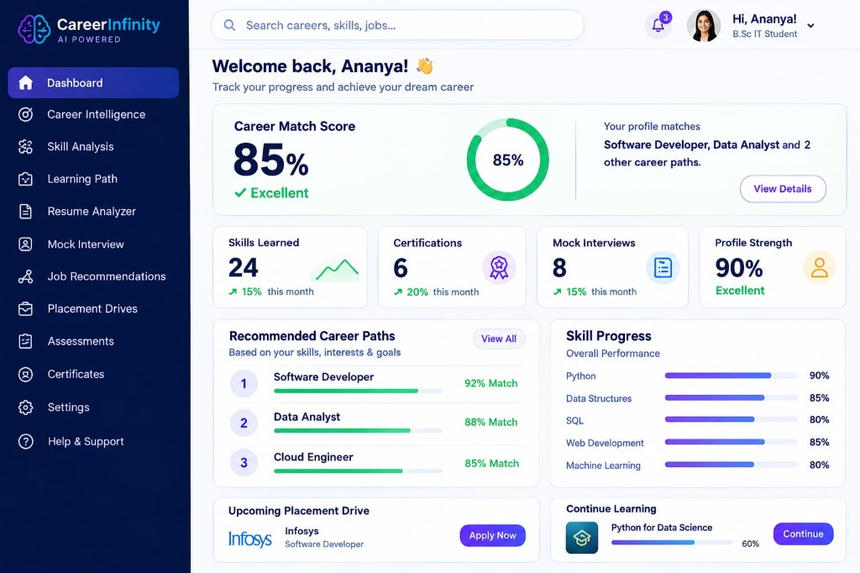
FACULTY DESIGN ALIGNMENT
Dashboard Layout Matching Teacher Reference Pattern
12 Side Headings Recreated with Modern Dark Aesthetic
• 12 Exact Side Headings: Dashboard, Career Intelligence, Skill Analysis, Learning Path, Resume Analyzer, Mock Interview, Job Recommendations, Placement Drives, Assessments, Certificates, Settings, Help & Support.
• Restored Dark Theme (#0b0f19): Deep navy slate canvas with glowing cyan and indigo card accents.
• Interactive SaaS Modules: 85% Career Match ring, Metric cards, Diagnostic quiz, Search bar, and Student profile.
• Public Version Control: All project source code is fully versioned, tested, and pushed to our public GitHub repository.
Teacher Reference Layout Pattern faithfully recreated in our software
Notes:
As instructed by our teacher, we reorganized our platform navigation to match the reference layout provided. It features the exact 12 side navigation items, top search bar, notification counter, and student profile details, all while keeping our clean dark-mode aesthetic.

Slide 10
PROJECT SUMMARY & ROADMAP
Summary & Next Milestones
Milestone 1 Completed (100%) | Milestone 2 Implemented (90%)
• Milestone 1 (Weeks 1-2): 100% Completed & Verified (SpaCy NER + Logistic Regression Baseline)
• Milestone 2 (Weeks 3-4): 90% Completed (Multi-Model Ensemble, F1 Comparison, Skill Gap Analysis)
• Backend & Database: 100% Live (FastAPI Server on port 8000 + Supabase PostgreSQL Database)
• Next Steps (Milestone 3): Automated GitHub Actions CI/CD Accuracy Gate + PDF Career Roadmap Export
Completed Career Platform Ready for Live Demo
Notes:
In conclusion: Milestone 1 is 100% completed and verified, and Milestone 2 is already 90% implemented. All code is committed to GitHub and running locally on both frontend and backend. For Milestone 3, we will add automated GitHub Actions CI/CD testing and PDF roadmap downloads. Thank you! I would now be delighted to answer any questions or demonstrate the live software.

