Slide 1

By: Tyler Campbell Ying Zhang Siqi(Sandy) Lin Aparna Kaliappan Sean Murren

Slide 2


Project Overview
A web-based application for students to find/create study groups for classes within a university
Allow users to schedule study group meetings
Provide different permission levels to users
General Users
Group Manager/Creator
Notes:
Sean

Slide 3

Requirements

Slide 4


Requirements – General User
Create an Account
Login and Logout
Create a public/private group
Join/leave groups
Group creator assigns permissions for group members
Message other group members
Chat within a group
Schedule meetings
Report users with improper behaviors
Notes:
Ying

Slide 5

Requirements - Admin
Add information about study locations and course catalog
Search for users
Delete users
Temporarily deactivate users
Reset user passwords
View reports
Delete all groups at the end of a semester
Notes:
Ying

Slide 6

Technologies
Notes:
Tyler

Slide 7




Technology Stack
Notes:
Tyler
An object-oriented HTTP framework in Python: decided on this because we are all familiar and more comfortable with OOP.
Angularjs very good skill to learn for industry, but mainly it has lots of attributes premade that we need such as calendars, tables, and its very well documented.
MariaDB: simmilar to sql its actually a fork of the mysql lots of sql implementations are similar so we just picked one that looked interesting
Bootstrap: we do not know if we will get to implementing this but if we have time we will implement this to make our application look more professional

Slide 8

Sample Mockup

Slide 9
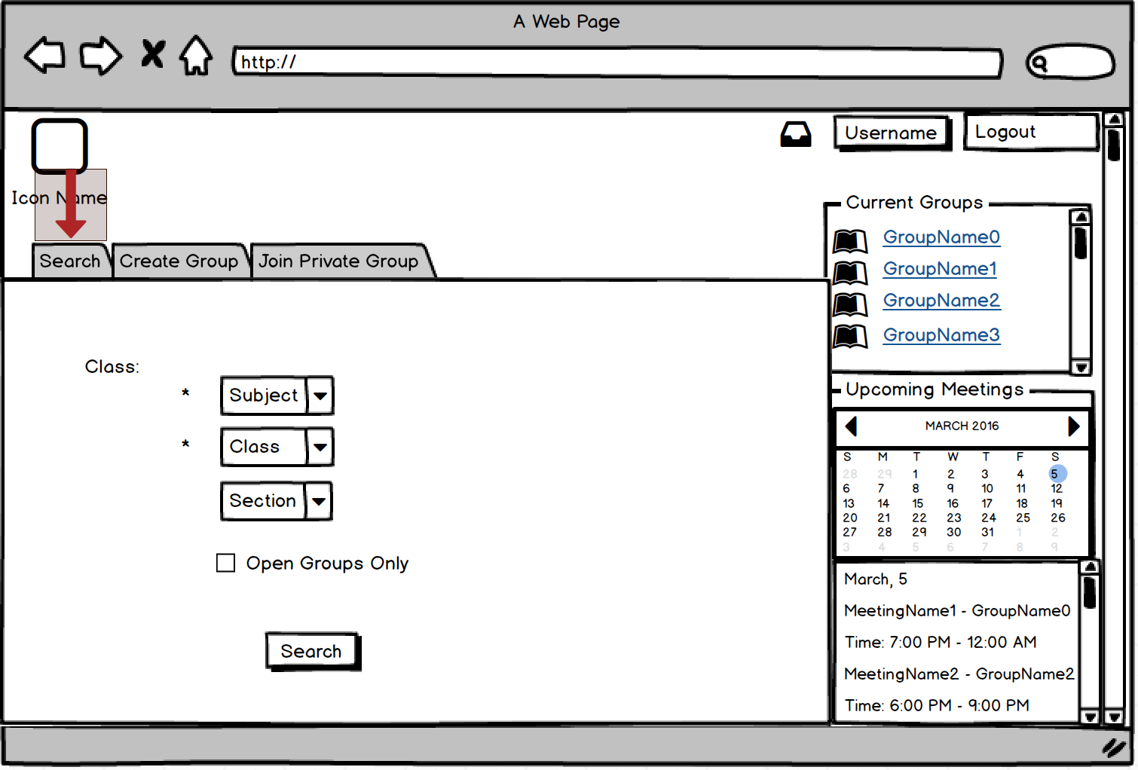
Home Page – Search Tab
Notes:
Sandy

Slide 10
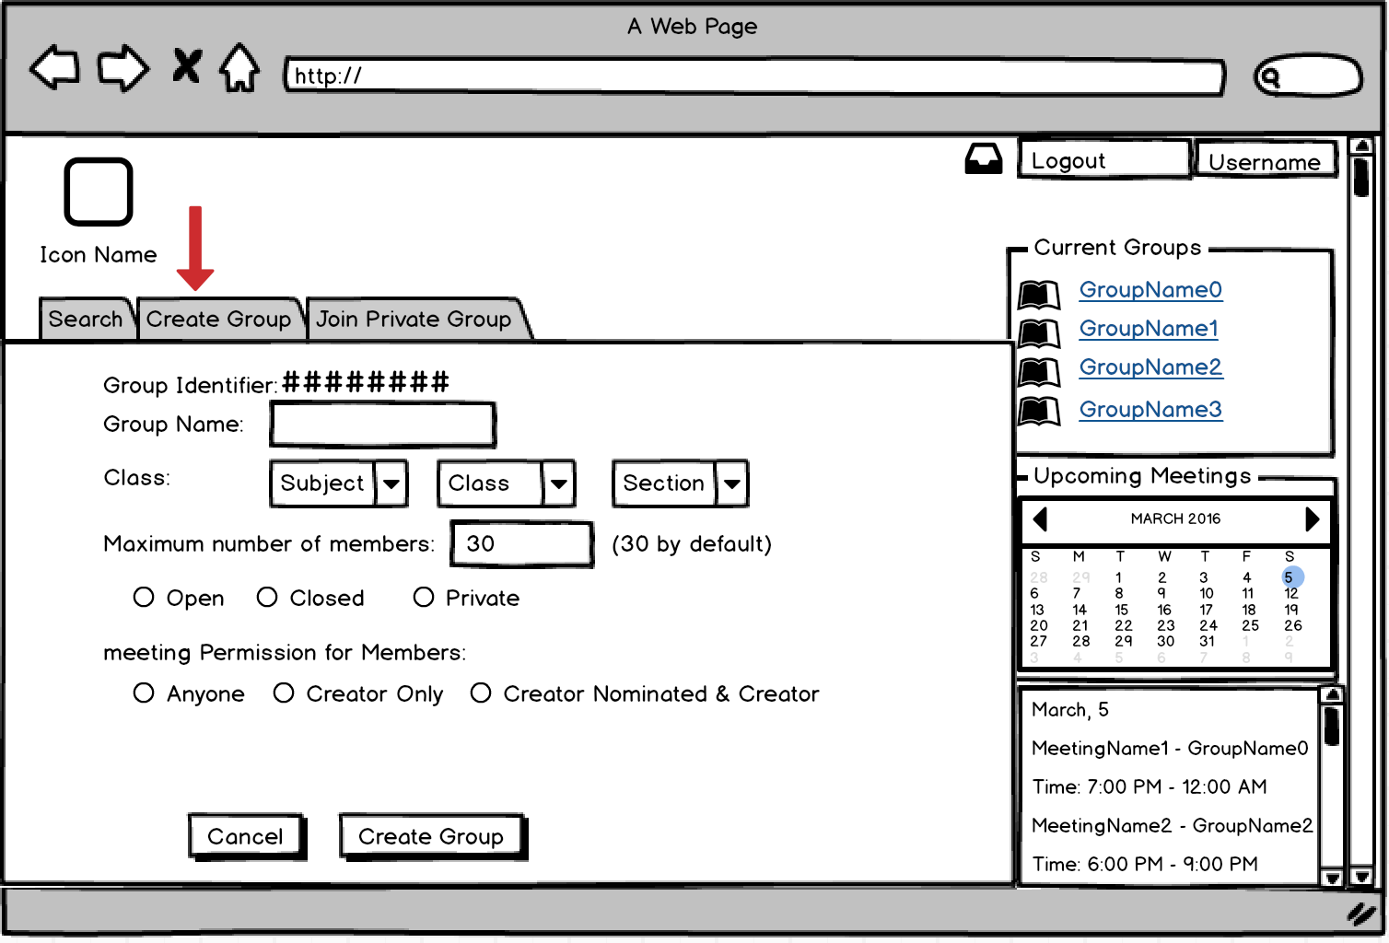
Home Page – Create Group Tab
Notes:
Tyler
This is the create group page where users will create study groups
you can give it a name
Choose a class based on sub, class, and section (which will be added in by the admin each semester)
A max number of group members
choose group type :
open - anyone can join
closed - does not show up on a search
private- need private code to join group
Meeting permissions:.....

Slide 11
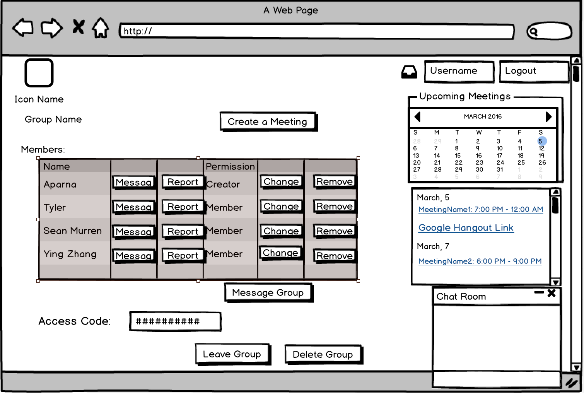
Group Page – Group Creator View
Notes:
Sandy

Slide 12
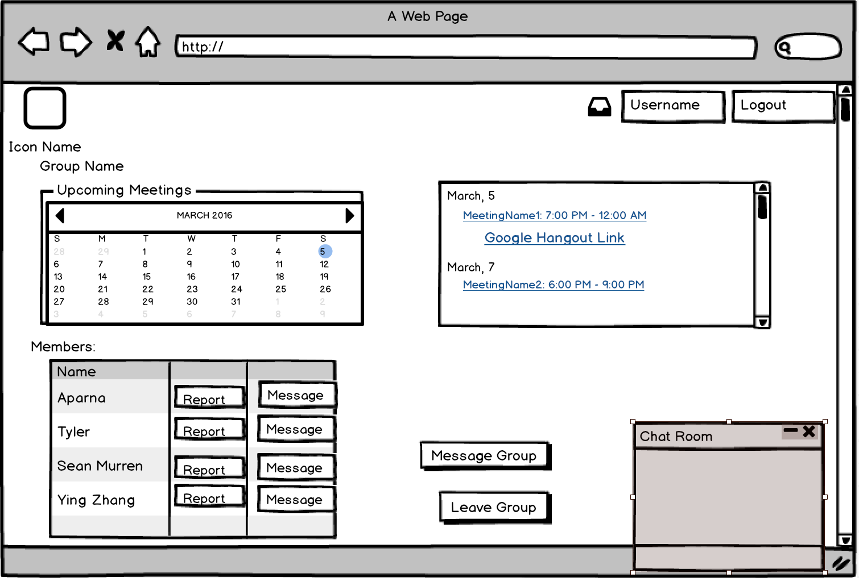
Group Page – Group Member View
Notes:
Sandy

Slide 13

System Design

Slide 14
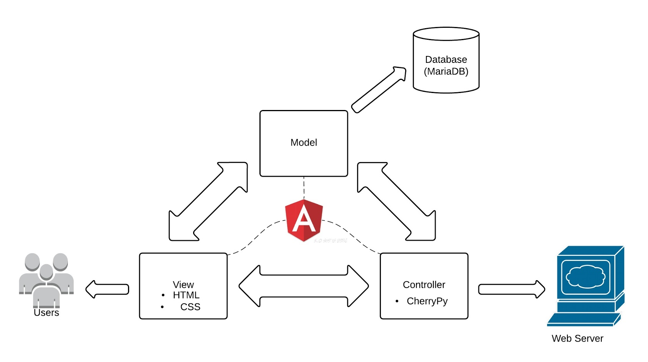
Architectural Design
Notes:
Tyler

Slide 15
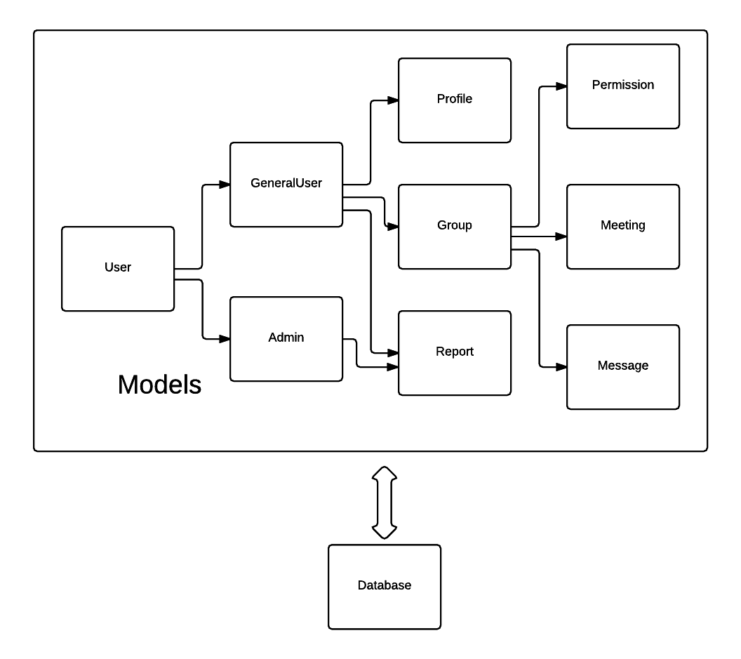
Decomposition Diagram
Notes:
Sean

Slide 16
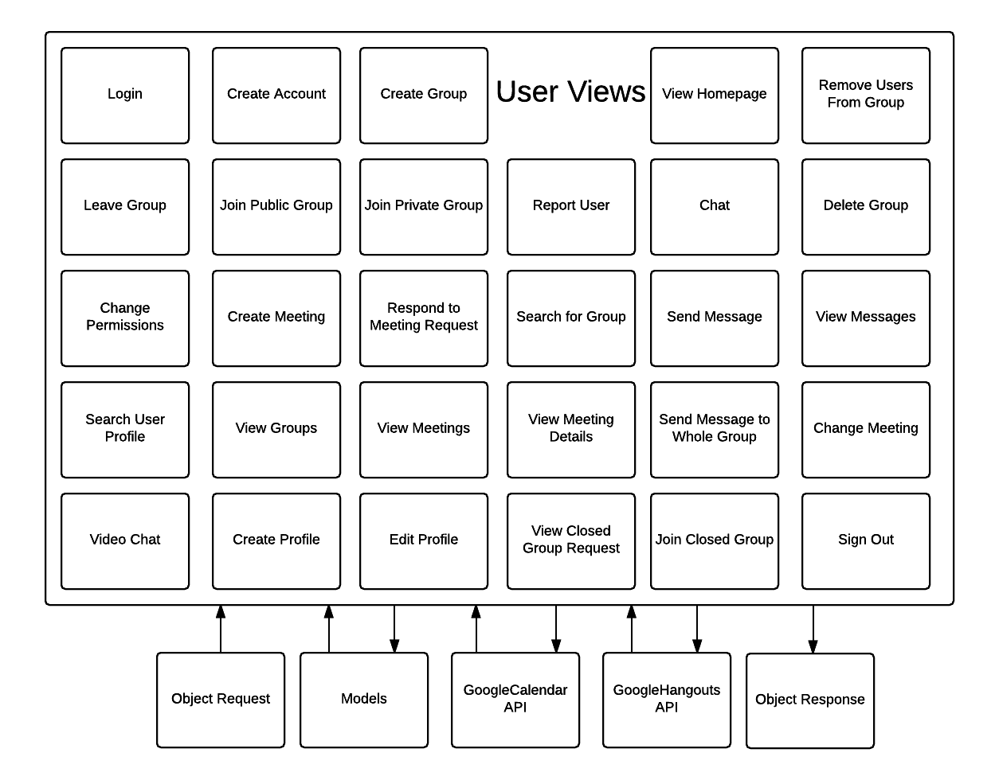
User Views
Notes:
Aparna

Slide 17
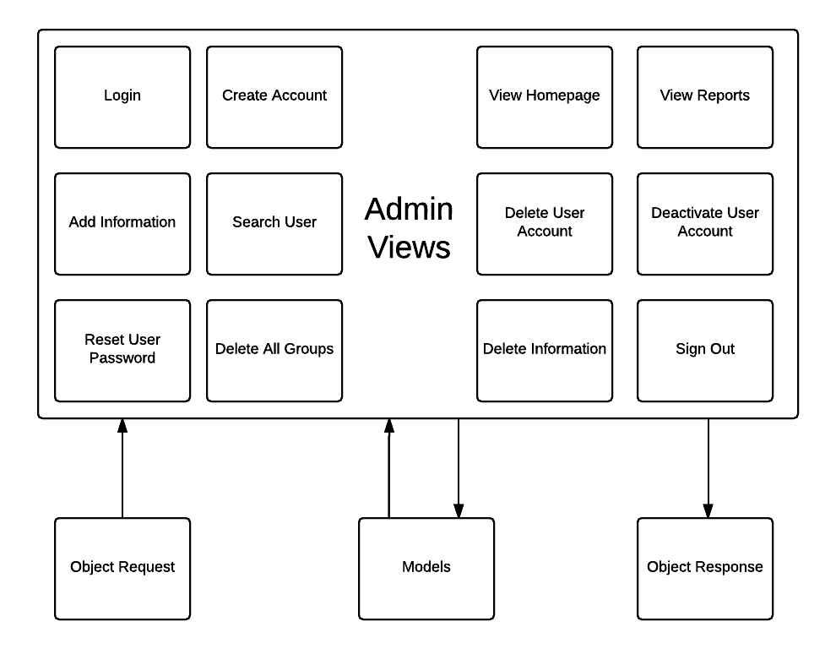
Admin View
Notes:
Aparna

Slide 18

THANKS!
Any questions?

Slide 19
CREDITS
Special thanks to all the people who made and released these awesome resources for free:
Presentation template by SlidesCarnival
Photographs by Unsplash

