Slide 1
Developing a National SDI for Pakistan: A Case Study on Road Network Digitization
RSG-601
Spatial Data Infrastructure

Slide 2
Presented By:
M. Taimoor Ashfaq (21-ARID-1032)
Syeda Rosheen Raza Kazmi (21-ARID-1041)
M. Daniyal Mansoor (21-ARID-1025)
Haiqa Noor (21-ARID-1014)
Wajahat Hussain (21-ARID-1044)
RizwanUllah Khan (21-ARID-1037)
Presented To:
Mr. Abdul Basit
12

Slide 3
Outlines
Key Points and Framework for Understanding the Concept
Introduction | What is an SDI? Importance of SDI
Rationale | Pakistan’s Need for an SDI
Case Study | Road Network Distribution of Pakistan
Objectives | Intended Outcomes
Methodology | Data Standardization, Attribute Enrichment, Spatial Adjustment, Validation. Integration
Results and Discussion | Unveiling Insights: What the Data Tells Us
Conclusion | The Way Forward!

Slide 4

Introduction to SDI!
“Spatial Data Infrastructure is defined as a framework of policies, institutional arrangements, technologies, data, and people that enables the sharing and effective usage of geographic information by standardizing formats and protocols for access and interoperability.”
-World Bank
1

Slide 5
Importance of SDI
Data
Inter-operability
And Integration
Assurance of quality data accessibility
Informed Decision Making
Effective Resource Management
4

Slide 6
02
RATIONALE
Pakistan’s Need for SDI
5

Slide 7

Pakistan’s Need for SDI
National Spatial Datasets lacking consistency and coverage, hindering analysis and decision making
03
Lack of standardization creating challenges for integration into different geospatial systems
02
Missing attribution and gaps in metadata leading to reduced data integrity
Spatial misalignment leading to inaccurate spatial representations
7

Slide 8
03
CASE STUDY
An in-depth exploration of real world scenarios
10

Slide 9
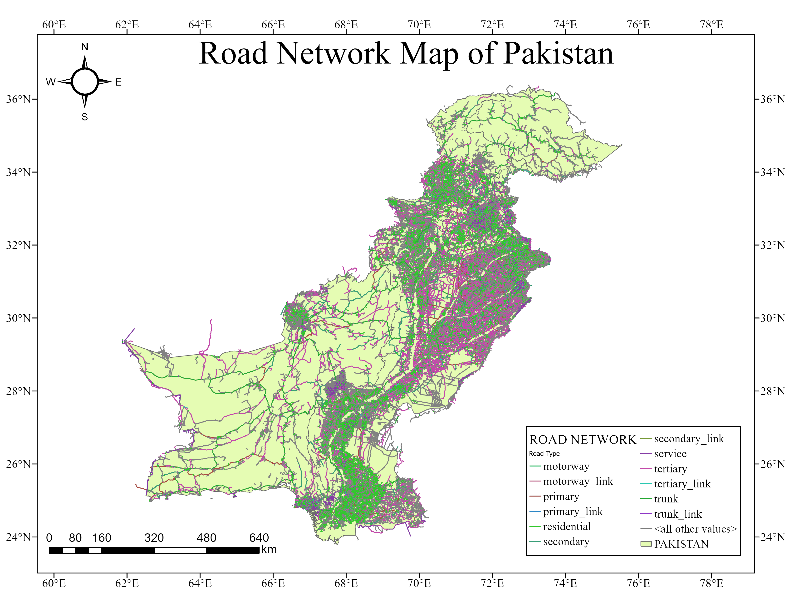
CASE STUDY
The total number of roads in Pakistan, according to the latest available data from the National Transport & Research Center (NTRC), is approximately 493,089 kilometers as of March 2020.
This includes:
National Highways: Maintained by the National Highway Authority (NHA), covering around 11,995 kilometers.
Provincial Roads: Managed by respective provincial governments.
Local Roads: Maintained by local authorities.
11

Slide 10
04
OBJECTIVES
Intended Outcomes!
12

Slide 11

OBJECTIVES
STANDARDIZATION OF ROADS
COMPREHENSIVE DATASET CREATION
POSITIONAL ACCURACY
TOPOLOGY AND NETWORK IMPROVEMENT
9

Slide 12
05
METHODOLOGY
Getting on with spatial analysis!
12

Slide 13
METHODOLOGY
A
B
Data Standardization
Data Acquisition
C
D
Attribute Enrichment
Spatial Adjustment
E
F
Topology Validation
Integration &Simplification
16

Slide 14
DATA ACQUISITION
METHODOLOGY
Utilized OpenStreetMap (OSM) as the primary data source for road features.
Extracted primary, secondary, and trunk roads data using QGIS tools i.e. the HCMGIS plugin.
Development of a File Geodatabase for standardization of data formats.
Establishment of naming conventions i.e. Translation of road names
DATA STANDRADIZATION
ATTRIBUTE ENRICHMENT
Cross referencing of data using updated and reliable sources such as Google Maps
SPATIAL ADJUSTMENT
Alignment of road features with updated, high-resolution Google’s Basemaps to enhance positional accuracy.
Merged redundant road segments and streamlined the dataset to develop a seamless and navigable road network
INTEGRATION & SIMPLIFICATION
17

Slide 15
06
RESULTS AND DISCUSSION
Getting on with spatial analysis!
22

Slide 16
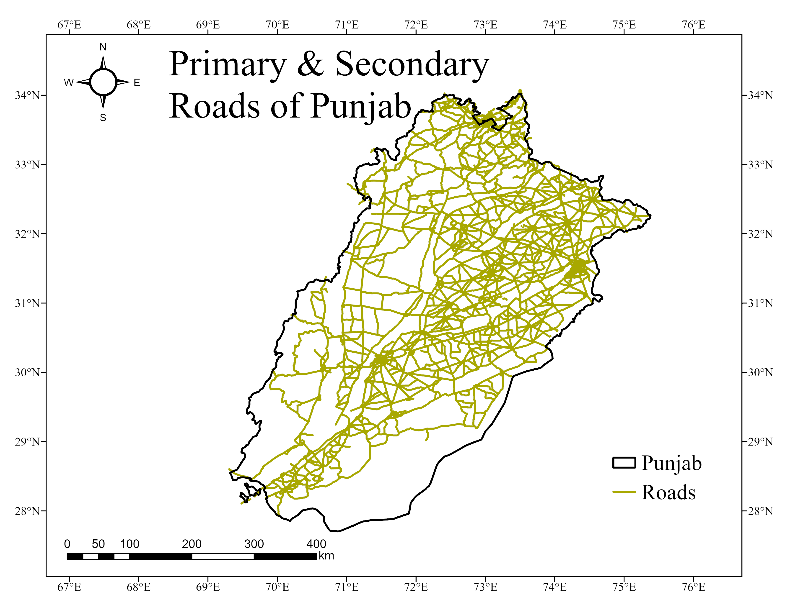
Punjab
Initial Roads 23000
Refined Roads 2415

Slide 17
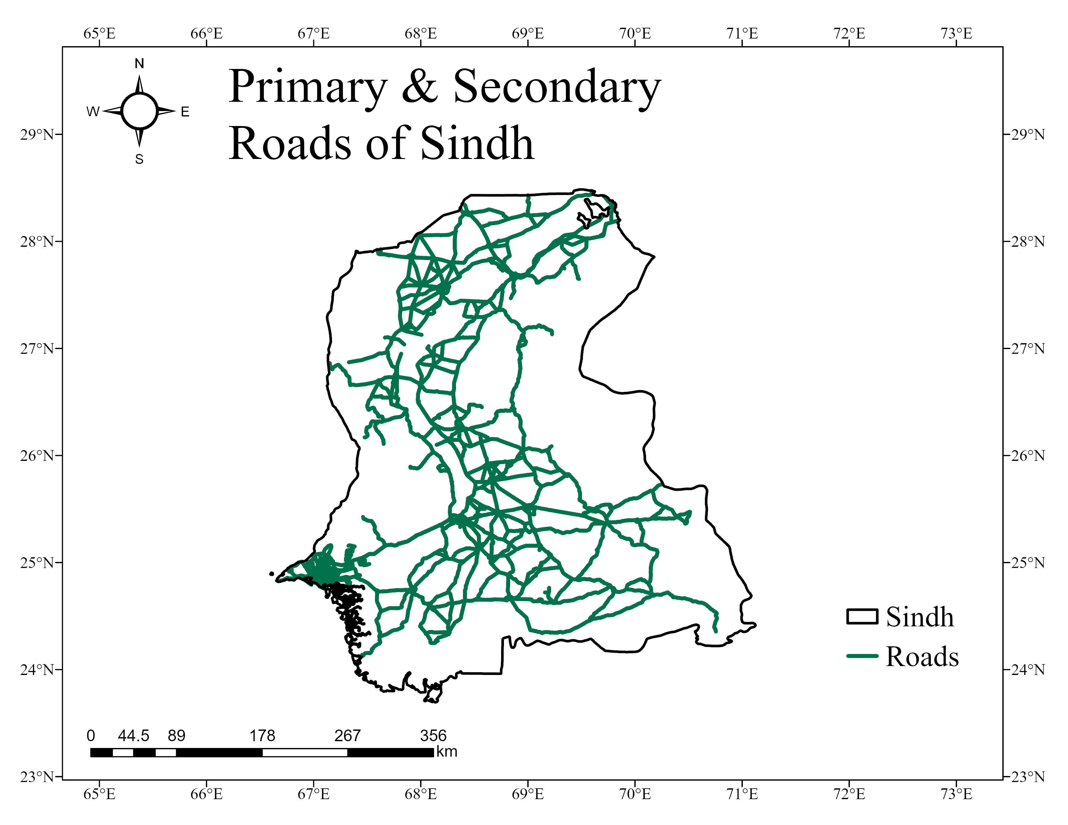
Sindh
Initial Roads 9000
Refined Roads 2200

Slide 18
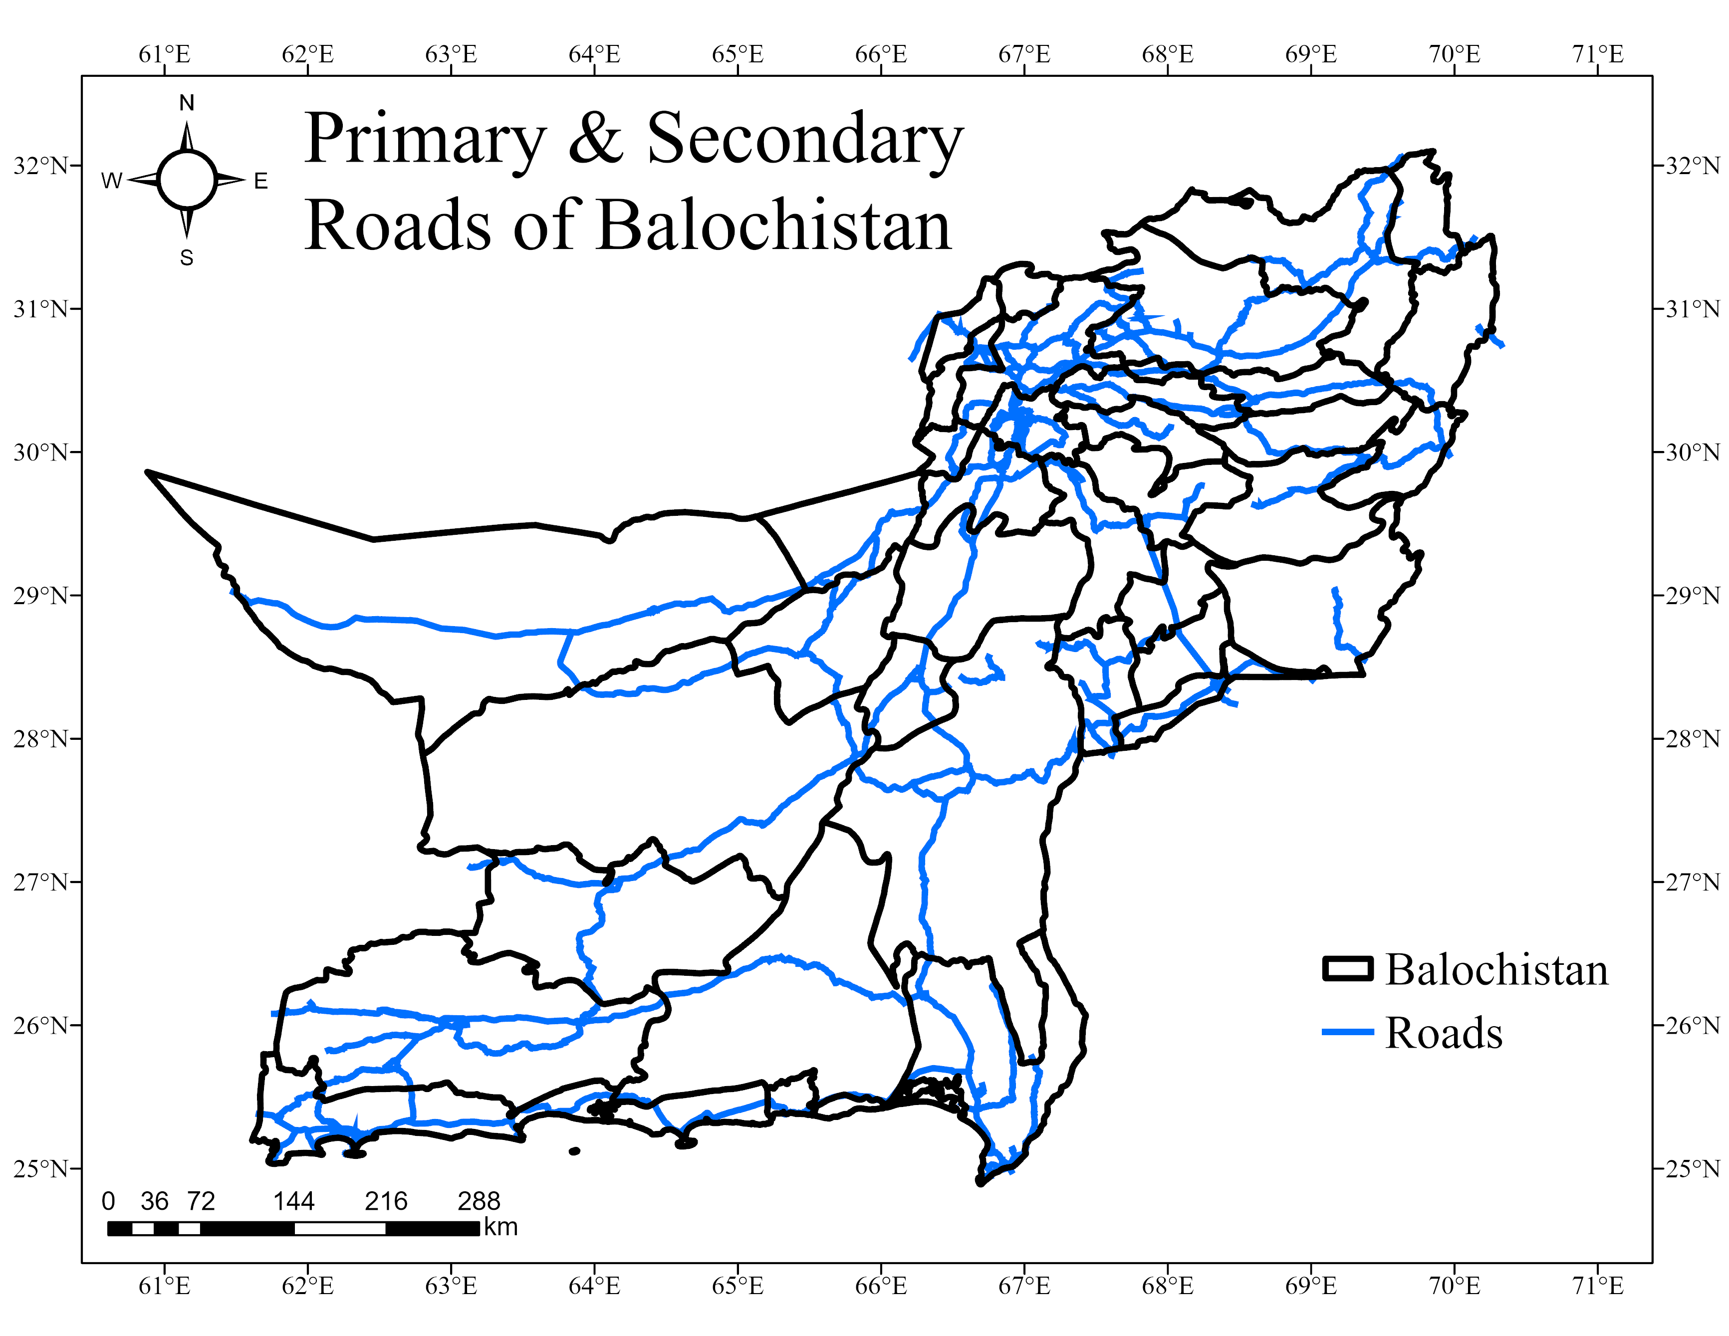

Balochistan
Refined Roads 200

Slide 19
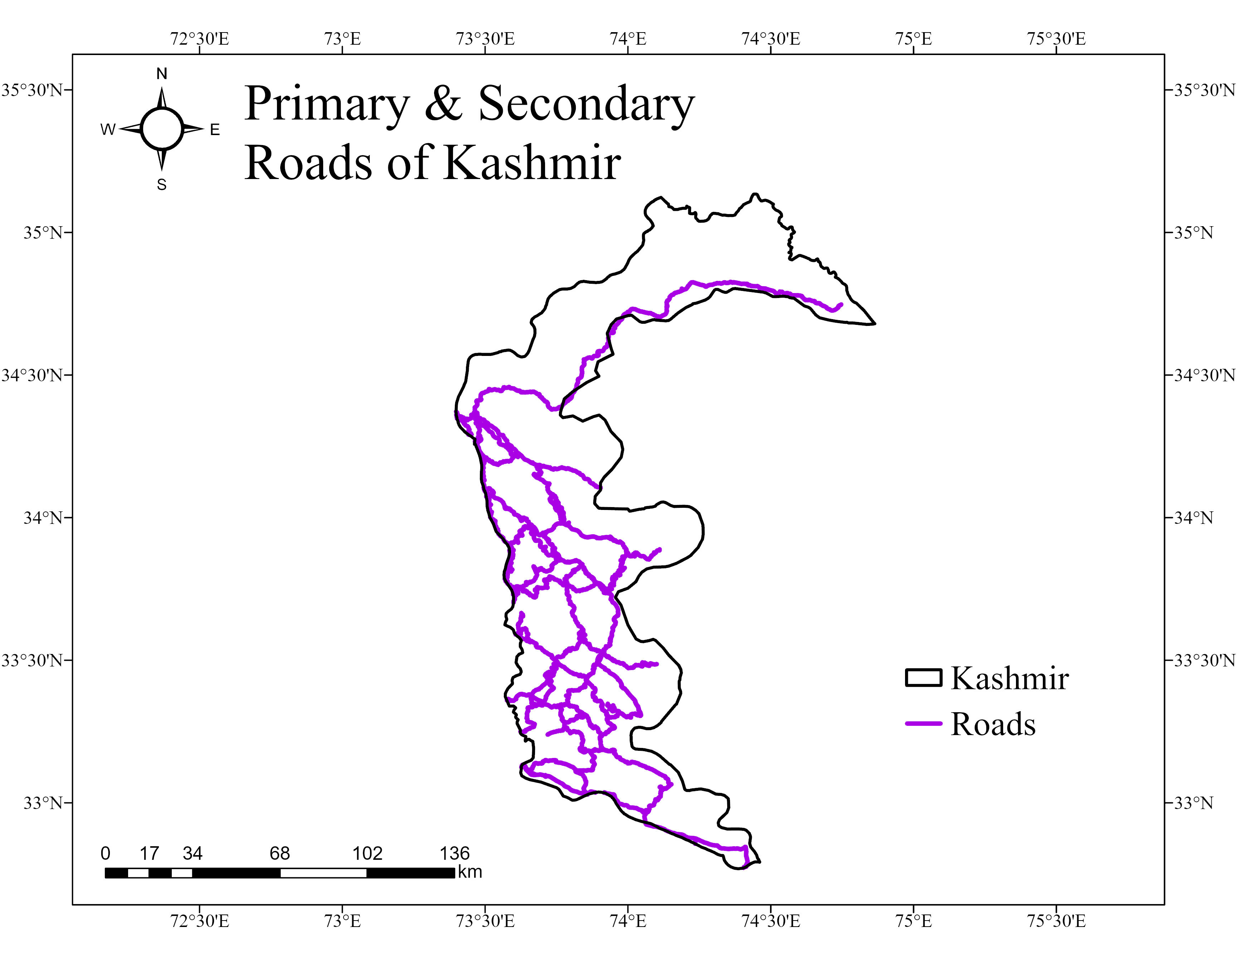


Azad Kashmir

Slide 20
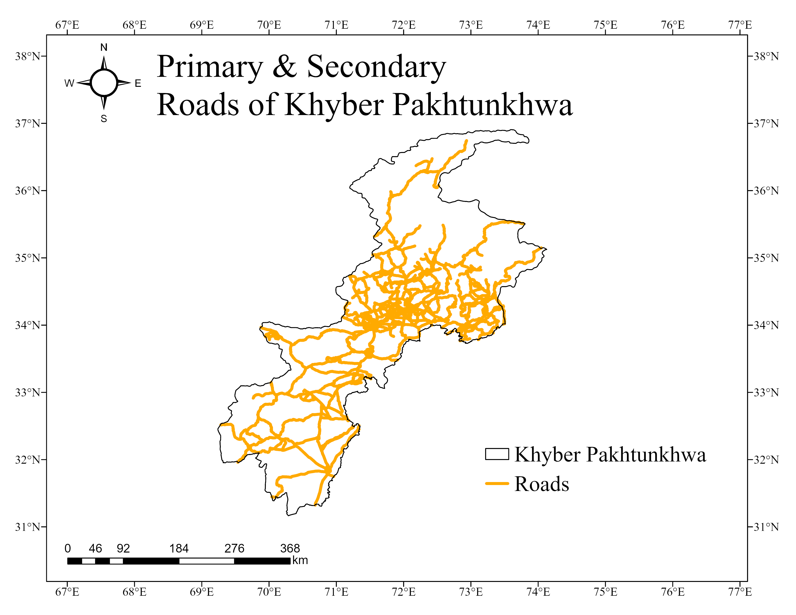


Khyber Pakhtunkhwa

Slide 21
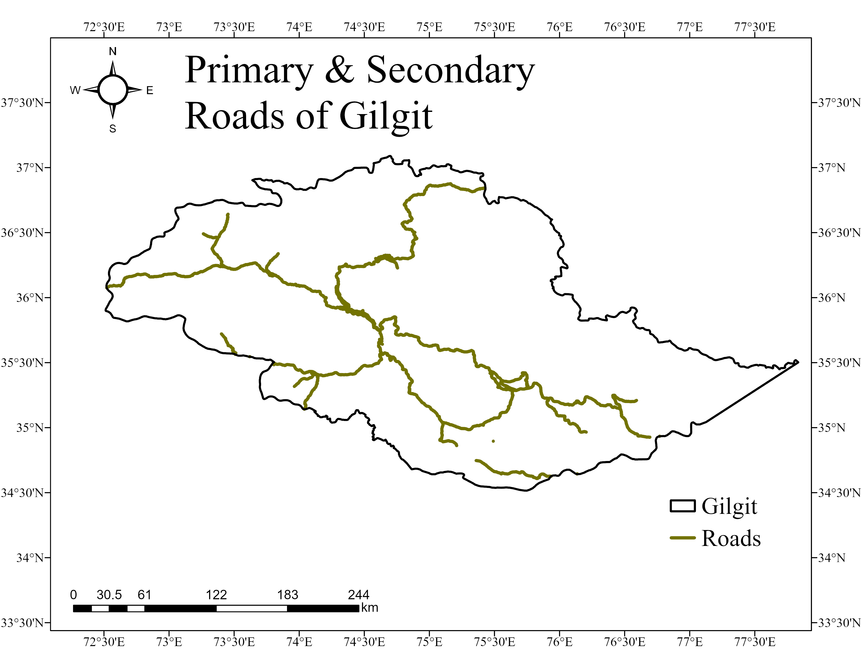


Gilgit

Slide 22
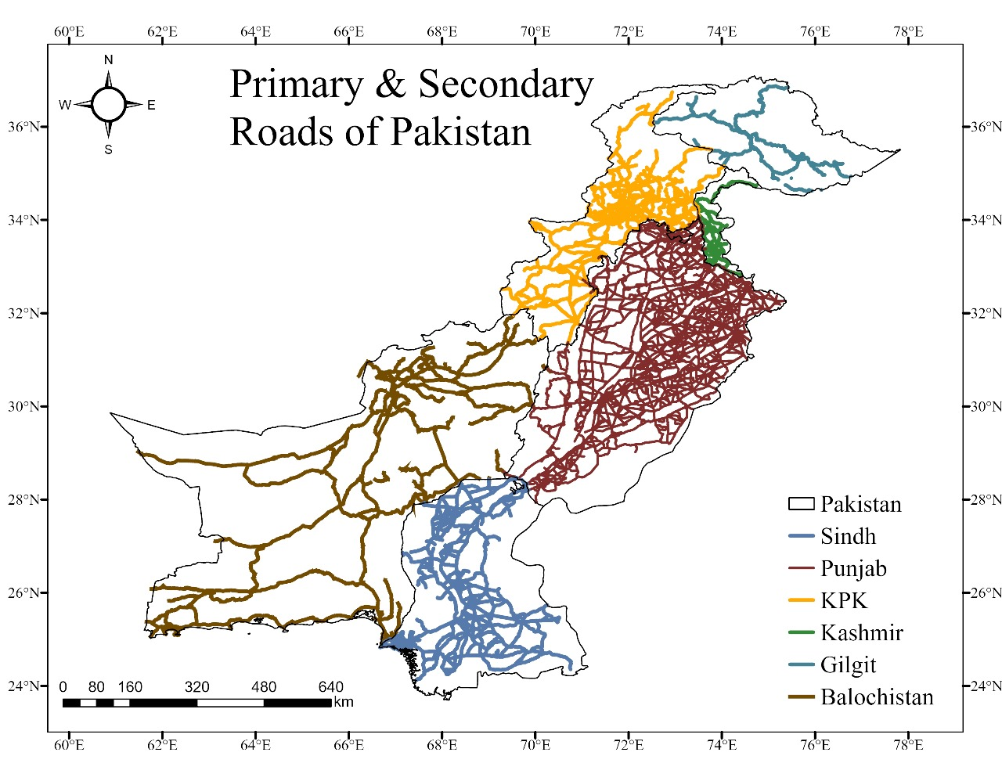
Results
Balochistan:
Initial Road Segments: 2500
Remaining Road Segments (after merging and editing): 200
Sindh:
Initial Road Segments: 15,000
Remaining Road Segments: 2200
Punjab:
Initial Road Segments: 23,000
Remaining Road Segments: 2415
Azad Jammu and Kashmir (AJK):
Initial Road Segments: 550
Remaining Road Segments: 173
Khyber Pakhtunkhwa (KPK):
Initial Road Segments: 3,000
Remaining Road Segments: 1,000
Gilgit-Baltistan:
Initial Road Segments: 650
Remaining Road Segments: 119
23

Slide 23
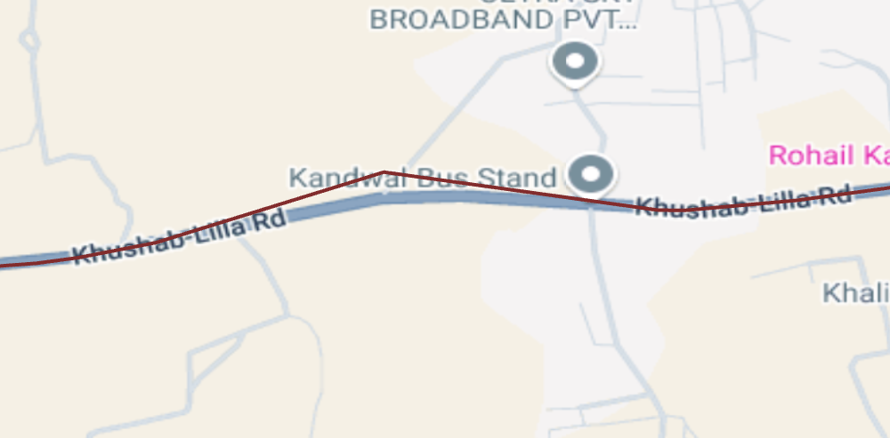
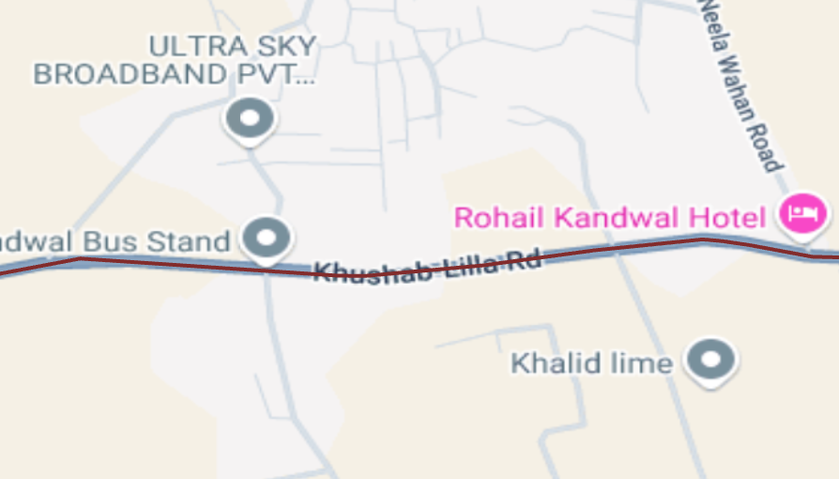
Spatial Alignment
23

Slide 24
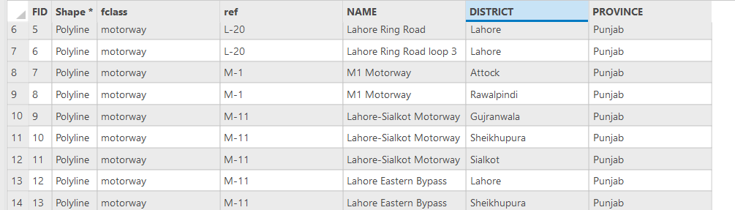
Attribute Enrichment
23

Slide 25
06
CONCLUSION
Getting on with spatial analysis!
29

Slide 26
Conclusion
These results highlight the effectiveness of the merging and editing process in reducing redundancy and enhancing the dataset's accuracy.
The reduction in road segments represents a cleaner, more reliable network that is well-suited for integration into the National Spatial Data Infrastructure (NSDI).
The refined road network dataset has been streamlined, accurate, and ready for deployment in the NSDI framework.
This enhanced dataset supports seamless geospatial analysis and ensures stakeholders can access reliable data for decision-making.
The methodology demonstrated here can serve as a model for similar geospatial data refinement projects in other regions.
30

Slide 27
THANKS!
Do you have any questions?
31

