Slide 1
Digitization and Hazard Assessment of Energy Sector Infrastructure Data
Presented By: M. Taimoor Ashfaq
Presented To: Dr. Muhammad Shafeeq

Slide 2
Outlines
Key Points and Framework for Understanding the Concept
Introduction | Importance of Exposure Analysis, Types of Vulnerable Infrastructures
Objectives | The Goals!
Scope of Work | Outline of digitization, hazard analysis, and reporting tasks.
Methodology | Implementation of Techniques
Results and Discussion | Unveiling Insights: What the Data Tells Us
Conclusion | The Way Forward!

Slide 3

Introduction
One of the important components of Natural Catastrophe(NATCAT) model is exposure analysis to estimate national assets are risk from hydro-meteorological and geo-physical hazards.

Slide 4
Types of Energy Infrastructure Data
Power Plants
Transmission Poles
Transmission Lines
Grid Stations

Slide 5
02
Objectives

Slide 6
Objectives
Create accurate geospatial datasets for Pakistan’s energy sector infrastructure (transmission lines and grid stations) and evaluate their susceptibility to natural hazards, including floods (riverine and flash floods), cyclones, and earthquakes.
Deliver actionable insights through digitized data, hazard assessment tables, and maps to support risk mitigation and improve disaster preparedness for Pakistan’s energy sector.

Slide 7
03
SCOPE OF WORK
An in-depth exploration!

Slide 8




Scope of Work
Geospatial Data Digitization
Data Collection and Integration
Geodatabase Development
Natural Hazard Vulnerability Assessment

Slide 9
04
METHODOLOGY
Getting on with spatial analysis!

Slide 10
METHODOLOGY
A
B
Data Collection
Data Cleaning & Validation
C
Digitization of Energy Infrastructure
D
Data Storage

Slide 11
DATA SOURCES
PRIMARY
Consolidated List of Data Sources
Requisite Data By NTDC
ADDITIONAL
OpenStreetMap (OSM)
Google Imagery
NATCAT Hazard Layers

Slide 12
Primary Data Source
S.No. | Organization | Authority/Division/ Department/Subsidiary/Facility | Core Areas | Data
1. | Ministry of Energy | Power Division | Electric Power | Spatial
 |  | Private Power and Infrastructure Board (PPIB) Alternate Energy Development Board (ADB) | Alternate Energy
2. | Ministry of Water Resources | Water and Power Development Authority (WAPDA) | Generation of Power, Prevention of Water Logging & Reclamation of Saline Land, Irrigation, Water Supply & Drainage, Flood Control, Hydro Reservoir, Hydropower Generation, River Flow Information | Spatial
3. | National Transmission & Despatch Company (NTDC) | Asset Management System (Grid Station Information System (GSIS)) |  | Spatial
4. | National Electric Power Regulatory Authority (NEPRA) |  | Regulation of Generation, Transmission and Distribution of Electric Power
5. | Karachi Electric Supply Corporation Limited (KESC) |  | Utility company for electricity supply
6. | Oil & Gas Development Company Limited | Pirkoh Gas Company Private Limited | Oil & Gas
7. | Pakistan Atomic Energy Commission (PAEC) | Karachi Nuclear Power Plant (KANUPP) Unit 1, Unit-2 (K-2) & Unit-3 (K-3), Chashma Nuclear Power Generating Station (CNPGS) | Nuclear Power generation
8. | Chashma Nuclear Power Plant | CHASHNUPP-I, CHASHNUPP-II, CHASHNUPP-III CHASHNUPP-IV) and ((CHASHNUPP-V)- planned unit)
9. | NESPAK National Engineering Services Pakistan |  | State-owned enterprise and an energy contractor | Spatial
10. | Engro Energy Limited | Engro Powergen Qadirpur Limited | Fossil Fuel | Spatial
11. | Independent Power Producers (IPPs) | The Hub Power Company Limited (HUBCO) | Fossil Fuel
 |  | Rousch (Pakistan) Power Limited | Natural Gas as fuel
 |  | Uch Power | Gas - Thermal Power Generation
12. | Pakistan Bureau of Statistics (PBS) |  | Census of Electricity Establishments | Statistical
13. | Energy Department (Government of Punjab) | Punjab Thermal Power Private Limited (PTPL)
 |  | Punjab Energy Efficiency & Conservation Agency (PEECA)
 |  | Punjab Energy Holding Company Limited (PEHCL)
 |  | Quaid-e-Azam Thermal Power Limited (QATPL)
 |  | Directorate of Power Projects (DoPP)
 |  | Punjab Power Management Unit (PPMU)
 |  | Punjab Power Development Co. Ltd (PPDCL)
 |  | Punjab Power Development Board (PPDB)

Slide 13
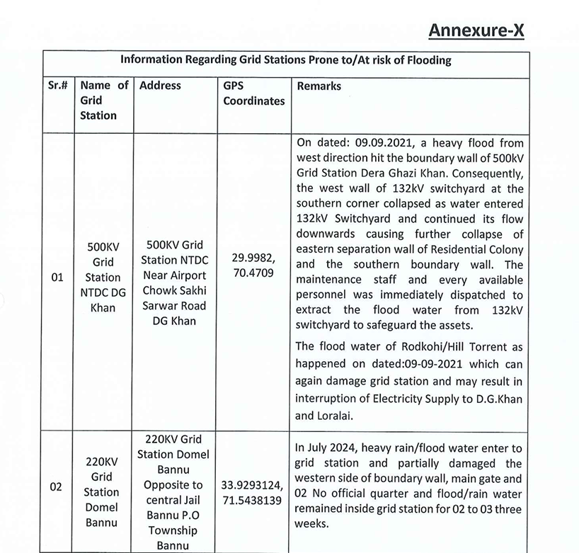
PrimaryData Sources

Slide 14
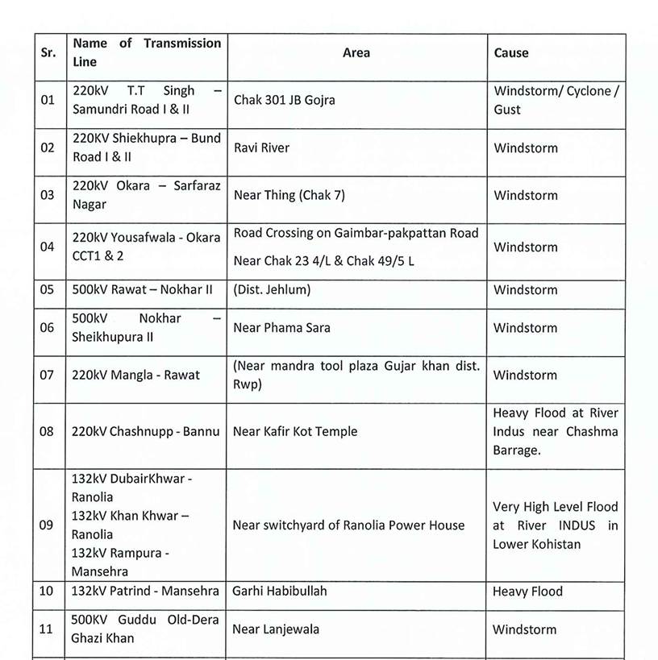
Data Sources

Slide 15

Data Collection
Following Energy Sector Data was acquired using forementioned data sources:
Transmission Lines acquisition using Open-source platforms and NTDC
Grid Stations acquisition using requisite NTDC Energy Sector data

Slide 16
05
RESULTS AND DISCUSSION
Getting on with spatial analysis!

Slide 17
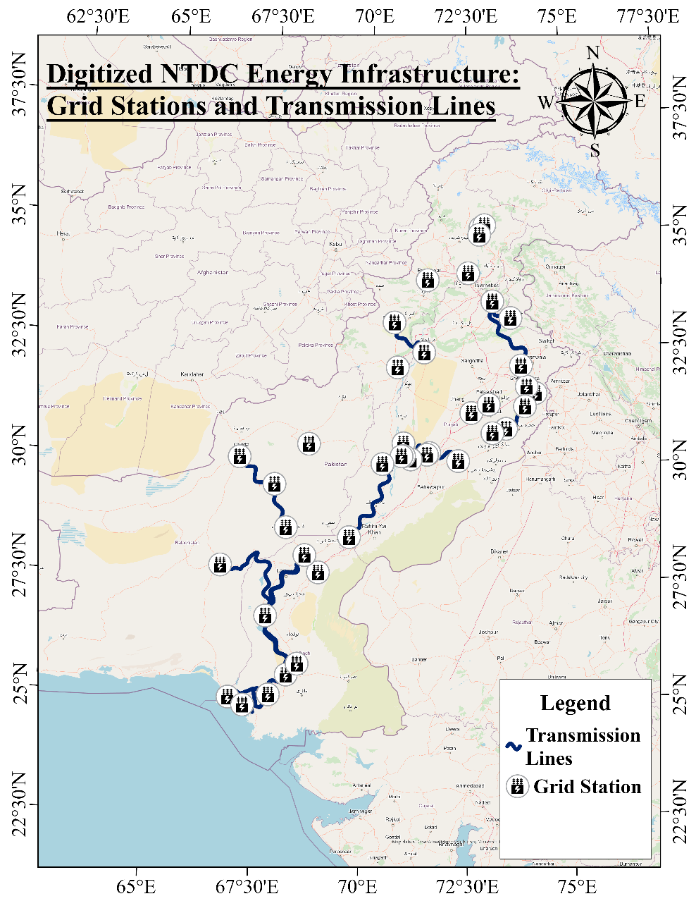
Results

Slide 18
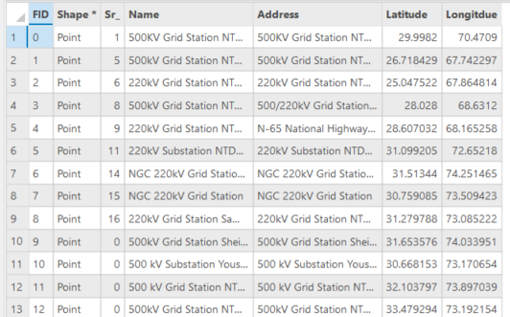
Results

Slide 19
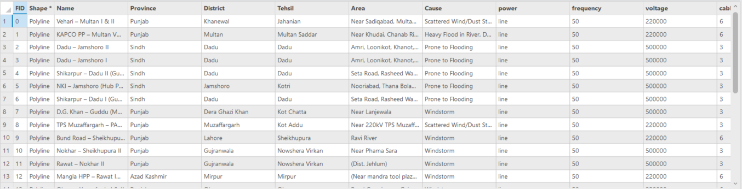
Results

Slide 20
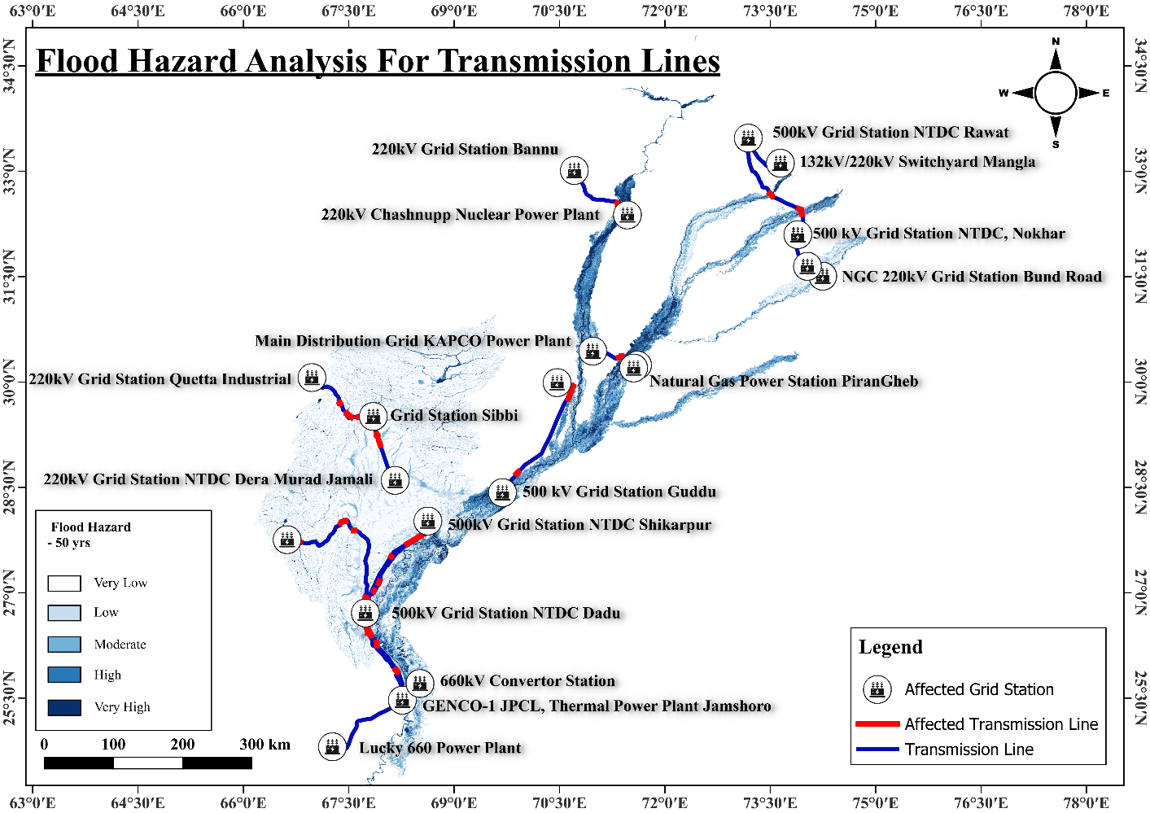
Results

Slide 21
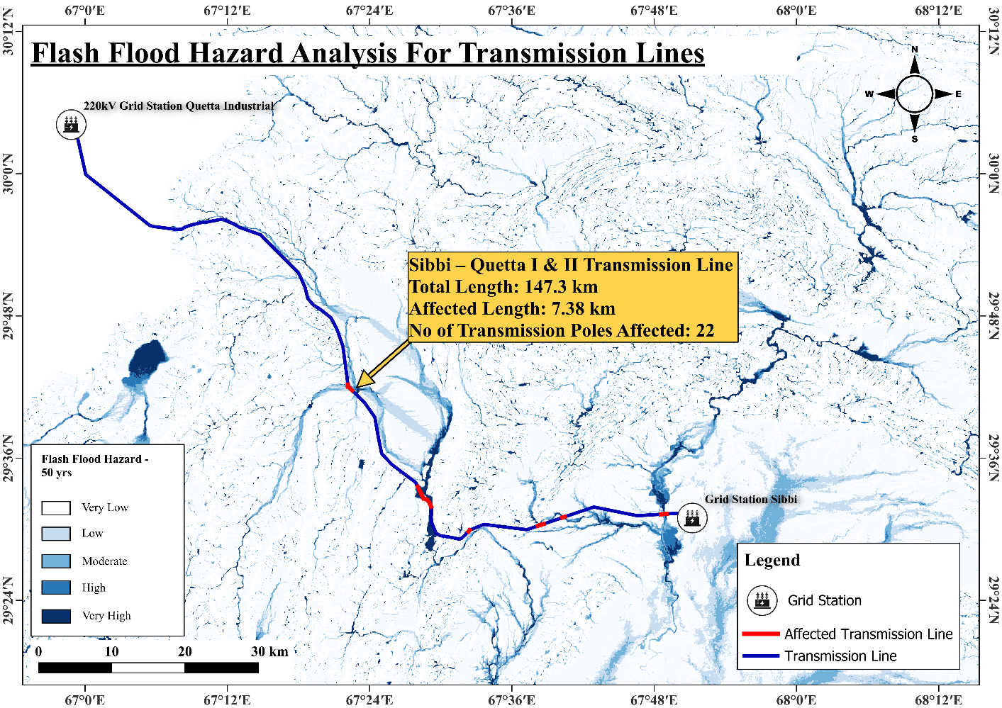
Results

Slide 22
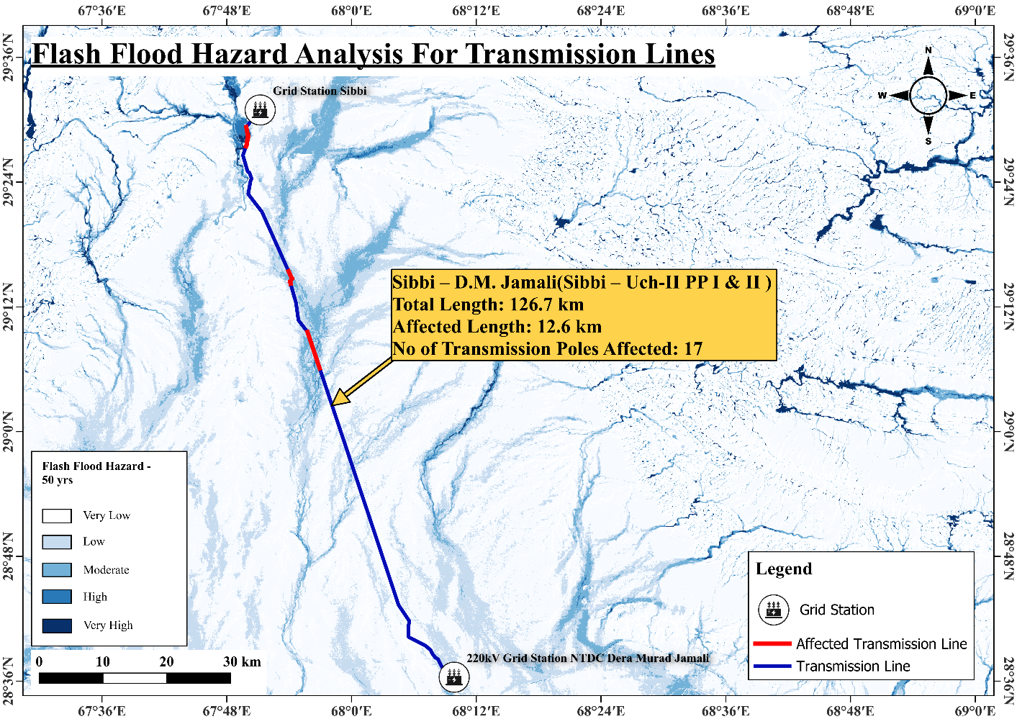
Results

Slide 23
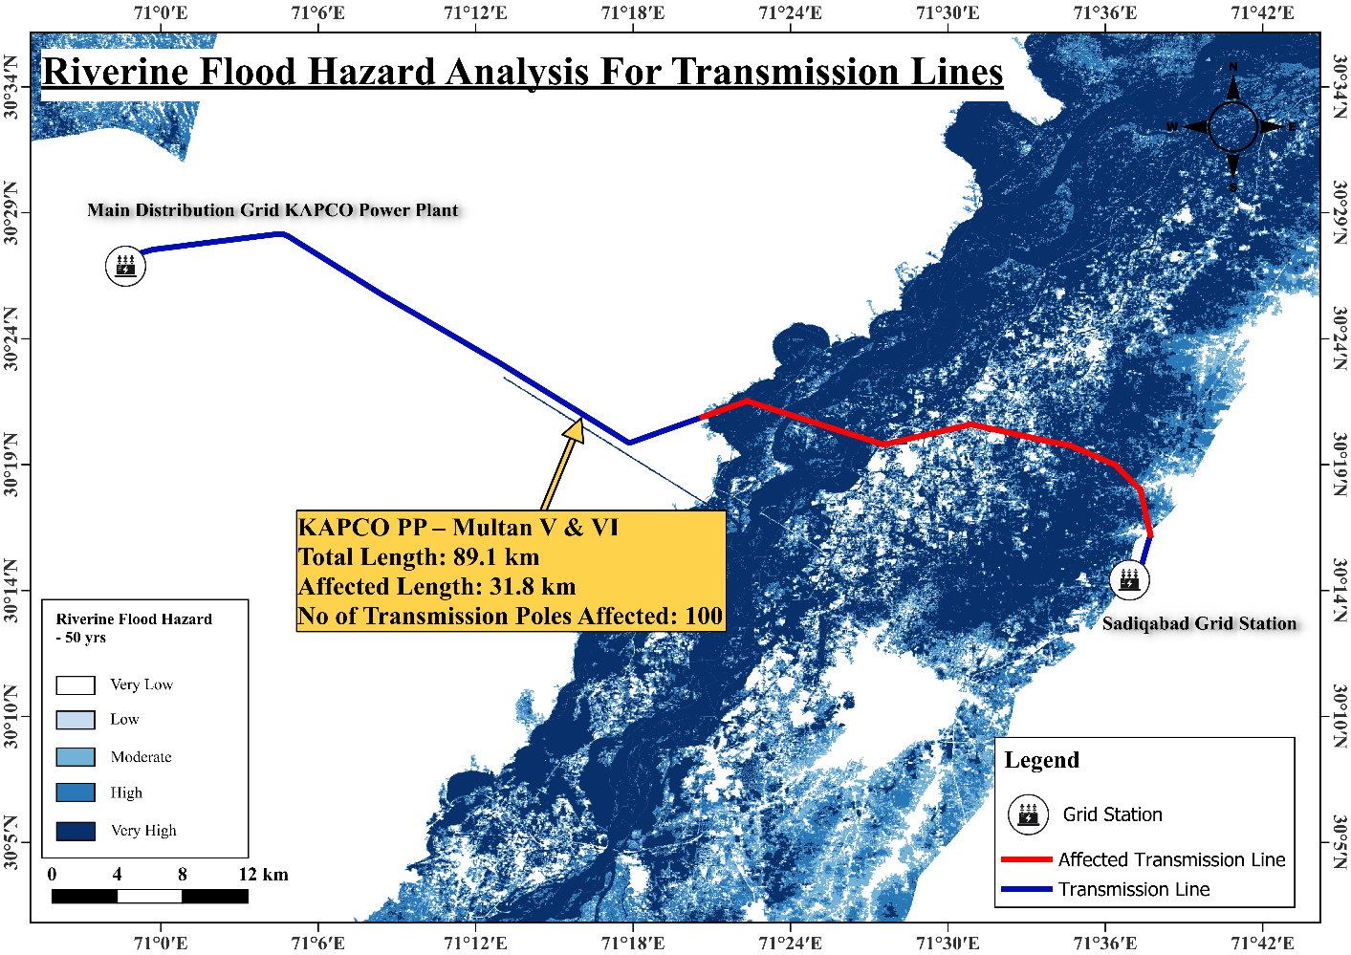
Results

Slide 24
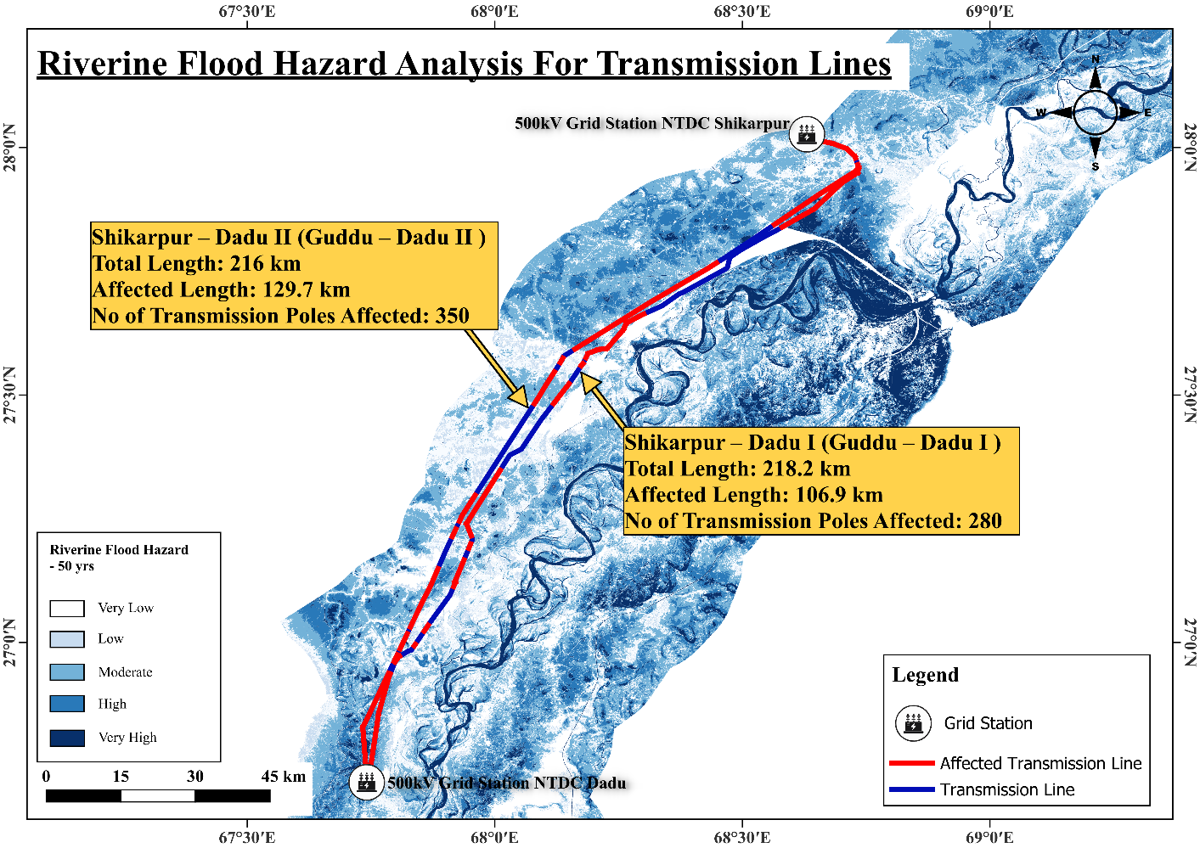
Results

Slide 25
Flood Severity Assessment
Sr. | Name of Grid Station | District | Tehsil | Severity Level | Voltage
1 | 500kV Grid Station NTDC Dadu | Dadu | Dadu | Moderate-Very High | 500kV
2 | 220kV Grid Station NTDC Rohri | Sukkur | Rohri | Very High | 220kV
3 | 500kV Grid Station NTDC Shikarpur | Shikarpur | Shikarpur | Moderate | 500kV
4 | 500kV Grid Station Sheikhupura | Sheikhupura | Sheikhupura | Low | 500kV
5 | 500 kV Grid Station Guddu | Rajanpur | Rajanpur (Tribal Area) | High | 500kV
6 | Natural Gas Power Station PiranGheb | Multan | Multan Saddar | Very High | N/A
7 | 660kV Convertor Station Faqir Noorthiani | Matiari | Matiari | Moderate | 660kV

Slide 26
Cyclone Severity Assessment
Sr. | Name of Transmission Line | District | Tehsil | Severity Level | Affected Length(km) | Voltage
1 | Shikarpur – Dadu II (Guddu – Dadu II ) | Dadu | Dadu | Very Low | 53.57 | 500kV
2 | Shikarpur – Dadu I (Guddu – Dadu I ) | Dadu | Dadu | Very Low | 47.53 | 500kV
3 | D.G. Khan – Guddu (Multan – Guddu III ) | Dera Ghazi Khan | Kot Chatta | Very Low | 178.40 | 500kV
4 | NKI – Jamshoro (Hub PP – Jamshoro I ) | Jamshoro | Kotri | Moderate | 157.75 | 500kV
5 | Dadu – Khuzdar I & II | Jhal Magsi | Jhal Magsi | Very Low | 46.90 | 220kV
6 | Sibbi – D.M. Jamali(Sibbi – Uch-II PP I & II ) | Kachhi | Balanari | Very Low | 52.75 | 220kV
7 | D.M. Jamali – Uch-I PP (Sibbi – Uch-II PP I & II ) | Nasirabad | Dera Murad Jamali | Very Low | 43.87 | 220kV
8 | Gharo - Jhimpir II (Jhimpir – Gharo I & II ) | Malir Karachi | Bin Qasim Town | High | 3.23 | 220kV
9 | Port Qasim CFPP – Matiari I & II | Matiari | Matiari | Moderate | 31.96 | 220kV
10 | Dadu – Jamshoro II | Dadu | Dadu | Very Low | 29.39 | 500kV
11 | Dadu – Jamshoro I | Dadu | Dadu | Very Low | 20.78 | 220kV

Slide 27
Earthquake Severity Assessment
Sr. | Name of Grid Station | District | Tehsil | Severity Level | Voltage
1 | 220kV Grid Station NTDC Dera Murad Jamali | Nasirabad | Dera Murad Jamali | Severe | 220k V
2 | Grid Station Sibbi | Sibbi | Sibbi | Severe | 220kV
3 | 500kV Grid Station NTDC Rawat | Rawalpindi | Rawalpindi | Severe | 500kV
4 | Duber Khwar Hydroelectic Plant | Kohistan Lower | Pattan | Severe | 132kV
5 | 17 MW Ranolia Hydro Power Station | Kohistan Lower | Bankad | Severe | 132kV
6 | Khan Khwar Hydel Power Station | Shangla | Bisham | Severe | 132kV
7 | 220kV Grid Station Bannu | Bannu | Domel | Very Strong to Severe | 220kV
8 | 220KV Grid Station Sheikh Muhammadi | Peshawar | Peshawar | Very Strong to Severe | 500/220/132kV

Slide 28
06
CONCLUSION
The Way Forward!

Slide 29
Conclusion
The task successfully digitized energy infrastructure data.
Vulnerabilities of energy infrastructure to floods, cyclones, and earthquakes was assessed.
The Hazard Assessment Provided critical insights for risk mitigation and infrastructure resilience planning.

Slide 30
THANKS!
Do you have any questions?
31

