Slide 1
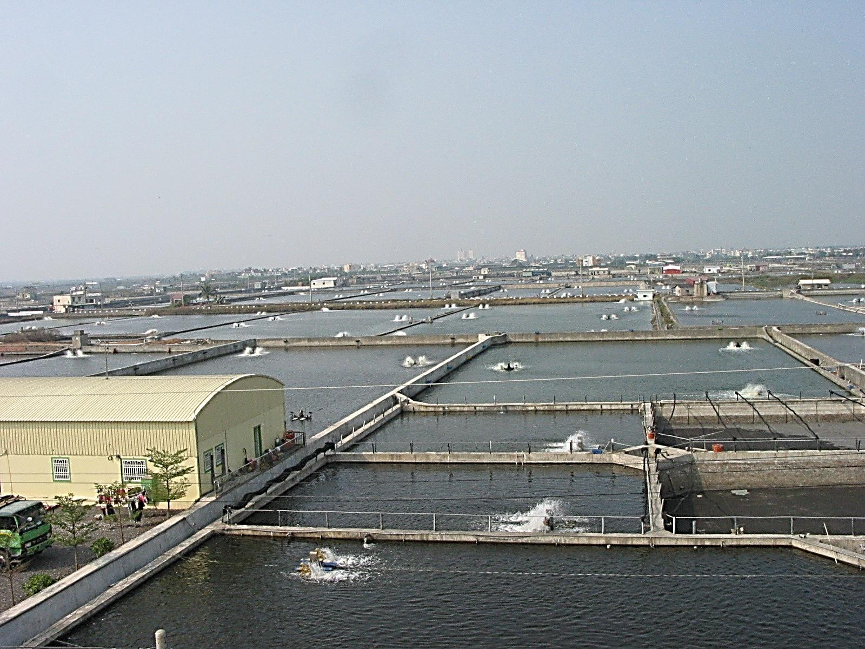
Water Quality Prediction System Base on Aquaculture
2017 Asia Open Data Hackathon
生生不息

Slide 2
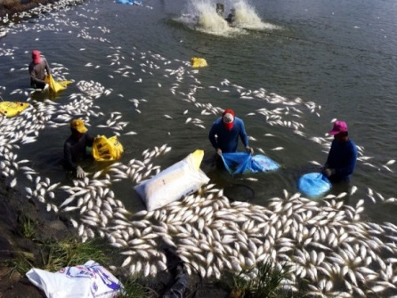
Background
2017 Asia Open Data Hackathon
生生不息
Fish die-of

Slide 3



Solution
2017 Asia Open Data Hackathon
生生不息
environment parameters(Government’s open data)
data analysis and prediction
IoT Technology

Slide 4
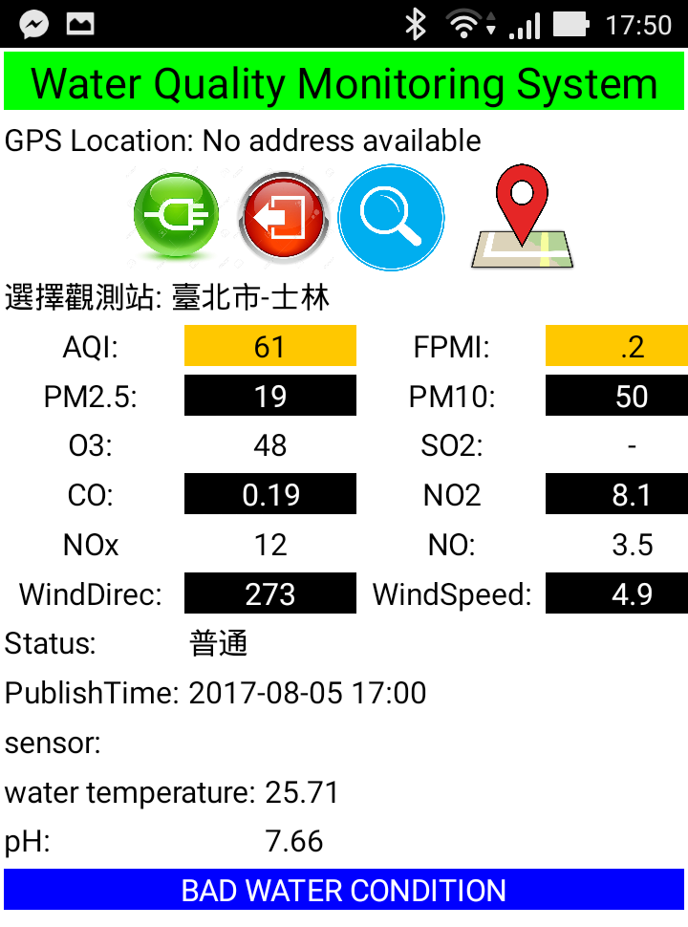
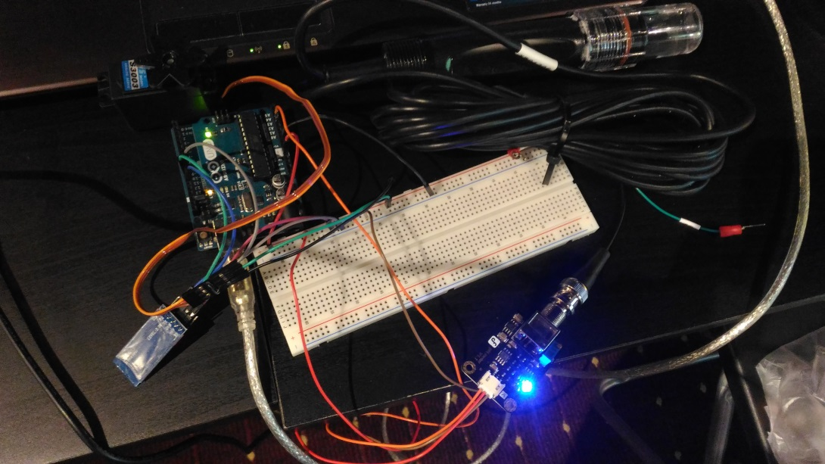
MVP
2017 Asia Open Data Hackathon
生生不息

Slide 5
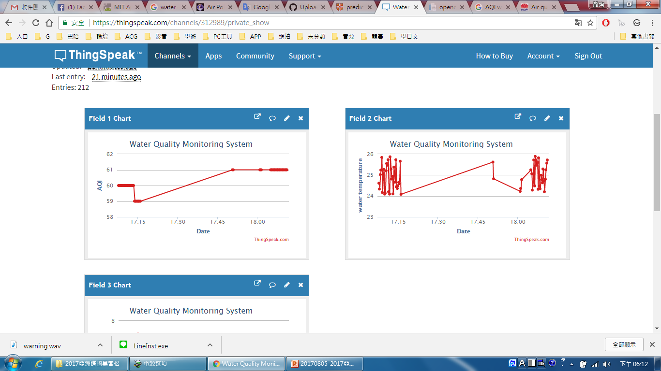
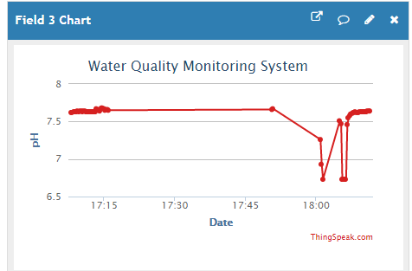
MVP
2017 Asia Open Data Hackathon
生生不息
ThingSeak IoT Platform
https://thingspeak.com/channels/312989

Slide 6
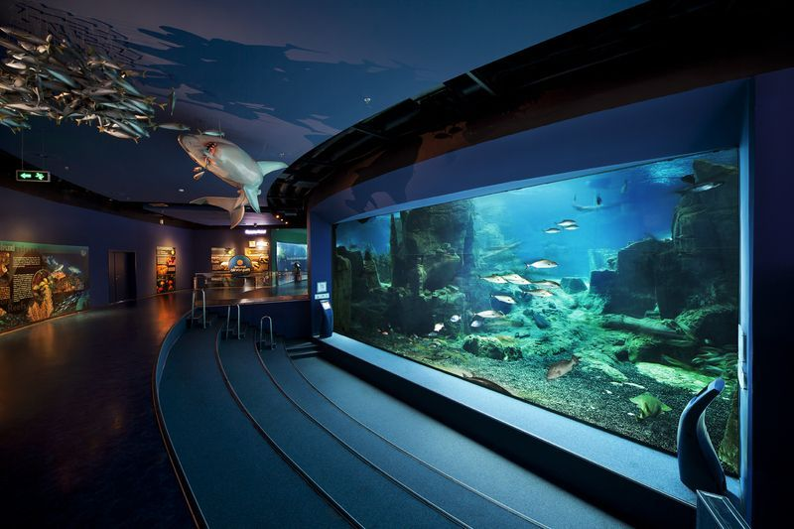
IT IS THE RIGHT TIME TO DO THE RIGHT THING
2017 Asia Open Data Hackathon
生生不息
APPRECIATE
恰 逢 其 時
EXPECT TO MAKE SOME CONTRIBUTIONS TO THE WORLD.

