Slide 1

Normalization
Lucas Cordova

Slide 2
Data Normalization
Normalization is the process of creating table designs by assigning specific fields or attributes to each table in the database
Normalization involves applying a set of rules that can help you identify and correct inherent problems and complexities in your table designs
The normalization process typically involves four stages:
Unnormalized design
First normal form
Second normal form
Third normal form

Slide 3
Data Normalization
Standard Notation Format
Starts with the name of the table, followed by a parenthetical expression that contains the field names separated by commas. The primary key field(s) is underlined, like this:
NAME (FIELD 1, FIELD 2, FIELD 3)
A repeating group is a set of one or more fields that can occur any number of times in a single record, with each occurrence having different values

Slide 4
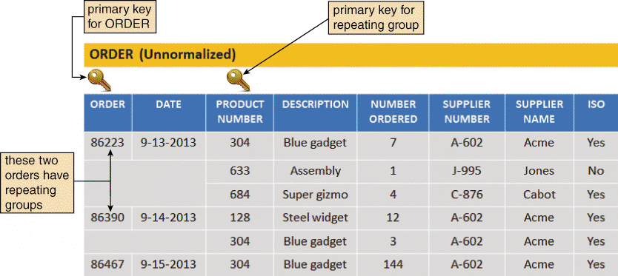
Data Normalization (Cont.)
In the ORDER table design, two orders have repeating groups that contain several products. ORDER is the primary key for the ORDER table, and PRODUCT NUMBER serves as a primary key for the repeating group. Because it contains repeating groups, the ORDER table is unnormalized

Slide 5
Data Normalization (Cont.)
First Normal Form (1NF)
A table is in first normal form (1NF) if it does not contain a repeating group
When you eliminate the repeating group, additional records emerge — one for each combination of a specific order and a specific product
The result is more records, but a greatly simplified design

Slide 6
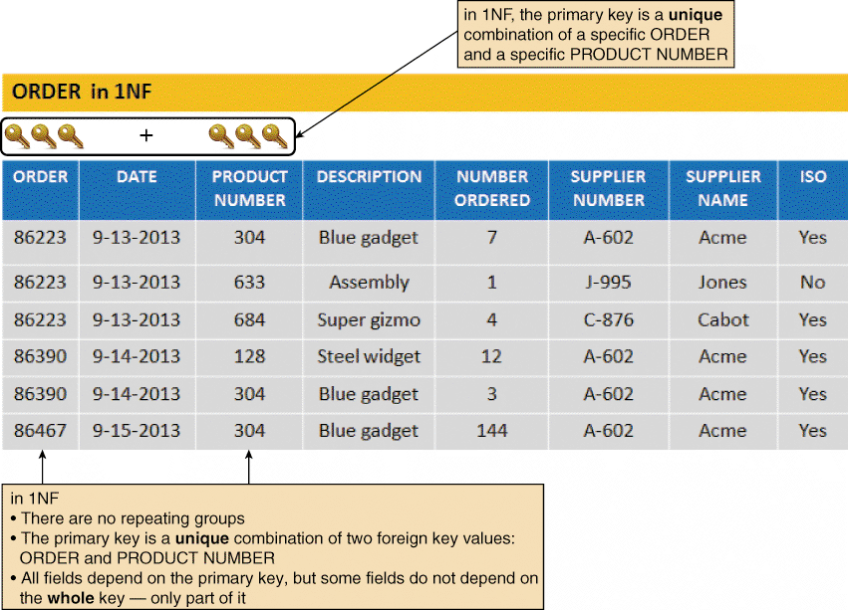
Data Normalization (Cont.)
The ORDER table as it appears in 1NF. The repeating groups have been eliminated. Notice that the repeating group for order 86223 has become three separate records, and the repeating group for order 86390 has become two separate records. The 1NF primary key is a combination of ORDER and PRODUCT NUMBER, which uniquely identifies each record

Slide 7
Data Normalization (Cont.)
Second Normal Form (2NF)
Must understand the concept of functional Dependence
Field A is functionally dependent on Field B if the value of Field A depends on Field B
A DATE value is functionally dependent on an ORDER, because for a specific order number, there can be only one date
Objective is to break the original table into two or more new tables and reassign the fields so that each non-key field will depend on the entire primary key in its table

Slide 8
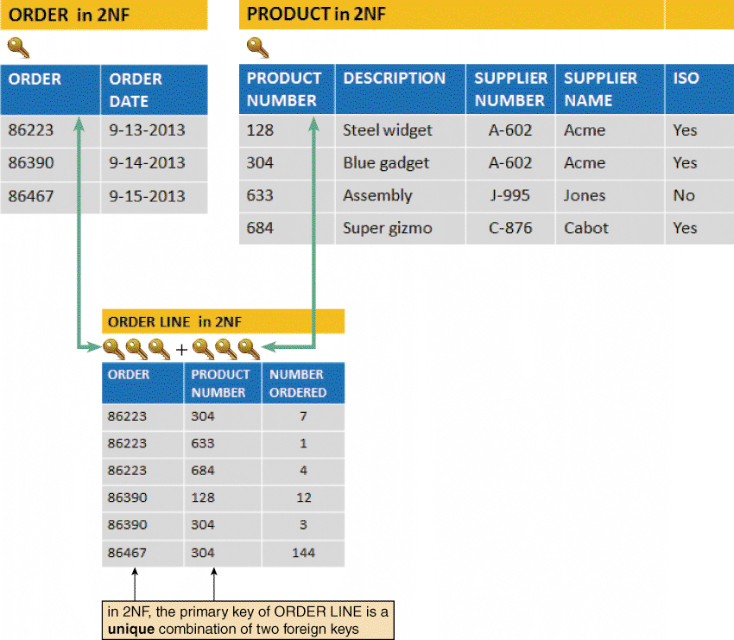
Data Normalization (Cont.)
ORDER, PRODUCT, and ORDER LINE tables in 2NF. All fields are functionally dependent on
the primary key

Slide 9
Data Normalization (Cont.)
Third Normal Form (3NF)
A design is in 3NF if every non-key field depends on the key, the whole key, and nothing but the key
A 3NF design avoids redundancy and data integrity problems that still can exist in 2NF designs
To convert the table to 3NF, you must remove all fields from the 2NF table that depend on another non-key field and place them in a new table that uses the non-key field as a primary key

Slide 10
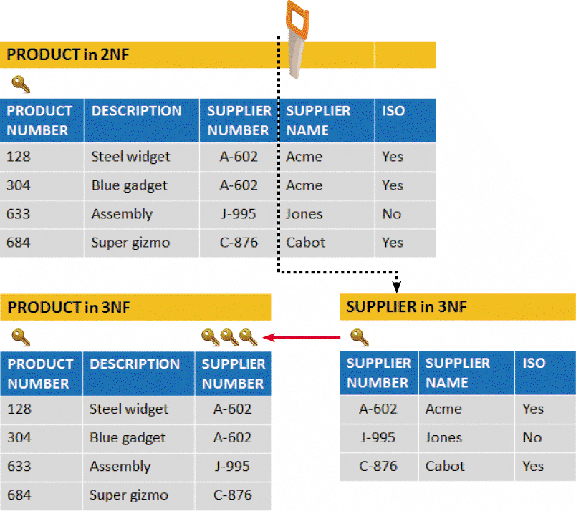
Data Normalization (Cont.)
When the PRODUCT table is transformed from 2NF to 3F, the result is two separate tables:
PRODUCT and SUPPLIER. Note that in 3NF, all fields depend on the key, the whole key, and nothing but the key!

Slide 11
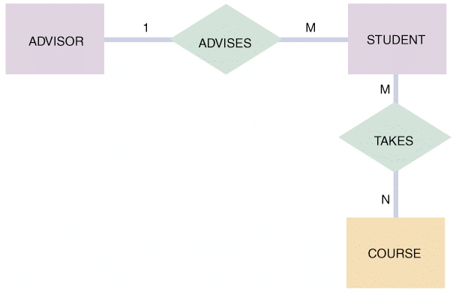
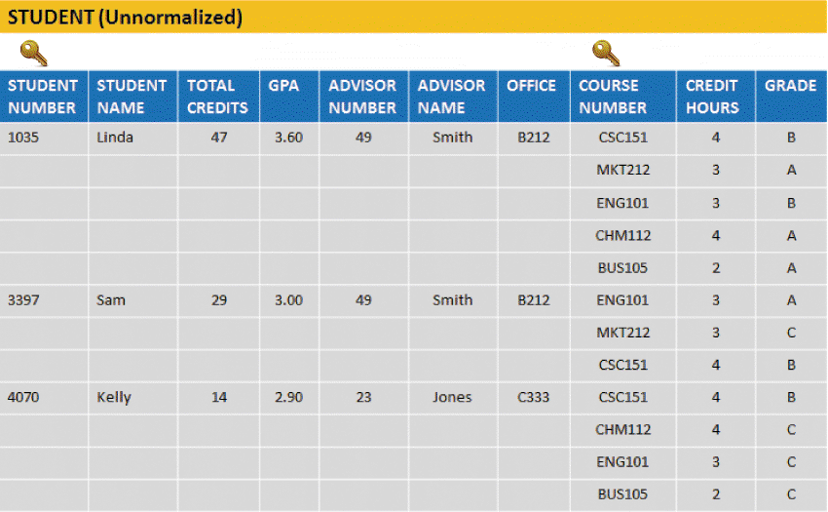
Two Real-World Examples
Example 1: Crossroads College
An initial entity-relationship diagram for ADVISOR,
STUDENT, and COURSE
The STUDENT table is unnormalized because it contains a repeating group that represents the courses each student has taken

Slide 12
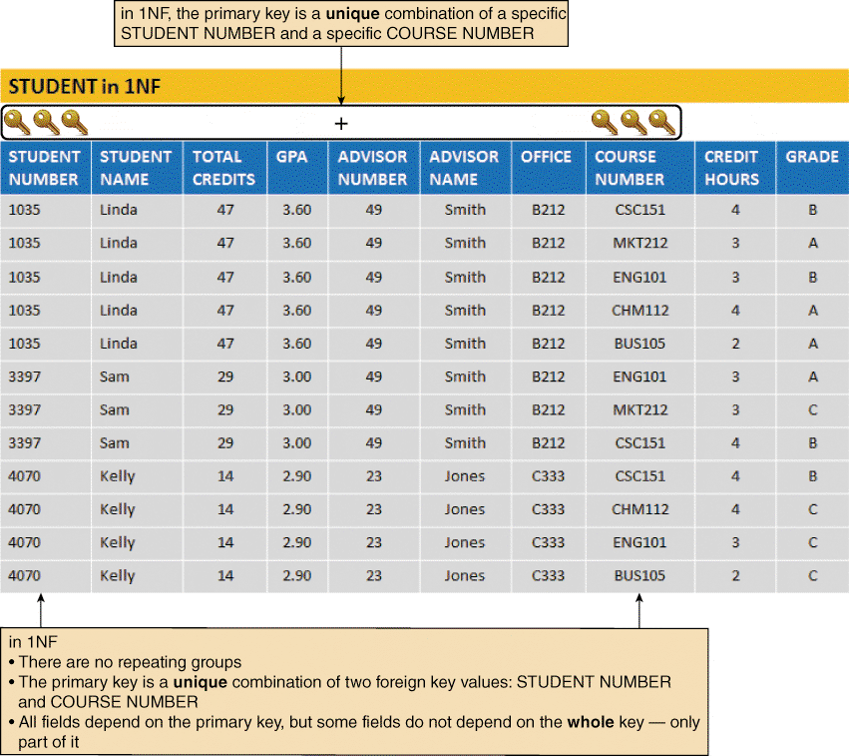
Two Real-World Examples (Cont.)
The STUDENT table in 1NF. Notice that the primary key has been expanded to include STUDENT NUMBER and COURSE NUMBER

Slide 13
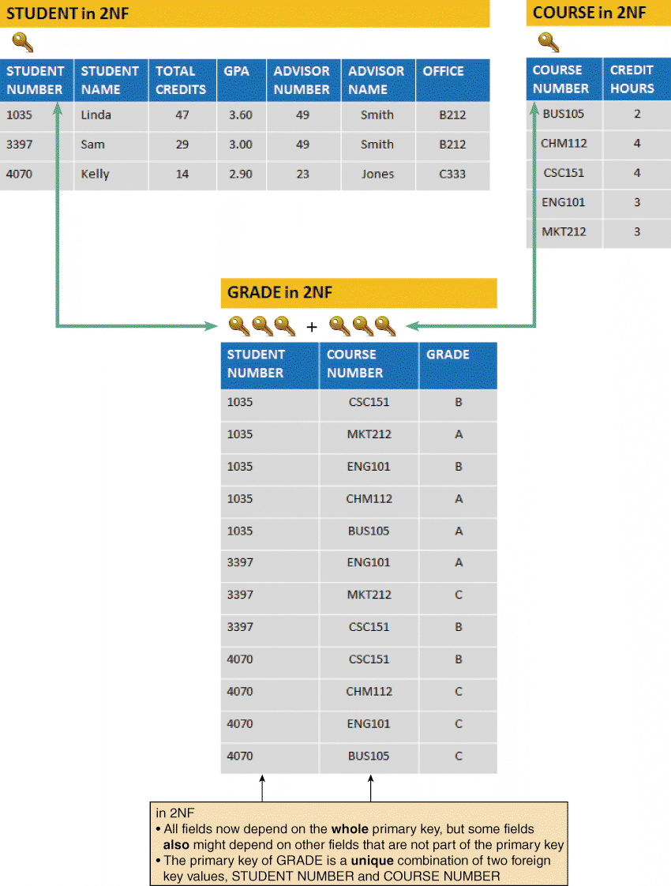
Two Real-World Examples (Cont.)
The STUDENT, COURSE, and GRADE tables in 2NF. Notice that all fields are functionally dependent on the entire primary key of their respective tables

Slide 14
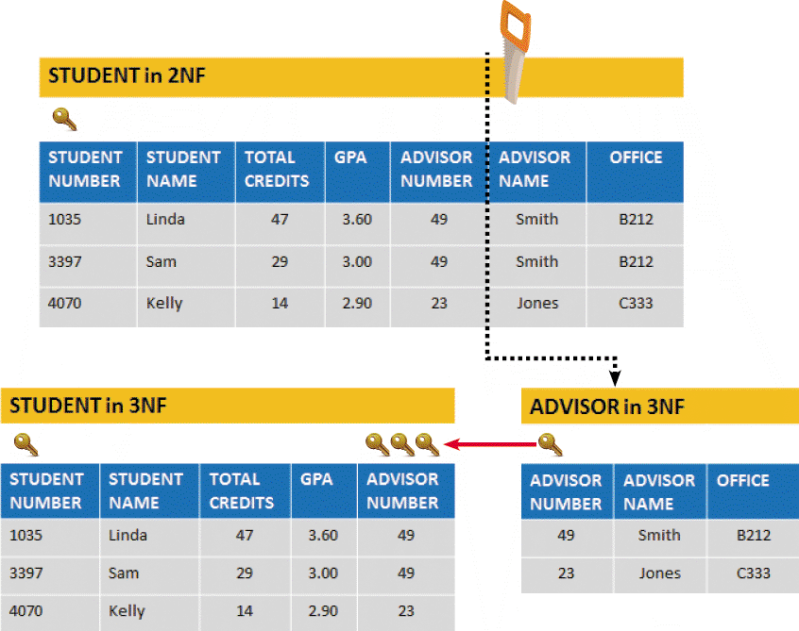
Two Real-World Examples (Cont.)
STUDENT, ADVISOR, COURSE, and GRADE tables in 3NF. When the STUDENT table is
transformed from 2NF to 3NF, the result is two tables: STUDENT and ADVISOR

Slide 15
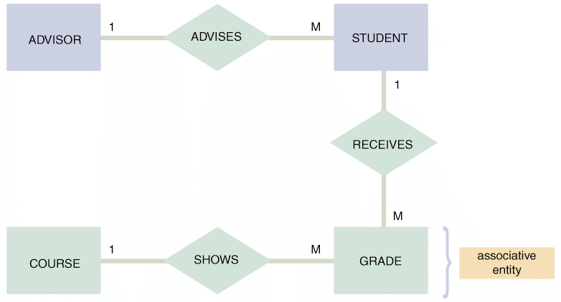
Two Real-World Examples (Cont.)
The entity-relationship diagram for STUDENT, ADVISOR, and COURSE after normalization. The GRADE entity was identified during the normalization process. GRADE is an associative entity that links the STUDENT and COURSE tables

Slide 16
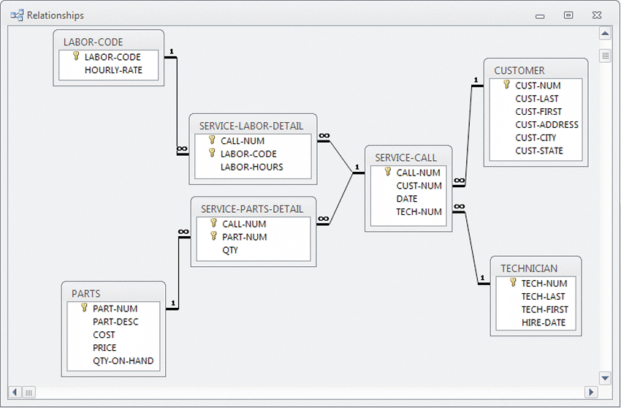
Two Real-World Examples (Cont.)
Example 2: Magic Maintenance
A relational database design for a computer service company uses common fields to link the tables and form an overall data structure. Notice the one-to-many notation symbols, and the primary keys, which are indicated with gold-colored key symbols

Slide 17
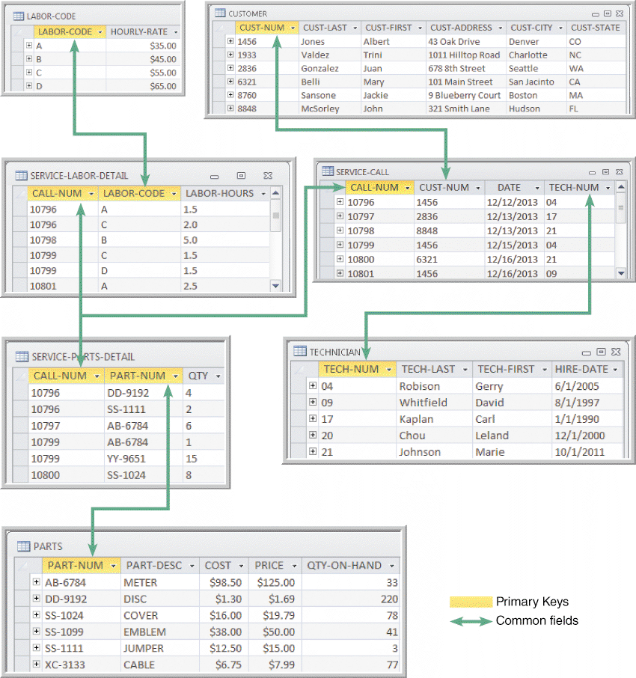
Two Real-World Examples (Cont.)
Sample data, primary keys, and common fields for the database shown.
The design is in 3NF. Notice that all nonkey fields functionally depend on a primary key, the whole primary key, and nothing but the primary key

